Slide 1
DISTRICT TECHNICAL OFFICIALS
SEMINAR CUM EXAMINATION
AFI LEVEL “C” TOECS
ORGANISED BY
ATHLETICS FEDERATION OF INDIA

Slide 2
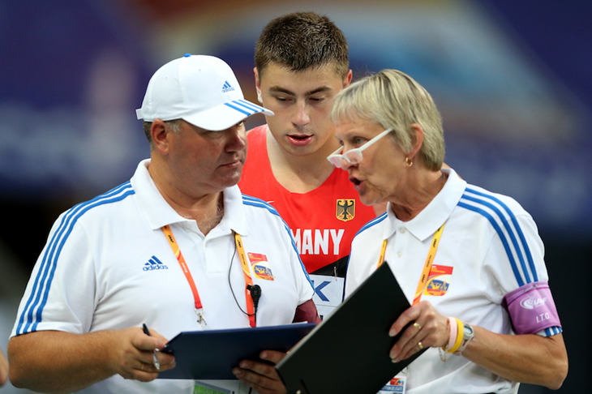
PROTESTS AND APPEALS
ORAL PROTEST TO REFEREE
APPEAL TO JURY OF APPEAL
RULE TR 8 (146)

Slide 3
PROTEST
CONCERNING THE STATUS OF AN ATHLETE
CONCERNING THE RESULT OR CONDUCT
OF AN EVENT

Slide 4
PROTEST
CONCERNING THE RESULT OR CONDUCT
OF AN EVENT
AFTER ANNOUNCEMENT OF RESULT
IMMEDIATE ORAL PROTEST

Slide 5
PROTEST
AFTER ANNOUNCEMENT OF RESULT
TO WHOM PROTEST SHALL BE MADE
Any protest shall be made orally to the Referee
CONDITION
Protests concerning the result or conduct of an event shall be made within 30 minutes of the official announcement of the result of that event.

Slide 6
PROTEST
AFTER ANNOUNCEMENT OF RESULT
WHO CAN PROTEST
An athlete
Someone acting on their behalf
An official representative of a team. if they are competing in the same round of the event to which the protest (or subsequent appeal) relates.
Or are competing in a competition in which a team points score is being conducted).

Slide 7
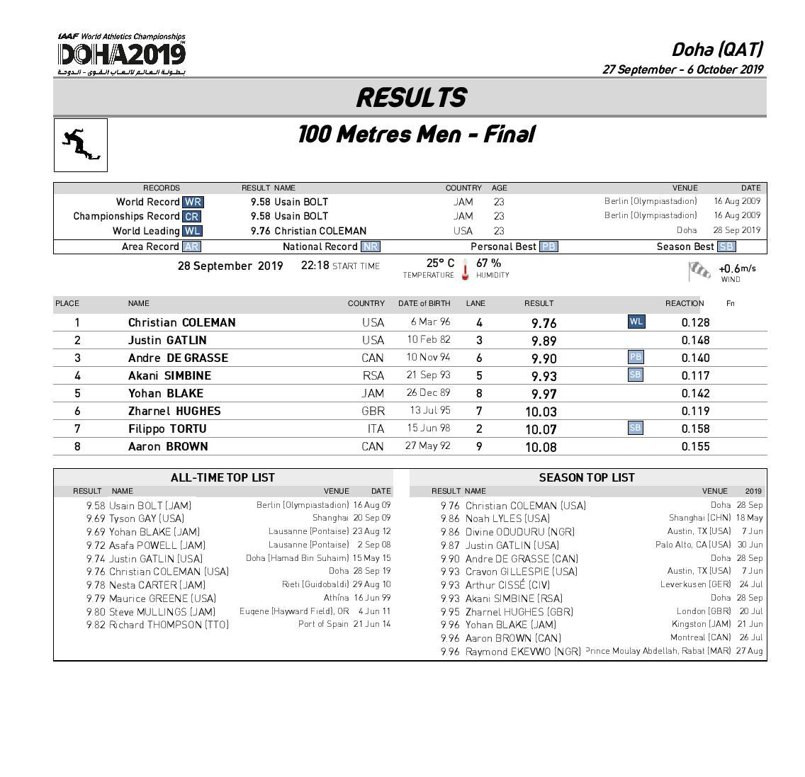
PROTEST
AFTER ANNOUNCEMENT OF RESULT
RESPONSIBILITY OF THE ORGANISERS
The Organisers of the competition shall be responsible for ensuring that the time of the announcement of all results is recorded.
Result announced at
10.00AM

Slide 8
PROTEST
AFTER ANNOUNCEMENT OF RESULT
HOW TO ARRIVE AT A FAIR DECISION
May consider any available evidence which concerned Referee think necessary
May consider a film or picture produced by an official video recorder
May consider any other available video evidence

Slide 9
PROTEST
AFTER ANNOUNCEMENT OF RESULT
RIGHT OF THE REFEREE
The Referee may decide on the protest
May refer the matter to the Jury of Appeal.
RIGHT OF THE ATHLETE
If the Referee makes a decision, an Athlete has a right of appeal to the
Jury

Slide 10
PROTEST
AFTER ANNOUNCEMENT OF RESULT
HOW TO PROTEST IN ABSENCE OF THE REFEREE
Where the Referee is not accessible
or available, the protest should be made
to them through the Technical
Information Centre.

Slide 11
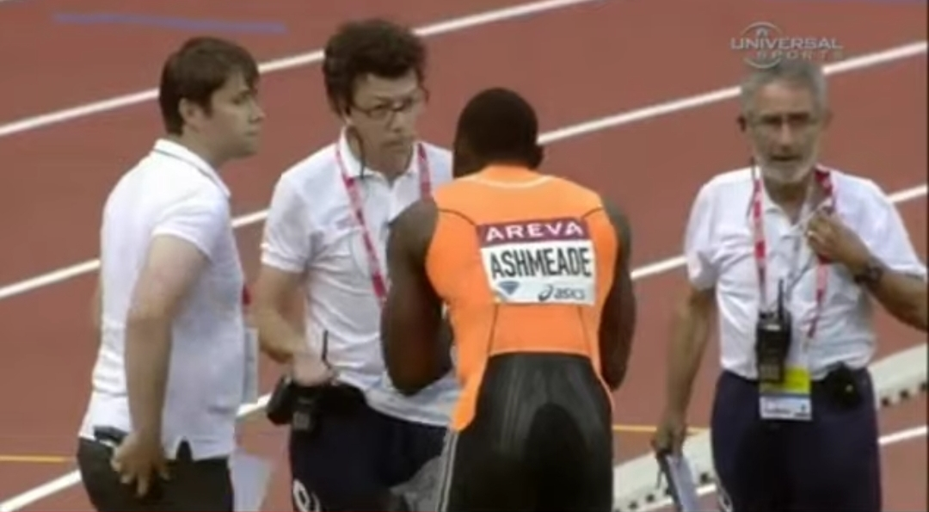
PROTEST
IMMEDIATE ORAL PROTEST
IN A TRACK EVENT
If an athlete makes an immediate oral protest against having been charged with a false start
Track Referee may, if they are in any doubt, allow the athlete to compete “under protest” in order to preserve the rights of all concerned.

Slide 12
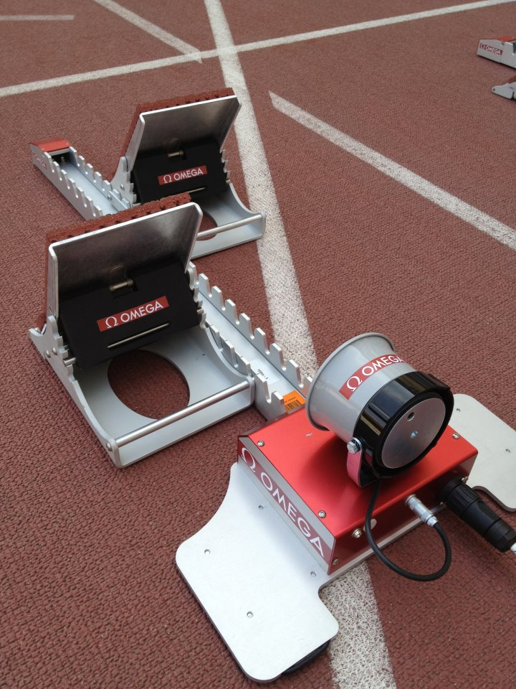
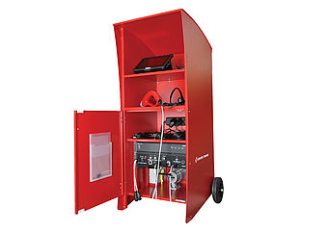
IMMEDIATE ORAL PROTEST
IN A TRACK EVENT
CONDITION
If the false start was indicated by a World Athletics certified start Information system - Competing “under protest” shall not be allowed
In cases where it is very clear by visual observation that the athlete has committed a false start.
EXCEPTION
Any reason the Referee determines that the information provided by the system is obviously inaccurate.

Slide 13
PROTEST
IMMEDIATE ORAL PROTEST
IN A TRACK EVENT
A protest may be based on the failure of the starter to recall a false start
A protest may be based on the failure of the starter to abort a start
CONDITION
The protest may be made only by, or on behalf of, an athlete who has completed the race.

Slide 14
PROTEST
IMMEDIATE ORAL PROTEST
IN A TRACK EVENT
DECISION
If the protest is upheld, any athlete who committed the false start or whose conduct should have led to the start being aborted, and who was subject to warning or disqualification according to Rules 16.5, 16.7, 16.8 or 39.8.3 of the Technical Rules, shall be warned or disqualified

Slide 15
PROTEST
IMMEDIATE ORAL PROTEST
IN A TRACK EVENT
POWER OF THE REFEREE
Whether or not there may be any warning or disqualification, the Referee shall have the authority to declare the event or part of the event void and that it or part of it shall be held again if in their opinion justice demands it.

Slide 16
PROTEST
IMMEDIATE ORAL PROTEST
IN A TRACK EVENT
RIGHT OF THE ATHLETE
In this situation an Athlete has he right of protest and appeal whether or not a Start Information System is used

Slide 17
PROTEST
IMMEDIATE ORAL PROTEST
IN A TRACK EVENT
If a protest or appeal is based on an athlete’s incorrect exclusion from an event due to a false start and it is upheld after the completion of the race
If applicable, to be advanced to subsequent rounds.
No athlete should be advanced to a subsequent round without competing in all rounds unless the Referee or Jury of Appeal determines otherwise in the particular circumstances of the case – “the shortness of time before the next round or the length of the race. “

Slide 18
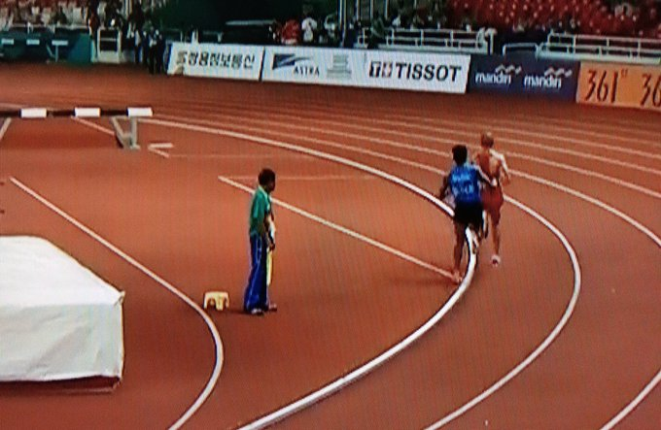
IMMEDIATE ORAL PROTEST
IN A TRACK EVENT
When a protest is made by or on behalf of an athlete or team which did not finish a race
The protest shall be dismissed- IF
The athlete or team was or should have been disqualified for a breach of the Rules unrelated to the matter raised in the protest.

Slide 19
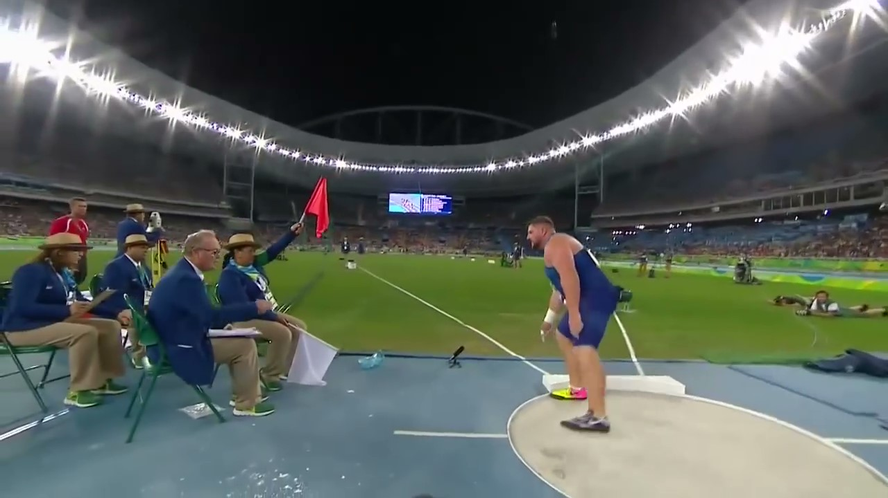
IMMEDIATE ORAL PROTEST
IN A FIELD EVENT
If an athlete makes an immediate oral protest against having a trial judged as a failure
If the Referee of the event is in any doubt
Order that the trial be measured and the result recorded, in order to preserve the rights of all concerned.

Slide 20
PROTEST
IMMEDIATE ORAL PROTEST
IN A FIELD EVENT
If the protested trial occurred
During the first three rounds of trials of a horizontal Field event in which more than eight athletes are competing, and the athlete would advance to any subsequent rounds of trials only if the protest or subsequent appeal was upheld
In a vertical Field event, where the athlete would advance to a higher height only if the protest or subsequent appeal is upheld

Slide 21
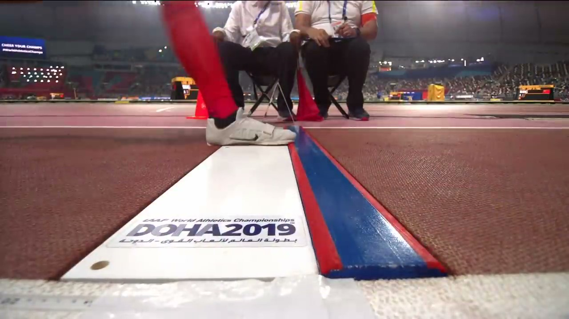
IMMEDIATE ORAL PROTEST
POWER OF THE REFEREE
The Referee may, if they are in any doubt, allow the athlete to continue competing “under protest” to preserve the rights of all concerned.
In cases where the Referee is sure that the decision of the Judges is correct, particularly by their own observation or advice received from a video Referee, the athlete should not be allowed to continue.
For example in the long jump a clear mark made in the plasticine by the athlete in question or in a throwing event where the implement has clearly landed outside the sector.

Slide 22
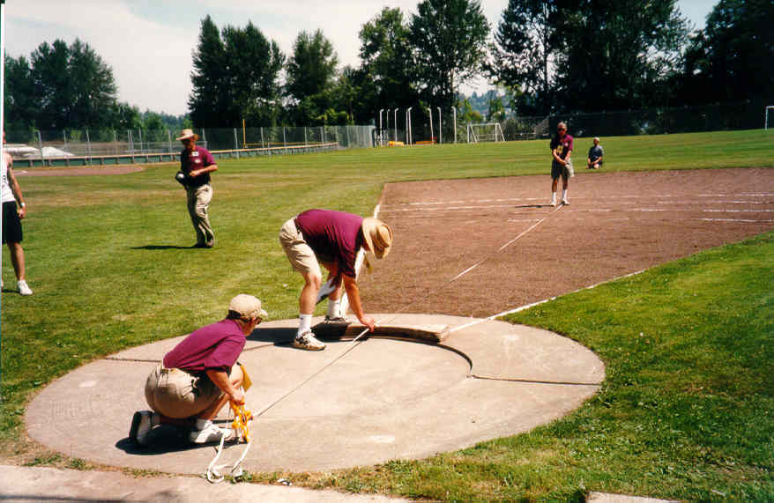
IN A FIELD EVENT
RESPONSIBILITY OF JUDGE WITH SPIKE OR PRISM
The good operation of this Rule means that the Judge with the spike or prism should always mark the point of landing (except in throwing events where the implement clearly lands outside the sector) even when they see a red flag. Apart from the possibility that the athlete may make an immediate oral protest, it is also possible that the Judge with the flags may have incorrectly or accidentally raised the wrong one.

Slide 23
IMMEDIATE ORAL PROTEST
IN A FIELD EVENT
VALIDITY OF THE PROTESTED PERFORMANCE
The protested performance of the athlete and any other performance achieved by them while competing “under protest” will become valid only if a subsequent decision to that effect is made by the Referee or an appeal to the Jury of Appeal is made and it is upheld.

Slide 24
IMMEDIATE ORAL PROTEST
IN A FIELD EVENT
VALIDITY OF THE PERFORMANCE
In Field events where, as a result of an athlete competing “under protest”, another athlete is allowed to continue in the competition when they would otherwise not have done so, such athlete’s performances and eventual results will remain valid irrespective of whether the “under protest” athlete’s immediate oral protest is successful.

Slide 25
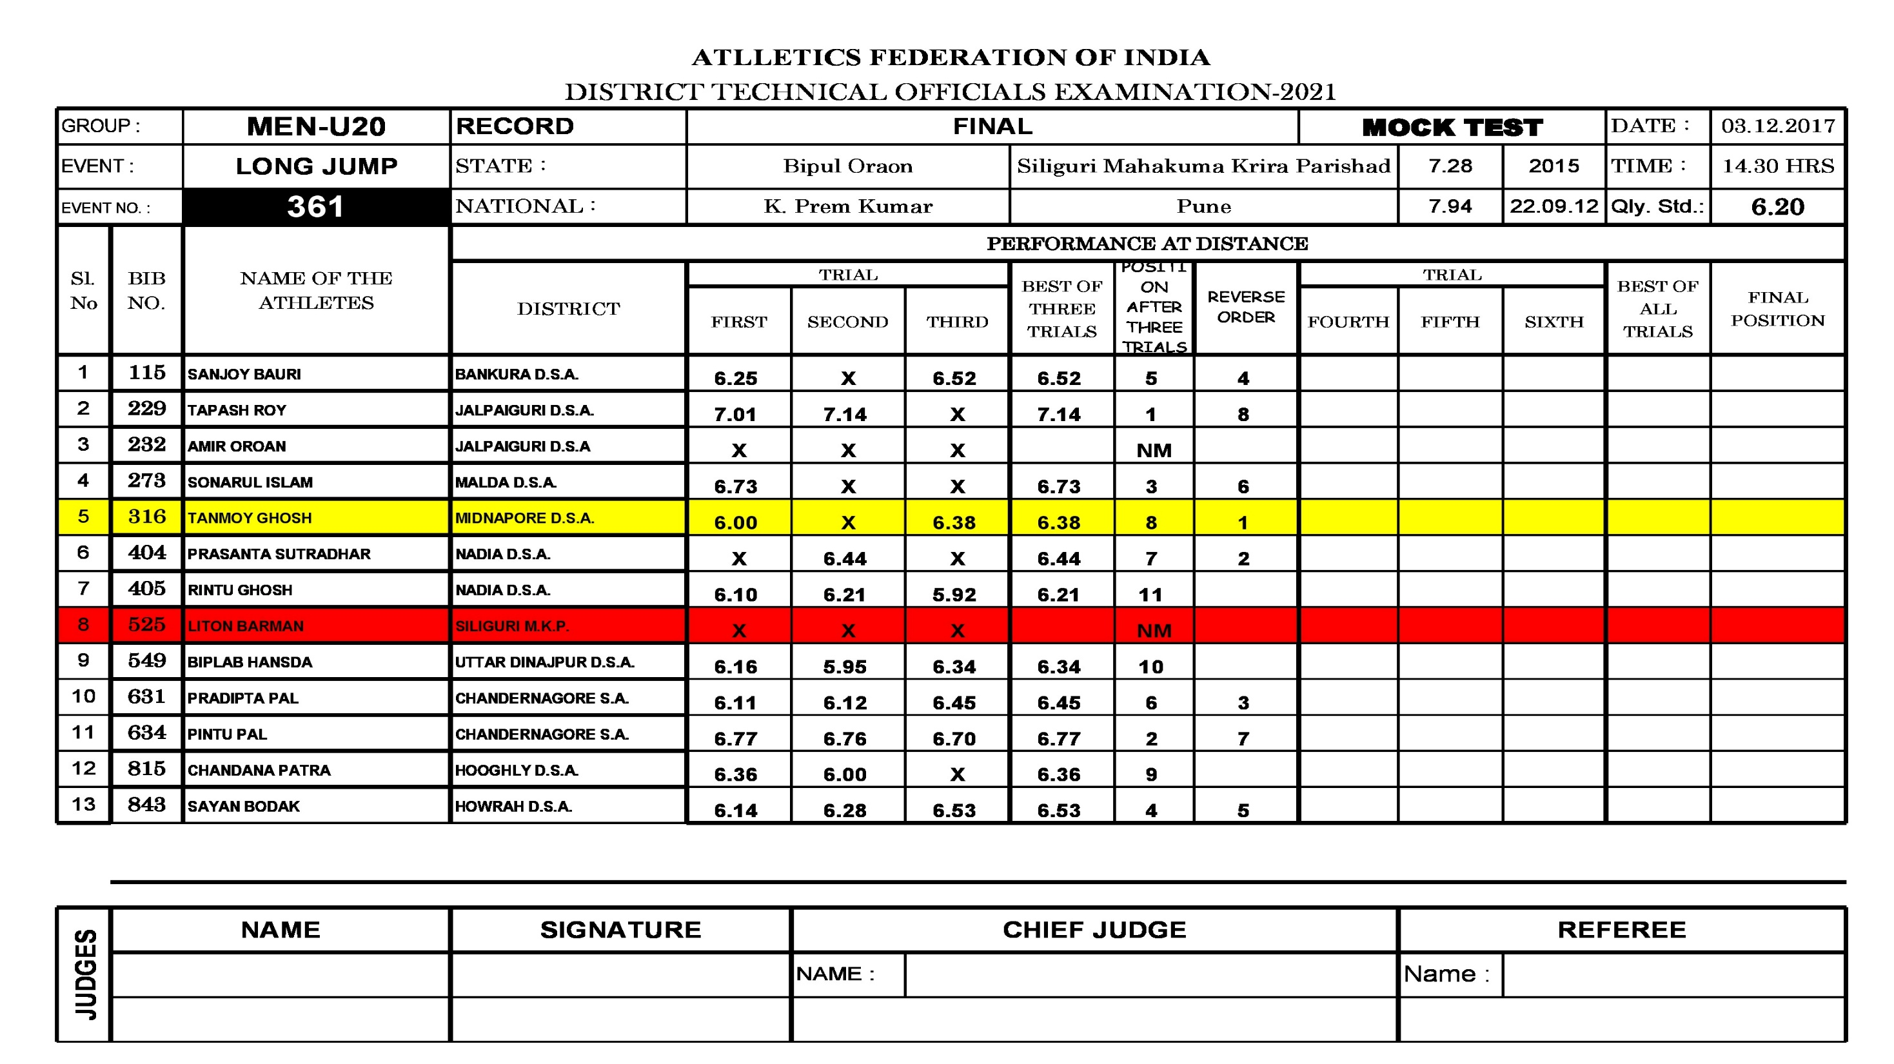

Slide 26
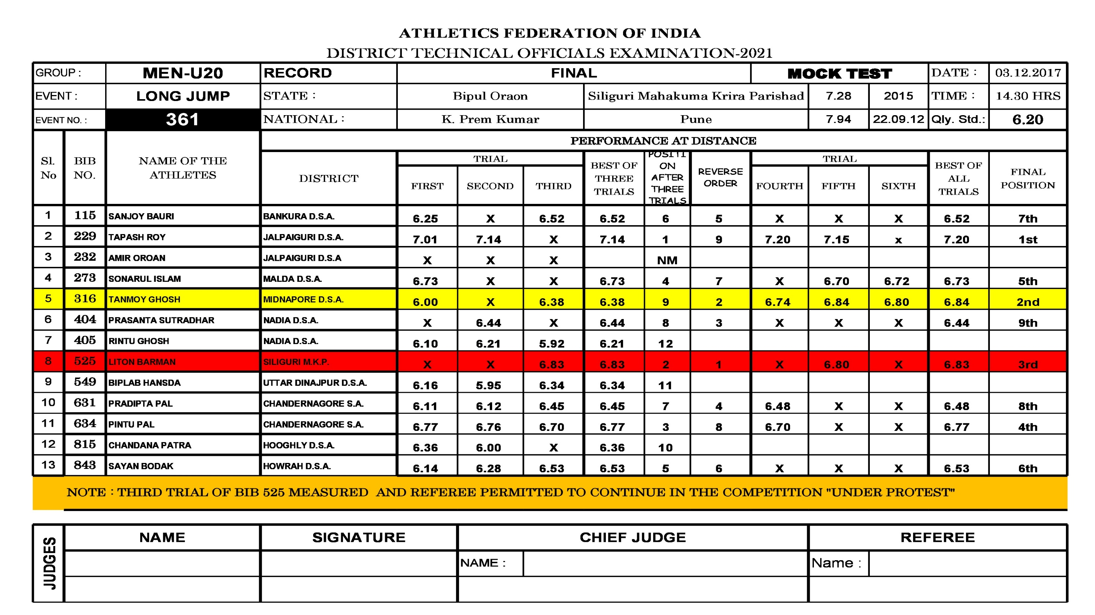

Slide 27
APPEAL TO JURY OF APPEAL
RULE TR 12 (116)
RULE TR 8.7(146)

Slide 28
JURY OF APPEAL
In the interest of the proper conduct of the competitions, a Jury of Appeal should be appointed at all competitions.
It normally consist of three, five or seven persons.
One of the member shall be the Chairman.
Another one shall be the secretary. (If appropriate he may be a person not included in the jury).
If an appeal related to Race Walking then one member of the Jury shall be a Race walking Judge.

Slide 29
JURY OF APPEAL
The primary functions of the Jury of Appeal
To deal with all appeals under Rule 8 of the Technical Rules, and with any matters arising during the course of the competition which are referred to it for decision.

Slide 30
AN APPEAL TO THE JURY OF APPEAL
CONDITIONS
An appeal to the Jury of Appeal must be made within 30 minutes.
Of the official announcement of the amended result of an event arising from the decision made by the Referee, or
Of the advice being given to those making the protest, where there is no amendment of any result.

Slide 31
AN APPEAL TO THE JURY OF APPEAL
CONDITIONS
It shall be in writing, signed by the athlete, by someone acting on their behalf or by an official representative of a team
shall be accompanied by a deposit of usd 100, or its equivalent, which will be forfeited if the appeal is not

Slide 32
WHO CAN APPEAL
An athlete
Someone acting on their behalf
An official representative of a team. if they are competing in the same round of the event to which the protest (or subsequent appeal) relates.
Or are competing in a competition in which a team points score is being conducted).

Slide 33
DUTY OF THE REFEREE
The relevant Referee shall, after their decision on a protest, immediately inform the TIC of the time of the decision. If the Referee was unable to communicate this orally to the relevant team(s) /athlete (s), the official time of the announcement will be that of posting of the amended result or of the decision at the TIC.

Slide 34
HOW TO DERIVE A DECISION BY THE JURY OF APPEAL
The Jury of Appeal shall consult all relevant persons, including the relevant Referee.
If the Jury of Appeal is in doubt, other available evidence may be considered.
If such evidence, including any available video evidence, is not conclusive, the decision of the Referee or the Chief Race Walking Judge shall be upheld.

Slide 35
RECONSIDER A DECISION
The Jury of Appeal may reconsider a decision if new conclusive evidence is presented, provided the new decision is still applicable.
Normally, such re-consideration may be undertaken only prior to the victory Ceremony for the applicable event.
Unless the relevant governing body determines that circumstances justify otherwise.

Slide 36
DUTY OF THE JURY OF APPEAL
Decisions involving points which are not covered by the Rules shall be reported subsequently by the Chairman of the Jury of Appeal to the Chief executive Officer of World Athletics.
CONCLUTION
The decision of the Jury of Appeal (or of the Referee in the absence of a Jury of Appeal or if no appeal to the Jury is made) shall be final and there shall be no further right of appeal, including to CAs.

Slide 37
Sanjay Ghosh

