Slide 1
DISTRICT TECHNICAL OFFICIALS SEMINAR & EXAMINATION-2021 BATCH-1 Day Three Date-23.01.2021 Lecturer- Sri Sambhudas Bandyopadhyay Moderator- Sri Sanjay Ghosh Topic- Circle Throws

Slide 2
SYLLABUS OF CIRCLE THROWS
1.Specifications of implements for different age groups in India
2.Throwing circle and sector.
3.Basic Rules.
4.Failure
5.Rules about assistance like use of gloves and taping.
6.Competing order ,Number of Trials and Ties.
7.Time allowed for trials
8.Measurement and recording.

Slide 3
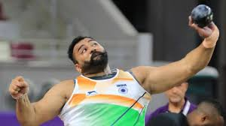
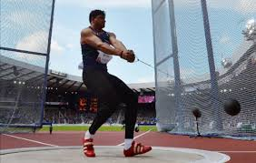
THROWS FROM CIRCLE
DISCUS THROW
SHOT PUT
HAMMER THROW

Slide 4
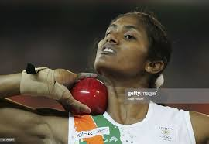
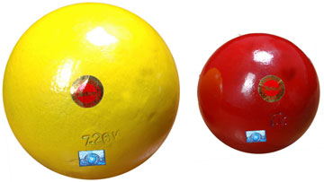
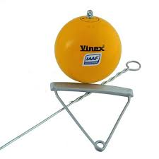
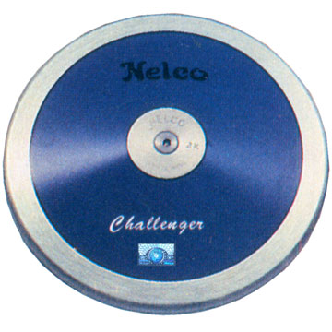
SPECIFICATION OF CIRCLE THROW IMPLEMENTS FOR DIFFERENT AGE GROUPS IN INDIA
Implement | Women | U 23 Women | U 20 Women | U 18 Women | U 16 Girls | U 14 Girls
 | 4.000kg | 4.000kg | 4.000kg | 3.000kg | 3.000kg | 2.000kg
 | 4.000kg | 4.000kg | 4.000kg | 3.000kg | 3.000kg | x
 | 1.000kg | 1.000kg | 1.000kg | 1.000kg | 1.000kg | x
Shot Put
Hammer
Discus

Slide 5
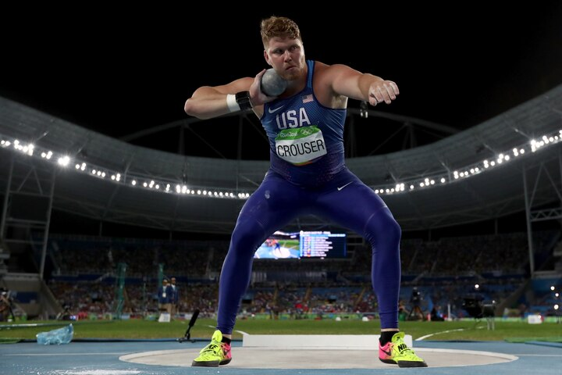
SPECIFICATION OF CIRCLE THROW IMPLEMENTS FOR DIFFERENT AGE GROUPS IN INDIA
Implement | Men | U 23 Men | U 20 Men | U 18 Men | U 16 Boys | U 14 Boys
 | 7.260kg | 7.260kg | 6.000kg | 5.000kg | 4.000kg | 3.000kg
 | 7.260kg | 7.260kg | 6.000kg | 5.000kg | 4.000kg | x
 | 2.000kg | 2.000kg | 1.750kg | 1.500kg | 1.250kg | x
Shot Put
Hammer
Discus

Slide 6
Shot put
The shot shall be of solid iron, brass or any metal not softer than brass, or a shell of such metal filled with lead or other solid material

Slide 7
DISCUS
The body of the discus may be solid or hollow and shall be made of wood, or other suitable material, with a metal rim, the edge of which shall be circular

Slide 8
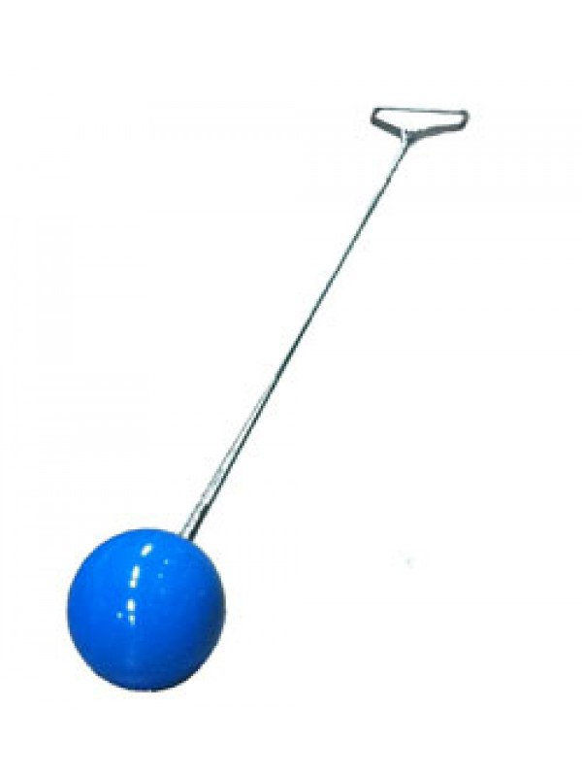
The Hammer shall consist of three main parts: a metal head, a wire and a handle.
HAMMER

Slide 9
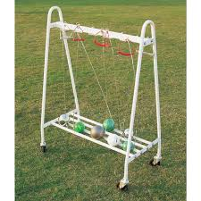
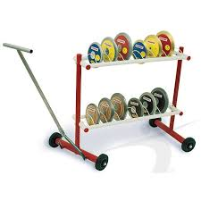
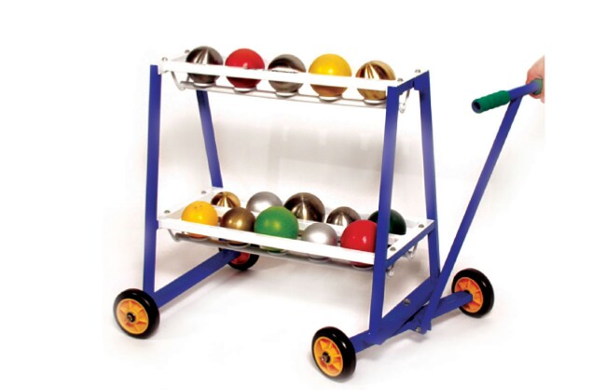
IMPLEMENTS
Implements normally provide by the OC.
Personal implement may be allowed provided that this implement is not in the competition pool.
But in local level competition we have to consider the personal implement for speed up the competition.

Slide 10
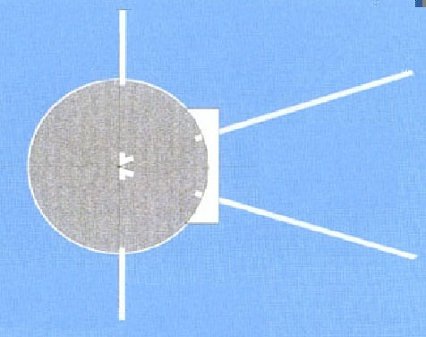
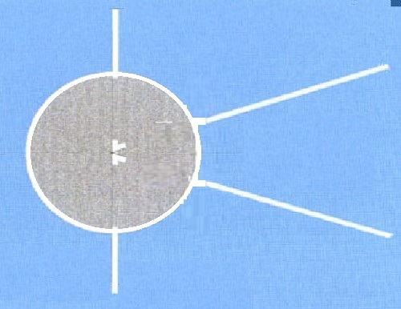
75cm Min
75cm Min
20m
20m
2.50m+/-5mm inside diameter
2.135m
+/- 5mm
Inside
diameter
34.92
0
12m
0
34.92
12m
20m
20m
5cm
5cm
Shot Put Sector
Discus Sector

Slide 11
75cm Min
20m
2.135m+/-5mm inside diameter
0
12m
34.92
Inside Radius 1.067m
20m
5cm
Hammer Sector and Landing Area

Slide 12
Stop Board
The stop board shall be white and made of wood or other
suitable material in the shape of an arc

Slide 14
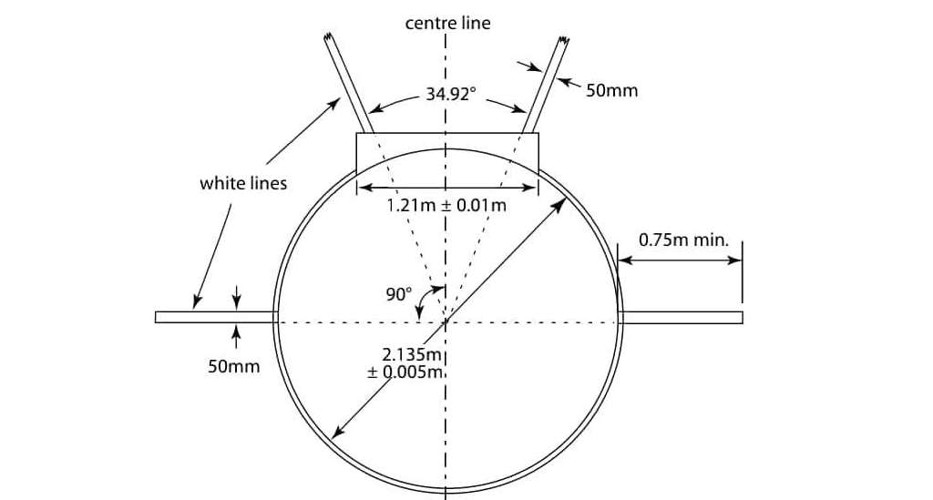
COMMON BASIC RULES OF CIRCLE THROWS
Shot put Discus and hammer throw must start from stationary position in side the circle.
An athlete is allowed to touch the inside of the rim.
An athlete can enter the circle in any direction as per his or her wish.
An athlete may interrupt a trial once started, may lay the implement down inside or outside the circle and may leave the circle .In these circumstances an athlete may leave the circle in any direction as per their choice.
An athlete can not leave the circle before the implement touches on the ground.

Slide 15
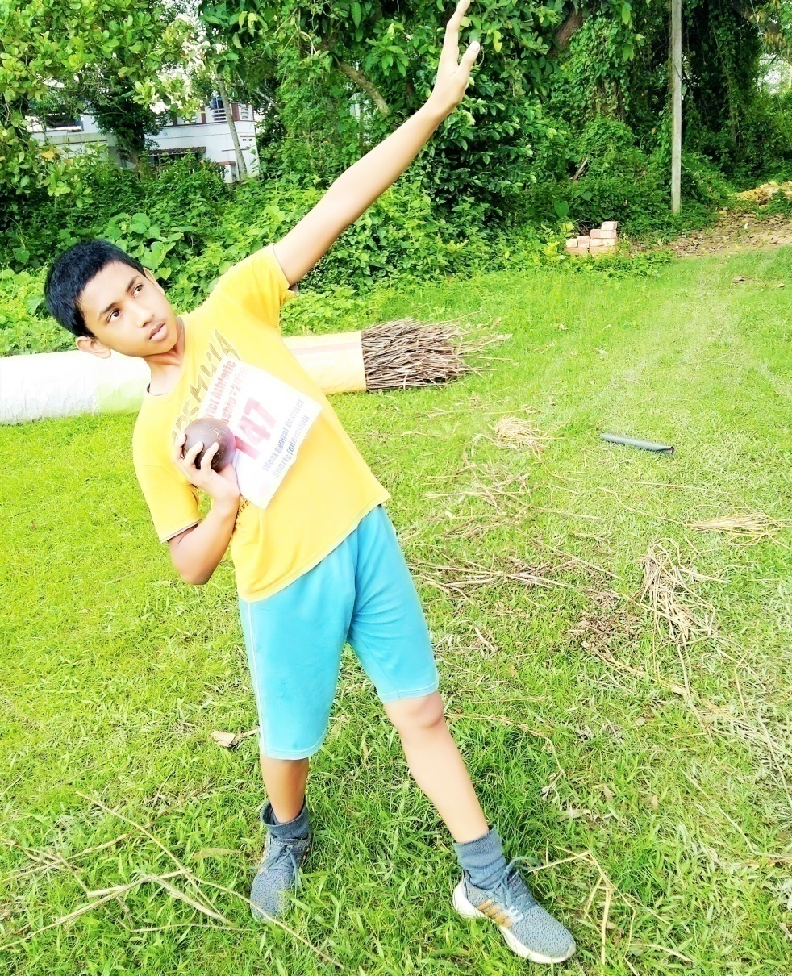
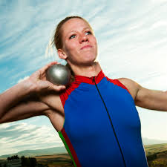
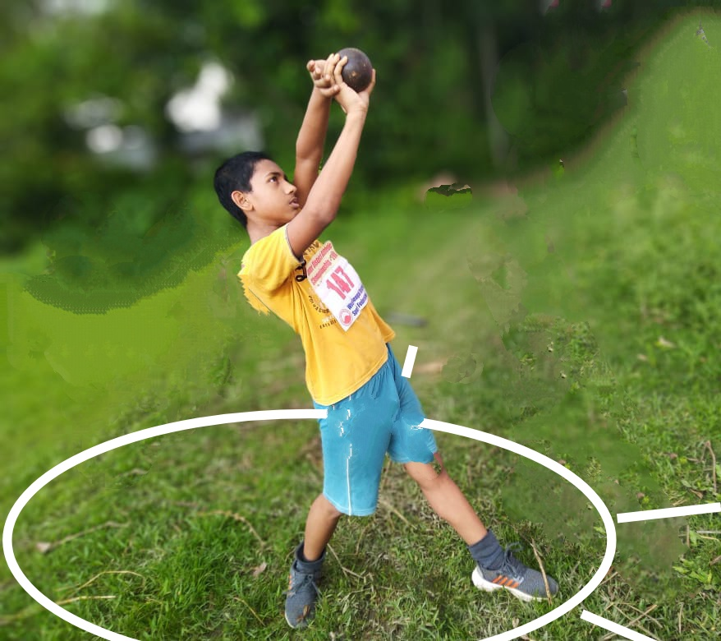
Shot Put Competition
The shot shall be put from the shoulder with one hand only
The shot shall not be taken behind the line of the shoulders.
When about to commence a put, the shot shall touch or be in close proximity to the neck or chin and the hand shall not be dropped below this position .

Slide 16
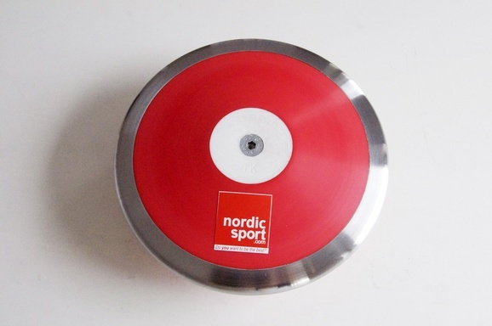
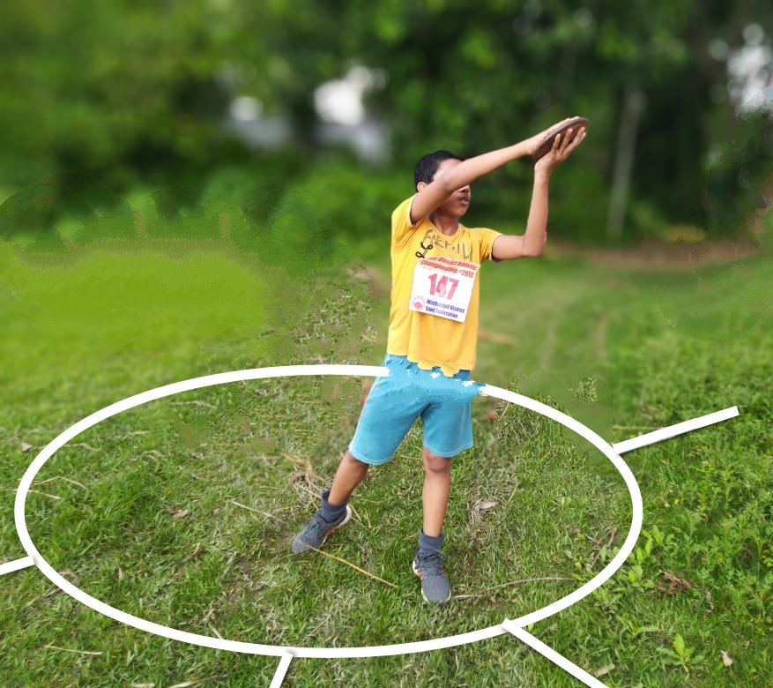
Discus Throw
The discus can only be thrown by an athlete when he or she will stand inside a circle which has a diameter of 2.5m.
Discus can be thrown in both hands but it is disadvantage. There is no such specification that how to hold and how to throw.

Slide 17
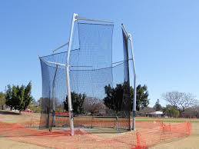
DISCUS CAGE
.
All Discus Throws shall be made from an enclosure or cage to ensure the Safety of spectators, officials and athletes .

Slide 18
PRACTICE TRIALS AT THE COMPETITION AREA
At the competition area just before beginning of the event, each athlete may have practice trials. In the case of throwing events, the practice trials will be in drawn order.
Number of practice trials that may be included in the warm-up time available Whilst for major events, two remains a standard practice, this is regarded as a minimum and should time be available and some or all or the athletes

Slide 19
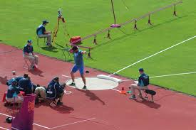
ONCE A COMPETITION HAS BEGUN, ATHLETES ARE NOT PERMITTED TO USE, (FOR PRACTICE PURPOSES, AS APPROPRIATE)
The circles or the ground within the sector with or without implements.

Slide 20
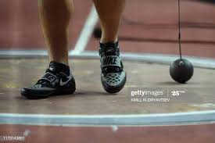
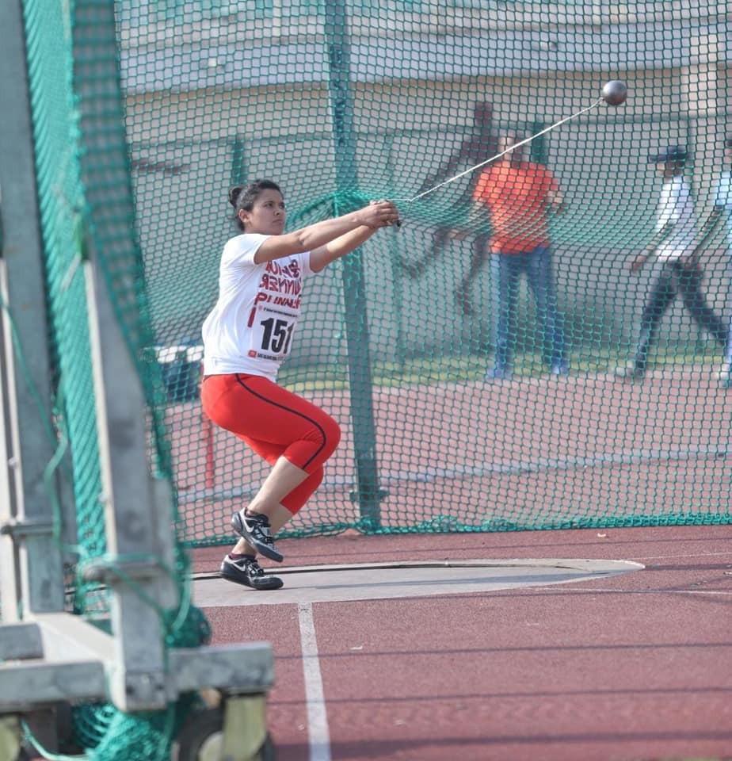
HAMMER THROW COMPETITION
An athlete, in their starting position prior to the preliminary swings or turns, is allowed to put the head of the hammer on the ground inside or outside the circle
It shall not be considered a failure if the head of the hammer touches the ground inside or outside the circle, or the top of the rim.
If the hammer breaks during a throw or while in the air, it shall not count as a failure.

Slide 21
HAMMER CAGE
All Hammer Throws shall be made from an enclosure or cage to ensure the Safety of spectators, officials and athletes .

Slide 22
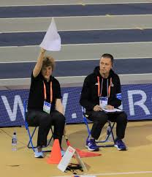
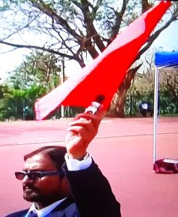
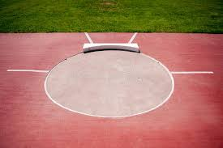
Completion of Trials and indication
The completion of a valid trial shall be determined as follows
Once the athlete leaves the circle in accordance with Rule 32.17 of the Technical Rules.
The Judge shall raise white flag to indicate a valid trial and raise red flag to indicate failure.
The Judge may reconsider a decision if they believe the incorrect flag.

Slide 23
Absence during Competition
An athlete may not leave the immediate area of the event during the progress of the competition, unless they have the permission of, and is accompanied by, an official. If possible, a warning should be given first, but for subsequent instances or in serious cases the athlete shall be disqualified
Replacement Trials
If, for any reason beyond their control, an athlete is hampered in a trial and is unable to take it, or the trial cannot be correctly recorded, the Referee shall have the authority to award them a replacement trial or to re-set the time either partially or in full.
No change in the order shall be permitted.

Slide 24
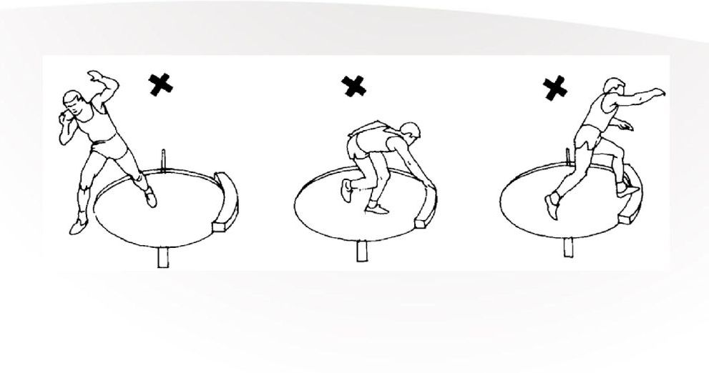
IT SHALL BE A FAILURE
Releases the shot other than as permitted under rules 33.1 and 38.1 of the Technical Rules
After they have stepped into the circle and begun to make a throw, touches with any part of their body the top (or the top inside edge) of the rim or the ground outside the circle.
In the shot Put, touches with any part of their body any part of the stop board other than its inner side. Inside edge of the stop board is considered top of the stop board.
It shall be a failure if an athlete does not commence his throwing procedure in side the circle within his time limit.

Slide 25
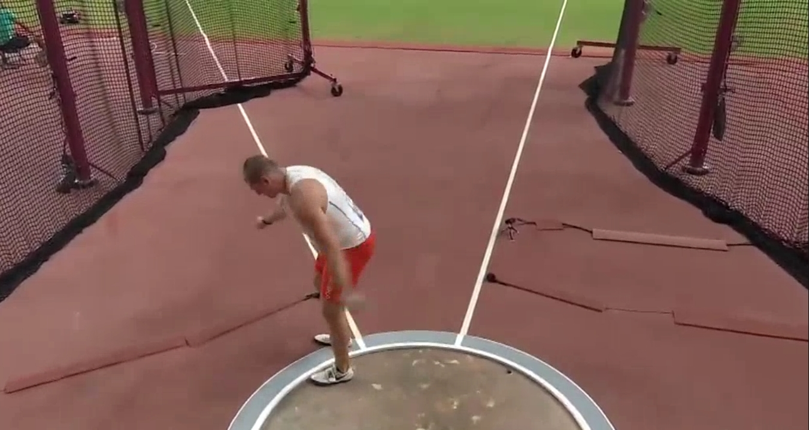
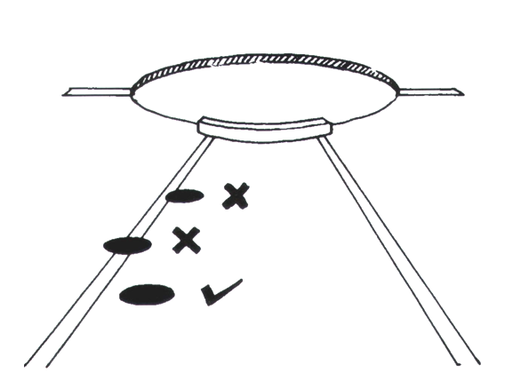
It shall be a failure if the athlete leaves the circle or runway before the implement has touched the ground, or
For throws made from a circle, if when leaving the circle, the athlete’s first contact with the top of the rim or the ground outside the circle is not completely behind the white line which is drawn outside the circle running.
It shall be a failure if the shot, the discus, the hammer head first land touches the sector line or the ground outside the sector line.

Slide 26
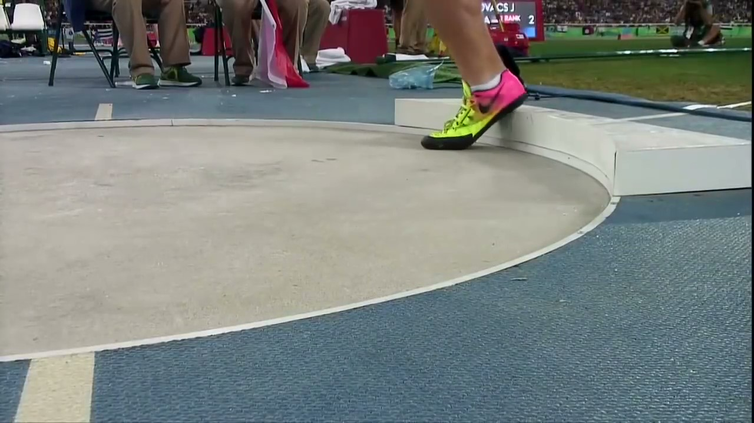
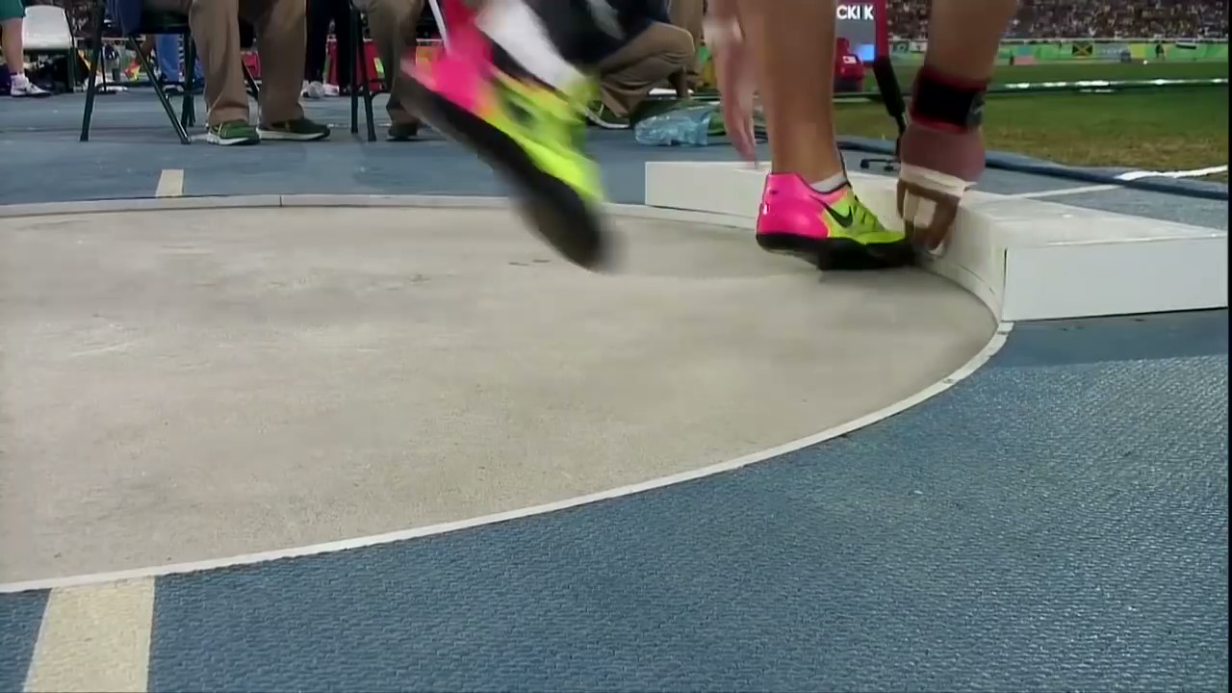
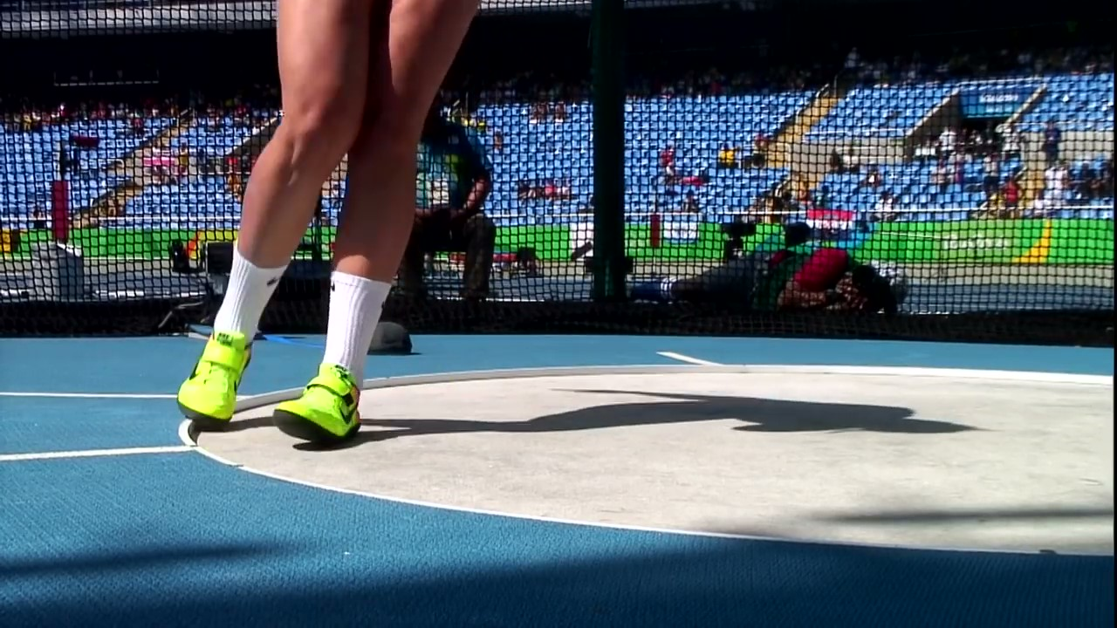
DISQUALIFICATION

Slide 27
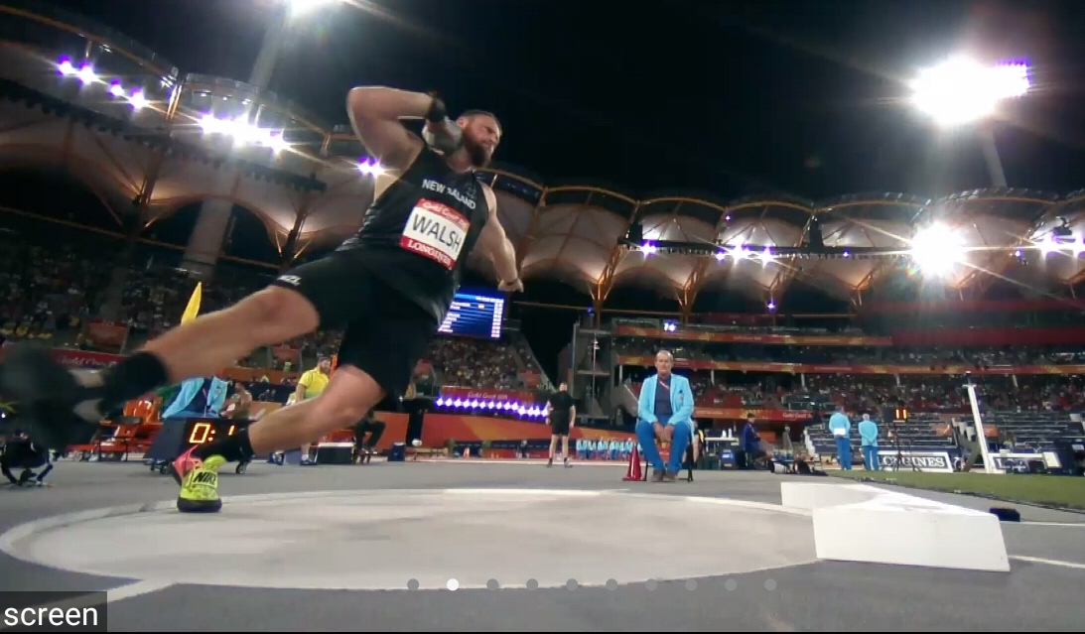
IT SHALL NOT BE A FAILURE
Discus and Hammer strikes near side of the the cage and lands inside the landing area.
The head of the hammer touches during rotation inside or outside the circle or on the rim.
The hammer breaks during a throw or while in the air.
The hammer head lands inside the landing area but wire and handle touches outside the landing area.
After landing the implement inside the landing area touches on the rim at the rear half of the circle then leaves the circle through front half.
In the air discus is outside the landing area but lands inside .

Slide 28
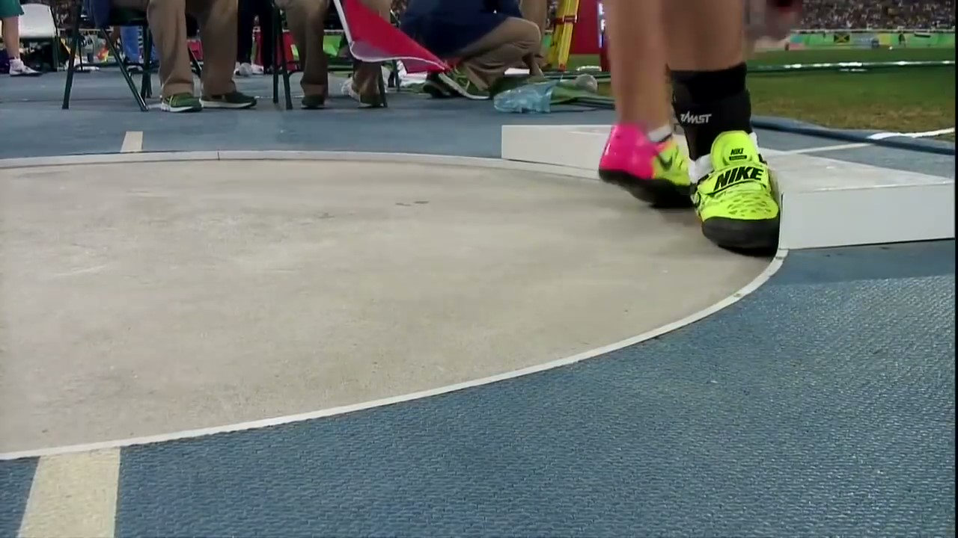
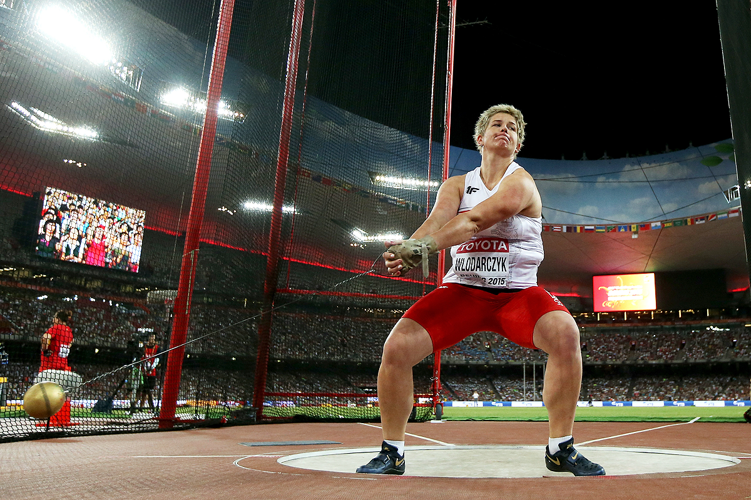
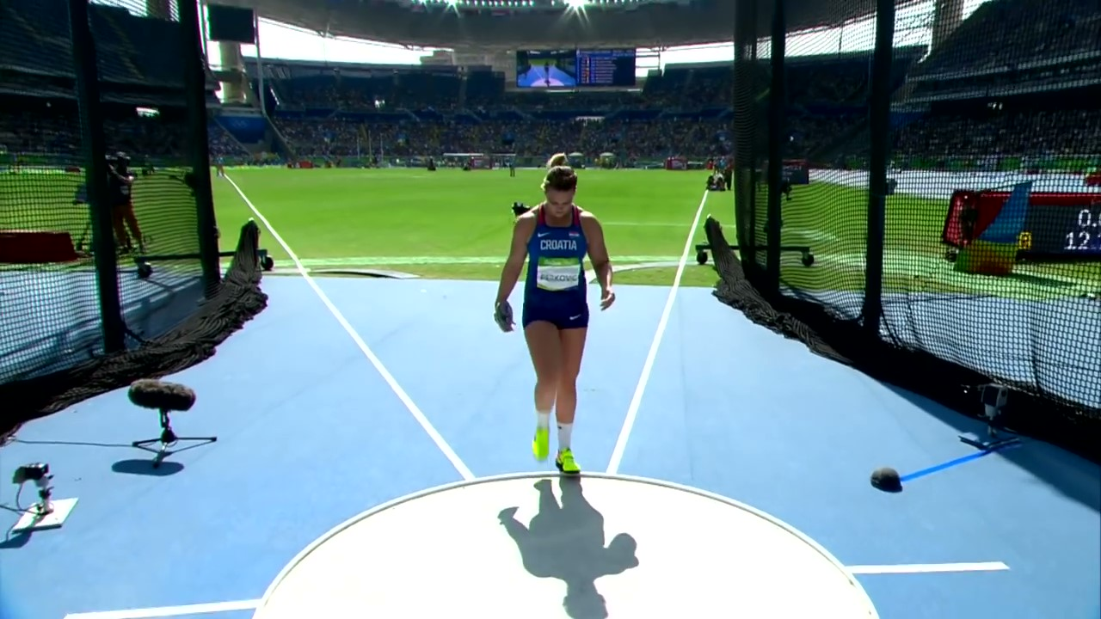
NO DISQUALIFICATION

Slide 29
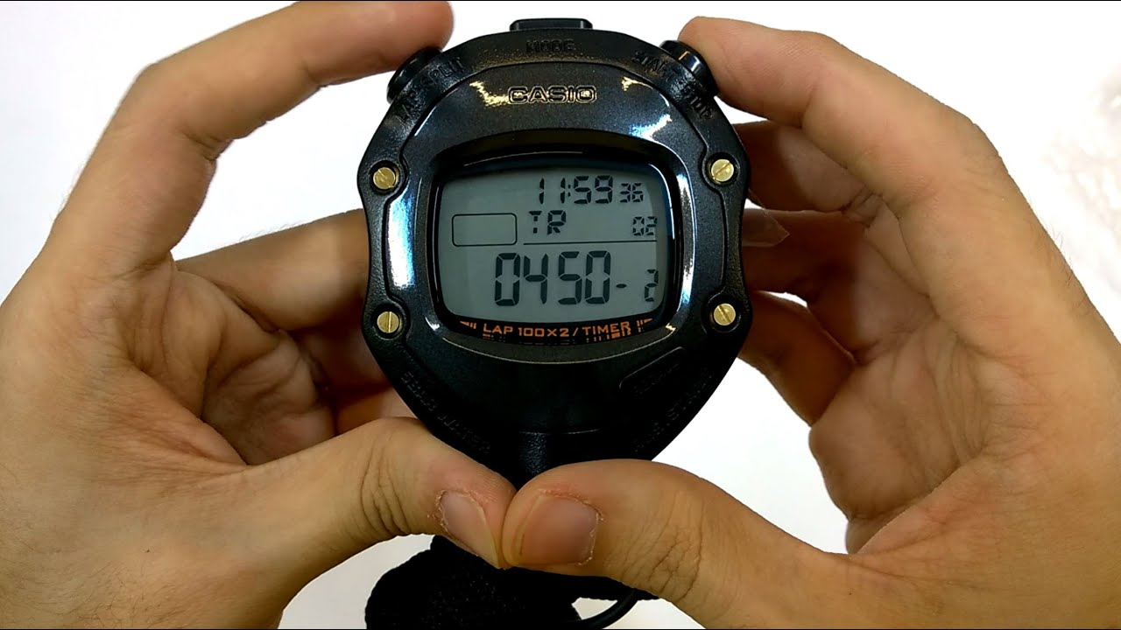
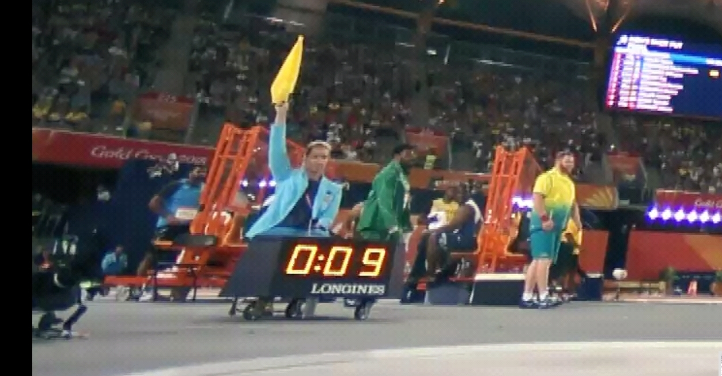
TIME ALLOWED FOR TRIALS
Events | More Than 3 Athletes | 2 or 3 Athletes | Consecutive Trials by Any Athlete
 | 1 min | 1 min | 2 min
 | 1 min | 1 min | 2 min
 | 1 min | 1 min | 2 min
A clock which shows the remaining time allowed for a trial should be visible to an athlete. In addition, an official shall raise and keep raised, a yellow flag, or otherwise indicate, during the final 15 seconds of the time allowed.
Shot Put
Hammer
Discus

Slide 30
Competing Order and Trials
No of Athletes | 1st Three Round of Trials | Number of Trials | After 3 Rounds of Trial | Position after Three Trials | Order of Throws
8 or Less | Drawn by lot | 6 Trials | Reverse ranking, 1st will throw last. | A-1 B-2 C-3 D-4 E-5 F-6 G-7 H-8 | 8 7 6 5 4 3 2 1
More than 8 | Drawn by lot | Each athlete shall be allowed three trials and the eight athletes with the best valid performances shall be allowed three additional trials | Reverse ranking, 1st will throw last.
Qualification round. Max 3 trials, drawn by lot .Select at least best 12 for finals.

Slide 31
Ties
The second best performance of the athletes having the same best performances shall determine whether there has been a tie. Then, if necessary, the third best, and so on.
.
SCORE SHEET EVENT-SHOT PUT
NAME | BIB | TRIAL-1 | TRIAL-2 | TRIAL-3 | BEST | POSITION
ASHOKE | 220 | 14.20m | 13.95m | 13.25m | 14.20m | 2nd
SAHIDUL | 325 | 13.95m | 14.20m | 13.60m | 14.20m | 1st
BENJAMIN | 430 | x | 13.95m | 14.20m | 14.20m | 3rd

Slide 32
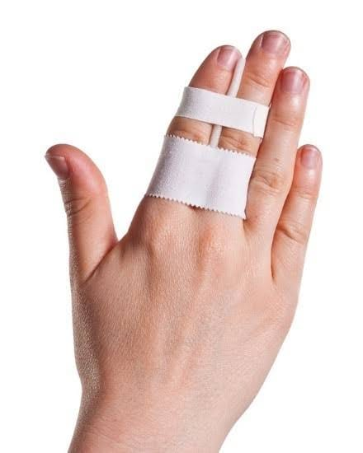
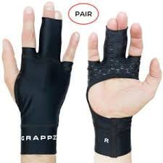
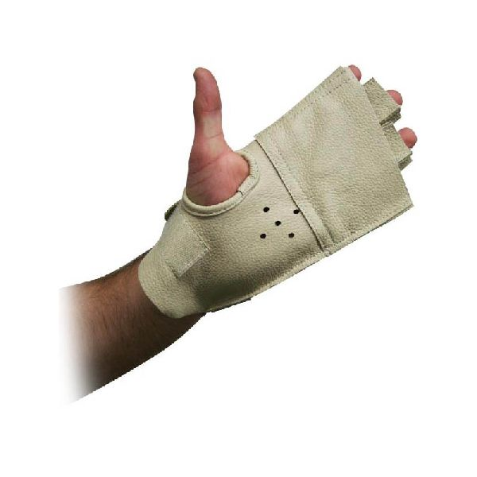
Assistance not allowed.
The following shall be considered assistance and are therefore not allowed:
-The taping of two or more fingers together.
- The use of gloves except in the Hammer

Slide 33
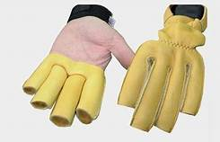
Rules about Gloves .
Gloves are allowed for Hammer Throwing event provided that other than top of the thumb fingers should be cut and open.

Slide 34
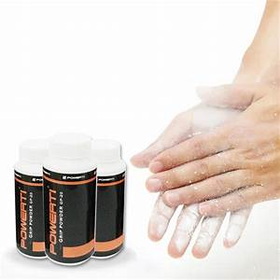
The following shall not be considered assistance and are therefore allowed
- The use by of a suitable substance on their hands only or in the case of a hammer thrower on their gloves. shot putter may use such substances on their neck.
Magnesium powder can use.

Slide 35
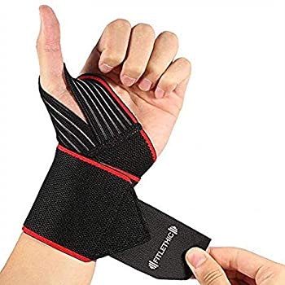
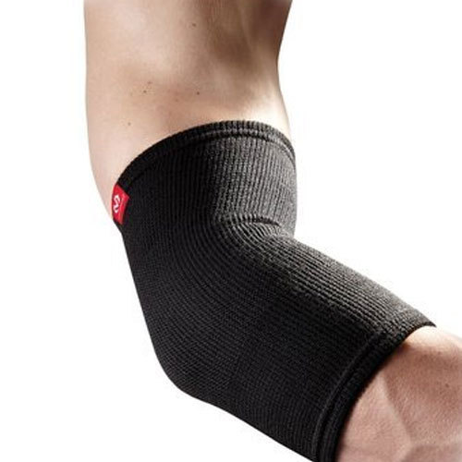
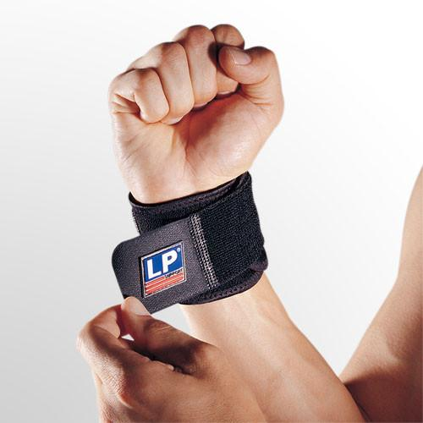
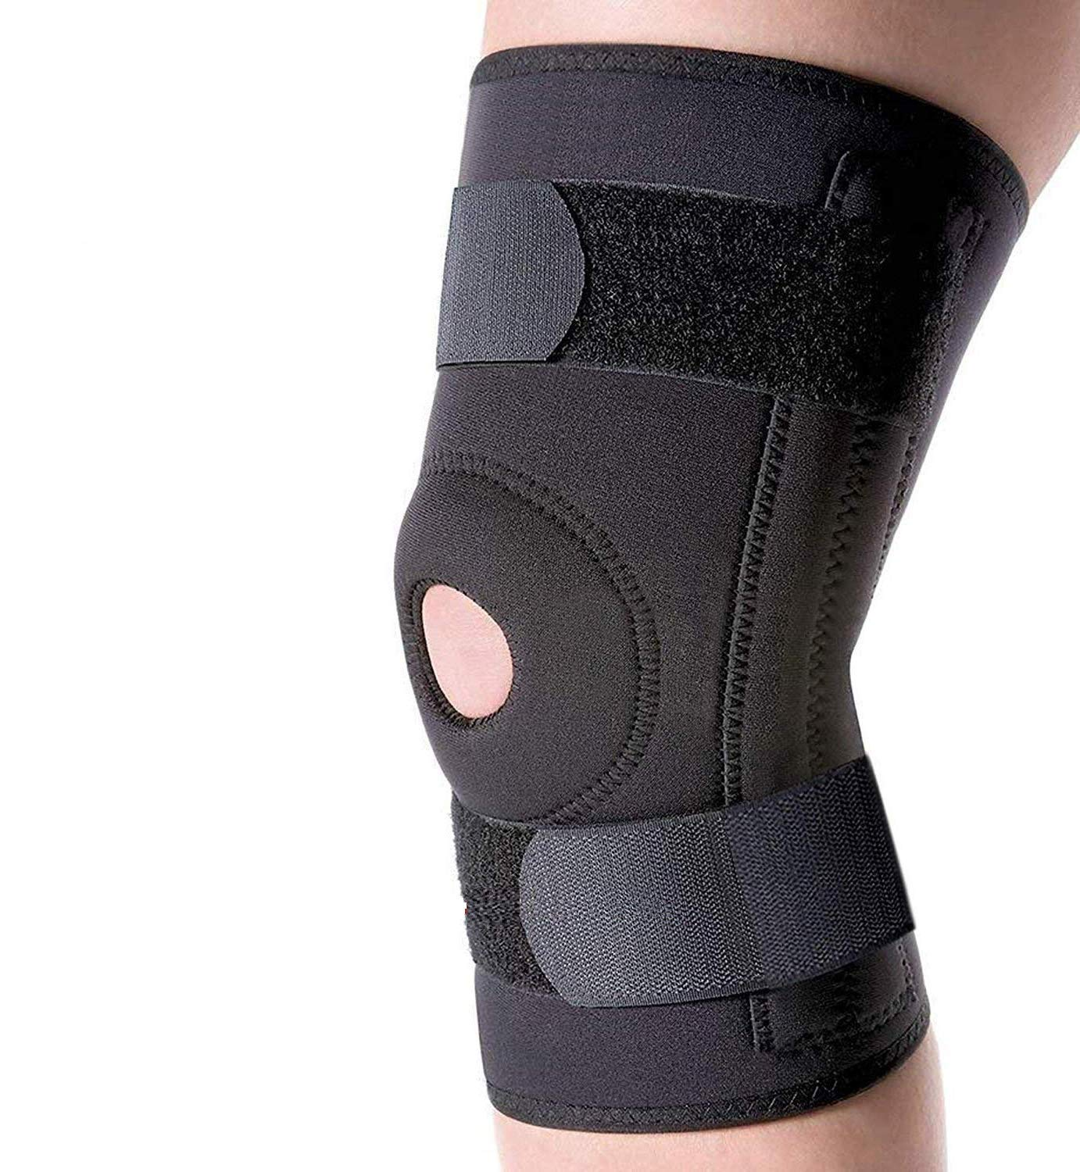
ASSISTANCE ALLOWED
WRIST BAND
ELBOW SUPPORT
KNEE SUPPORT
IS PERMISSIBLE

Slide 36
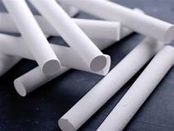
-The placement by an athlete, in the shot Put and discus Throw, on the implement, chalk or a similar substance
Athlete can use chalk on the implement.

Slide 37
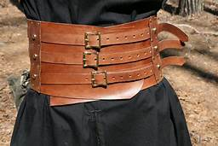
Belt is allowed for all throwing events provided that no extra weight is attached with the belt.

Slide 38
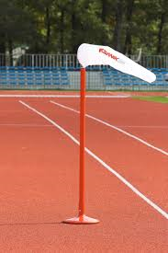
Wind Socks
One or more wind sock(s) should be placed in an appropriate position to show the athletes the approximate direction and strength of the wind.
WHICH CIRCLE THROW EVENT WIND SOCK IS USED?

Slide 39
MEASUREMENT AND RECORDING
TWO SYSTEMS OF MEASUREMENT
1.MEASUREMENT BY STEEL /FIBRE GLASS TAPE
2.MEASUREMENT BY EDM

Slide 41
Distance Measurement
In all throwing events, distances shall be recorded to the nearest 0.01m below the distance measured if the distance measured is not a whole centimetre
The shot, discus and hammer head, to the inside of the circumference of the circle along a line to the centre of the circle; or
The head of the javelin to the inside edge of the arc, along a line to the centre of the circle of which the arc is part
Q. If the distance is between 16.5 m and 16.6 m ,then what distance we will record ?

Slide 42
SITUATION
Discus hits the cage and lands inside the landing area.
After throw the wire and handle is separated from the metal head in hammer throw event.
Shot lands on the sector tape but 90 percent is inside the sector.
During putting the shot athlete’s shoe lace touches on the stop board.
An athlete leaves the circle before the discus touches the ground.
A shot putter use chalks on the shot before throw.
Discus thrower spraying magnesium powder on the circle and on the shoe before his trial.
During rotation hammer head touches out side or inside the circle.

Slide 43
SAMPLE QUESTIONS AND ANSWERS
Q1.The weight of the women Shot shall be:
Ans: A-5kg B-3kg C-4 kg D-2kg
Q2.The diameter of the Discus circle is:
Ans: A-1.25m B-2.50m C-1.067m D-2.135m
Q3. Which assistance is not permissible in shot Put event
Ans: A-Gloves B-Wrist band C-Elbow support D-Waist belt
Q4.The angel of the throwing circle shall be:
Ans: A-34.92 B-34.94 C-34.93 D-34.95 degree.
Q5. The colour of the stop board shall be:
Ans: A-Blue B-Red D-White E-Black
Q6.The Hammer head lands inside the landing area but wire and handle touches outside:
Ans: A-Foul throw B-Valid Throw C-Replacement Trial. D-None.

Slide 44
A MAN CAN NOT PERFECT SO TRY TO ACHIEVE PERFECTION.
Thank you all
Wish you all good luck for the DTO exam.
Sambhudas Bandyopadhyay
M-9474745474

