Slide 1
A.F.I. Online TOECS Level-C DTO Seminar-cum Examination 2021 Lecturer -HANIF IKBAL Technical Official AFI
TOPICS ARE
Officials of the meet and their duties in brief
Age groups and events in India
Clothing, Shoes, Spikes, Bibs
Entries , order of events and start list
Flow of Athletes (Call room, Mixed Zone, Post event)

Slide 2
RULES BOOK TO BE FOLLOW
Front Cover 2020 Edition
Back Cover 2020 Edition

Slide 3
International Officials
Official of the meet and their duties in brief
MANAGEMENT OFFICIALS
Competition Director
Meeting Manager
Technical Manager
Event Presentation Manager
COMPETITION OFFICIALS
Referee Call Room
Referee Track
Referee Field
Referee Combined Events
Referee Outside stadium Events
Starter, Re-caller, Starter’s Assistant
Video Referee
Timekeepers
Photo Finish Judge
Chief Judge, Judges
Walking Judges
Recorder
Umpire
Lap scorer
Competition Secretary
Marshal
Wind Gauge Operator
(a) Organizational Delegate(s)
(b) Technical Delegate(s)
(c) Medical Delegate
(d) Anti-Doping Delegate
(e) International Technical Officials
(f) International Race Walking Judges
(g) International Road Course Measurer
(h) International Starter
(I) International Photo Finish Judge
(j) Jury of Appeal
1.1(a) and (e), the IAAF may appoint an Advertising Commissioner.
ADDITIONAL OFFICIALS
Announcers
Statisticians
Advertising Commissioner
Official Surveyor
Doctors
Stewards
Photographers

Slide 4
Organisational Delegates
Work with LOC at all times & Report regularly to the AFI
Deal with financial matters & responsibilities with LOC and
Cooperate with the T.D’s.
Technical Delegates
Ensure that all technical arrangements are in complete conformity with WA Technical Rules,
Submit proposals for the timetable of events, entry standards, implements list, determine the qualifying standards for the Field Events, control the entries , arrange heats, rounds and the groups.
Report regularly to appointing Authority
Chair Technical Meeting .

Slide 5
Competition Director
Shall plan the technical organisation and Resolve any technical problems together with TD
Keep in contact with all key officials.
Meeting Manager
Responsible for correct conduct of the Competition.
Check that all officials have reported for duty, appoint substitutes if required, authority to remove any official who is not abiding by the Rules.

Slide 6
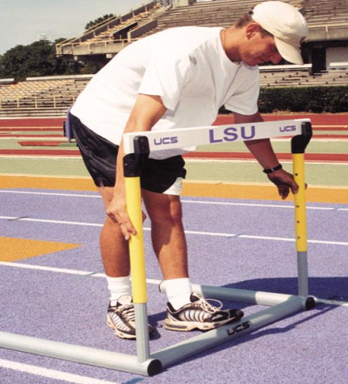
Technical Manager
Responsible for:-
Ensuring that the track, runways, circles, arcs, sectors, landing areas for Field Events and all equipment and implements are in accordance with the Rules.
Placement and removal of equipment and implements
Checking and marking any personal implements permitted according to Rule.

Slide 7
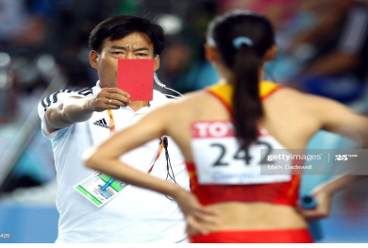
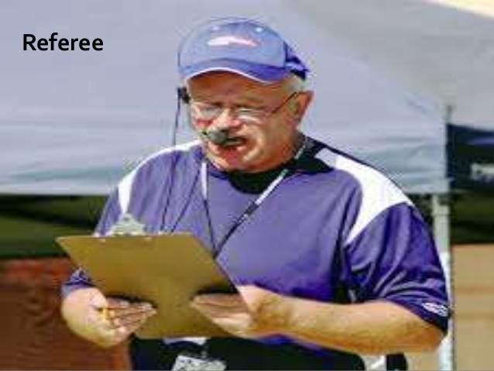
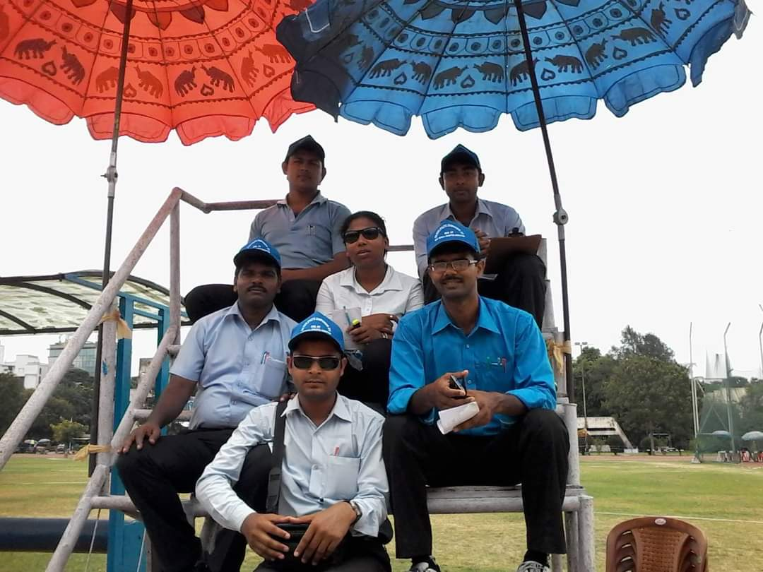
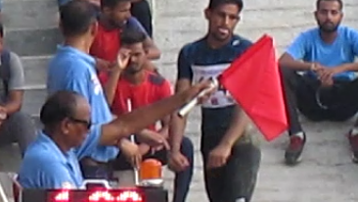
Referees
Entire control of the event up to victory ceremony.
Supervise record performance, check all result and signed ,
Decides disputed matters,
Can warn & exclude an athlete
Reconsider a decision, can rerun a race.
Judges
Chief Judge Allocate the duties.
Judges Decide the finished order, Record & measure each valid trial in Field Event, indicate validity or non-validity, time elapsed.
benefit of any doubt goes to the favor of athlete.

Slide 8
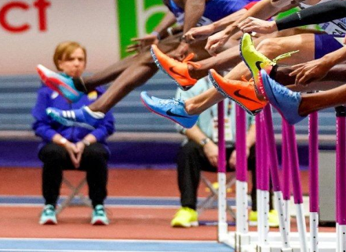
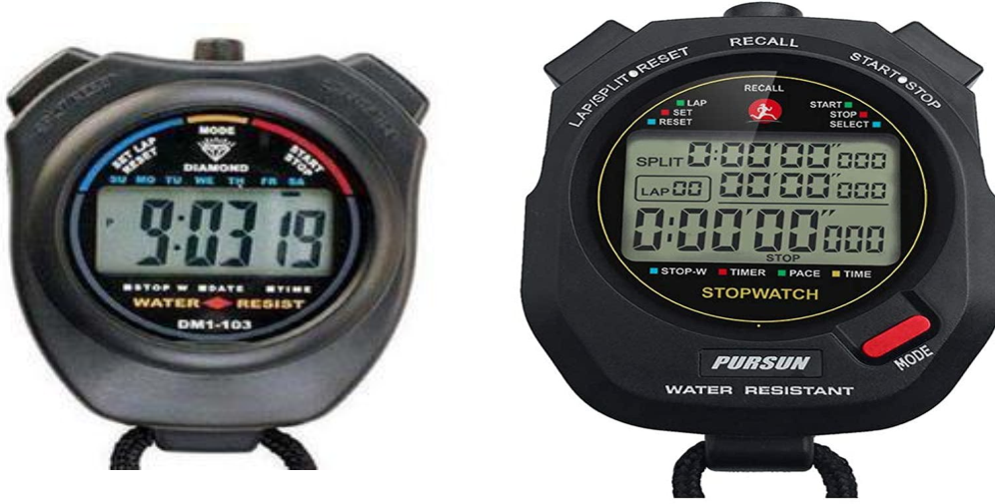
Umpires (Running and Race Walking Events)
Umpires are the eyes of Referee, without authority to make final Decisions
In case of any violation or breach of rules make Communicate immediately & written report to referee
Timekeepers Judges
Timekeepers record time of a race by stop watches.

Slide 9
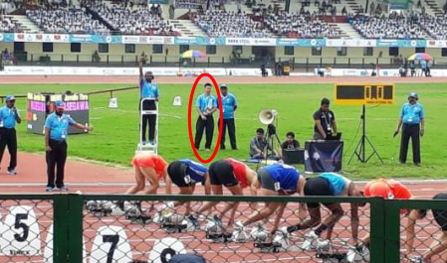
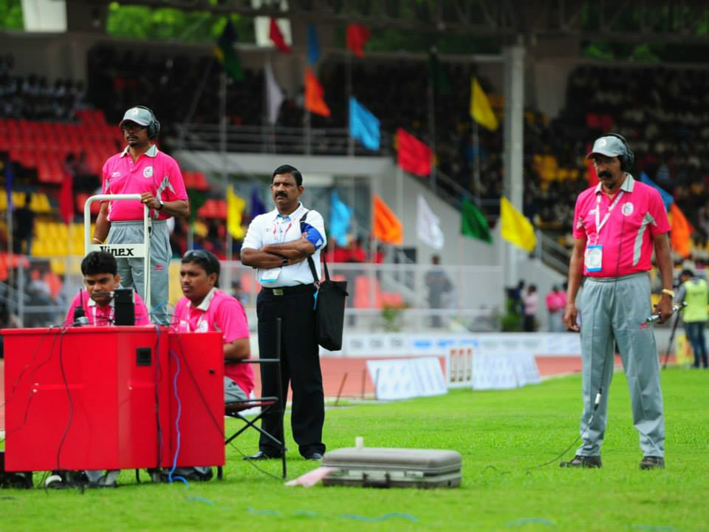
Start Coordinator
Allocate duties, Supervise duties, keep all papers, inform starter to start.
Starter
Start the race, decide who takes false start.
Recallers
Recall the race & inform to starter.
Starter’s Assistants
Place athletes in correct heat & lined athletes on assembly line.
Check BIB no worn correctly .
Readiness of baton in relay race.

Slide 10
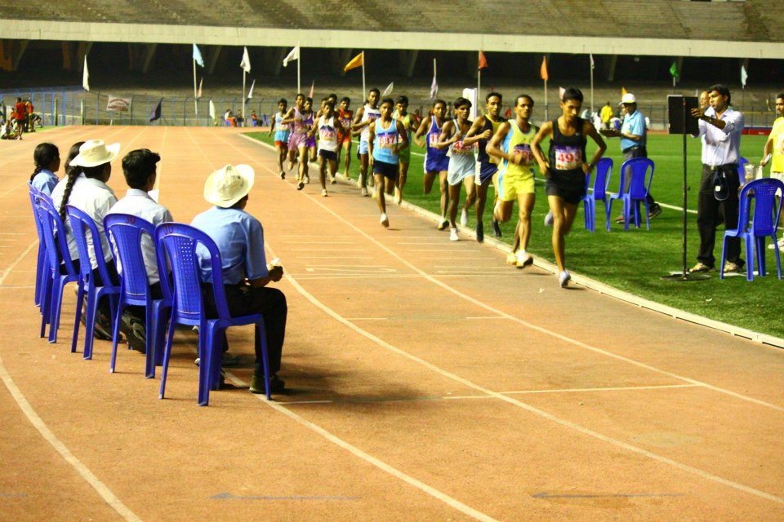
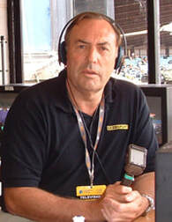
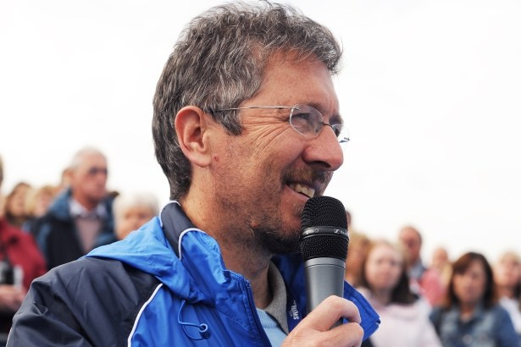
Lap Scorers
Keep record of each and every laps
maintain laps display board and Final lap signaled by ringing bell
Competition Secretary
Collect full results, relay to announcer, keep records & convey result card to competition director
Announcer
inform public sufficient information about on going events.

Slide 11
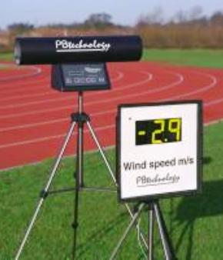
Wind Gauge Operator
Placed gauge & record wind velocity in the running direction.
Call Room Judges
Ensure athletes are wearing officially approved national or club uniform clothing.
Bibs are worn correctly and correspond with start lists,
Check shoes, number and dimension of spikes,
Advertising on clothing and athletes bags comply with Rules & Regulations and
No unauthorized material is taken into the arena.

Slide 12
Age groups and events in India
MEN
U23 MEN
U20 MEN
U18 BOYS
U16 BOYS
U14 BOYS
WOMEN
U23 WOMEN
U20 WOMEN
U18 GIRLS
U16 GIRLS
U14 GIRLS
The Age will be determine on the basis of last date/day of the Championships.
Almost all event are held as per WA/AFI. Event list and all Specification is available in AFI website www.indianathletics.in

Slide 13
ATHLETICS FEDERATION OF INDIA
TECHNICAL COMMITTEE
LIST of EVENTS * MEN & BOYS * Year 2020 (With Abbreviations)
MEN & U23 MEN |  |  |  |  | U20 MEN
Sl.No. | EVENTS | Abbreviations | Specification |  | Sl.No. | EVENTS | Abbreviations | Specification
1 | 100 Metres | 100m |  |  | 1 | 100 Metres | 100m
2 | 200 Metres | 200m |  |  | 2 | 200 Metres | 200m
3 | 400 Metres | 400m |  |  | 3 | 400 Metres | 400m
4 | 800 Metres | 800m |  |  | 4 | 800 Metres | 800m
5 | 1500 Metres | 1500m |  |  | 5 | 1500 Metres | 1500m
6 | 5000 Metres | 5000m |  |  | 6 | 5000 Metres | 5000m
7 | 10,000 Metres | 10,000m |  |  | 7 | 10,000 Metres | 10,000m
8 | 110 Metres Hurdles | 110mH | 1.067m |  | 8 | 110 Metres Hurdles | 110mH | 0.991m
9 | 400 Metres Hurdles | 400mH | 0.914m |  | 9 | 400 Metres Hurdles | 400mH | 0.914m
10 | 3000 Metres Steeplechase | 3000mSC | 0.914m |  | 10 | 3000 Metres Steeplechase | 3000mSC | 0.914m
11 | High Jump | HJ |  |  | 11 | High Jump | HJ
12 | Pole Vault | PV |  |  | 12 | Pole Vault | PV
13 | Long Jump | LJ |  |  | 13 | Long Jump | LJ
14 | Triple Jump | TJ |  |  | 14 | Triple Jump | TJ
15 | Shot Put | SP | 7.260kg |  | 15 | Shot Put | SP | 6.000kg
16 | Discus Throw | DT | 2.000kg |  | 16 | Discus Throw | DT | 1.750kg
17 | Hammer Throw | HT | 7.260kg |  | 17 | Hammer Throw | HT | 6.000kg
18 | Javelin Throw | JT | 800g |  | 18 | Javelin Throw | JT | 800g
19 | 4 x 100 Metres Relay | 4 x 100mR |  |  | 19 | 4 x 100 Metres Relay | 4 x 100mR
20 | 4 x 400 Metres Relay | 4 x 400mR |  |  | 20 | 4 x 400 Metres Relay | 4 x 400mR
21 | 4 x 400 Metres Mixed Relay | 4 x 400mMR |  |  | 21 | 4 x 400 Metres Mixed Relay | 4 x 400mMR
22 | Decathlon (Two Days) | Dec | 10 events |  | 22 | Decathlon (Two Days) | Dec | 10 events
23 | 20,000 Metres Race Walk | 20,000mRW | 20,000m |  | 23 | 10000 Metres Race Walk | 10000mRW | 10,000m
24 | 20 Kilometres Race Walk | 20kmRW | 20km |  | 24 | 10 Kilometres Race Walk | 10kmRW | 10km
25 | 50 Kilometres Race Walk | 50kmRW | 50km |  | 25 | 8 Kilometres Cross-Country | JM | 8km
26 | 10 Kilometres Cross-Country | SM | 10km

Slide 14
 |  |  |  |  | U16 BOYS
U18 BOYS |  |  |  |  | 1 | 100 Metres | 100m
1 | 100 Metres | 100m |  |  | 2 | 300 Metres | 300m
2 | 200 Metres | 200m |  |  | 3 | 800 Metres | 800m
3 | 400 Metres | 400m |  |  | 4 | 2000 Metres | 2000m
4 | 800 Metres | 800m |  |  | 5 | 80 Metres Hurdles (7 flight.) | 80mH | 0.838m
5 | 1500 Metres | 1500m |  |  | 6 | High Jump | HJ
6 | 3000 Metres | 3000m |  |  | 7 | Long Jump | LJ
7 | 110 Metres Hurdles | 110mH | 0.914m |  | 8 | Shot Put | SP | 4.000kg
8 | 400 Metres Hurdles | 400mH | 0.838m |  | 9 | Discus Throw | DT | 1.250kg
9 | 2000 Metres Steeplechase | 2000mSC | 0.838m. |  | 10 | Hammer Throw | HT | 4.000kg
10 | High Jump | HJ |  |  | 11 | Javelin Throw | JT | 600g
11 | Pole Vault | PV |  |  | 12 | Medley Relay | MedleyR
12 | Long Jump | LJ |  |  | 13 | Hexathlon (Two Days) | Hex | Six Events
13 | Triple Jump | TJ |  |  | 14 | 5000 Metres Race Walk | 5000mRW | 5000m
14 | Shot Put | SP | 5.000kg |  | 15 | 2 Kilometres Cross-Country | JB2 | 2km
15 | Discus Throw | DT | 1.500kg
16 | Hammer Throw | HT | 5.000kg |  | U14 BOYS
17 | Javelin Throw | JT | 700g |  | 1 | 60 Metres | 60m
18 | Medley Relay | MedleyR |  |  | 2 | 600 Metres | 600m.
19 | Decathlon (Two Days) | Dec | 10 events |  | 3 | High Jump | HJ
20 | 10,000 Metres Race Walk | 10,000mRW | 10,000m |  | 4 | Long Jump | LJ
21 | 6 Kilometres Cross-Country | JB6 | 6km |  | 5 | Shot Put | SP | 3.000kg
DECATHLON (MEN , U 23 Men, U20 Men & U18 Boys) |  |  |  |  | 6 | Ball Throw | BT | 159g.± 4g.
DAY "1": 100m, Long Jump, Shot Put, High Jump & 400m. |  |  |  |  | 7 | Triathlon (One Day) | Tri | Three Events
DAY "2": 110mH, Discus Throw, Pole Vault, Javelin Throw & 1500m. |  |  |  |  | HEXATHLON (U 16 BOYS )
TRIATHLON (U 14 BOYS) |  |  |  |  | DAY "1": 100m, Long Jump & Shot Put.
ONE DAY: 60m, Long Jump & Ball Throw. |  |  |  |  | DAY "2": High Jump, Javelin Throw & 1000m.

Slide 15
ATHLETICS FEDERATION OF INDIA
TECHNICAL COMMITTEE
LIST of EVENTS * WOMEN & GIRLS * Year 2020 (With Abbreviations)
WOMEN & U 23WOMEN |  |  |  |  | U20 WOMEN
Sl.No. | EVENTS | Abbreviations | Specification |  | Sl.No. | EVENTS | Abbreviations | Specification
1 | 100 Metres | 100m |  |  | 1 | 100 Metres | 100m
2 | 200 Metres | 200m |  |  | 2 | 200 Metres | 200m
3 | 400 Metres | 400m |  |  | 3 | 400 Metres | 400m
4 | 800 Metres | 800m |  |  | 4 | 800 Metres | 800m
5 | 1500 Metres | 1500m |  |  | 5 | 1500 Metres | 1500m
6 | 5000 Metres | 5000m |  |  | 6 | 3000 Metres | 3000m
7 | 10,000 Metres | 10,000m |  |  | 7 | 5000 Metres | 5000m
8 | 100 Metres Hurdles | 100mH | 0.838m. |  | 8 | 100 Metres Hurdles | 100mH | 0.838m.
9 | 400 Metres Hurdles | 400mH | 0.762m. |  | 9 | 400 Metres Hurdles | 400mH | 0.762m.
10 | 3000 Metres Steeplechase | 3000mSC | 0.762m. |  | 10 | 3000 Metres Steeplechase | 3000mSC | 0.762m.
11 | High Jump | HJ |  |  | 11 | High Jump | HJ
12 | Pole Vault | PV |  |  | 12 | Pole Vault | PV
13 | Long Jump | LJ |  |  | 13 | Long Jump | LJ
14 | Triple Jump | TJ |  |  | 14 | Triple Jump | TJ
15 | Shot Put | SP | 4.000kg |  | 15 | Shot Put | SP | 4.000kg
16 | Discus Throw | DT | 1.000kg |  | 16 | Discus Throw | DT | 1.000kg
17 | Hammer Throw | HT | 4.000kg |  | 17 | Hammer Throw | HT | 4.000kg
18 | Javelin Throw | JT | 600g |  | 18 | Javelin Throw | JT | 600g
19 | 4 x 100 Metres Relay | 4 x 100mR |  |  | 19 | 4 x 100 Metres Relay | 4 x 100mR
20 | 4 x 400 Metres Relay | 4 x 400mR |  |  | 20 | 4 x 400 Metres Relay | 4 x 400mR
21 | 4 x 400 Metres Mixed Relay | 4 x 400mMR |  |  | 21 | 4 x 400 Metres Mixed Relay | 4 x 400mMR
22 | Heptathlon (Two days) | Hep | 7 Events |  | 22 | Heptathlon (Two days) | Hep | 7 Events
23 | 20,000 Metres Race Walk | 20,000mRW | 20,000m |  | 23 | 10,000 Metres Race Walk | 10,000mRW | 10,000m.
24 | 20 Kilometres Race Walk | 20kmRW | 20km |  | 24 | 10 Kilometres Race Walk | 10kmRW | 10km
25 | 10 Kilometres Cross-Country | SW | 10km |  | 25 | 6 Kilometres Cross-Country | JW | 6km

Slide 16
U18 GIRLS |  |  |  |  | U16 GIRLS
1 | 100 Metres | 100m |  |  | 1 | 100 Metres | 100m
2 | 200 Metres | 200m |  |  | 2 | 300 Metres | 300m
3 | 400 Metres | 400m |  |  | 3 | 800 Metres | 800m
4 | 800 Metres | 800m |  |  | 4 | 2000 Metres | 2000m
5 | 1500 Metres | 1500m |  |  | 5 | 80 Metres Hurdles (8 flight.) | 80mH | 0.762m
6 | 3000 Metres | 3000m |  |  | 6 | High Jump | HJ
7 | 100 Metres Hurdles | 100mH | 0.762m. |  | 7 | Long Jump | LJ
8 | 400 Metres Hurdles | 400mH | 0.762m. |  | 8 | Shot Put | SP | 3.000kg
9 | 2000 Metres Steeplechase | 2000mSC | 0.762m. |  | 9 | Discus Throw | DT | 1.000kg
10 | High Jump | HJ |  |  | 10 | Javelin Throw | JT | 500g
11 | Pole Vault | PV |  |  | 11 | Medley Relay | MedleyR
12 | Long Jump | LJ |  |  | 12 | Hexathlon (Two Days) | Hex | Six Events
13 | Triple Jump | TJ |  |  | 13 | 3000 Metres Race Walk | 3000mRW | 3000m
14 | Shot Put | SP | 3.000kg |  | 14 | 2 Kilometres Cross-Country | JB2 | 2km
15 | Discus Throw | DT | 1.000kg
16 | Hammer Throw | HT | 3.000kg |  | U14 GIRLS
17 | Javelin Throw | JT | 500g |  | 1 | 60 Metres | 60m
18 | Medley Relay | MedleyR |  |  | 2 | 600 Metres | 600m.
19 | Heptathlon (Two days) | Hep | 7 Events |  | 3 | High Jump | HJ
20 | 5000 Metres Race Walk | 5000mRW | 5000m |  | 4 | Long Jump | LJ
21 | 4 Kilometres Cross-Country | JG4 | 4km |  | 5 | Shot Put | SP | 2.000kg
 |  |  |  |  | 6 | Ball Throw | BT | 159g.± 4g.
HEXATHLON (U 16 GIRLS) |  |  |  |  | 7 | Triathlon (One Day) | Tri | Three Events
DAY "1": 100m Hurdles, Long Jump & Shot Put. |  |  |  |  | HEPTATHLON (Women, U 23 Women & U20 Women)),
DAY "2": High Jump, Javelin Throw & 800m. |  |  |  |  | HEPTATHLON (U 18 GIRLS)
TRIATHLON (U 14 GIRLS) |  |  |  |  | DAY "1": 100m Hurdles, High Jump, Shot Put & 200m.
ONE DAY: 60m, Long Jump & Ball Throw. |  |  |  |  | DAY "2": Long Jump, Javelin Throw & 800m.

Slide 17
ATHLETICS FEDERATION OF INDIA
TECHNICAL COMMITTEE
18th NATIONAL INTER DISTRICT JUNIOR ATHLETICS MEET 2020
LIST of EVENTS * BOYS & GIRLS * Year 2020 (With Abbreviations)
U16 BOYS |  |  |  |  | U16 GIRLS
Sl.No. | EVENTS | Abbreviations | Specification |  | Sl.No. | EVENTS | Abbreviations | Specification
1 | 100 Metres | 100m |  |  | 1 | 100 Metres | 100m
2 | 300 Metres | 300m |  |  | 2 | 300 Metres | 300m
3 | 1000 Metres | 1000m |  |  | 3 | 1000 Metres | 1000m
4 | 80 Metres Hurdles (7 flight) * | 80mH | 0.838m. |  | 4 | 80 Metres Hurdles (8 flight) * | 80mH | 0.762m.
5 | High Jump | HJ |  |  | 5 | High Jump | HJ
6 | Long Jump | LJ |  |  | 6 | Long Jump | LJ
7 | Shot Put | SP | 4.000kg |  | 7 | Shot Put | SP | 3.000kg
8 | Discus Throw | DT | 1.250kg |  | 8 | Discus Throw | DT | 1.000kg
9 | Javelin Throw | JT | 600g |  | 9 | Javelin Throw | JT | 500g
U14 BOYS |  |  |  |  | U14 GIRLS
1 | 60 Metres | 60m |  |  | 1 | 60 Metres | 60m
2 | 600 Metres | 600m |  |  | 2 | 600 Metres | 600m
3 | High Jump (Scissor) | HJ |  |  | 3 | High Jump (Scissor) | HJ
4 | Long Jump | LJ |  |  | 4 | Long Jump | LJ
5 | Shot Put | SP | 3.000kg |  | 5 | Shot Put | SP | 2.000kg
6 | Ball Throw | BT | 159g. ± 4g. |  | 6 | Ball Throw | BT | 159g. ± 4g.
*~* RULES *~*
U16 BOYS * U16 GIRLS
* | BOYS - 80 m. Hurdles - 7 Flights * Height - 0.838m. * 13.5m / 8.6m / 14.9m
* | GIRLS - 80 m. Hurdles - 8 Flights * Height - 0.762m. * 12m / 8m / 12m
U14 BOYS * U14 GIRLS
1 | Boys & Girls - High Jump shall be on Scissor pattern.
2 | Boys & Girls - Ball Throw- Sector - Javelin * Specification - Leather or Synthetic Ball of 159g.±4g. & 0.23m circumference.

Slide 18
GENERAL RULES
1 | A Senior Athlete can enter maximum in Two Individual Event & Two Relay events. However, A Junior Athlete can enter in Two Individual Events & One Relay event.
2 | If the Two individual events are track events, only one of these races should be longer than 200m. in U 18 & U16 groups.
3 | Only Three athletes can enter in each event (Except relays) in Seniors (Men,Women & U 23) Athletics Championships and also in single age group Championships for Juniors i.e. National Federation Cup Junior Athletics Championships & National Youth Athletics Championships.
4 | Only Two athletes can enter in each event (Except relays) in all Age group Junior Athletics Championships i.e. National Junior Athletics Championships & Zonal Junior Athletics Championships.
5 | Four Athletes can enter in each relay event in all Athletics championships . Any Four Additional Athletes from among those entered for the Championships, whether for Relay or any other event, may be used in the composition of the Relay Team in any Round. * World Athletics Technical Rules 2020 - Part 'I' - Para 24.10 of Rule 170 {Relay Races}
6 | No athlete below 16 years of age is entitled to enter in Men, Women and U 23, U 20, U18 years Boys & Girls categories.
7 | The District Units can enter Two Athletes in one event in National Inter District Junior Athletics Meet. However an Athlete can participate in One Event Only.
8 | The District Units can enter only 13 Athletes with 2 Team Officials in National Inter District Junior Athletics Meet.
9 | No athlete below 12 years of age is entitled to enter in National Junior, Zonal & National Inter District Junior Athletics Meet.
10 | The athletes are required to produce the Original Date of Birth Certificate (as per AFI Guidelines) at the time of Age Verification.
11 | The date of reckoning the Age of an Age Group Athlete will be the last date/day of the Championships.
12 | Running Shoes or Sports Shoes are compulsory for participating in all Athletics Championships.
13 | The Rules/Regulations of World Athletics Technical Rules 2020 will be applicable on Athletics Championships.
14 | The Rules & Guidelines of Indian Athletics Manual (updated on 01.01.2020) will be applicable to all Athletics Championships.
C. K. Valson |  |  |  |  |  | 1st APRIL 2020
Hony Secretary- AFI |  |  |  |  |  | New Delhi.

Slide 19
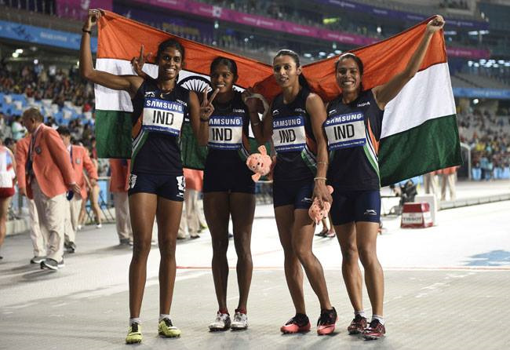
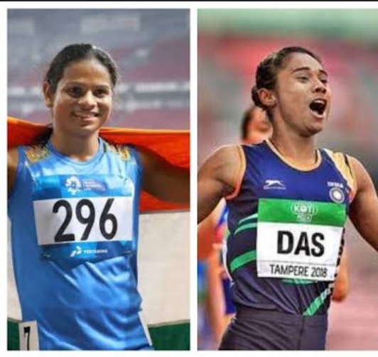
(CLOTHING, SHOES AND ATHLETE BIBS
CLOTHING
Clean, designed and worn so as not to be objectionable.
Non-transparent even if wet.
Not to impede the view of the Judges.
Cloths must be officially approved by the Governing Body.

Slide 20
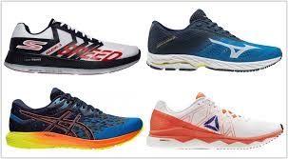
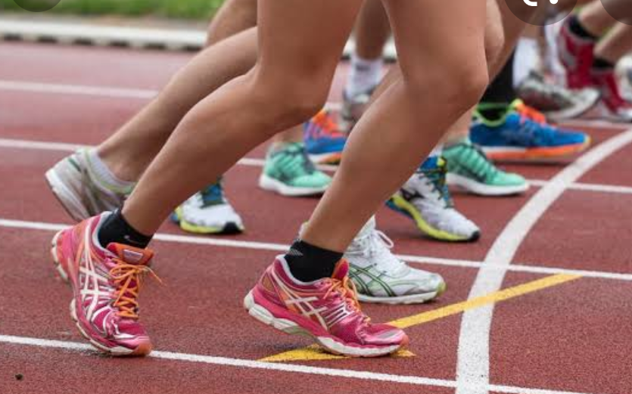
SHOES
Athletes may compete barefoot or with footwear on one or both feet. But in INDIA barefoot not allowed for athletes safety purposes.
The purpose of shoes for competition is to give protection and stability to the feet and a firm grip on the ground.

Slide 21
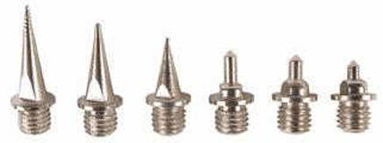
NUMBER & DIMENSIONS OF SPIKES
Any number of spikes up to 11 may be used but the number of spike positions shall not exceed 11. Dimension of spike for synthetic surface not more than 9mm except in High Jump and Javelin Throw- where not to exceed 12mm
Fit through in 4mm gauge

Slide 22
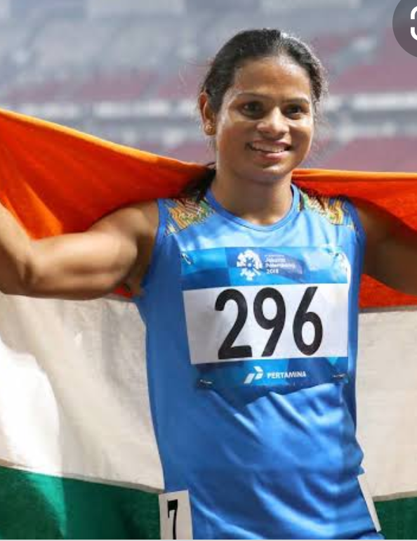
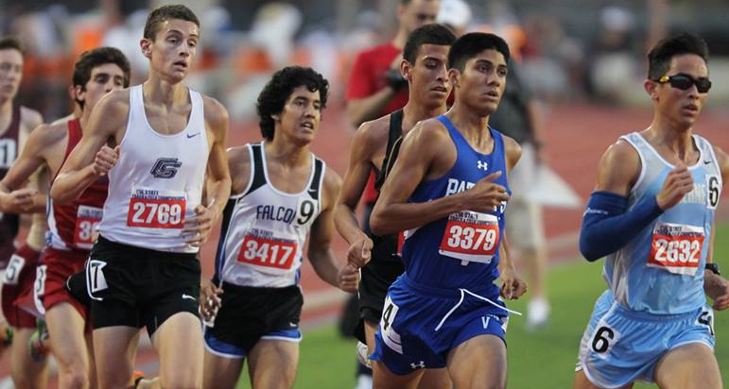
ATHLETE BIBS
Every Athlete Shall Be Provided With Two Bibs Which, During The Competition, Shall Be Worn Visibly On The Front Of The Torso And Back.
Athlete Can use 1 BIB only in All Jumping Event.
Names Of The Athletes Can Be Printed On The Bibs.
Worn As Issued And May Not Be Cut, Folded Or Obscured In Any Way.
In Running Or Walking Events Of 10,000 Meters And Longer, The Bibs May Be Perforated To Assist The Circulation Of Air
“Thigh Numbers” On Adhesive Tapes When Photo Finish Equipments Are In Use.

Slide 23
Entries, order of events and Start List
Entries –Have to be submitted in a prescribed format within the time limit given by the organiser
Final confirmation before day by day of competition
TD has the authority to accept & reject Entries .
And after careful verification TD will prepare start list , signed it & published the start list

Slide 24
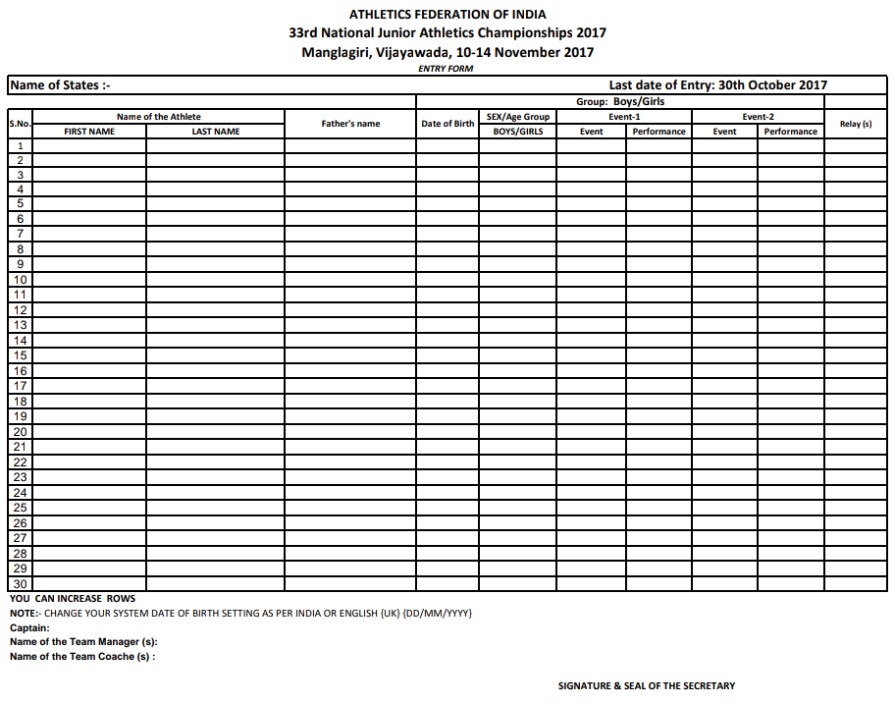
ENTRY FORM
Collect from AFI Website

Slide 25
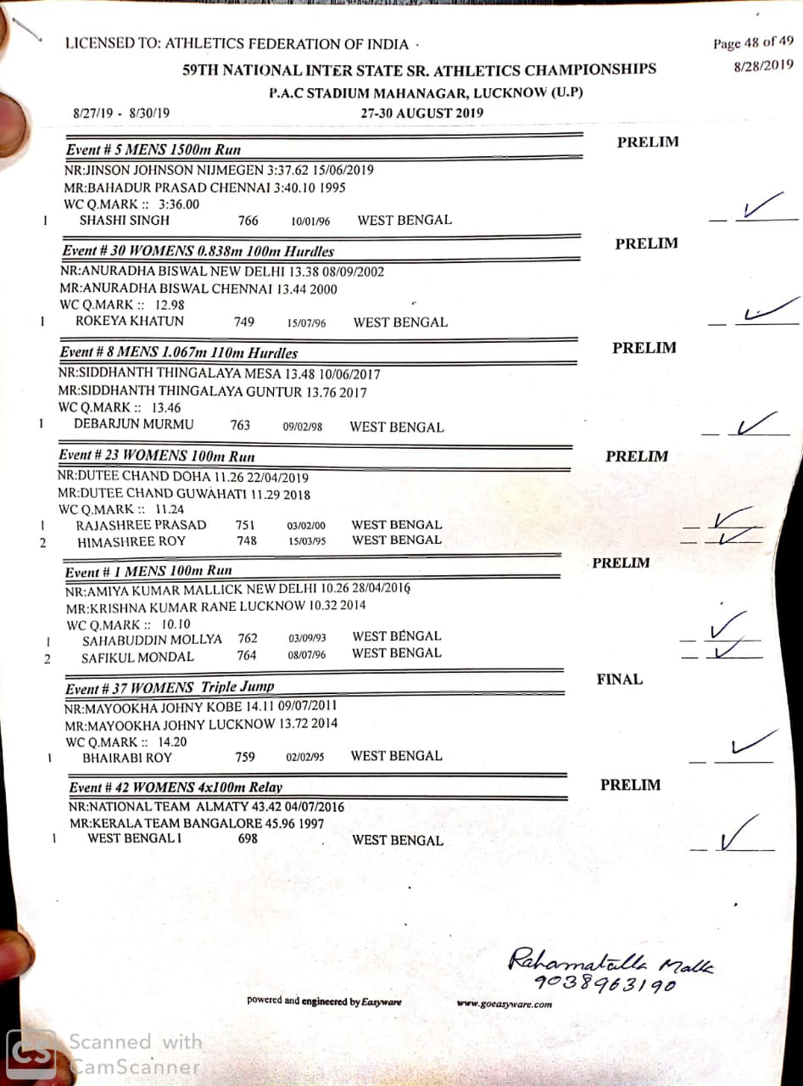
CONFIRMATION FORM
SUBMIT TO TIC

Slide 26
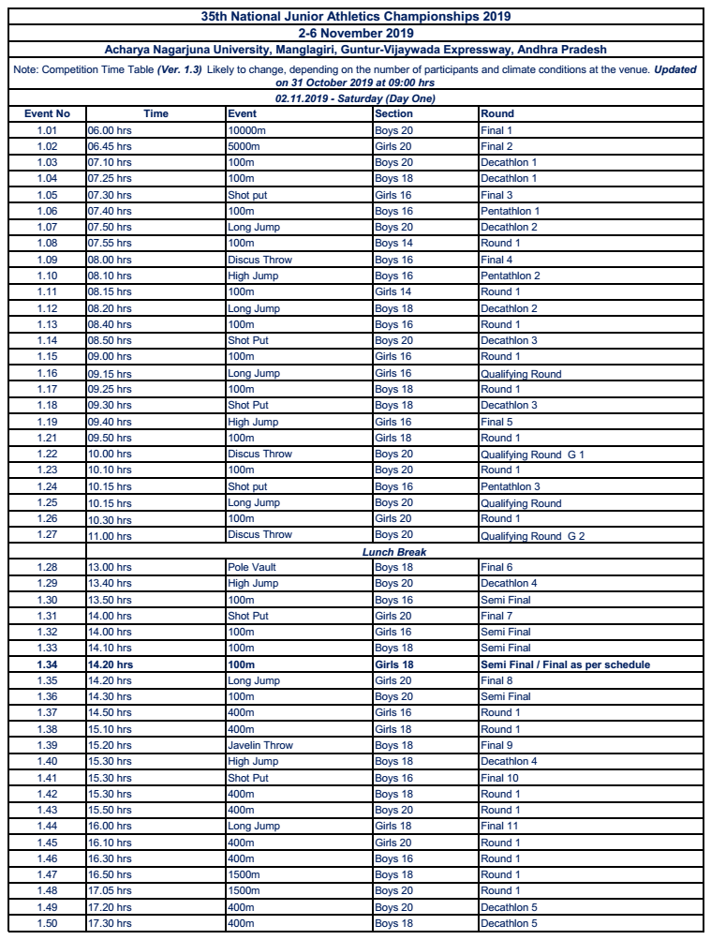
ORDER OF EVENTS
COLLECT FROM TIC

Slide 27
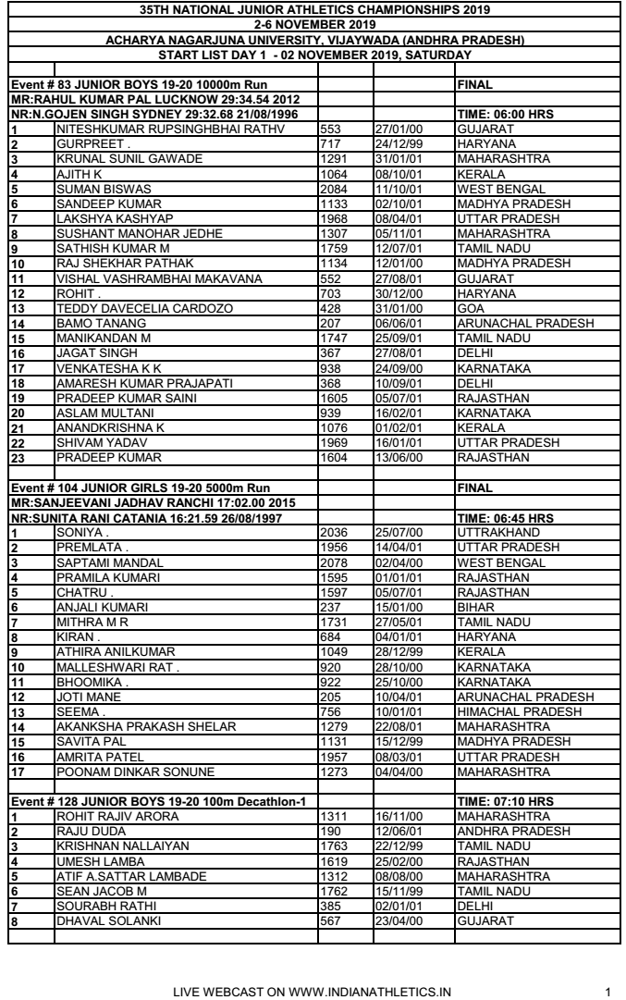
COLLECT FROM TIC

Slide 28
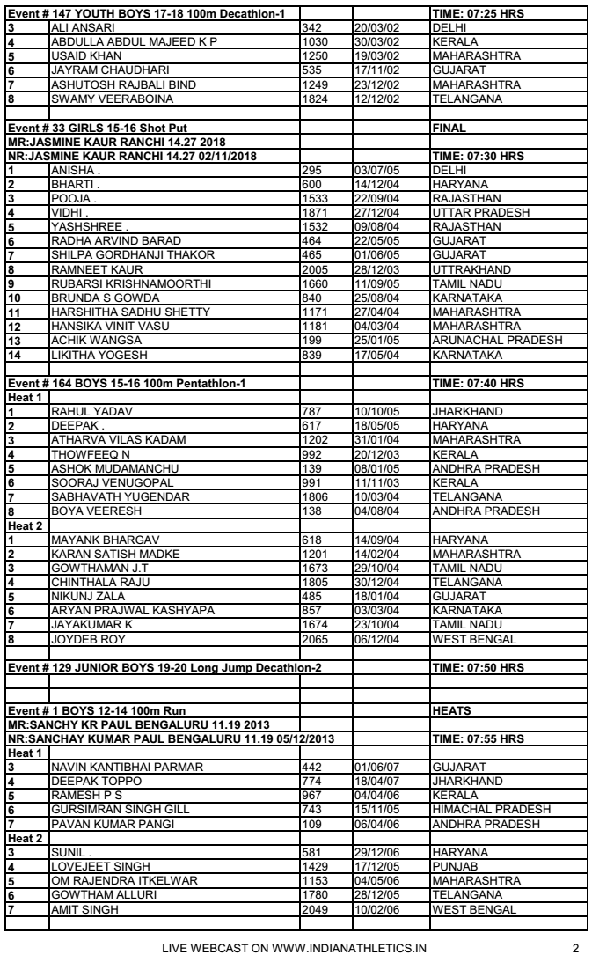
COLLECT FROM TIC

Slide 29
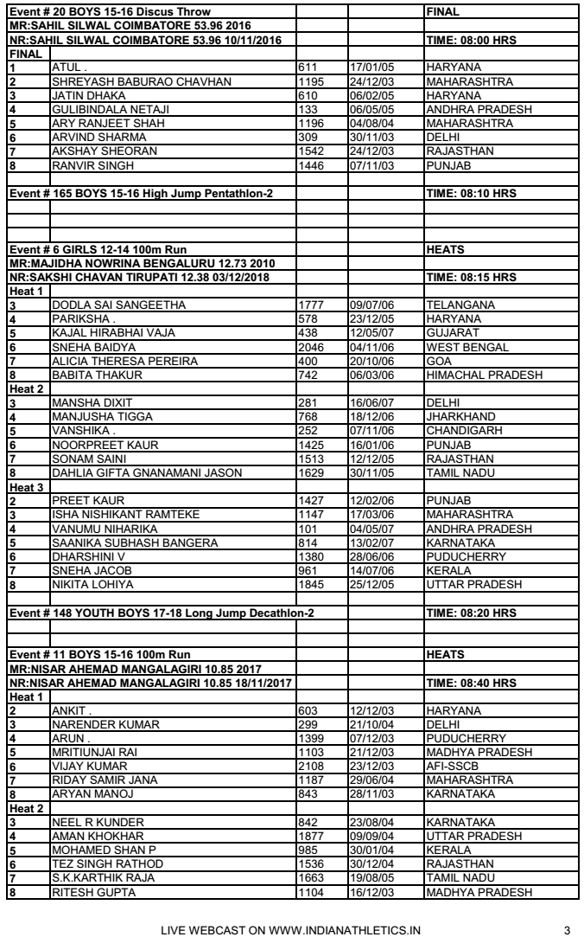
COLLECT FROM TIC

Slide 30
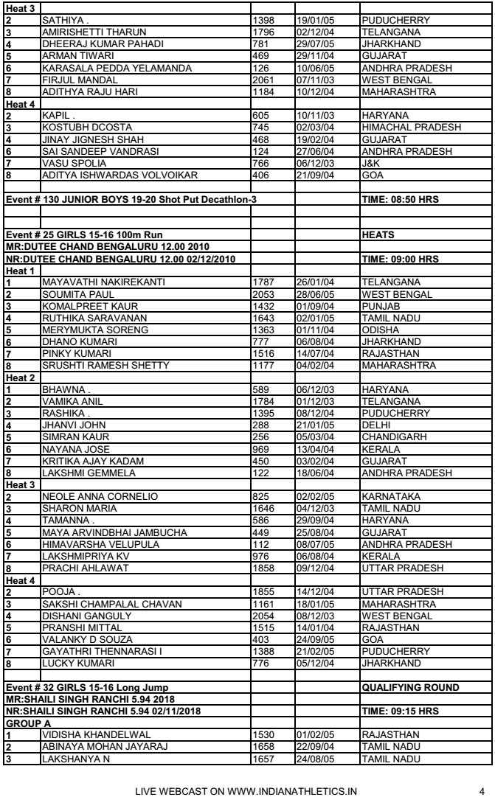
COLLECT FROM TIC

Slide 31
Flow of Athletes :-
Call room- Athletes have to report here first and they will be guided to participate.
FOP- Field of play- compete in competition,
Mixed Zone- after completion of event go through and may have to meet the press,
Post event- collect your belongings, attend medal ceremonies, may have to wait for Dope test if any.

Slide 32
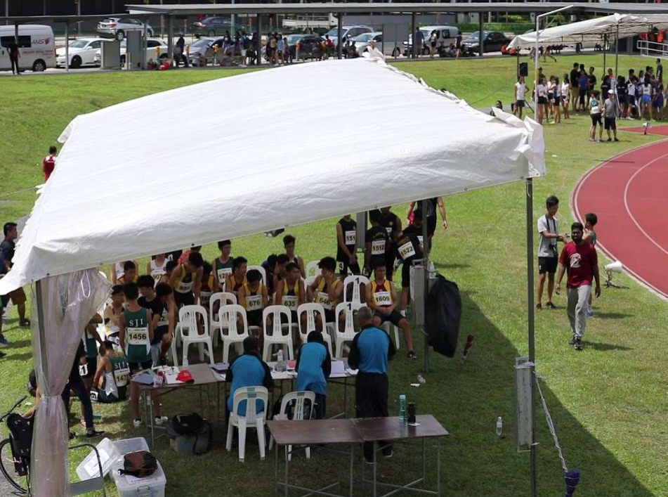
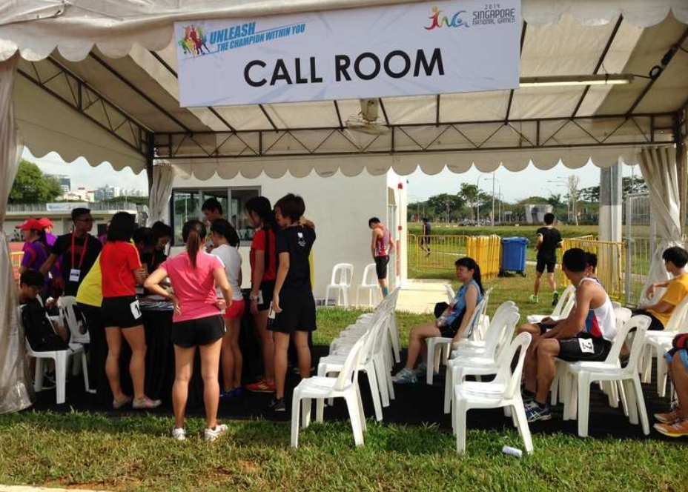

Slide 33
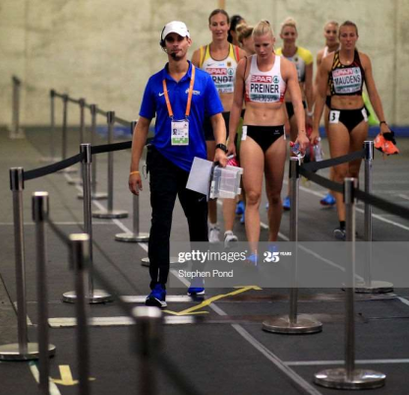
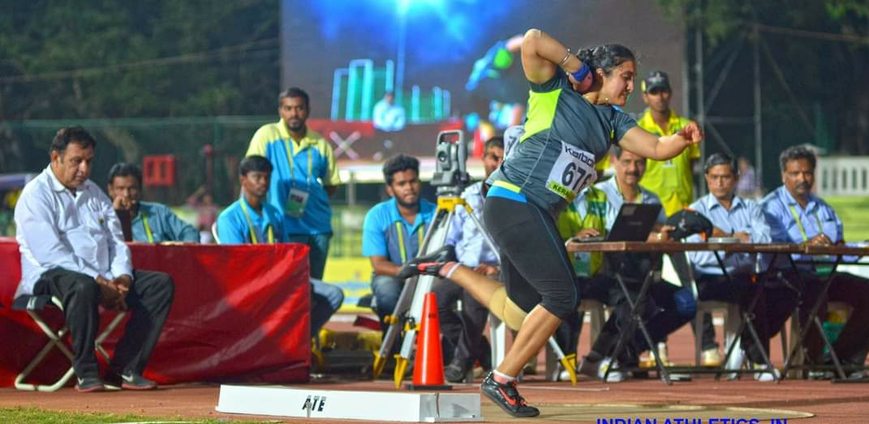
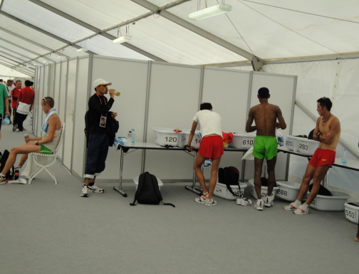
CALL ROOM JUDGE’S GUIDE TO ATHLETES
F.O.P.
MIXED ZONE
POST EVENT

Slide 34
SPECIAL THANKS TO MY ASSOCIATION A.F.I. FOR GIVING ME THIS OPPURTUNITY AND THANKS TO ALL FOR LISTENING HANIF IKBAL ikbal.tito@gmail.com whatsApp-9734605606

