Slide 1
IN LIFE
NO CHALLENGE NO SUCCESS
KNOW CHALLENGE KNOW SUCCESS

Slide 2
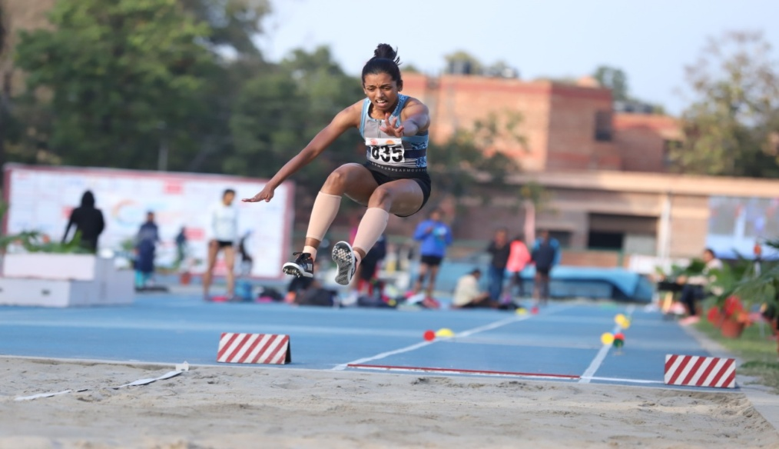
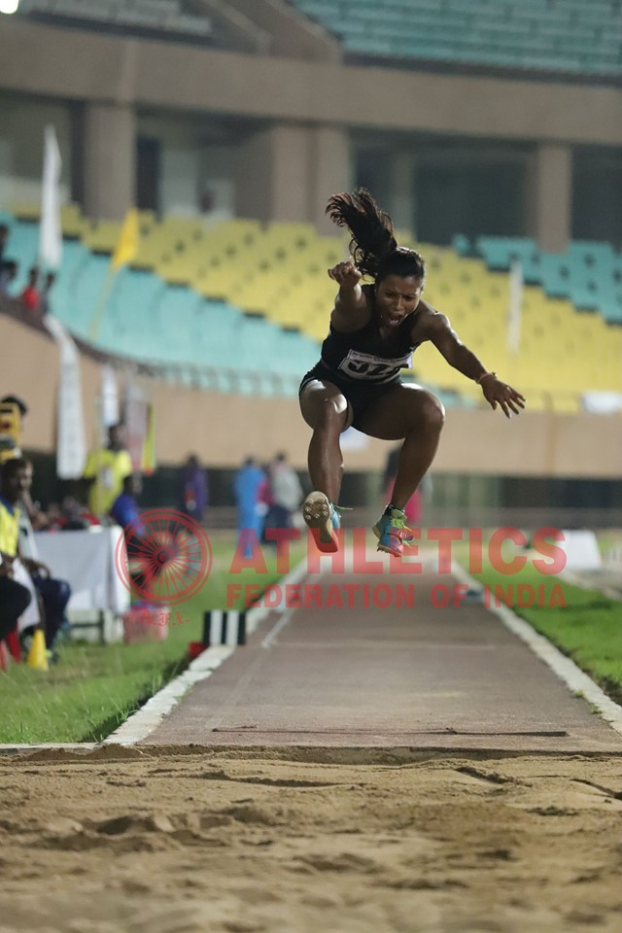
AFI D.T.O SEMINAR
HORIZONTAL JUMPS
LONG JUMP AND TRIPLE JUMP

Slide 3
AFI D.T.O SEMINAR
DISCUSS ABOUT :
RUNWAY, TAKEOFF BOARD & LANDING AREA
COMPETING ORDER, NUMBER OF TRIALS
FAILURES – BASIC RULES
MEASURMENT & RECORDING ( SCORE SHEET )
TIES
TIME ALLOWED FOR TRIALS
MARKERS

Slide 4
RUNWAY, TAKE OFF BOARD & LANDING
AREA OF LONG JUMP
Long Jump Take Off Board
Length 1.22 m Width 20 Cm
Deep 10 Cm
Colour should be white
Plasticine Indicator
.10m width, length 1.22m,
7mm height 90°angle
Colour should be contrasting
1.22m
Landing Area
Filled with soft
Damp sand
2.75m to 3m
At least 10m
From the takeoff
line
Nearer end of Landing area to
Take Off line is 1m-3m
Takeoff line situated between
Take off board & plasticine board
Runway 40m minimum
Condition permit then 45m

Slide 5
COMPETING ORDER, NUMBER OF TRAILS
Competing Order Drawn by Lot.
All the Athletes may have practice trial before start the event.
During competition
When more than 8 : all the Athletes may take 3 trials and after that the best of 8 Athletes as per their performance get another 3 round of trials.
When 8 or below : all the Athletes may take 6 round of trials.
After 3rd round competing order will be reverse order.

Slide 6
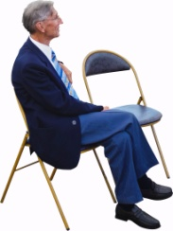
VALID JUMP – LONG JUMP
Jumper can jump from Take Off Board or before (must be within 1.22m width of runway) without touching Take Off Line or beyond.
Jumper taking off by one foot only.
Leaving the landing area is also important for Validity of Jump.

Slide 7
FAILURES – LONG JUMP
An Athlete fails if :-
Touching Take Off Line or beyond Take Off Line When taking Take Off.
Take off from outside either end of Take Off Board i.e Out side from 1.22 m (without touching the Take Off Board).
After Take Off but before landing 1st contact outside the landing area.
Employ any Form of Somersaulting whilst running up or act of jumping.

Slide 8
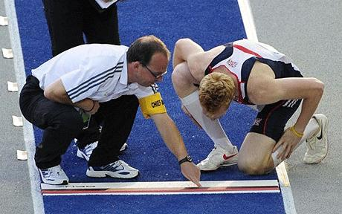
If the Athlete claim to know where is the fault occurred then the officials must show him.

Slide 9
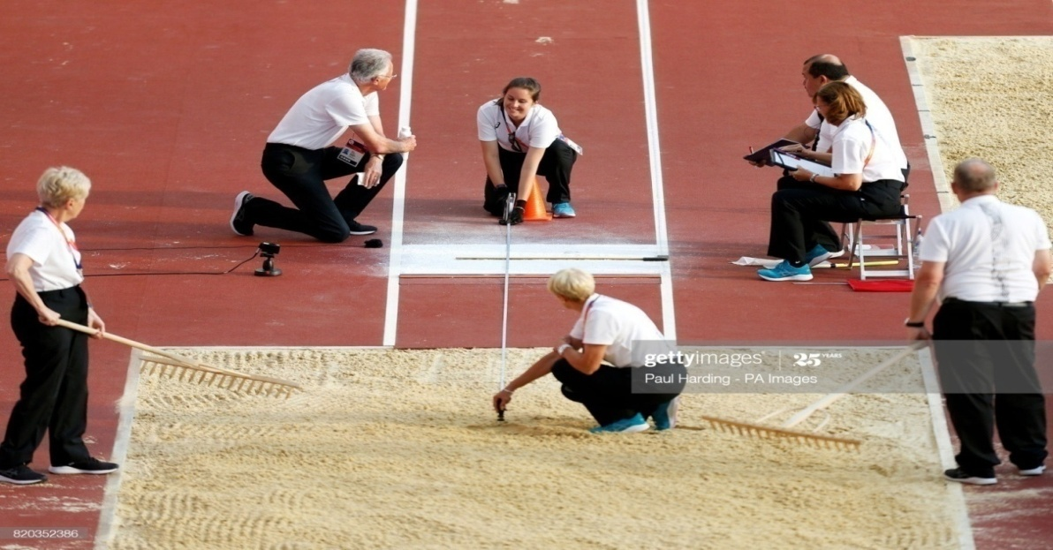
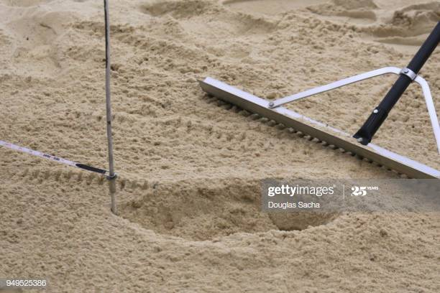
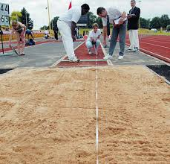
MEASUREMENT PROCEDURE :
When the Officials going to measure then be careful about ‘0’ of the measuring tape
All valid jumps must be measured and recorded to the nearest of 01 cm. ( i.e : 6.25 m NOT 6.256 m )
The distance between the Take-off -line and nearest break made on the sand perpendicularly by the jumper is considered as his performance.

Slide 10
TIES
IF THE BEST PERFORMANCE OF THE TWO OR MORE ATHLETES WERE SAME - IS CALLED TIE.
HOW TO BREAK THE TIE :
FOLLOW THE SECOND BEST PERFORMANCE OF THE TIEING ATHLETES .
IF THE TIE IS REMAINS –
THEN THIRD BEST PERFORMANCE WILL BE CONSIDERED AND SO ON

Slide 11
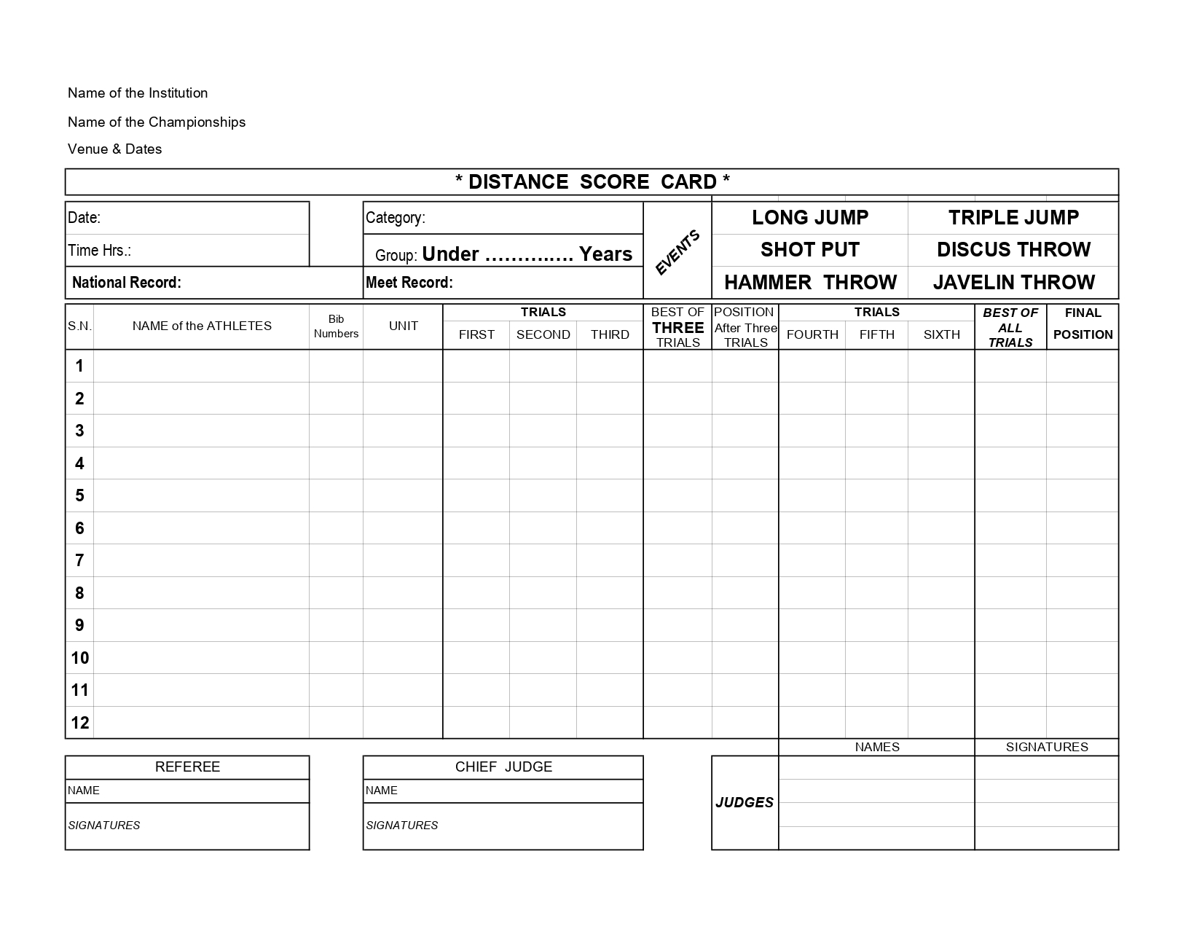
MEASUREMENT AND RECORD (SCORE SHEET)
ATHLETICS FEDERATION OF INDIA
59TH NATIONAL INTER STATE SENIORS ATHLETICS CHAMPIONSHIP
LUCKNOW, 27TH TO 30TH AUGUST 2019
30/08/2019
MEN
17:15 Hrs
SENIOR
M. Sreeshankar , 8.20m
K. Premkumar , 8.00m
SAHIL MAHABALI
312
HAR
7.23
7.20
7.24
7.24
7
7.28
7.35
7.24
7.35
5
SANDEEP
314
HAR
7.21
7.26
7.18
7.26
6
7.21
7.23
7.18
7.26
7
SAMSHEER E.
370
KAR
7.00
7.20
7.27
7.27
5
---
X
7.37
7.37
4
FEBI
423
KER
7.28
7.16
7.22
7.28
4
7.30
7.21
7.20
7.30
6
SHREESANKAR M.
424
KER
7.64
7.83
X
7.83
1
7.76
X
X
7.83
1
MUHAMMED YAHIYA
425
KER
X
7.20
7.10
7.20
9
7.20
9
ASHISH PATRA
523
OR
7.10
X
X
7.10
11
7.10
11
JAGROOP
569
PUN
7.20
X
7.23
7.23
8
7.20
X
X
7.23
8
BIKRAMJIT SINGH
570
PUN
X
7.13
7.05
7.13
10
7.13
10
SUBHASH
614
RAJ
6.70
X
6.80
6.80
12
6.80
12
RISHABH RISHISHWAR
720
UP
7.11
7.38
7.38
7.38
3
X
7.83
X
7.83
3
SHAMIT SINGH
721
UP
7.40
7.23
X
7.40
2
7.83
X
5.32
7.83
2
Name of CHIEF JUDGE
Name of JUDGE 1
Signature Judge 1
Name of REFEREE
Name of JUDGE 2
Signature Judge 2
Signature of REFEREE
Signature of CHIEF JUDGE
Name of JUDGE 3
Signature Judge 3
Name of JUDGE 4
Signature Judge 4

Slide 12
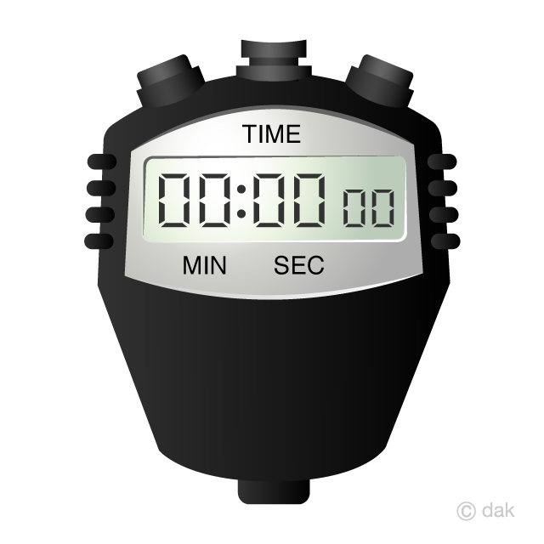
TIME ALLOWED FOR TRAILS
One minute.
00:00:00
00:15:00
00:59:00

Slide 13
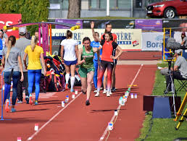
MARKERS
Athlete may use one or two markers along side the runway provided by the organizers

Slide 14
RUNWAY TAKE OFF BOARD & LANDING AREA OF TRIPLE JUMP
Take Off Board
Length 1.22 m Width 20 Cm
Deep 10 Cm
Colour should be white
Plasticine Indicator
.10m width, length 1.22m,
7 mm height 90°angle
Colour should be contrasting
1.22m
Landing Area
2.75m to 3m
At least 21m
From the takeoff Line.
Take off line situated
Between takeoff board
& plasticine board
Nearer end of the Landing area
from Take Off Line is
11m (Women)
13m (Men)
Runway 40m minimum
Condition permit then 45m

Slide 15
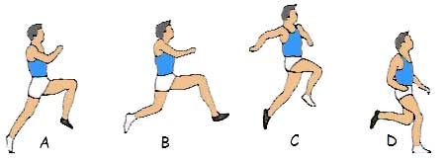
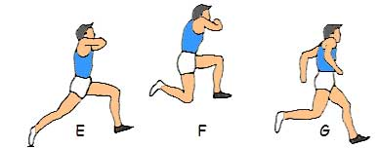
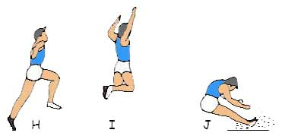
VALID JUMP – TRIPLE JUMP
THE TRIPLE JUMP CONSIST OF – A HOP, A STEP & A JUMP
THE HOP SHALL BE MADE SO THAT LAND
ON THE SAME FOOT AS THAT FROM
WHICH THEY HAVE TAKEN OFF
IN STEP THEY SHALL LAND ON OTHER FOOT
THEN JUMP IS PERFORMED
IF THE ABOVE SAID SEQUNCE IS NOT FOLLOWED IN ORDER THEN THE JUMP IS TREATED AS A FAILURE

Slide 16
TRIPLE JUMP
ALL OTHER RULES OF TRIPLE JUMP IS AS SAME AS LONG JUMP i.e.
Competing order
Number of trials
Time allowed for trials
Marker
Measuring procedure
Records & Ties
Failures

Slide 17
NUMBERS AND PLACEMENT OF OFFICIALS - RECOMMENDED
Referee - 1
Chief Judge - 1
Measurement Judge - 2
Athlete Control Judge - 1
Count Down Timer - 1
Plasticine Repairing Judge - 1
Sand Leveler - 1
Recorder - 2
Count Down Timer
Chief Judge
Sand Leveler
Landing Pit
Measurement Judge
Measurement Judge
Athlete Control Judge
Recorder
Referee
Sitting Area of Athletes
Plasticine Repairing Judge

Slide 18
THANK YOU

