Slide 1
DISTRICT TECHNICAL OFFICIALS
SEMINAR CUM EXAMINATION
ORGANISED BY
ATHLETICS FEDERATION OF INDIA

Slide 2
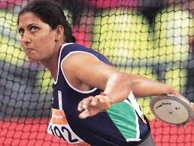
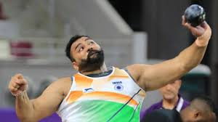
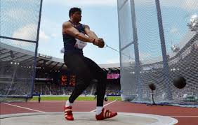
THROWS FROM CIRCLE
DISCUS THROW
SHOT PUT
HAMMER THROW

Slide 3
SPECIFICATIONS OF IMPLEMENTS FOR DIFFERENT AGE GROUPS
IN INDIA

Slide 4
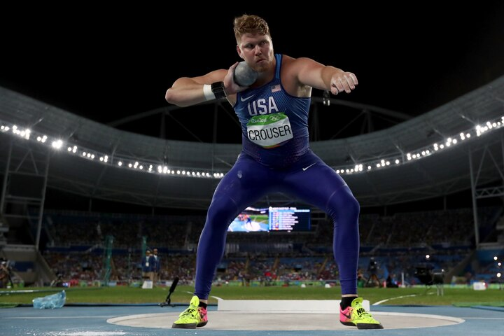
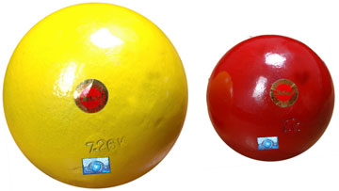
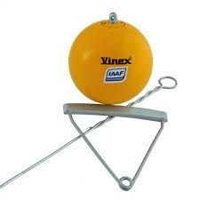

SPECIFICATION OF CIRCLE THROW IMPLEMENTS FOR DIFFERENT AGE GROUPS IN INDIA
Implement | Men | U 23 Men | U 20 Men | U 18 Boys | U 16 Boys | U 14 Boys
 | 7.260kg | 7.260kg | 6.000kg | 5.000kg | 4.000kg | 3.000kg
 | 7.260kg | 7.260kg | 6.000kg | 5.000kg | 4.000kg | x
 | 2.000kg | 2.000kg | 1.750kg | 1.500kg | 1.250kg | x
Shot Put
Hammer
Discus

Slide 5
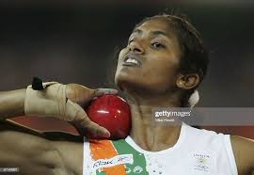
SPECIFICATION OF CIRCLE THROW IMPLEMENTS FOR DIFFERENT AGE GROUPS IN INDIA
Implement | Women | U 23 Women | U 20 Women | U 18 Girls | U 16 Girls | U 14 Girls
 | 4.000kg | 4.000kg | 4.000kg | 3.000kg | 3.000kg | 2.000kg
 | 4.000kg | 4.000kg | 4.000kg | 3.000kg | X | X
 | 1.000kg | 1.000kg | 1.000kg | 1.000kg | 1.000kg | X
Shot Put
Hammer
Discus

Slide 6
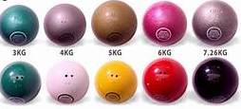
SHOT PUT
The shot shall be of solid iron, brass or any metal not softer than brass, or a shell of such metal filled with lead or other solid material.

Slide 7
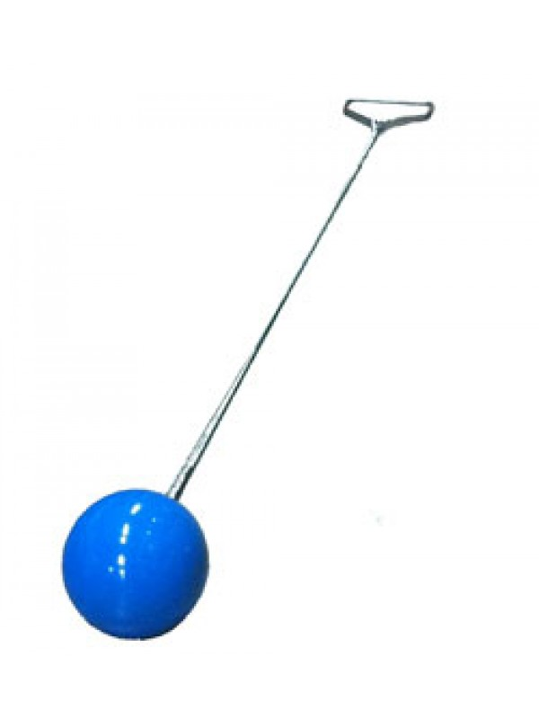
HAMMER
The Hammer shall consist of three main parts: a metal head, a wire and a handle. The Hammer shall be made of brass, solid iron or other metal not softer than brass.
The wire shall be single unbroken and straight length.
Handle shall be rigid and without hinging joints.

Slide 8

DISCUS
The body of the Discus may be solid or hollow and shall be made of wood or other suitable material with a metal rim the edge of which shall be circular. Each side of the Discus shall be identical and smooth.

Slide 9
THROWING CIRCLE AND SECTOR

Slide 10
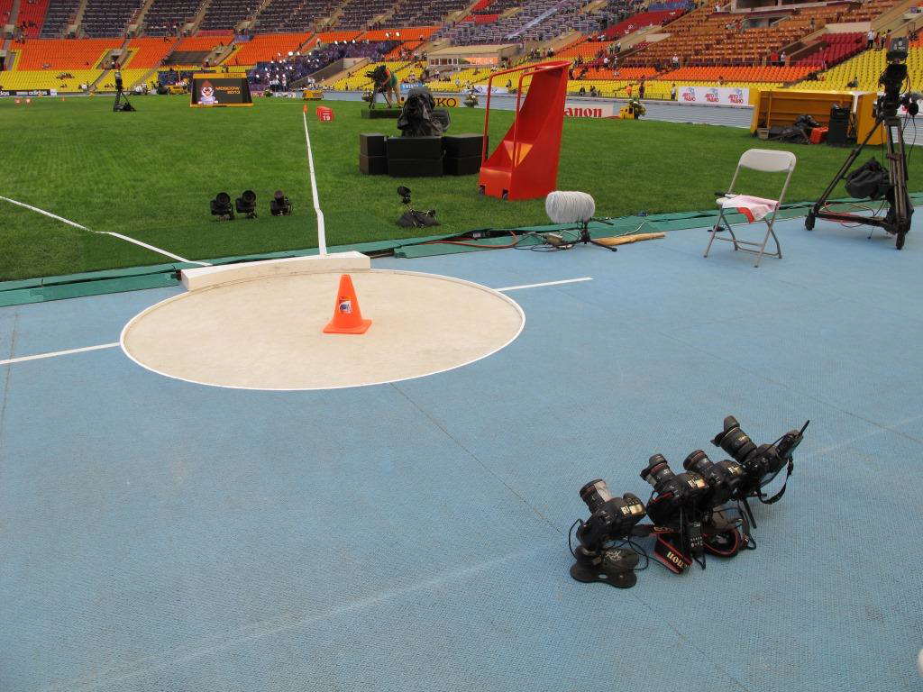
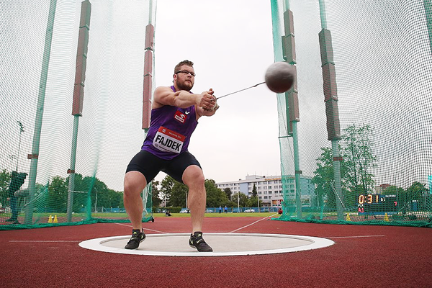
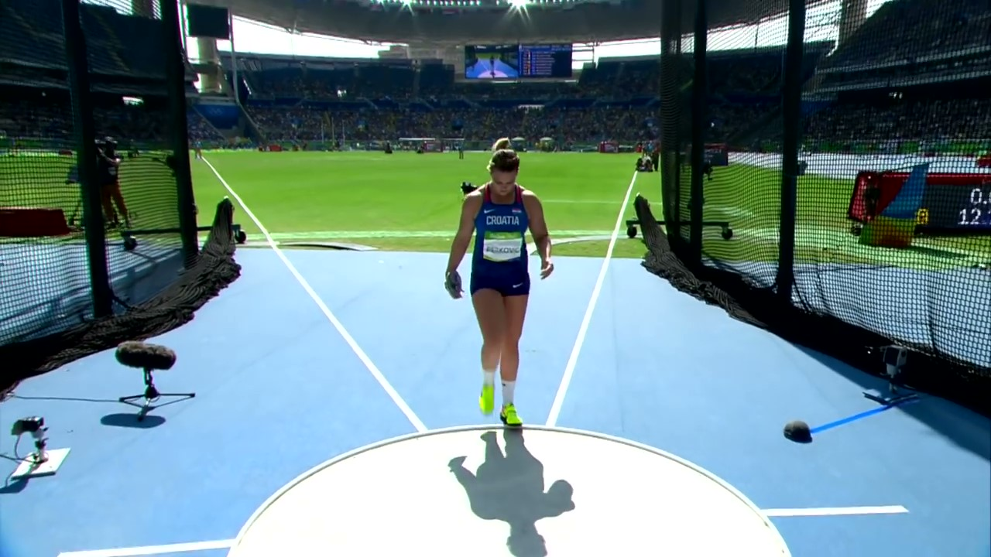
Shot Put Circle
& Sector
Hammer Circle
& Sector
Discus Circle
& Sector

Slide 11
SHOT PUT AND HAMMERCIRCLE AND SECTOR MARKINGS
INSIDE DIAMETER – 2.135M (+/- 0.005M)
REDIUS 1.067M
20m
0.75m
4m
5m
34.92
6m
1.067m
19.079m
3m
5m
0.75m
4m
20m
6m

Slide 12
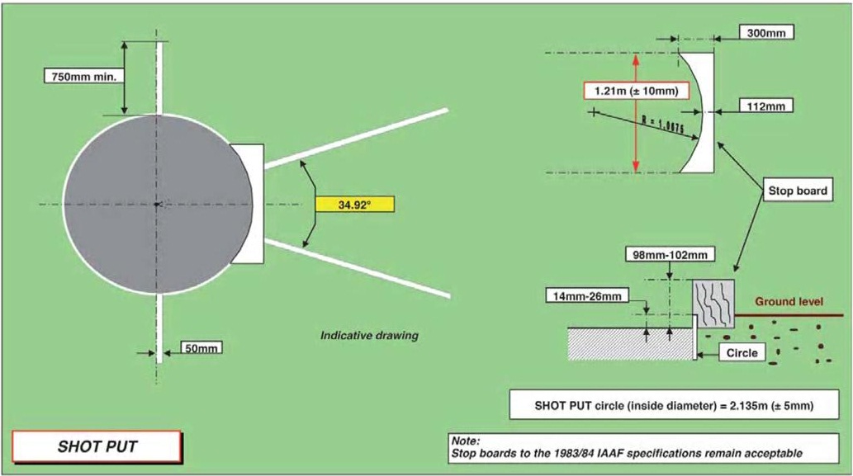

Slide 13
DISCUS CIRCLE AND SECTOR MARKINGS
INSIDE DIAMETER – 2.50M(+/- 0.005M)
REDIUS 1.25M
20m
0.75m
4m
5m
34.92
6m
1.25m
19.079m
3m
5m
0.75m
4m
20m
6m

Slide 14
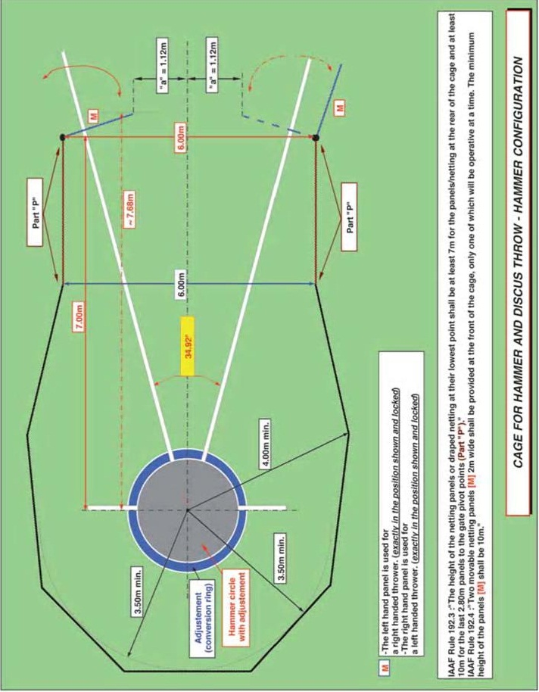

Slide 15
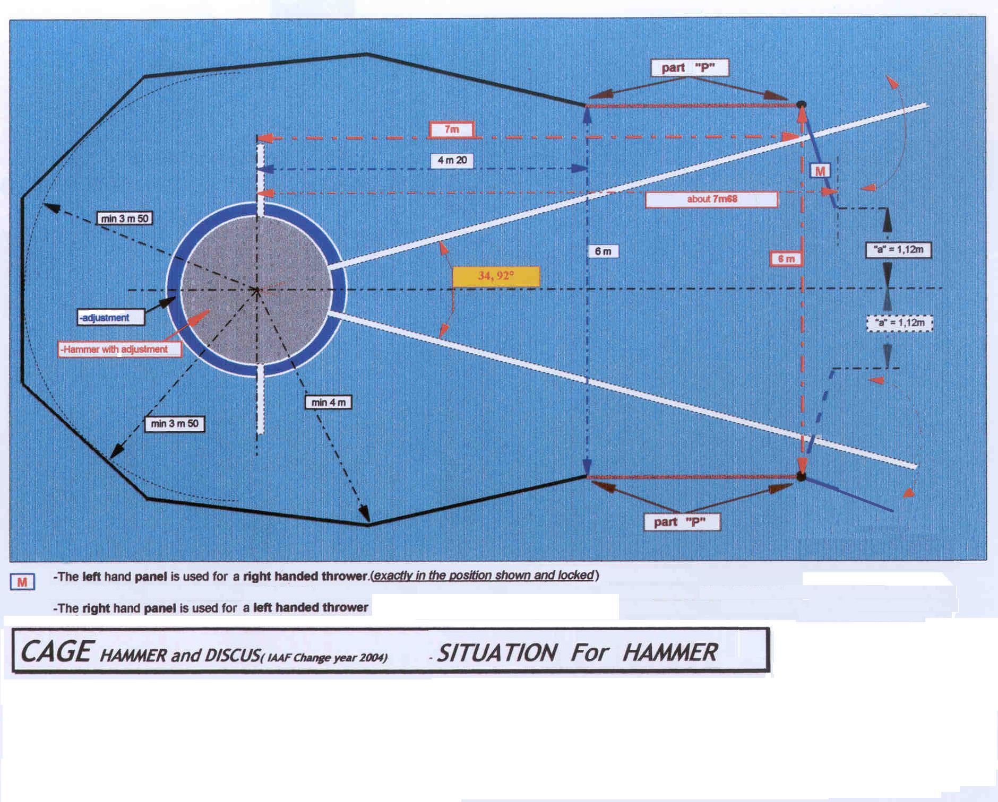

Slide 16
FAILURES-BASIC RULES

Slide 17
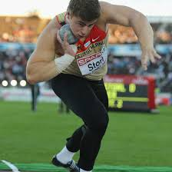
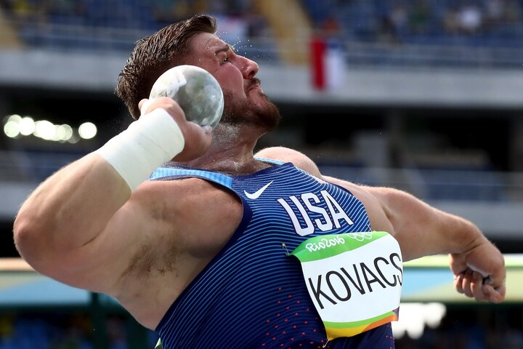
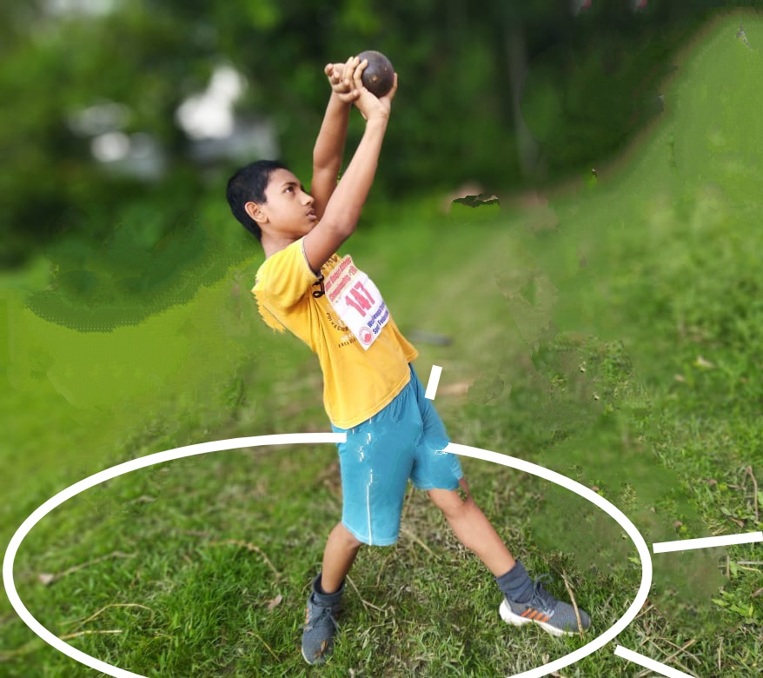
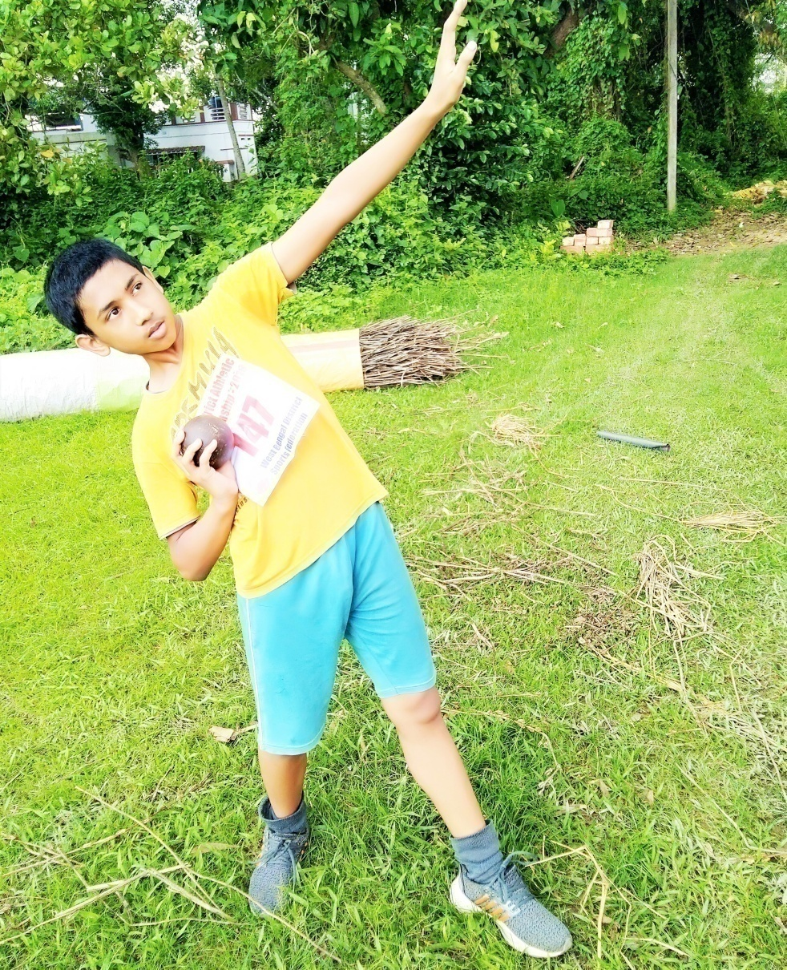
Releases the shot other than as permitted under rules 33.1 of the Technical Rules
The Shot shall be put from the shoulder with one hand only.
Valid Throw
Valid Throw
The shot shall touch or be in close proximity to the neck or chin and the hand shall not be dropped below this position during the action of putting.
The shot shall not be taken behind the line of the shoulder
Failure
Failure

Slide 18
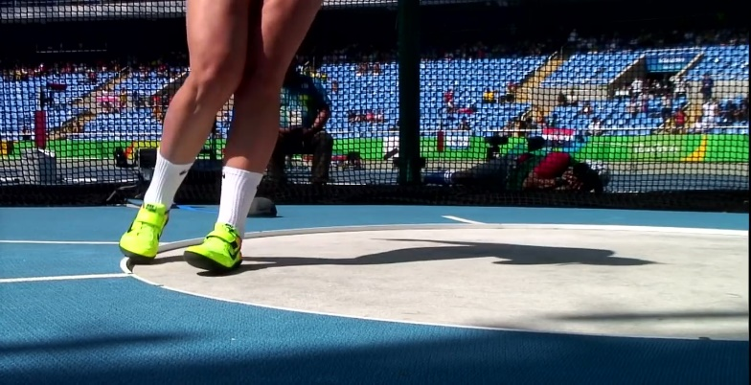
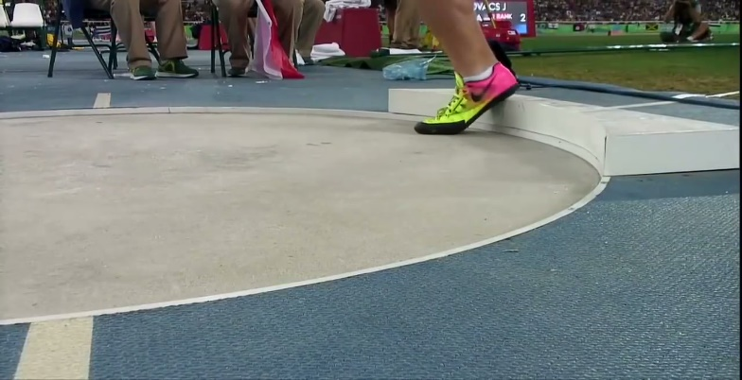
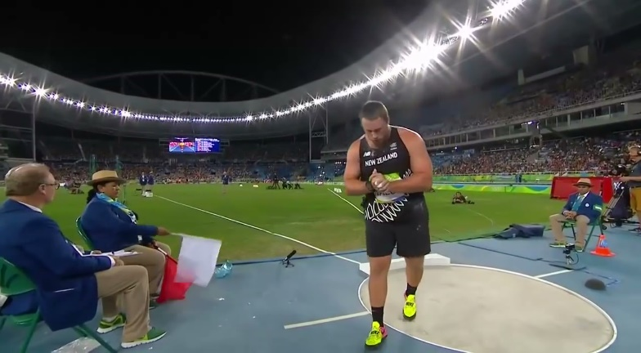
After they have stepped into the circle and begun to make a throw, touches with any part of their body the top (or the top inside edge) of the rim or the ground outside the circle.
In the shot Put, touches with any part of their body any part of the stop board other than its inner side. Inside edge of the stop board is considered top of the stop board.
It shall be a failure if the athlete leaves the circle or runway before the implement has touched the ground.

Slide 19
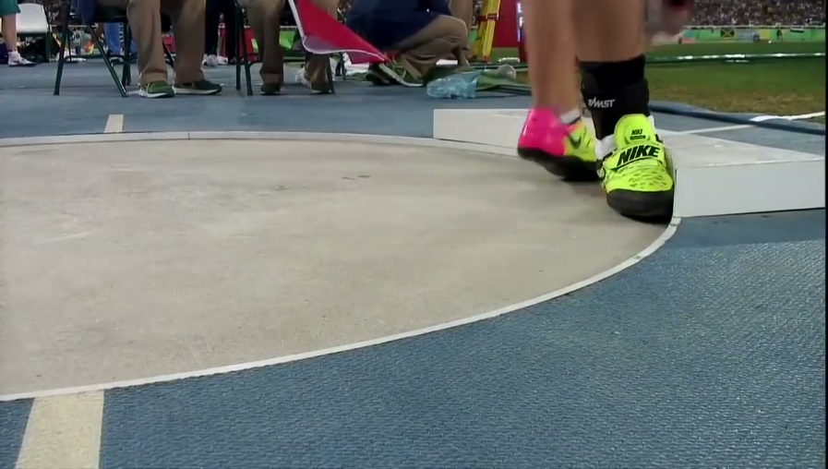
In the shot Put, touches with any part of their body any part of the stop board other than its inner side. Inside edge of the stop board is considered top of the stop board.
Valid
Invalid

Slide 20
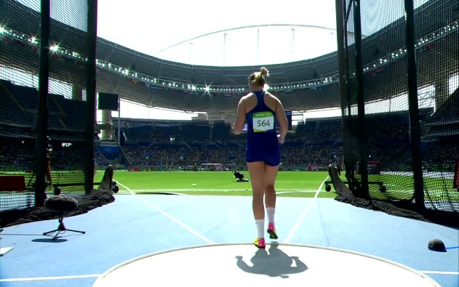
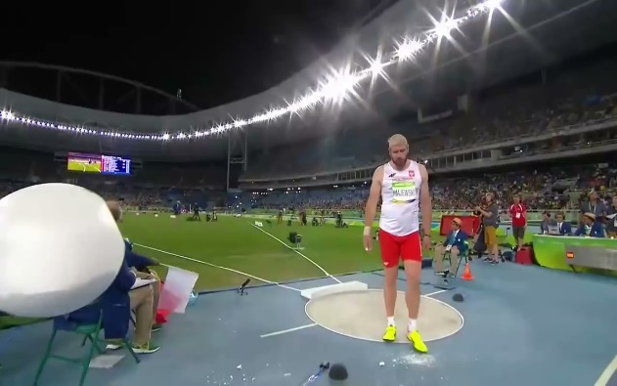
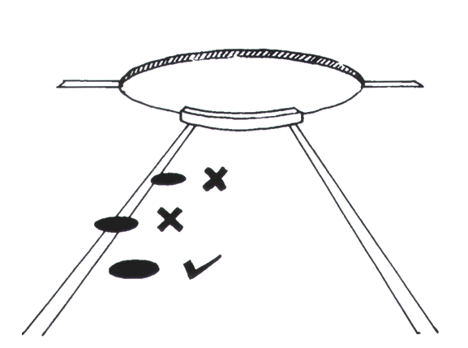
For throws made from a circle, if when leaving the circle, the athlete’s first contact with the top of the rim or the ground outside the circle is not completely behind the white line which is drawn outside the circle running.
Wrong Leaving
Right Leaving
It shall be a failure if the shot, the discus, the hammer head first land touches the sector line or the ground outside the sector line.

Slide 21
RULES ABOUT
GLOVES AND TAPING

Slide 22
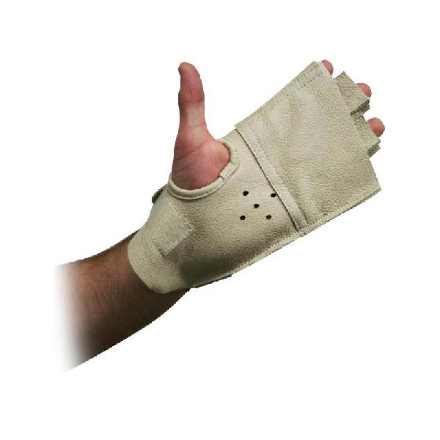

TR 32.4.3 GLOVES
The use of Gloves are allowed in the Hammer Throwing event provided it shall be smooth on the back and on the front and tip of the glove fingers, other than the thumb shall be open.
TR 32.5.1 GLOVES
A hammer thrower may use a suitable substance on their gloves.

Slide 23
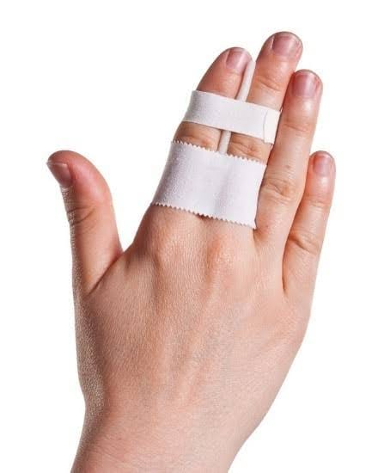
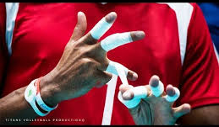
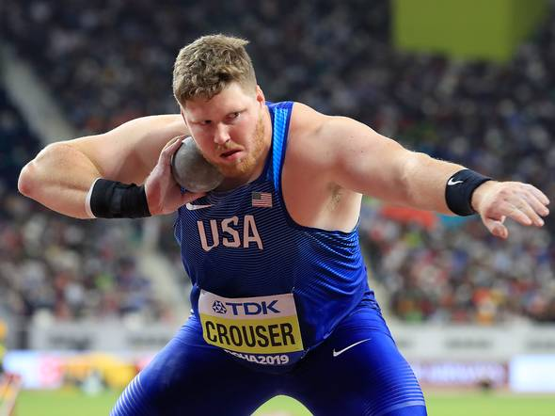
TR 32.4.1 TAPING
The taping of two or more fingers together. If taping is used on the hands and fingers, it may be continuous provided that as a result no two or more fingers are taped together in such a way that the fingers cannot move individually.
The taping should be shown to the Chief Judge before the event starts.
Note: If the Judges are aware, they shall direct any athlete not complying with this rule to correct the situation. If the athlete does not, such trial(s) shall be a failure. If a trial is completed before the non-compliance is noticed, the Referee shall decide what action shall be taken.

Slide 24
COMPETING ORDER, NUMBER OF TRIALS AND TIES

Slide 25
Competing Order and Trials
The athletes shall compete in an order drawn by lot.
If any athlete by their own decision makes a trial in an order different from that previously determined, Rule 18.5 of the Competition Rules and Rule 7.2 of the Technical Rules shall be applied. In the case of a warning, the result of the trial (valid or failure) will stand.
No athlete shall have more than one trial recorded in any one round of trials of the competition.

Slide 26
Competing Order and Trials
Where there are eight athletes or fewer, each athlete shall be allowed six trials unless the applicable regulations provide otherwise.
If more than one fail to achieve a valid trial during the first three round of trials, such athletes shall compete in subsequent rounds of trials before those with valid trials, in the same relative order according to the original draw.
where there are more than eight athletes, each athlete shall be allowed three trials and the eight athletes with the best valid performances shall be allowed three additional trials, unless the applicable regulations provide otherwise.

Slide 27
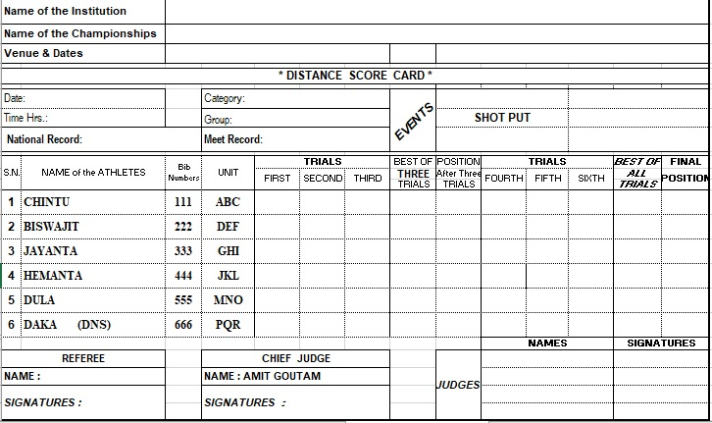
ATHLETICS FEDERATION OF INDIA
NATIONAL INTER DISTRICT JUNIOR ATHLETICS MEET
TIRUPATI(ANDHRA PRADESH)
23-25TH NOVEMBER 2019
24.11.2019
11.00
Under 14 Years
16.36m
14.05
15.00
x
15.00
3/iii
14.85
x
15.02
15.02
3 RD
x
x
14.95
14.95
5/i
14.82
x
14.90
14.95
5TH
14.85
x
15.02
15.02
2/iv
14.02
15.01
x
15.02
2 ND
x
15.26
x
15.26
1/v
r
15.26
1 ST
14.98
14.02
x
14.98
4/ii
x
x
x
14.98
4 TH
S.Banerjee
Amit G
S BANERJEE
AMIT GOUTAM

Slide 28
ATHLETICS FEDERATION OF INDIA
NATIONAL INTER DISTRICT JUNIOR ATHLETICS MEET
TIRUPATI(ANDHRA PRADESH)
23-25TH NOVEMBER 2019
24.11.2019
11.00
Under 14 Years
16.36m
X
X
x
X
NM/i
14.85
x
15.02
15.02
3 RD
x
x
14.95
14.95
3/iii
14.82
x
14.90
14.95
5TH
14.85
x
15.02
15.02
2/iv
14.02
15.01
x
15.02
2 ND
x
15.26
x
15.26
1/v
r
15.26
1 ST
X
X
x
X
NM/ii
x
14.98
x
14.98
4 TH
S.Banerjee
Amit G
S BANERJEE
AMIT GOUTAM

Slide 29
TIES
Ties
If there has been a tie
Consider 2nd best performance
If not resolved consider 3rd best performance and so on.
In case of a tie for any place, including 1st place, the tie shall remain

Slide 30
ATHLETICS FEDERATION OF INDIA
NATIONAL INTER DISTRICT JUNIOR ATHLETICS MEET
TIRUPATI(ANDHRA PRADESH)
23-25TH NOVEMBER 2019
24.11.2019
11.00
Under 14 Years
16.36m
14.05
15.00
x
15.00
3/iii
14.85
x
15.02
15.02
3 RD
x
x
14.95
14.95
5/i
14.82
x
14.90
14.95
5TH
14.85
x
15.02
15.02
2/iv
14.07
15.00
x
15.02
2 ND
x
15.26
x
15.26
1/v
r
15.26
1 ST
14.98
14.02
x
14.98
4/ii
x
x
x
14.98
4 TH
S.Banerjee
Amit G
S BANERJEE
AMIT GOUTAM

Slide 31
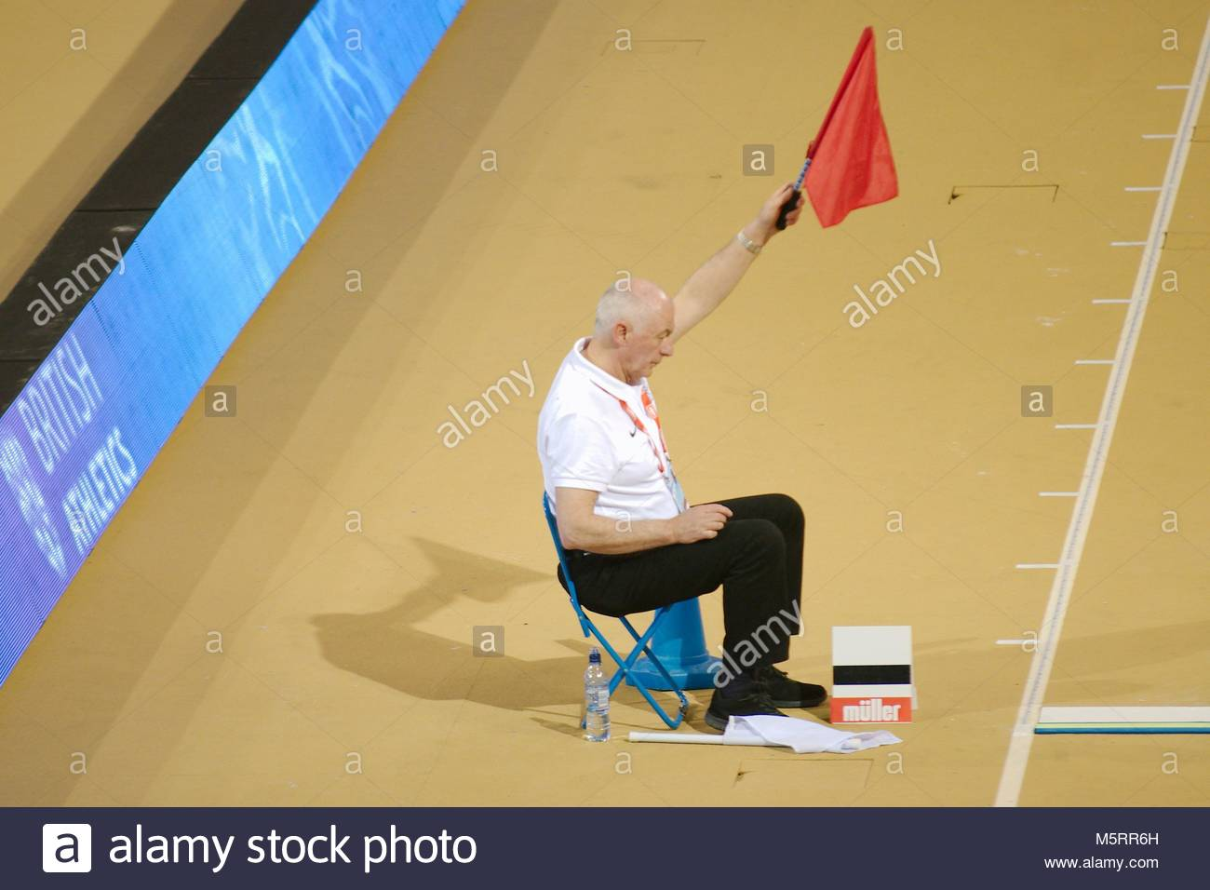
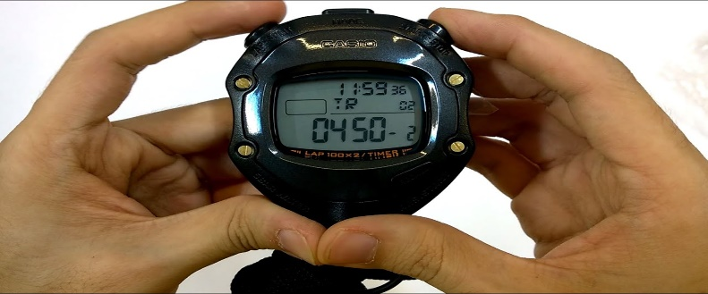
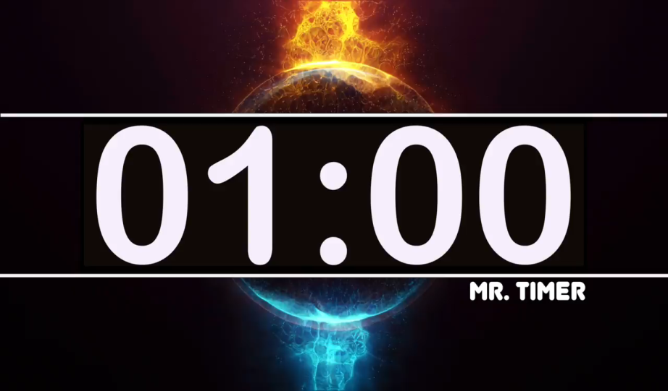
TIME ALLOWED FOR TRIALS
A clock which shows the remaining time allowed for a trial should be visible to an athlete. In addition, an official shall raise and keep raised, a yellow flag, or otherwise indicate, during the final 15 seconds of the time allowed.
Events | More Than 3 Athletes | 2 or 3 Athletes | Consecutive Trials by Any Athlete
 | 1 min | 1 min | 2 min
 | 1 min | 1 min | 2 min
 | 1 min | 1 min | 2 min
Shot Put
Hammer
Discus

Slide 32
MEASUREMENT AND RECORDING

Slide 33
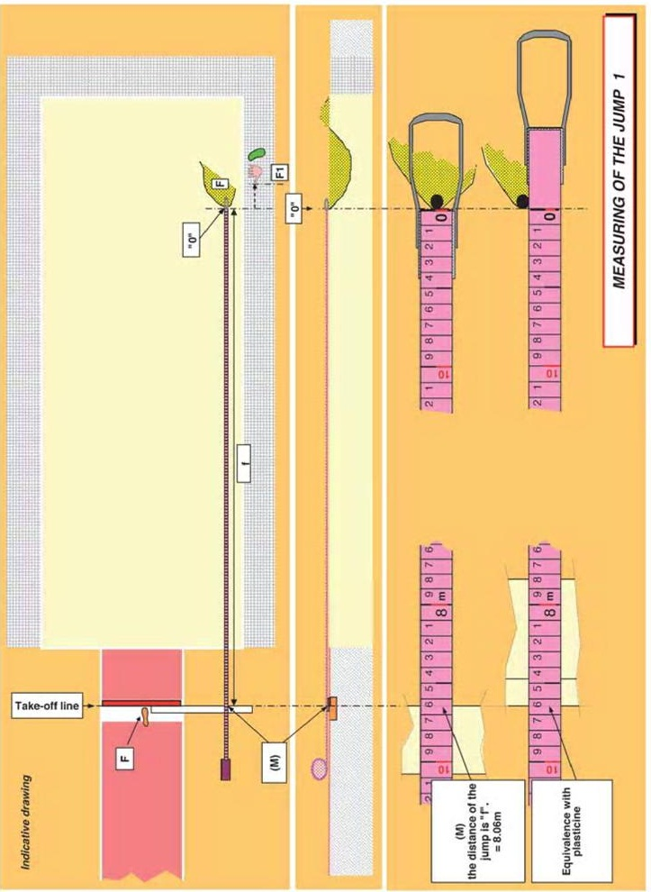
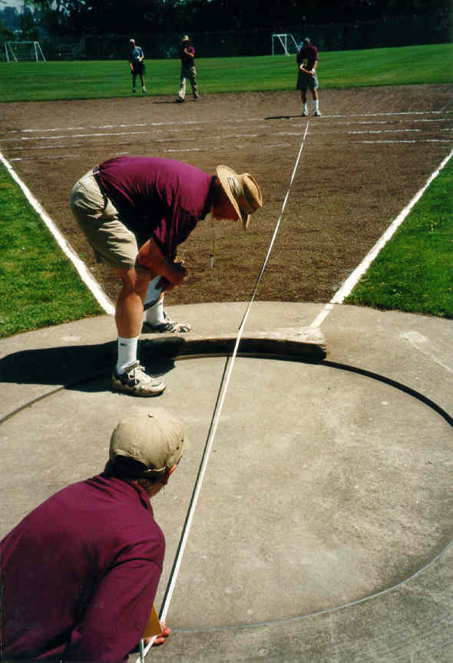
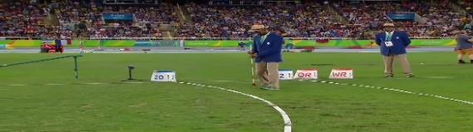
Distance Measurement
32.19 In all throwing events, distances shall be recorded to the nearest 0.01m below the distance measured if the distance measured is not a whole centimetre.
The measurement of each throw shall be made immediately after each valid trial (or after an immediate oral protest) from the nearest mark made in contacting the ground when it first lands by: to the inside of the circumference of the circle along a line to the centre of the circle

Slide 34
NUMBER AND PLACEMENT OF OFFICIALS
(SHOT PUT, HAMMER AND DISCUS THROW)
Technical Officials are stated here is general guidelines. Final numbers and positioning should be discussed and agreed with the Technical Delegates

Slide 35
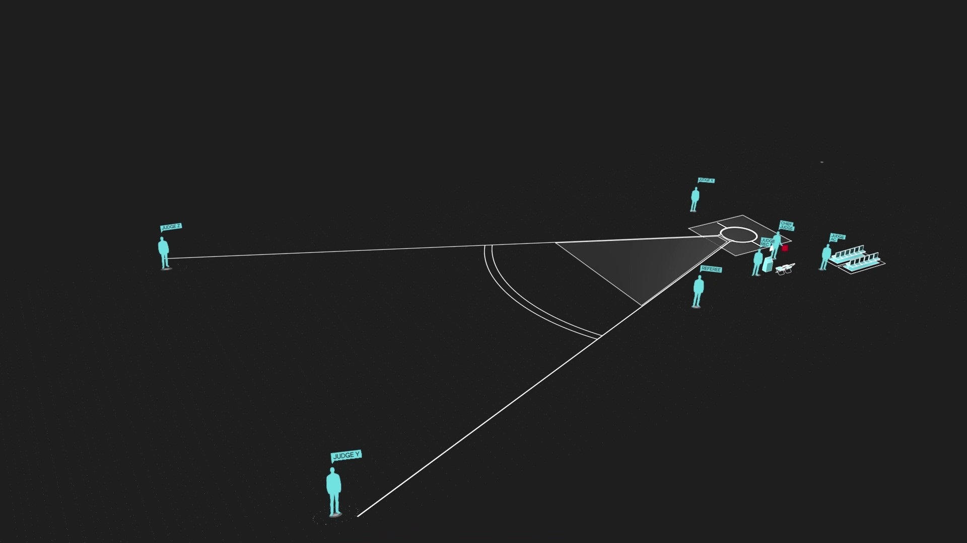

OFFICIALS
SHOT PUT
Judge (Other Side)
Referee
Chief Judge (With Flag)
Chief judge (With Flag)
Judge (Other side of Circle)
Judge (Landing)
Judge (Athlete Control)
Recorder
Recorder
Judge (Landing)
Referee
Judge (Spike/Prism)
Judge
(Implement)
Shot Put Rack
Judge (Implement)
Judge (Athlete Control)
Judge (Spike/Prism)

Slide 36
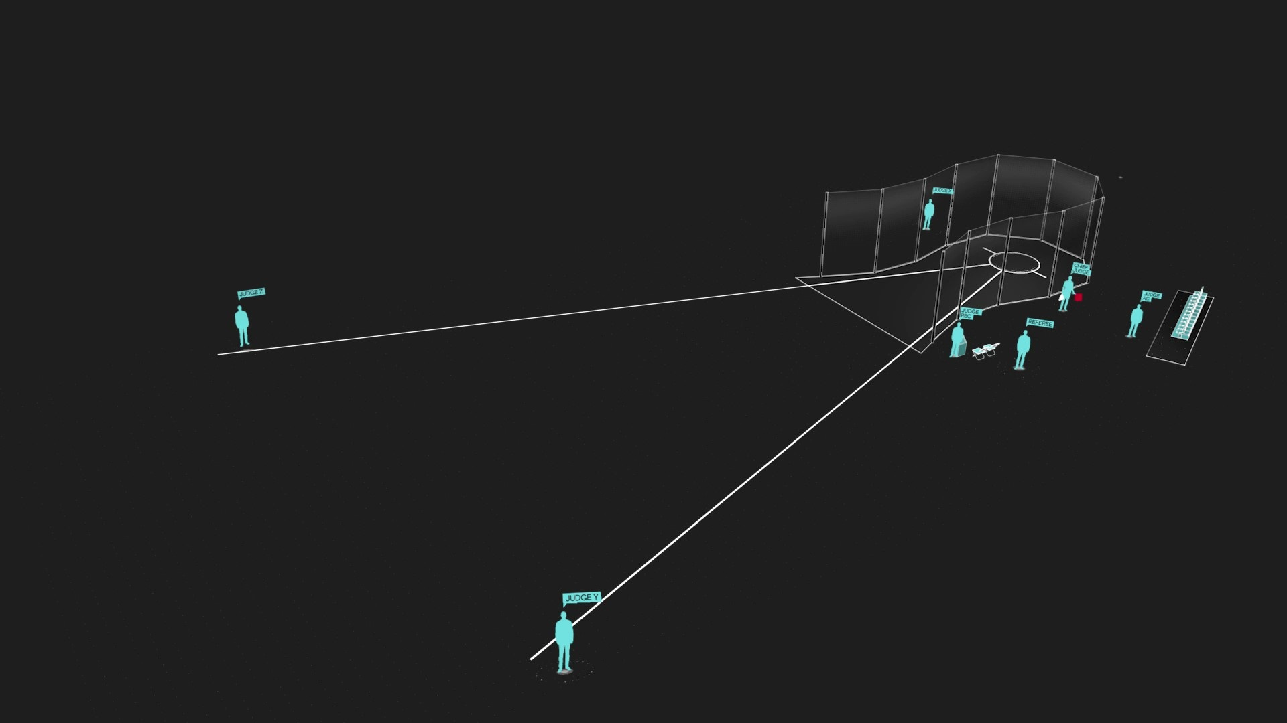

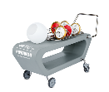
Judge (Other Side)
OFFICIALS
DICUS THROW
Referee
Chief Judge (With Flag)
Chief judge (With Flag)
Judge (Other side of Circle)
Athlete’s Bench
Recorder
Judge (Landing)
Judge (Athlete Control)
Judge (Landing)
Recorder
Referee
Judge (Spike/Prism)
Judge (Implement)
Judge
(Implement)
Judge (Athlete Control)
Discus Rack
Judge (Spike/Prism)

Slide 37
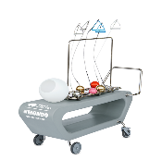
Judge (Other Side)
OFFICIALS
HAMMER THROW
Referee
Chief Judge (With Flag)
Chief judge (With Flag)
Judge (Other side of Circle)
Athlete’s Bench
Recorder
Judge (Landing)
Judge (Athlete Control)
Judge (Landing)
Recorder
Referee
Judge (Spike/Prism)
Judge (Implement)
Judge
(Implement)
Judge (Athlete Control)
Hammer Rack
Judge (Spike/Prism)

Slide 38
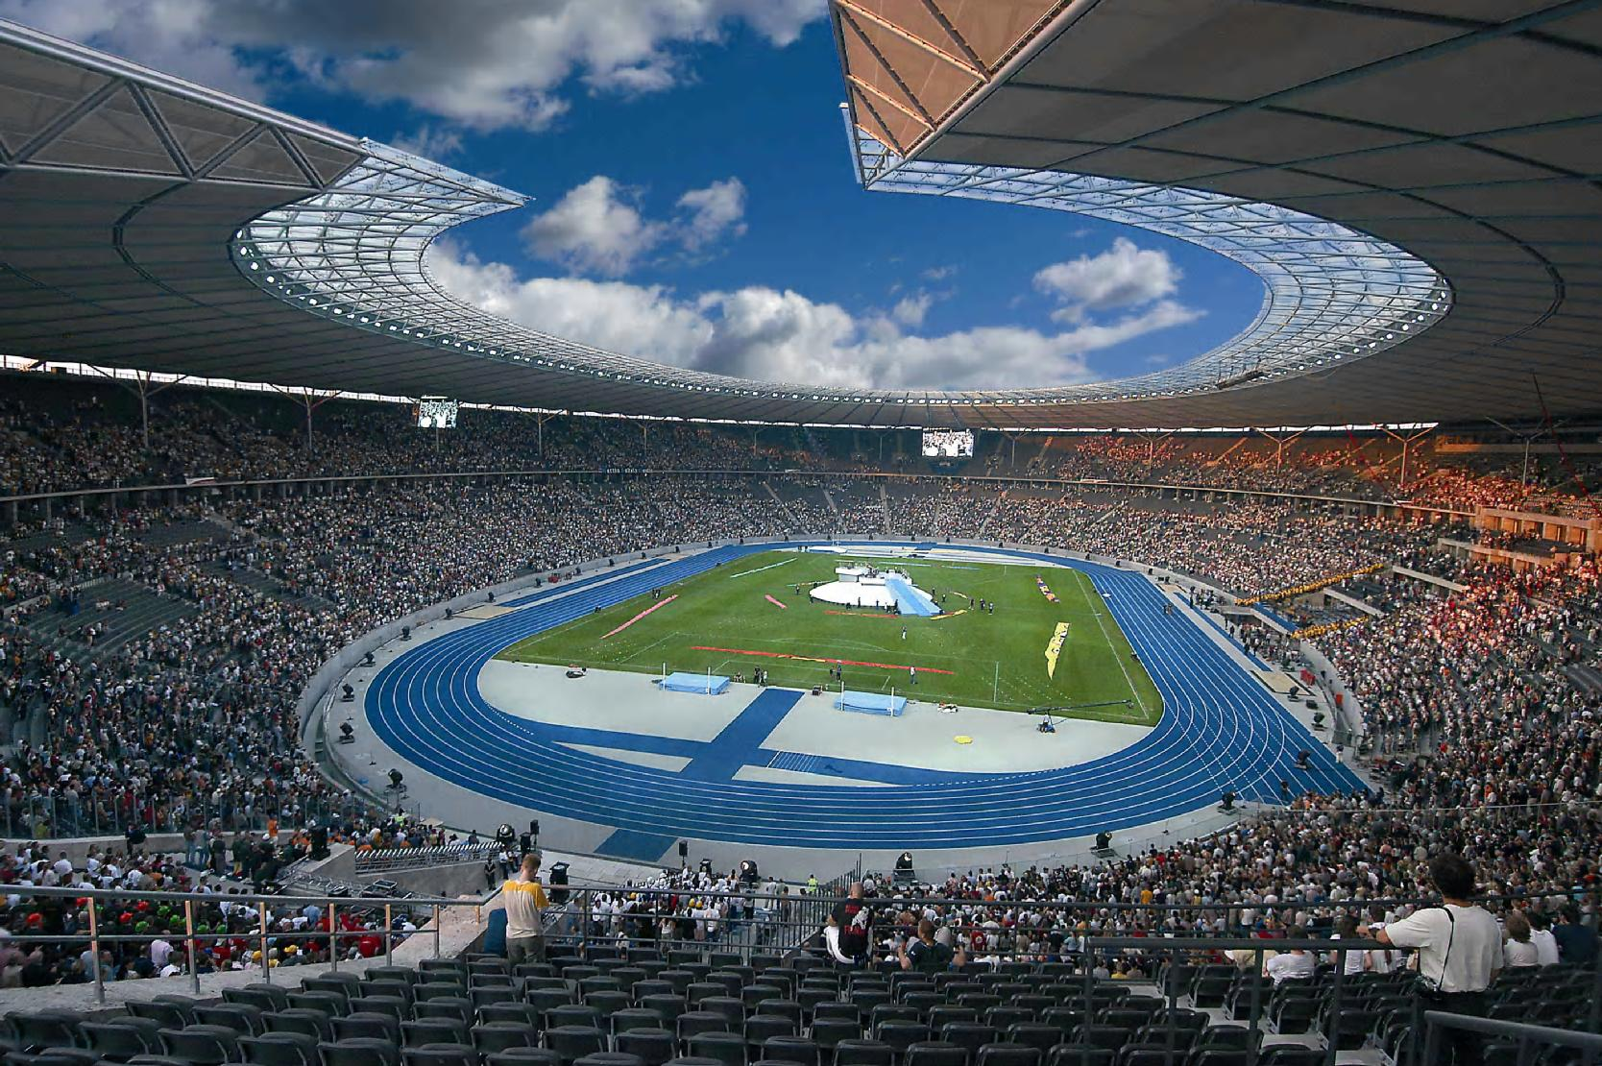
THANKS

