Slide 1
GENERAL
TECHNICAL RULES
(AS PER AFI)
Prepared by: Sanjay Ghosh, West Bengal

Slide 2

GENERAL RULES
All International Competitions shall be held under the Rules of World Athletics.
RECOMENDATION
All Members of World Athletics will adopt the Rules for the conduct of their own athletics competitions.
www.worldathletics.org
COMPETITION AND TECHNICAL RULES
EXCEPTION
In all competitions, events may be held in a different format from that provided under the Technical Rules, but rules giving more rights to the athletes than they would have obtained applying the actual Rules, may not be applied. These formats shall be decided or authorised by the relevant governing body having the control over the competition.

Slide 3
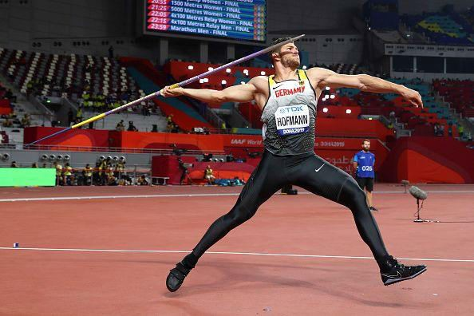
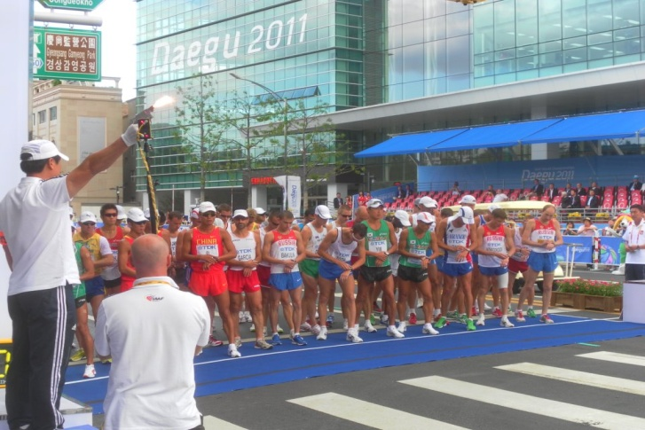

GENERAL RULES
LIMITATION OF CHANGING THE FORMAT OF WORLD ATHLETICS RULES
EXAMPLE
It is acceptable to reduce the number of trials in a Field Event or reduce the time allowed for an athlete to take their trial but not to increase either.
EXAMPLE
In Running and Race Walking Events, World Athletics Rules shall only be fully applied to any elite component or any other Group because of significant awards or prizes as per opinion of the organisers.
EXAMPLE
Organisers may Allow athletes (other than those competing in the elite or other categories to whom Rule 6.3 of the Technical Rules would apply) to use head or earphones when they are running on a closed course.

Slide 4
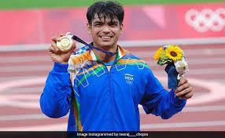
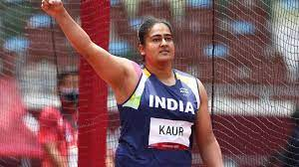
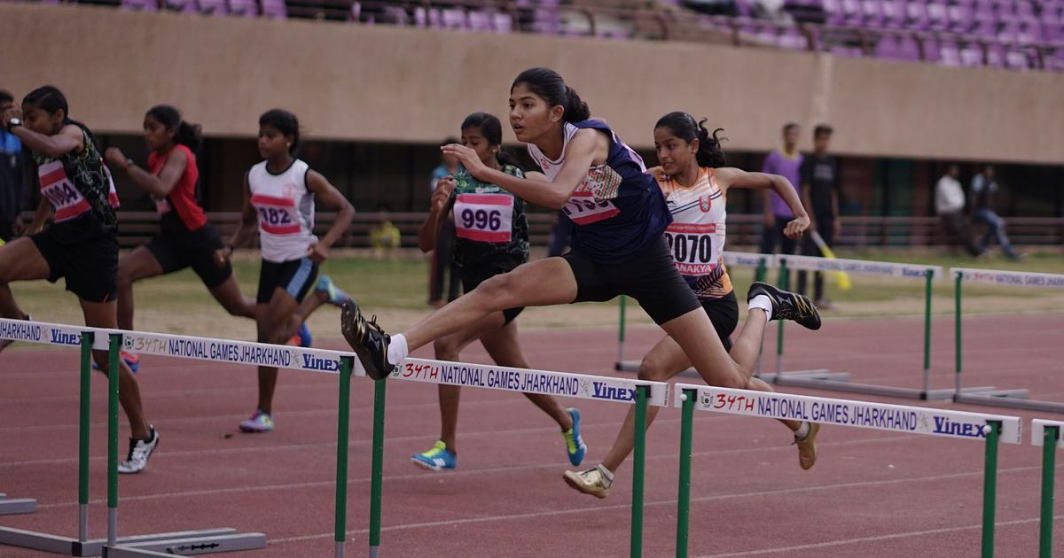
AGE AND SEX CATEGORIES
AGE for JUNIOR ATHLETES
The date of reckoning the age for athletes participating in age group Competitions will be as on the last date of the Competition.
For International Competitions the selection of Indian Team will be based on the age bracket sent by WA/AAA/SAAF/IOA etc.
Men
U23 men
U20 men
U18 men
U16 boys
U14 boys
Women
U23 Women
U20 Women
U18 Women
U16 Girls
U14 Girls

Slide 5
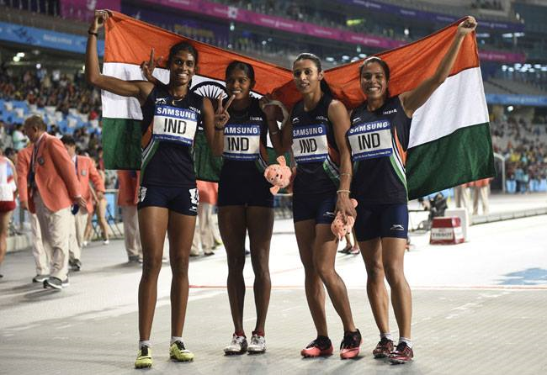
ENTRIES
Competitions under the Rules are restricted to eligible athletes.
The eligibility of an athlete to compete outside of their own country is as set forth in Requirements to Compete in International Competitions Rules. such eligibility shall be assumed unless an objection to their status is made to the Technical delegate(s).

Slide 6
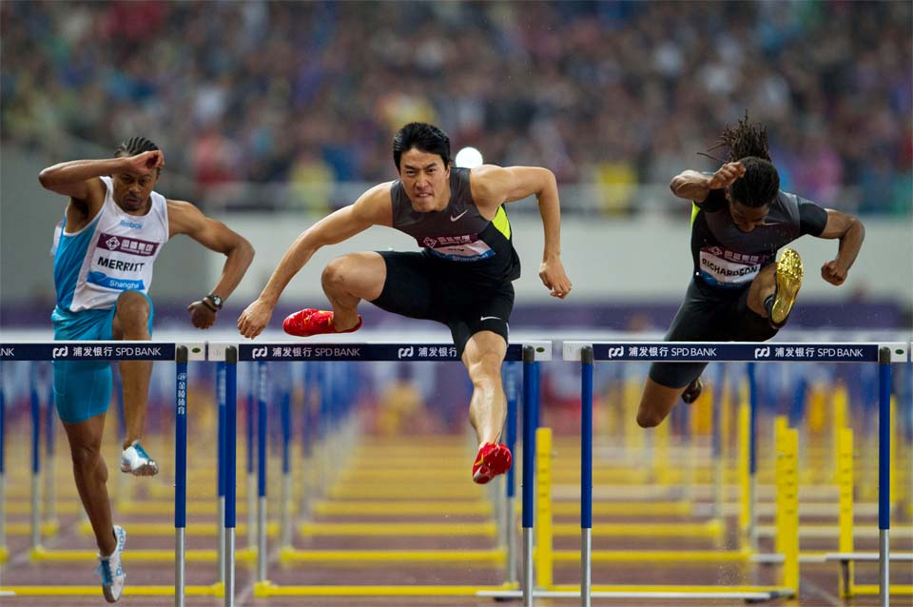
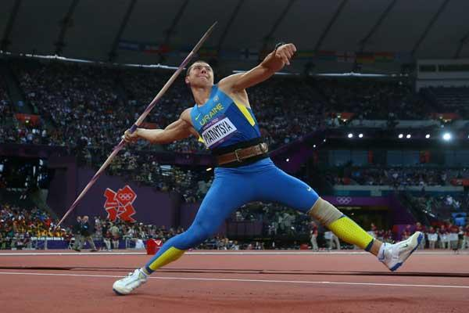
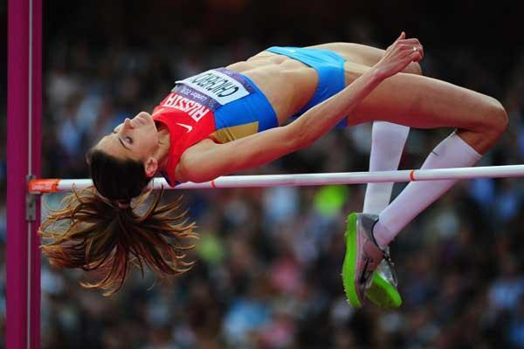
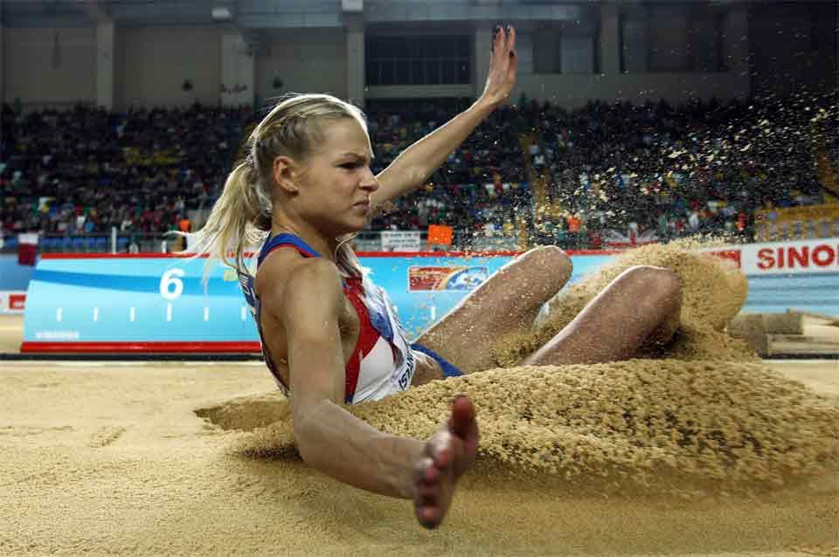
Simultaneous Entries
If an athlete is entered in both a Track event and a Field event, or in more than one Field event taking place simultaneously,
The appropriate Referee may,
For each trial in the High Jump and Pole vault
For other field events one round of trials at a time
Allow an athlete to take their trial in an order different from that decided upon by the draw prior to the start of the competition.
OR
Note: In Field Events, the Referee shall not allow an athlete to take a trial in a different order in the final round of trials.
In Combined Events, a change may be allowed in any round of trials.

Slide 7
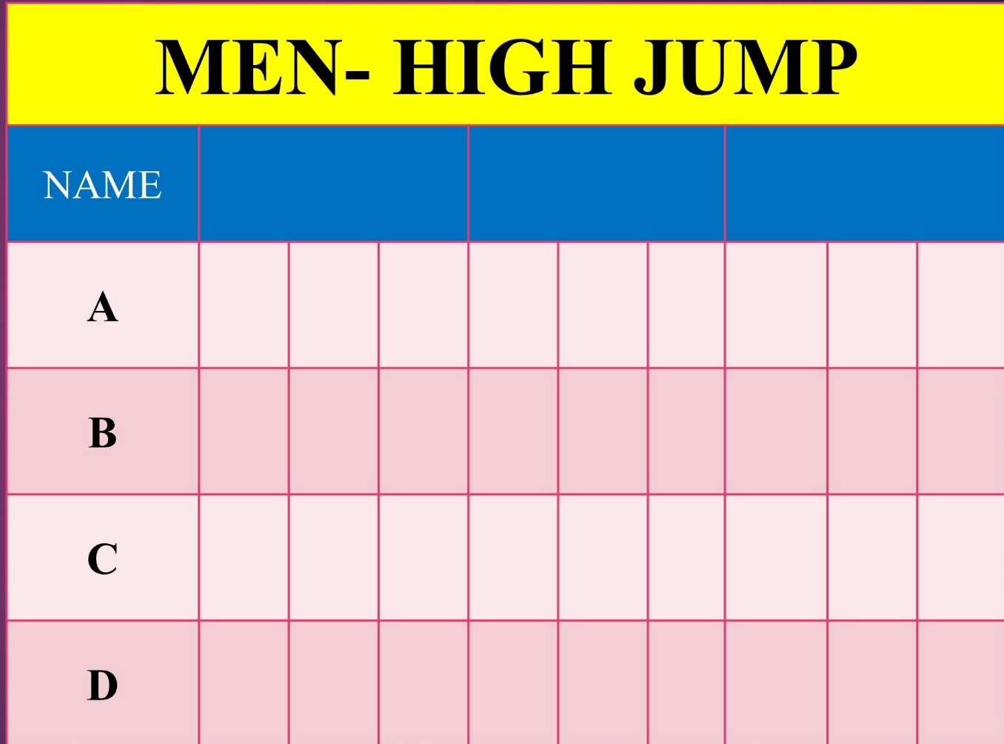
Simultaneous Entries
EXAMPLE
For each trial in the High Jump and Pole vault
Allow an athlete to take their trial in an order different from that decided upon by the draw prior to the start of the competition.
1.80m
1.84m
1.88m
X
X
O
X
X
X
X
O
X
X
X
However, if an athlete subsequently is not present for a particular trial, it shall be deemed that they are passing once the period allowed for the trial has elapsed.
X
O
X
X
X
O
X

Slide 8

Simultaneous Entries
EXAMPLE
for other field events one round of trials at a time
allow an athlete to take their trial in an order different from that decided upon by the draw prior to the start of the competition.
17.40
17.50
17.52
16.79
16.82
16.90
However, if an athlete subsequently is not present for a particular trial, it shall be deemed that they are passing once the period allowed for the trial has elapsed.
17.52
17.72
17.17
17.30
17.45

Slide 9
FAILURE TO PARTICIPATE
An athlete shall be excluded from participation in all further events in the competition, including relays, in cases where :
A final confirmation was given that the athlete would start in an event but then failed to participate.
He qualified in preliminaries or heats for further participation in an event but then failed to participate further.
An athlete failed to compete honestly with bona fide effort.
The relevant Referee, once aware of such a situation and is satisfied that the athlete who abandoned the race was not competing with a bona fide effort, must make a reference to this in the relevant results as “DNF TR 4.4.3”. The situation foreseen in this case, this Technical Rules will not apply to individual events within Combined Events.

Slide 10
FAILURE TO PARTICIPATE
EXCEPTION
Medical certificate , provided by and based on an examination of the athlete by the appointed Medical Delegate or Doctor so designated by the Organizers, may be accepted.
Factors independent of the athlete’s own actions, such as problems with the official transport system may, after the confirmation, also be accepted by the Technical Delegate(s).

Slide 11
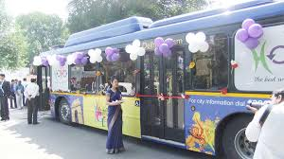
FAILURE TO REPORT TO
THE CALL ROOM(S)
An athlete shall be excluded from participation in any event in which he is not present in the Call Room(s) at the relevant time as published in the Call Room schedule. He shall be shown in the results as DNS.
The Relevant Referee will decide on this (including whether the athlete may compete under protest if a decision cannot be made immediately) and the corresponding reference must be made in the official results.
Justifiable reasons, like Problem with the official Transport System or an error in the published Call Room Schedule may ,after confirmation, be accepted by the Referee and the athlete may then be allowed to take part.
Event | Call Time and Report begins | Final Call | Call Room Closing
Hammer Throw (M) | 8:00 | 8:05 | 8:10
Triple Jump (W) | 9:05 | 9:10 | 9:15
1500m (M) | 10:00 | 10:05 | 10:10

Slide 12
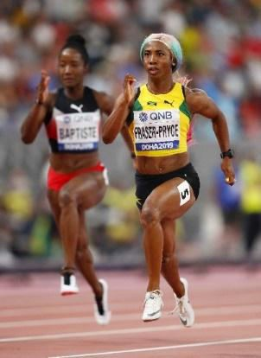
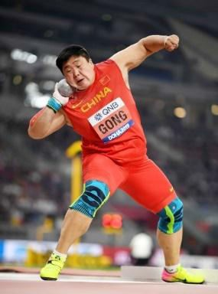
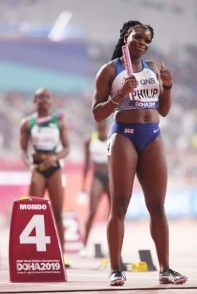
CLOTHING
Clothing must be clean, and designed and worn so as not to be objectionable.
The clothing must be made of a material which is non-transparent even if wet.
An athlete must not wear clothing, which could impede the view of the judges.
The victory Ceremony and any lap of honour are considered part of the competition for this purpose.

Slide 13
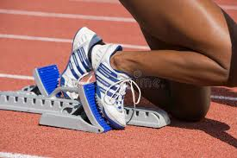
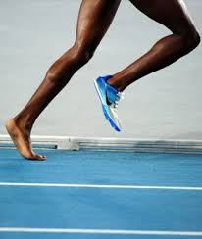
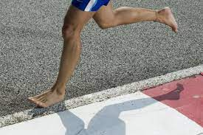
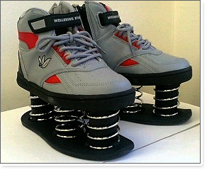
SHOES
Athletes may compete barefoot or with footwear on one or both feet.
The purpose of shoes for competition is to give protection and stability to the feet and a firm grip on the ground.
They must not give athletes any unfair assistance or advantage.

Slide 14
SHOES
Not Allowed
AS PER ATHLETICS FEDERATION OF INDIA
No Athlete will be allowed to participate
bare foot in any Athletics Competitions.
Allowed only
Not Allowed

Slide 15
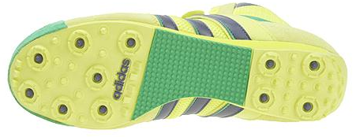
SHOES
Athletic Shoes: Spikes
The sole of the shoe (including the part beneath the heel of the Athletic Shoe) may be so constructed as to provide for the use of up to 11 spikes.
Any number of spikes up to 11 may be used, but the number of spike positions must not exceed 11.

Slide 16
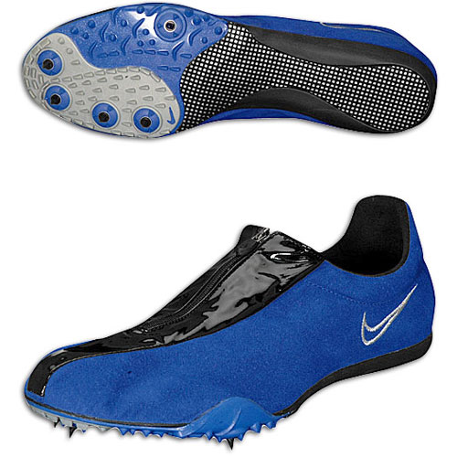
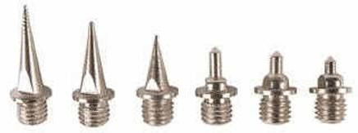
SHOES
Dimensions of spikes
FOR HIGH JUMP AND JAVELIN :
The part of each Spike which projects from the Sole or heel shall not exceed 12mm.
FOR OTHER EVENTS
Sole or heel shall not exceed 9mm.
**** The spike must be so constructed that it will, at least for the half of its length closest to the tip, fit through a square sided 4mm gauge. **** It may be lesser maximum if track manufacturer or stadium operator mandates.

Slide 17
ATHLETIC SHOE SOLE THICKNESS TABLE in force until 31 October 2024
Event | Maximum thickness of the sole
All Field Events (except Triple Jump) | 20mm
Triple Jump | 25mm
Track Events (including hurdle events) up to but not including 800m . For relays, the rule applies to the distance of the leg being run by each athlete. | 20mm
Track Events from 800m and above (including steeplechase events) For relays, the rule applies to the distance of the leg being run by each athlete. | 25mm
Cross-Country | 25mm spike shoe or 40mm non-spike shoe
Road Events (Running and Race Walking Events) including Track Race Walking Events | 40mm
Mountain and Trail Races | Any Thickness

Slide 18
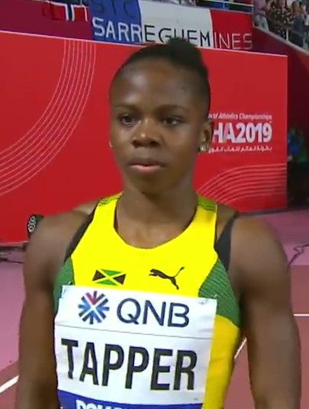
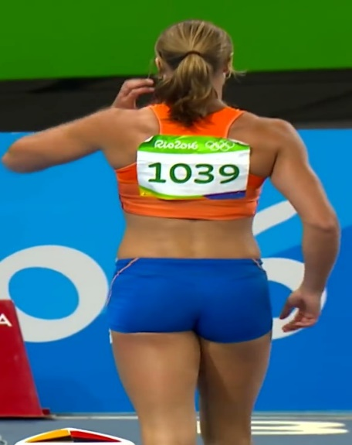
ATHLETE BIBS
Every athlete shall be provided with two bibs which, during the competition, shall be worn visibly on the front of the torso and back, except in the jumping events, Where one bib may be worn on the front of the torso or back only.
These bibs must be worn as issued and may not be cut, folded or obscured in any way. In running or walking events of 10,000 metres and longer, the bibs may be perforated to assist the circulation of air, but the perforation must not be made on any of the lettering or numerals which appear on

Slide 19
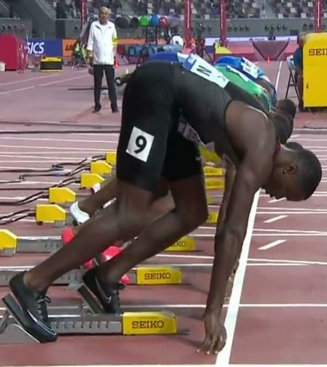
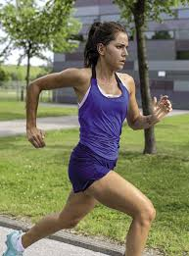
ATHLETE BIBS
Where a Photo Finish system is in operation, the Organisers may require athletes to wear additional number identification of an adhesive type on the side of their shorts or lower body.
No athlete shall be allowed to take part in any competition without displaying the appropriate bib(s) and/or identification. If an athlete does not follow they shall be disqualified
Maximum dimension shall be 24 cm in width and 20 cm. In height. Length of identification above the number maximum 5 cm. Length of the digits 6 cm. To 10 cm. And must be clearly visible Length of identification below the number maximum 3cm.

Slide 20

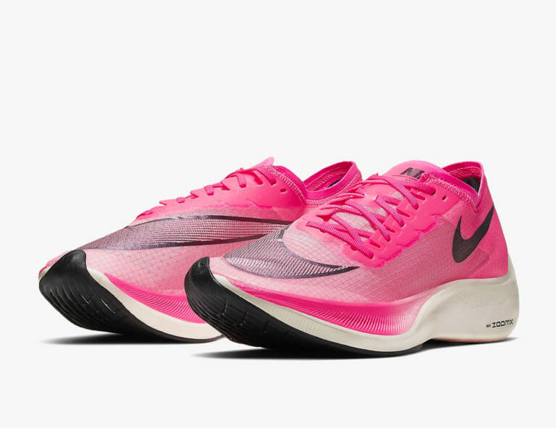
ASSISTANCE NOT ALLOWED
Pacing in races by persons not participating in the same race, by athletes lapped or about to be lapped or by any kind of technical device (other than those permitted under Rule 6.4.4 of the Technical Rules).
Possession or use of video recorders, radios, Cd, radio transmitters, mobile phone or similar devices in the competition area.

Slide 21
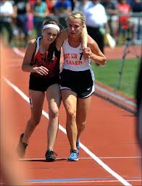
ASSISTANCE NOT ALLOWED
Provision of advice or other support by any official of the competition not related to or required by their specific role in the competition at the time (e.g., coaching advice, indication of the take-off point in a jumping event except to indicate a failure in Horizontal Jumps, time or distance gaps in a race etc.).
Receiving physical support from another athlete (other than helping to recover to a standing position) that assists in making forward progression in a race.

Slide 22
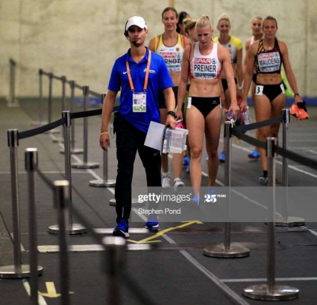
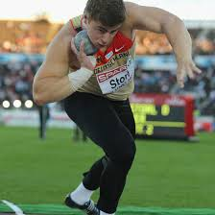
ASSISTANCE TO ATHLETES
Medical Examination and Assistance
Medical examination / treatment and/or physiotherapy may be provided either on the competition area itself by the official medical staff appointed by the Organisers and identified by armbands, vests or similar distinctive apparel or in designated medical treatment areas outside the competition area by accredited team medical personnel specifically approved by the medical or Technical delegate(s) for the purpose. such attendance or assistance by any other person, whether immediately before competition, once athletes have left the Call Room or during competition, is assistance.

Slide 23
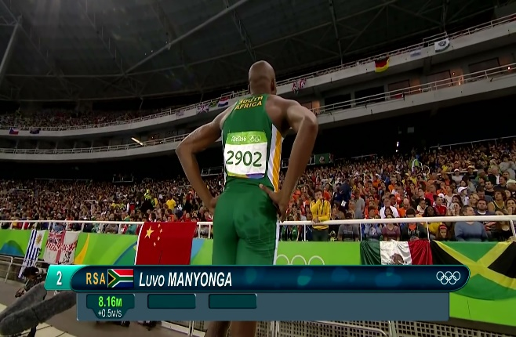
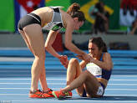
ASSISTANCE ALLOWED
Communication between the athletes and their coaches not placed in the competition area.
Receiving physical support from an official or other person designated by the organisers to recover to a standing position or to access medical assistance.

Slide 24
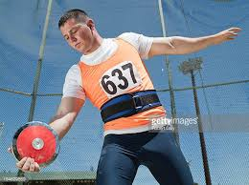
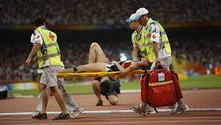
ASSISTANCE ALLOWED
Any kind of personal safeguard (e.g. bandage, tape, belt, support, wrist cooler, breathing aid etc.) for protection and/or medical purposes.
Medical examination / treatment and/or physiotherapy necessary to enable an athlete to participate or continue participation once on the competition area under Rule 6.1 of the Technical Rules.

Slide 25
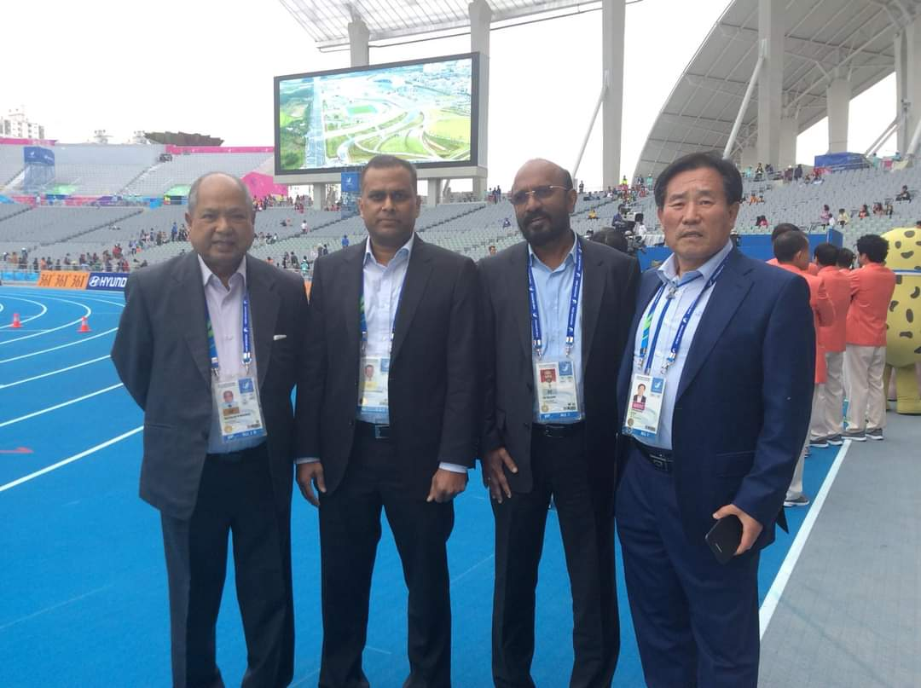
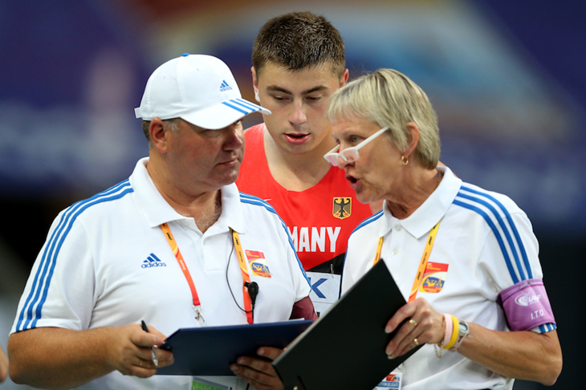
PROTESTS
CONCERNING STATUS
Protests concerning the status of an athlete to participate in a competition must be made, prior to the commencement of such competition, to the Technical Delegate(s).
Once the Technical Delegate(s) make(s) a decision, there shall be a right of appeal to the Jury of Appeal.
If the matter cannot be settled satisfactorily prior to the competition, the athlete shall be allowed to compete under protest and the matter be referred to the relevant governing body.
CONCERNING THE RESULT OR CONDUCT OF AN EVENT
To be made to the Concerned Referee

Slide 26
PROTEST
AFTER ANNOUNCEMENT OF RESULT
TO WHOM PROTEST SHALL BE MADE
Any protest shall be made orally to the Referee
CONDITION
Protests concerning the result or conduct of an event shall be made within 30 minutes of the official announcement of the result of that event.
AFTER ANNOUNCEMENT OF RESULT
WHO CAN PROTEST
An athlete
Someone acting on their behalf
An official representative of a team. if they are competing in the same round of the event to which the protest (or subsequent appeal) relates.
Or are competing in a competition in which a team points score is being conducted).

Slide 27
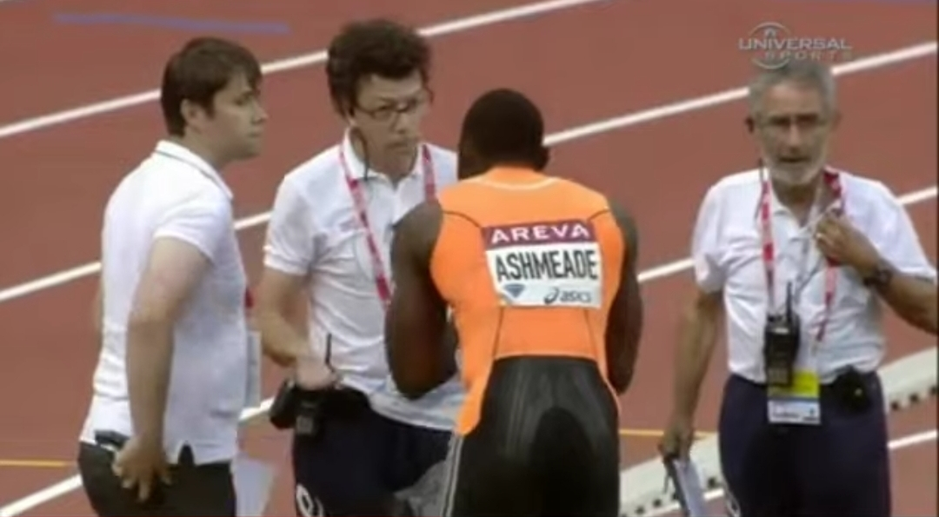
PROTEST
IMMEDIATE ORAL PROTEST
IN A TRACK EVENT
If an athlete makes an immediate oral protest against having been charged with a false start
Track Referee may, if they are in any doubt, allow the athlete to compete “under protest” in order to preserve the rights of all concerned.
POWER OF THE REFEREE
Whether or not there may be any warning or disqualification, the Referee shall have the authority to declare the event or part of the event void and that it or part of it shall be held again if in their opinion justice demands it.

Slide 28
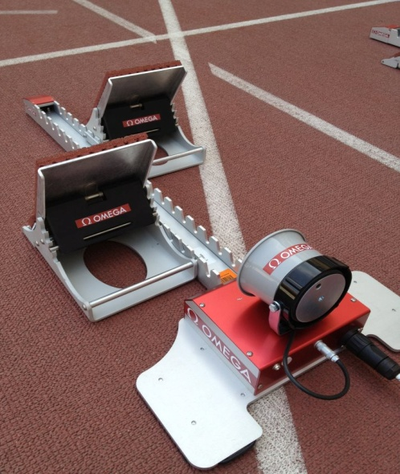
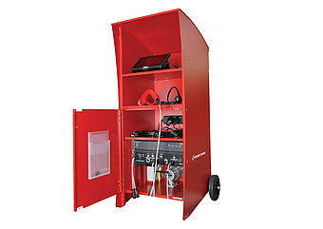
PROTEST
IMMEDIATE ORAL PROTEST IN A TRACK EVENT
CONDITION
If the false start was indicated by a World Athletics certified start Information system - Competing “under protest” shall not be allowed
In cases where it is very clear by visual observation that the athlete has committed a false start.
EXCEPTION
Any reason the Referee determines that the information provided by the system is obviously inaccurate.

Slide 29
PROTEST
IMMEDIATE ORAL PROTEST
IN A TRACK EVENT
A protest may be based on the failure of the starter to recall a false start
A protest may be based on the failure of the starter to abort a start
CONDITION
The protest may be made only by, or on behalf of, an athlete who has completed the race.
DECISION
If the protest is upheld, any athlete who committed the false start or whose conduct should have led to the start being aborted, and who was subject to warning or disqualification according to Rules 16.5, 16.7, 16.8 or 39.8.3 of the Technical Rules, shall be warned or disqualified

Slide 30
PROTEST
IMMEDIATE ORAL PROTEST
IN A TRACK EVENT
If a protest or appeal is based on an athlete’s incorrect exclusion from an event due to a false start and it is upheld after the completion of the race
If applicable, to be advanced to subsequent rounds.
No athlete should be advanced to a subsequent round without competing in all rounds unless the Referee or Jury of Appeal determines otherwise in the particular circumstances of the case – “the shortness of time before the next round or the length of the race. “

Slide 31
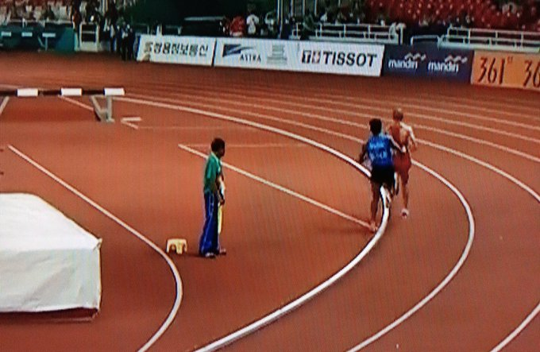
PROTEST
IMMEDIATE ORAL PROTEST
IN A TRACK EVENT
When a protest is made by or on behalf of an athlete or team which did not finish a race
The protest shall be dismissed- IF:
The athlete or team was or should have been disqualified for a breach of the Rules unrelated to the matter raised in the protest.

Slide 32
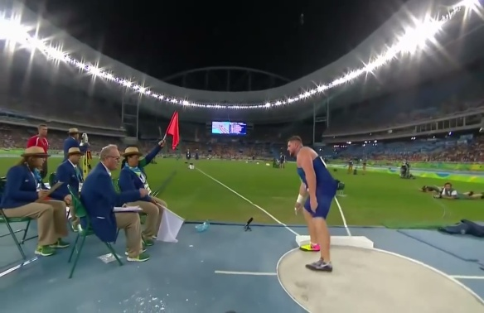
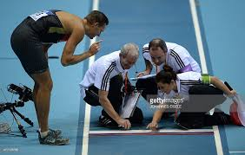
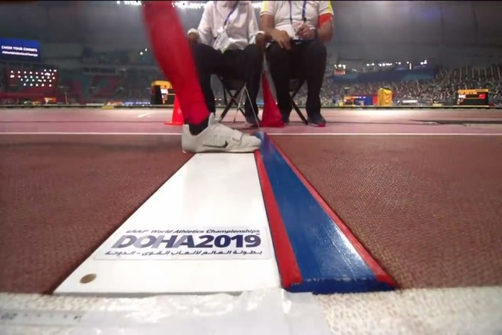
PROTEST
IMMEDIATE ORAL PROTEST
IN A FIELD EVENT
If an athlete makes an immediate oral protest against having a trial judged as a failure
If the Referee of the event is in any doubt
Order that the trial be measured and the result recorded, in order to preserve the rights of all concerned.
In cases where the Referee is sure that the decision of the Judges is correct, particularly by their own observation or advice received from a video Referee, the athlete should not be allowed to continue.
For example in the long jump a clear mark made in the Plasticine by the athlete in question or in a throwing event where the implement has clearly landed outside the sector.

Slide 33
PROTEST
IMMEDIATE ORAL PROTEST
IN A FIELD EVENT
If the protested trial occurred
During the first three rounds of trials of a horizontal Field event in which more than eight athletes are competing, and the athlete would advance to any subsequent rounds of trials only if the protest or subsequent appeal was upheld
In a vertical Field event, where the athlete would advance to a higher height only if the protest or subsequent appeal is upheld
VALIDITY OF THE PROTESTED PERFORMANCE
The protested performance of the athlete and any other performance achieved by them while competing “under protest” will become valid only if a subsequent decision to that effect is made by the Referee or an appeal to the Jury of Appeal is made and it is upheld.
In Field events where, as a result of an athlete competing “under protest”, another athlete is allowed to continue in the competition when they would otherwise not have done so, such athlete’s performances and eventual results will remain valid irrespective of whether the “under protest” athlete’s immediate oral protest is successful.

Slide 34
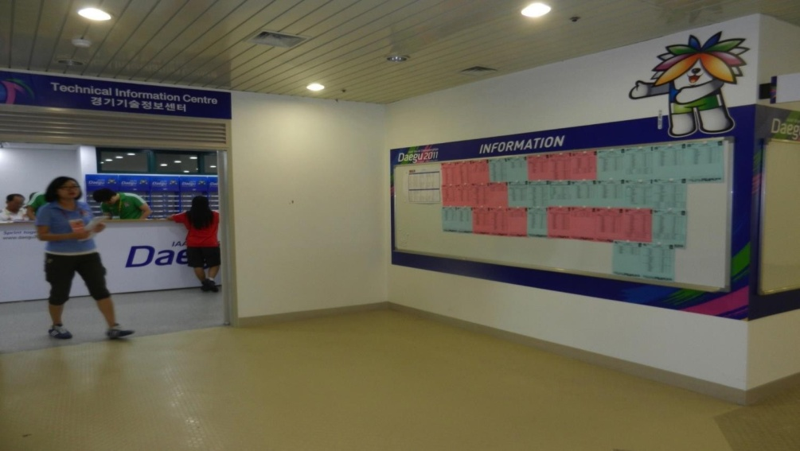
PROTEST
AFTER ANNOUNCEMENT OF RESULT
HOW TO ARRIVE AT A FAIR DECISION
May consider any available evidence which concerned Referee think necessary
May consider a film or picture produced by an official video recorder
May consider any other available video evidence
HOW TO PROTEST IN ABSENCE OF THE REFEREE
Where the Referee is not accessible or available, the protest should be made to them through the Technical Information Centre.
RIGHT OF THE REFEREE
The Referee may decide on the protest
May refer the matter to the Jury of Appeal.
RIGHT OF THE ATHLETE
If the Referee makes a decision, an Athlete has a right of appeal to the Jury

Slide 35
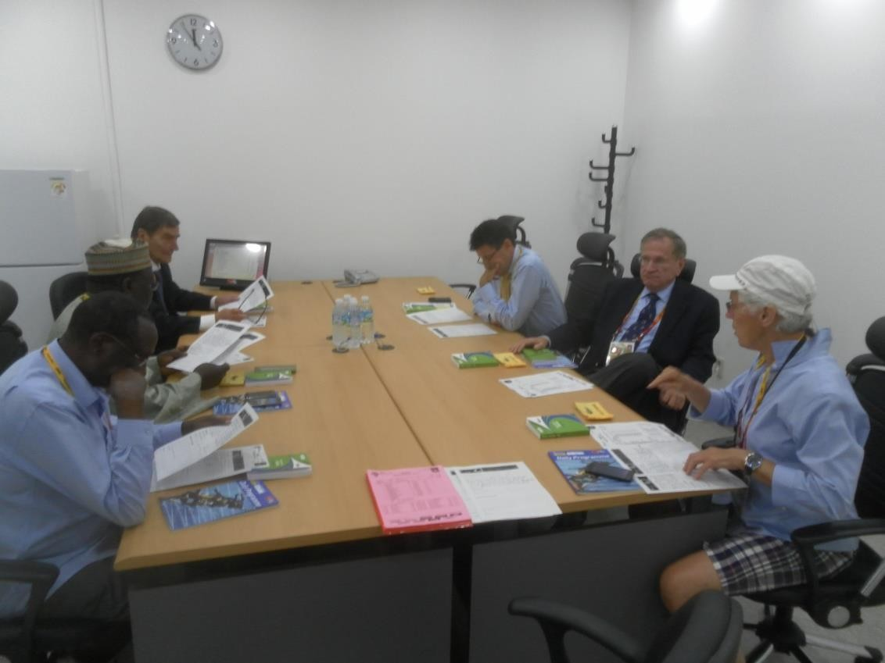
JURY OF APPEAL
In the interest of the proper conduct of the competitions, a Jury of Appeal should be appointed at all competitions.
It normally consist of three, five or seven persons.
One of the member shall be the Chairman.
Another one shall be the secretary. (If appropriate he may be a person not included in the jury).
If an appeal related to Race Walking then one member of the Jury shall be a Race walking Judge.
The primary functions of the Jury of Appeal
To deal with all appeals under Rule 8 of the Technical Rules, and with any matters arising during the course of the competition which are referred to it for decision.

Slide 36
AN APPEAL TO THE JURY OF APPEAL
CONDITIONS
An appeal to the Jury of Appeal must be made within 30 minutes.
Of the official announcement of the amended result of an event arising from the decision made by the Referee, or
Of the advice being given to those making the protest, where there is no amendment of any result.
It shall be in writing, signed by the athlete, by someone acting on their behalf or by an official representative of a team
shall be accompanied by a deposit of usd 100, or its equivalent, which will be forfeited if the appeal is not allowed.
WHO CAN APPEAL
An athlete
Someone acting on their behalf
An official representative of a team. if they are competing in the same round of the event to which the protest (or subsequent appeal) relates.
Or are competing in a competition in which a team points score is being conducted).

Slide 37
JURY OF APPEAL
HOW TO DERIVE A DECISION BY
THE JURY OF APPEAL
The Jury of Appeal shall consult all relevant persons, including the relevant Referee.
If the Jury of Appeal is in doubt, other available evidence may be considered.
If such evidence, including any available video evidence, is not conclusive, the decision of the Referee or the Chief Race Walking Judge shall be upheld.
RECONSIDER A DECISION
The Jury of Appeal may reconsider a decision if new conclusive evidence is presented, provided the new decision is still applicable.
Normally, such re-consideration may be undertaken only prior to the victory Ceremony for the applicable event.
Unless the relevant governing body determines that circumstances justify otherwise.

Slide 38
JURY OF APPEAL
DUTY OF THE JURY OF APPEAL
Decisions involving points which are not covered by the Rules shall be reported subsequently by the Chairman of the Jury of Appeal to the Chief executive Officer of World Athletics.
CONCLUSION
The decision of the Jury of Appeal (or of the Referee in the absence of a Jury of Appeal or if no appeal to the Jury is made) shall be final and there shall be no further right of appeal, including to CAs.

Slide 39
THANK YOU

