Slide 1
HORIZONTAL JUMPS
SOMNATH MALLICK

Slide 2
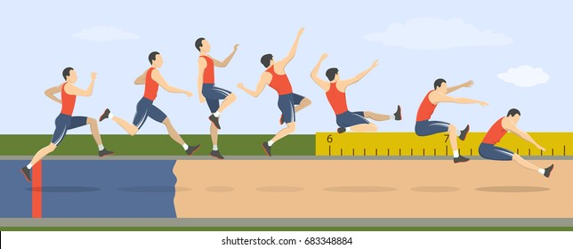
SYLLABUS --
HORIZONTAL JUMPS
GENERAL
RUNWAY
TAKE-OFF BOARD
LANDING AREA
TAKE-OFF LINE
DISTANCE MEASUREMENT
WIND MEASUREMENT
LONG JUMP
COMPETITION RULES
TRIPLE JUMP
COMPETITION RULES

Slide 3
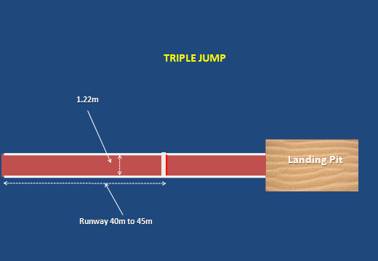
RUNWAY –
LONG JUMP & TRIPLE JUMP
The minimum length of the runway -- shall be 40 meters and where condition permit 45 meters.
From where we can measure it : Measured from relevant take-off line.
The width of the runway 1.22 meters ± 0.01 m.
The runway shall be marked by white lines 50 mm in width.

Slide 4
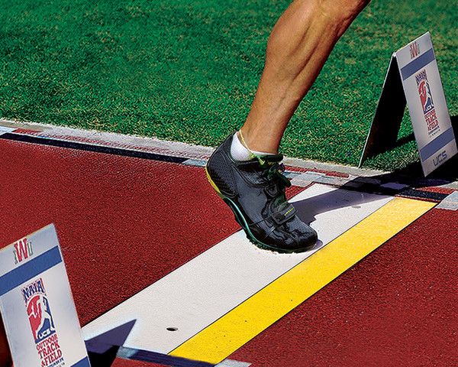
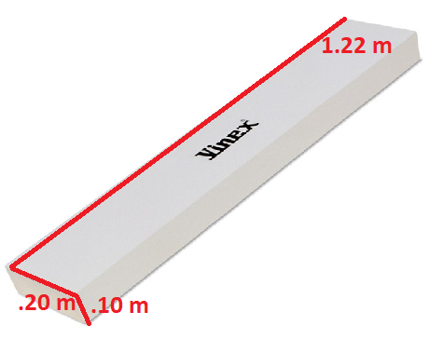
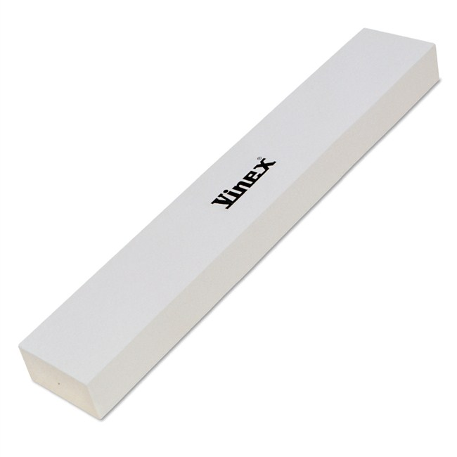
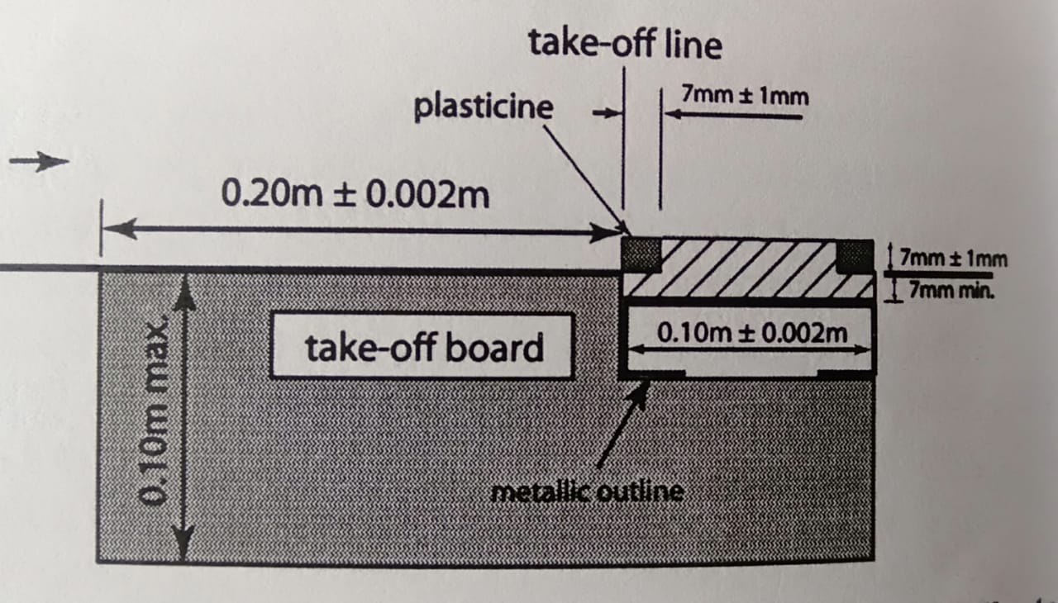
TAKE-OFF BOARD –
LONG JUMP & TRIPLE JUMP
Take-off Board shall be marked by a board.
Shape: Rectangular.
Made of : Wood or other suitable rigid material.
Size : Length 1.22 m ± 0.01 m.
Wide .20 m ± 0.002 m.
Deep .10 m
Colour : Shall be White.
Placement : Sunk level with the runway & the surface of the landing area.

Slide 5
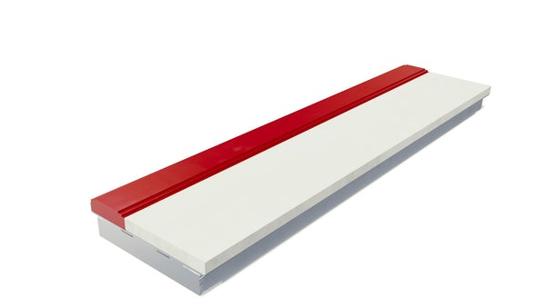
PLASTICINE INDICATOR BOARD –
LONG JUMP & TRIPLE JUMP
Plasticine Indicator Board shall consist of a rigid board.
Shape : Rectangular.
Size : Length : 1.22 m ±0.01 m.
Wide : .10 m ± 0.002 m.
Height : 7 mm from the surface level of the take-off board.
Angle : The surface of the plasticine nearer to the take-off line shall be 90 degree.
Colour of the PLASTICINE : Contrasting colour to the take-off board. Where possible third contrasting colour.
Purpose : Identify the footprint ( foul ) of the athlete.

Slide 6
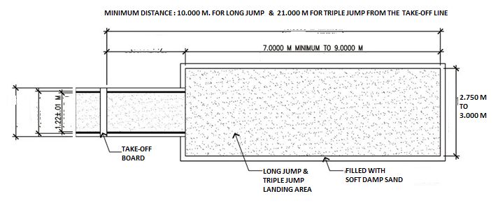
LANDING AREA –
LONG JUMP & TRIPLE JUMP
The landing area shall have a minimum width of 2.75 m & the maximum width of 3.00 m. For Both events.
The distance between the take-off line & the far end of the landing area for :
*Long Jump : At least 10 m. *Triple Jump : At least 21 m.
The distance between the take-off line & the nearer end of the landing area for :
*Long Jump : 1m to 3m. *Triple Jump : Men- Not less then 13m. Women- Not less then 11m.
This distance shall be appropriate for the level of competition
Landing area filled with Soft Damp Sand.

Slide 7
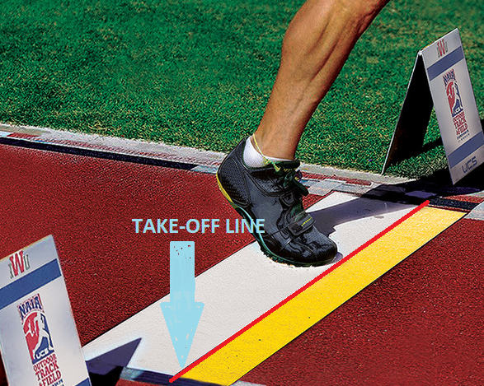
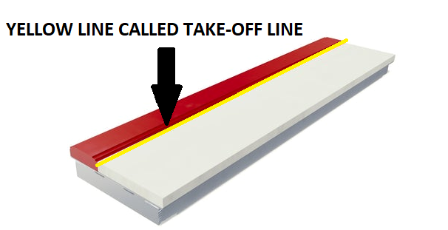
TAKE-OFF LINE –
LONG JUMP & TRIPLE JUMP
What is Take-off Line & Where it can be found ?
The Take-off Line is an imaginary line.
The Take-off line is placed between the Take off board & Plasticine board.

Slide 8
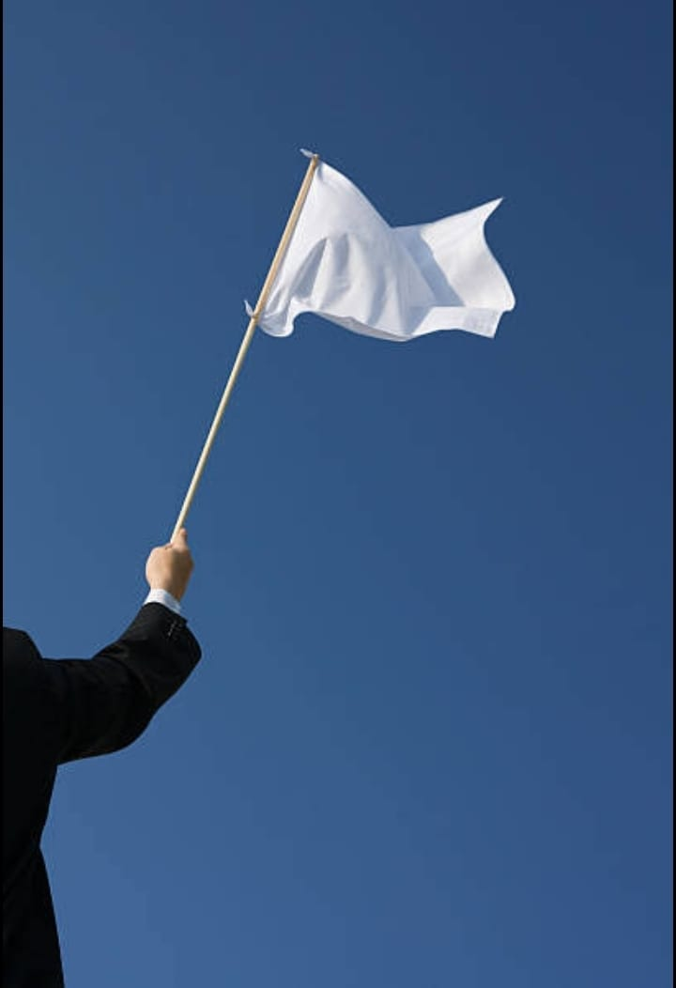
COMPLETION OF TRIALS –
LONG JUMP & TRIPLE JUMP
The judge shall not raise a white flag to indicate a valid trial until a trial is completed.
The completion of valid trial shall be determined as follows :
Once the athlete leaves the landing area in accordance with rule.
( i.e. Landing area leaving rules )
The judge shall raise a red flag to indicate a foul jump
Measurement procedure will start after receiving the VALID JUMP indication.

Slide 9
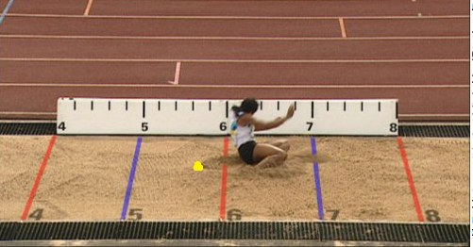
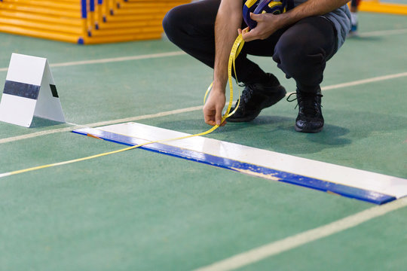
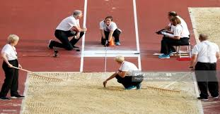
DISTANCE MEASURMENT –
LONG JUMP & TRIPLE JUMP
All valid trials should be measure after immediately completion --- from the nearest break in the landing area made by any part of the body or anything that was attached to the body at the time it made a mark.
The distance shall be recorded to the nearest 0.01m below the distance measured if the distance is not a whole centimetre. ( Example : Actual reading was 7.956 m. Recorded as 7.95 m. )
The measurement shall be taken perpendicular to the take-off line or its extension.

Slide 10
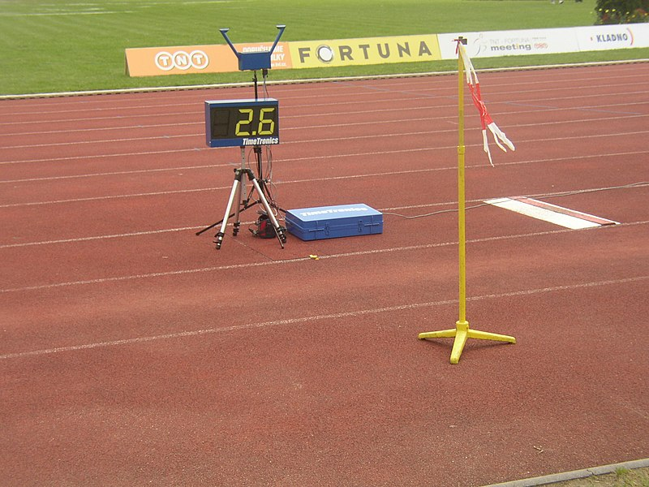
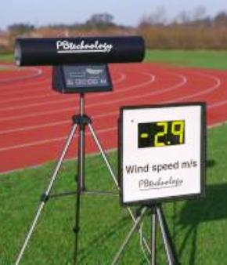
WIND MEASURMENT –
LONG JUMP & TRIPLE JUMP
Wind gauge shall be placed 20m from the take-off line. The measuring plane shall be positioned 1.22 m high and not more then 2.00 m away from the runway.
The wind velocity measuring period is 5 seconds from the time an
athlete passes a mark placed alongside the runway for :
Long jump – 40 m
Triple jump – 35 m
If the athlete run less then the above distance – wind velocity shall be
measured from the time they commence their run.
The wind gauge shall be read in meter per second, rounded to the
next higher tenth of meter per second. Reading as follows:
in positive direction : +2.03 m/s = +2.1
in opposite direction : -2.03 m/s = - 2.0

Slide 11
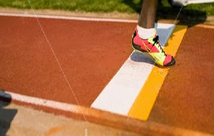
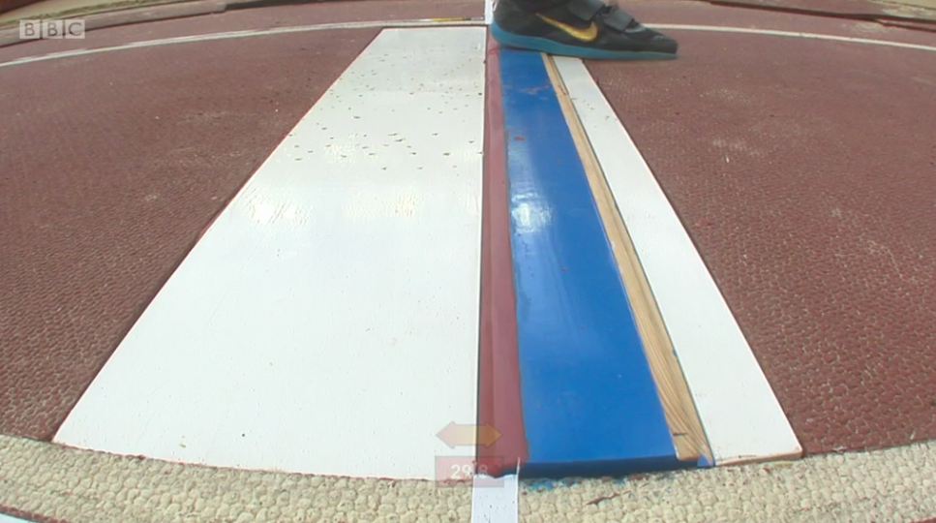
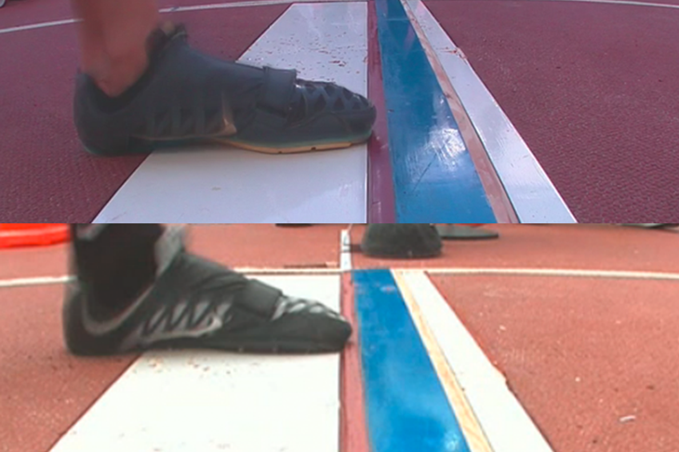
COMPETITION RULES –
LONG JUMP
An athlete fails if :
While taking off – break the vertical plane of the take off
line with any part of their foot/shoe, --
Whether running up without jumping or act of jumping.

Slide 12
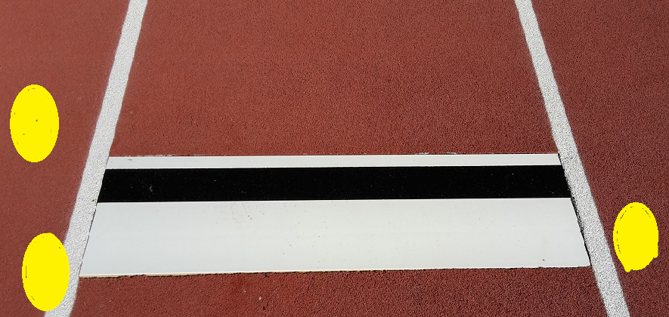
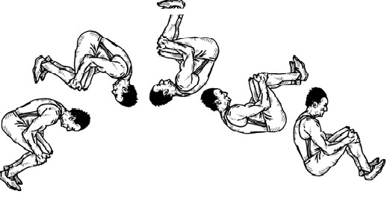
COMPETITION RULES –
LONG JUMP
An athlete fails if :
They take off from outside either end of the board,
weather beyond or before the extension of the take off line.
They employ any type of somersaulting whilst running up or in the act of jumping.

Slide 13
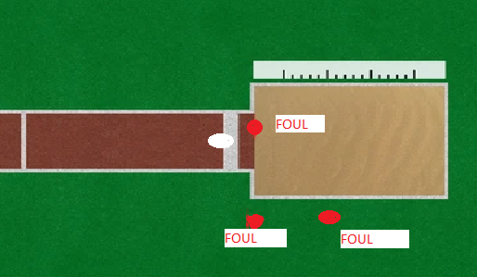
COMPETITION RULES –
LONG JUMP
An athlete fails if :
After taking off but before their first contact with the landing area --
-- They touch the runway or
-- Ground outside the runway or
-- Outside the landing area.

Slide 14
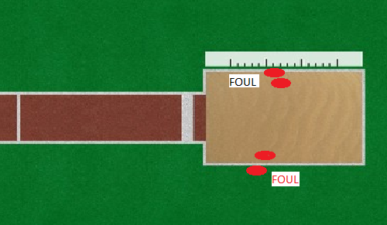
COMPETITION RULES –
LONG JUMP
An athlete fails if :
In the course of landing –
They touch the border or
The ground outside, the landing
Area closer to the take off line,
Then the nearest break made in
The sand.

Slide 15
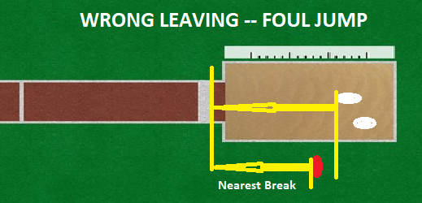
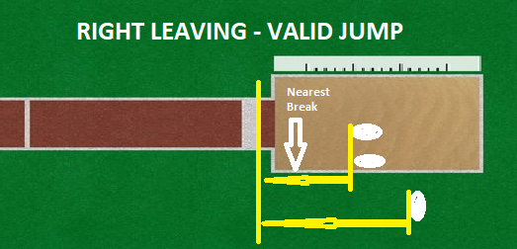
COMPETITION RULES –
LONG JUMP
An athlete fails if :
Leave the landing area in any manner other then – the described following technical rule.
The rule :
When leaving the landing area,
an athlete’s first contact by foot with its border or
ground outside shall be further from take-ff line
then the nearest break in the sand ( Which may
be any mark made on overbalancing completely
inside the landing area or when back, closer to the
take-off line than the initial break on landing ).
This first contact is considered leaving.

Slide 16
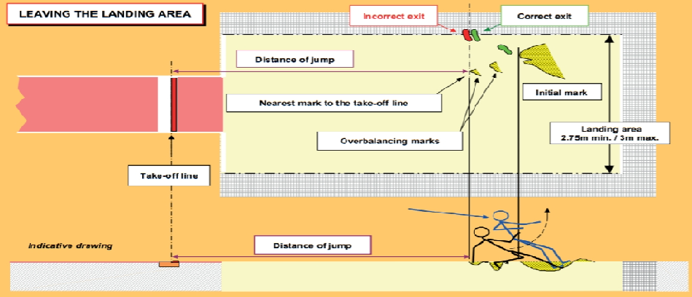
COMPETITION RULES –
LONG JUMP

Slide 17
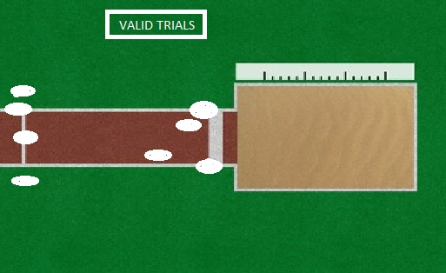
COMPETITION RULES –
LONG JUMP
An athlete shall not be regarded to have failed if :
They run outside the white lines marking the runway
at any point.
They take off before reaching the board.
( Within from RUNWAY )
A part of their shoe/foot is touching the ground
outside end of the take off board should be before
the take off line.
They walk back through the landing area after having
left the landing area.

Slide 18
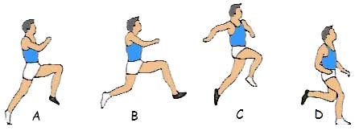
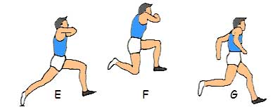
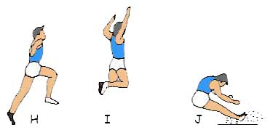
COMPETITION RULES –
TRIPLE JUMP
The Triple Jump consist of A HOP, A STEP & A JUMP in that order.
THE HOP SHALL BE MADE SO THAT LAND
ON THE SAME FOOT AS THAT FROM
WHICH THEY HAVE TAKEN OFF
IN STEP THEY SHALL LAND ON OTHER FOOT
THEN JUMP IS PERFORMED
IF THE ABOVE SAID SEQUNCE IS NOT FOLLOWED IN ORDER THEN THE JUMP IS TREATED AS A FAILURE
AND ALSO ALL TECHNICAL RULES OF LONG JUMP SHALL BE APPLIED FOR CONDUCTING TRIPLE JUMP EVENT

Slide 19
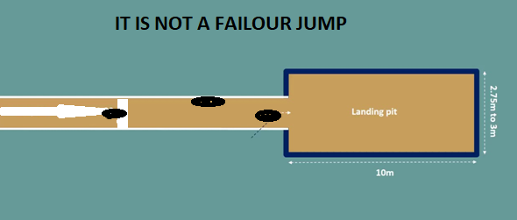
COMPETITION RULES –
TRIPLE JUMP
It is not a failure :
If an athlete while jumping – touches the ground with sleeping leg.
If the athlete touches the white line or ground outside between take off line & the landing area.
Lands in the pit in the step phase through no fault of their own. ( i.e. If the judge incorrectly indicate the take off board.)

Slide 20
THANK YOU

