Slide 1

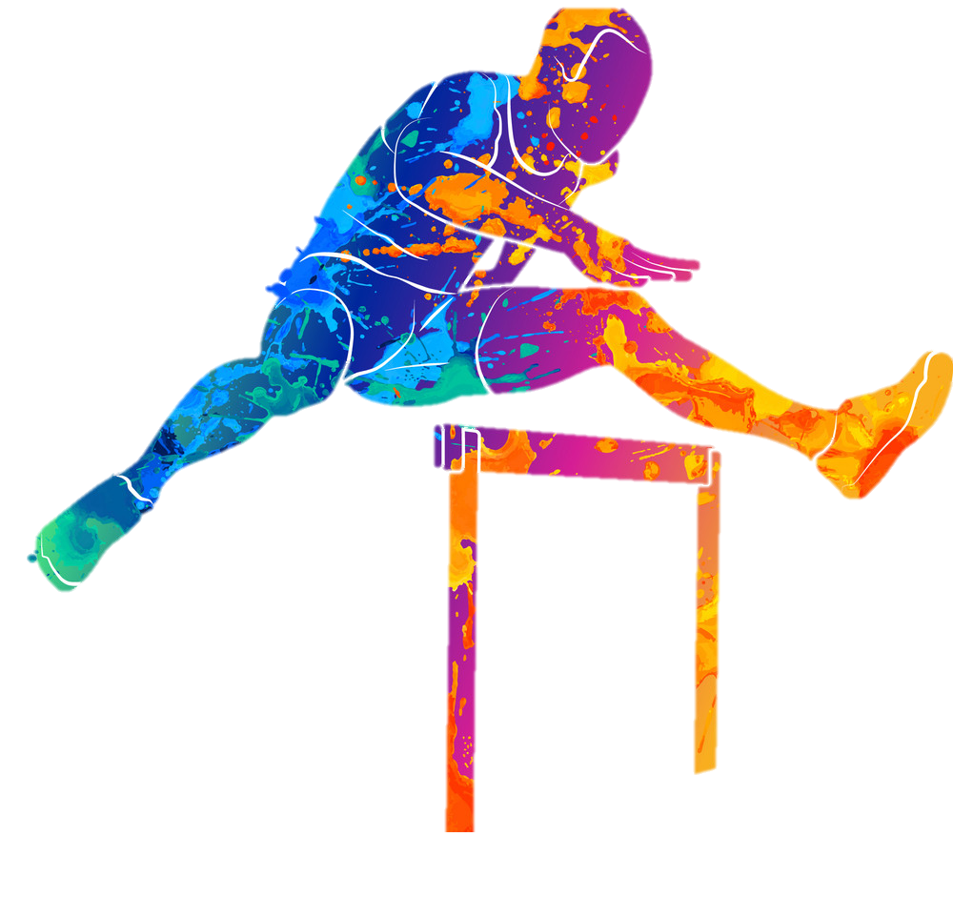
Hurdles, SteepleChase and Relay Races
Prepared by: Dr. Kuldip Singh

Slide 2
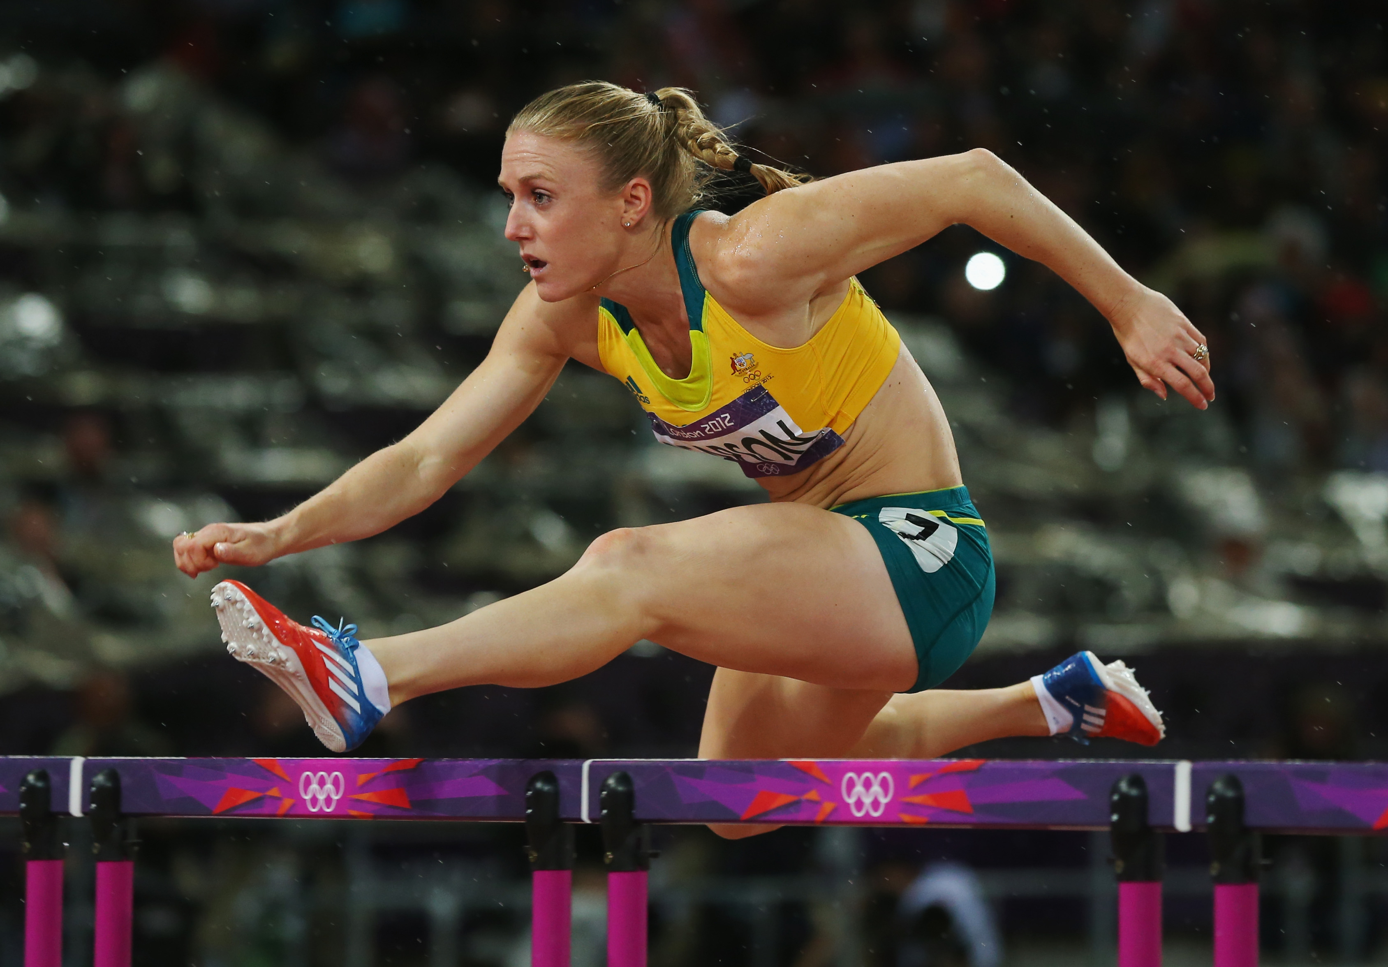
HURDLE RACES

Slide 3

Hurdles : Age Category and Event
The standard distances shall be:
Men, U23 Men, U20 Men and U18 Men: 110m, 400m
Boys U16: 80 m
Women, U23 Women, U20 Women and U18 Women:
100m, 400m
Girls U16: 80 m
There shall be ten flights of hurdles in each lane for 100mH, 110mH and 400mH
In 80mH Boys U16, there are 7 flights in each lane.
In 80mH Girls U16, there are 8 flights in each lane

Slide 4
The standard heights of hurdles
Distance of race | Men / U23 Men | U20 Men | U18 Men | U16 Boys | Women / U20 Women | U18 Women | U16 Girls
100m/110m | 1.067m | 0.991m | 0.914m | --- | 0.838m | 0.762m | ---
400m | 0.914m | 0.914m | 0.838m | --- | 0.762m | 0.762m | ---
80m | --- | --- | --- | 0.838m | --- | --- | 0.762m
Note:
Due to manufacturing varieties, hurdles up to 1.000m are also acceptable in the U20, 110m Hurdles.

Slide 5
Construction of a Hurdle
The hurdles shall be made of metal or some other suitable material with the top bar of wood or other non-metallic suitable material.
They shall consist of two feet and two uprights supporting a rectangular frame, reinforced by one or more cross bars, the uprights to be fixed at the extreme end of each base.
The hurdle shall be of such a design that a force at least equal to the weight of 3.6kg applied horizontally to the centre of the top edge of the top bar is required to tilt it.
The hurdle may be adjustable in height for each event.
The counterweights shall be adjustable so that at each height a force at least equal to the weight of 3.6kg and not more than 4kg is required to tilt it.

Slide 6
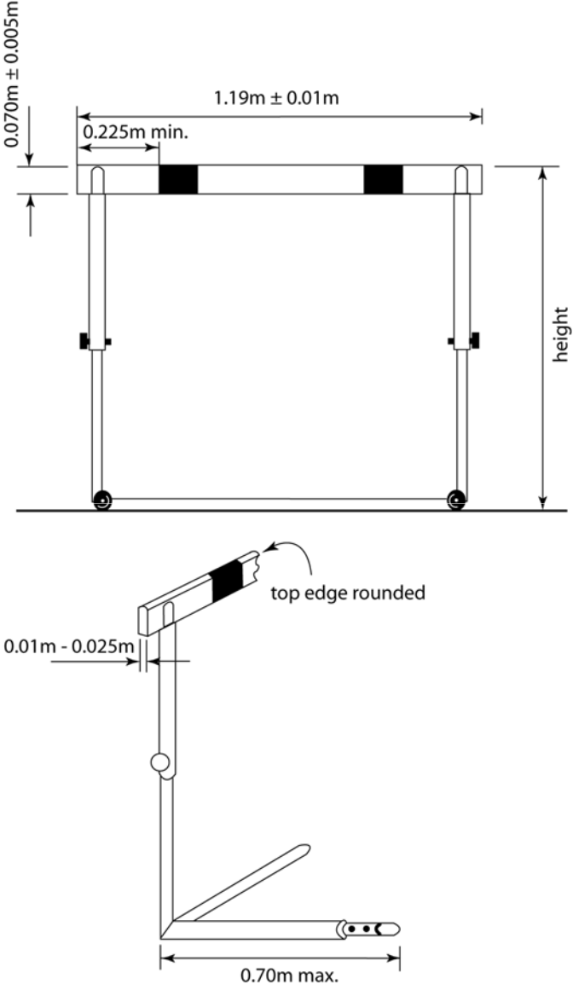
Construction of a Hurdle

Slide 7
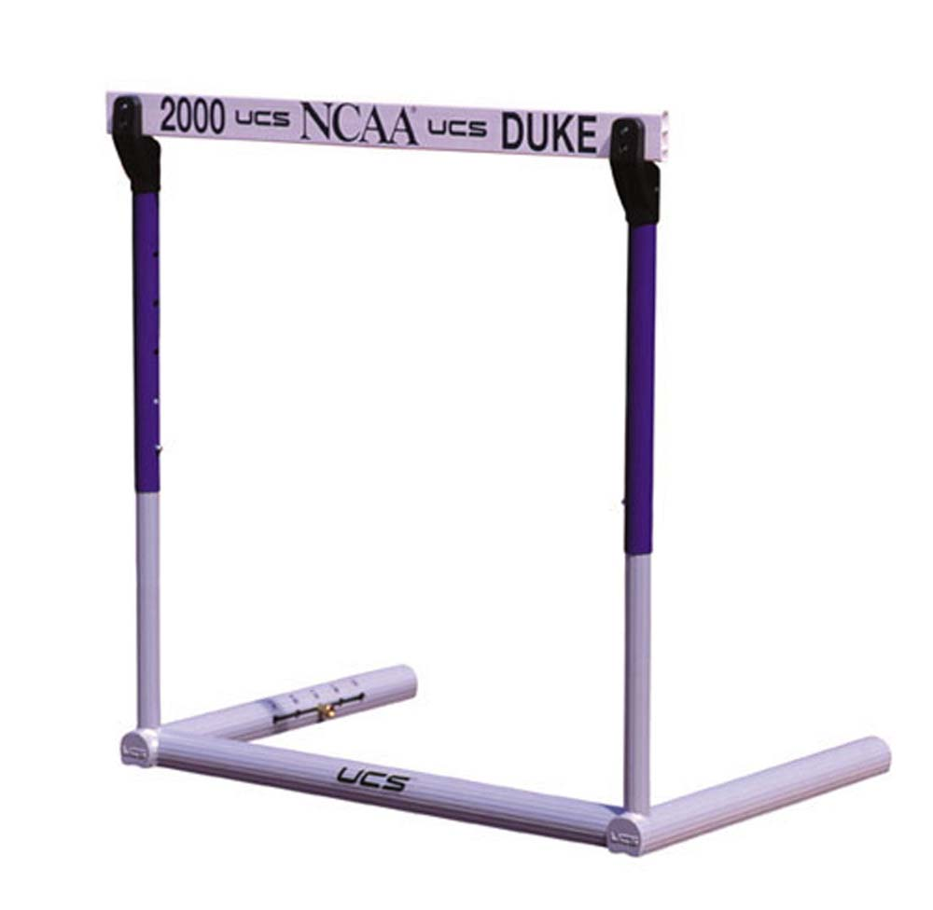
The Top Bar
At least 0.225m
The height of the top bar shall be 70mm ± 5mm.
The thickness of this bar shall be between 10mm and 25mm, and the top edges should be rounded.
The bar shall be firmly fixed at the extremities.
The top bar shall be painted with white and black stripes,
or with other strong distinctive contrasting colours (and also in contrast with the surrounding environment),
such that the lighter stripes, which shall be at least 0.225m wide are on the outside.
It shall be coloured so as to be visible to all sighted athletes.

Slide 8
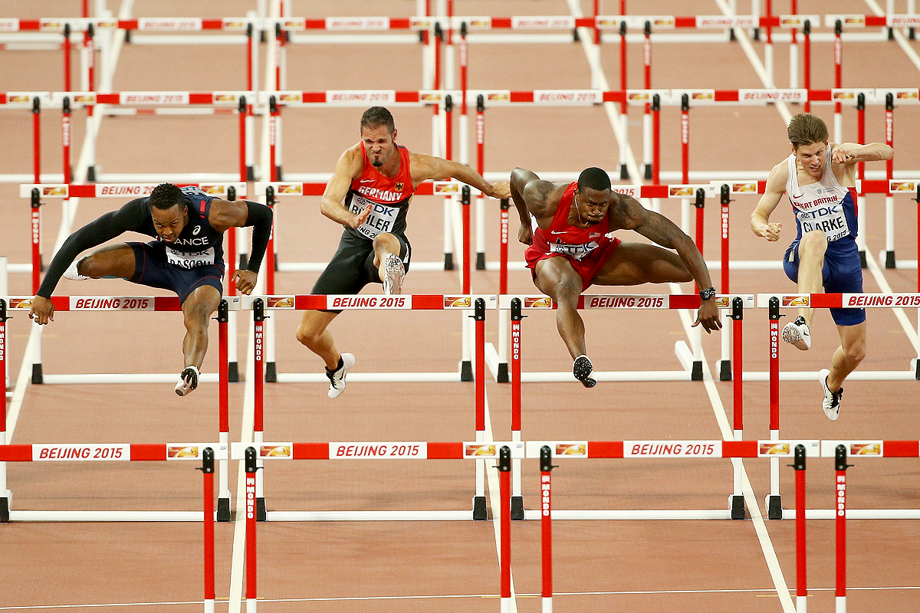
Correct clearance of hurdles
110m Hurdle in Beijing World Athletics Championship (Correct clearance of hurdles)

Slide 9
failures in Hurdle Races
TR22.6 (168.6) - not going over each hurdle
TR22.6.1 (168.7(a)) - trailing leg at hurdle clearance below the horizontal plane of top of hurdle
TR22.6.2 (168.7(b)) - knocking down / displacing a hurdle in an illegal way
TR22.6.3 (168.6) - knocking down / displacing a hurdle in another lane

Slide 10

Disqualification
To avoid disqualification, the athletes shall run in their allotted lanes and each athlete shall go over each hurdle and keep to their own lane throughout.
They will be disqualified if:
their foot or leg is, at the instant of clearance, beside the hurdle (on either side), below the horizontal plane of the top of any hurdle; or
they knock down or displace any hurdle by hand, body or the upper side of the lead leg;
they directly or indirectly knock down or displace a hurdle in their or in another lane in such a manner that there is effect or obstruction upon any other athlete(s) in the race,

Slide 11
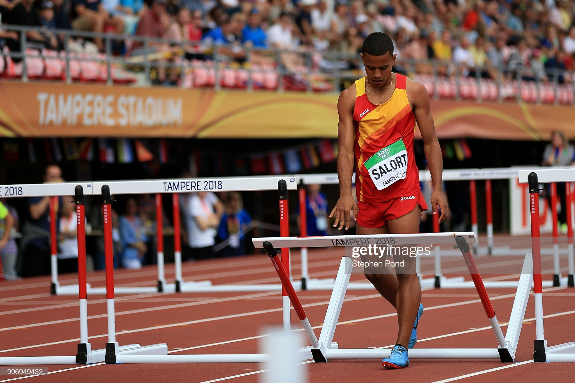
Failure
Knocking down of hurdle by hand (Failure)

Slide 12
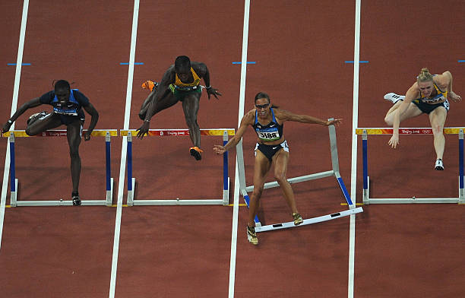
Knocking down of a hurdle by front side of leading foot during the race (Failure)
Failure

Slide 13
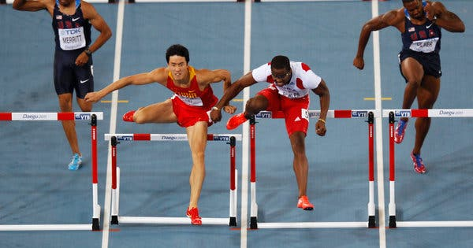
Failure
Obstruction during hurdle race (Failure)

Slide 14
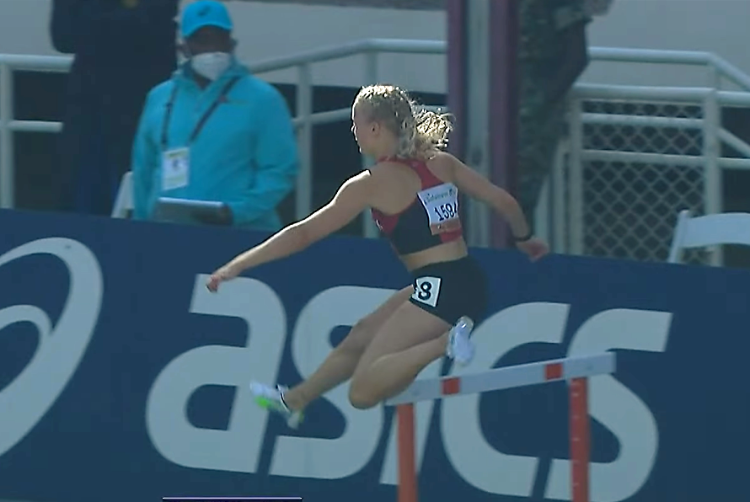
Failure
Trailing leg below the horizontal plane of top bar (Failure)

Slide 15
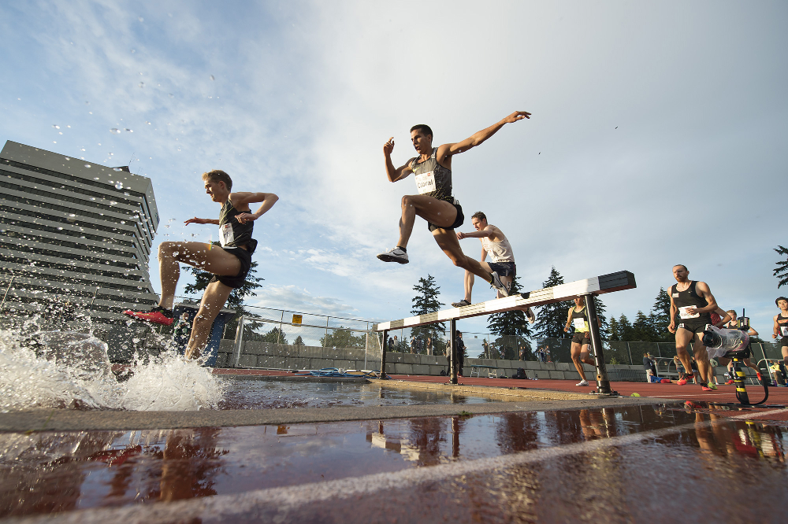
Steeplechase Races

Slide 16
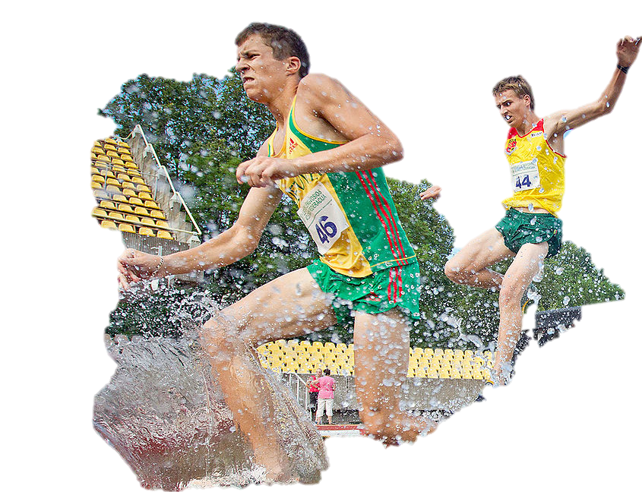
Steeplechase Races
The standard distances shall be: 2000m and 3000m.
For the 3000m event, there shall be 28 hurdle jumps and 7 water jumps.
The distance from the start to the beginning of the first lap shall not include any jumps, the hurdles being removed until the athletes have entered the first lap.
For the steeplechase events, there shall be five jumps in a complete lap, with the water jump as the fourth.
The jumps should be evenly distributed, so that the distance between the jumps shall be approximately one fifth of the nominal length of the lap.

Slide 17
2000m Steeplechase
For the 2000m event:
There shall be 18 hurdle jumps and 5 water jumps.
The first jump is at the third hurdle of a lap.
The previous hurdles shall be removed until the athletes have passed them for the first time.
Note: In the 2000m event, if the water jump is on the inside of the track, the finish line has to be passed twice before the first complete lap with five jumps.
In national level competitions, this event is held for U18 Boys and U18 Girls.
The height of the hurdle for U18 Boys is 0.838m and for U18 Girls is 0.762m.

Slide 18
The Top Bar
The top bars shall be made of wood or other suitable material.
It shall be painted with white and black stripes, or with other distinctive contrasting colours (and also in contrast with the surrounding environment),
The lighter stripes, which should be at least 0.225m wide, are on the outside and shall be coloured so as to be visible to all sighted athletes.
The hurdle shall be placed on the track so that at least 0.30m of the top bar will extend inside the inner edge of the track.

Slide 19
Height of the top bar of Steeplechase Hurdle
The height of the hurdle in all categories of women events is 0.762m.
In Men, U23 Men and U20M, the height of the hurdle is 0.914m and the event is 3000m steeplechase.
In U18 Boys, the height of the hurdle is 0.838m and the event is 2000m steeplechase.

Slide 20
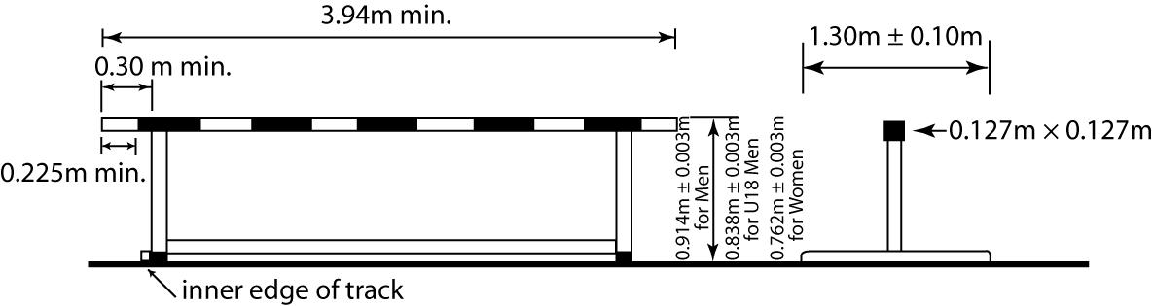
Construction of a steeplechase Hurdle
Weight of the hurdle should be between 80 Kg to 100kg

Slide 21
The Water Jump
The water jump, including the hurdle, shall be 3.66m ± 0.02m in length and the water pit shall be 3.66m ± 0.02m in width.
The bottom of the water pit shall consist of a synthetic surface, or matting, of sufficient thickness to ensure safe landing, and allow for the spikes to grip satisfactorily.
The depth of the water closest to the hurdle shall be 0.50m ± 0.05m for approximately 1.20m.
From there, the bottom shall have a uniform slope upwards to the level of the track at the farther end of the water pit.
At the start of a race, the surface of the water shall be level with the surface of the track within a margin of 20mm

Slide 22
Construction of Water Jump

Slide 23
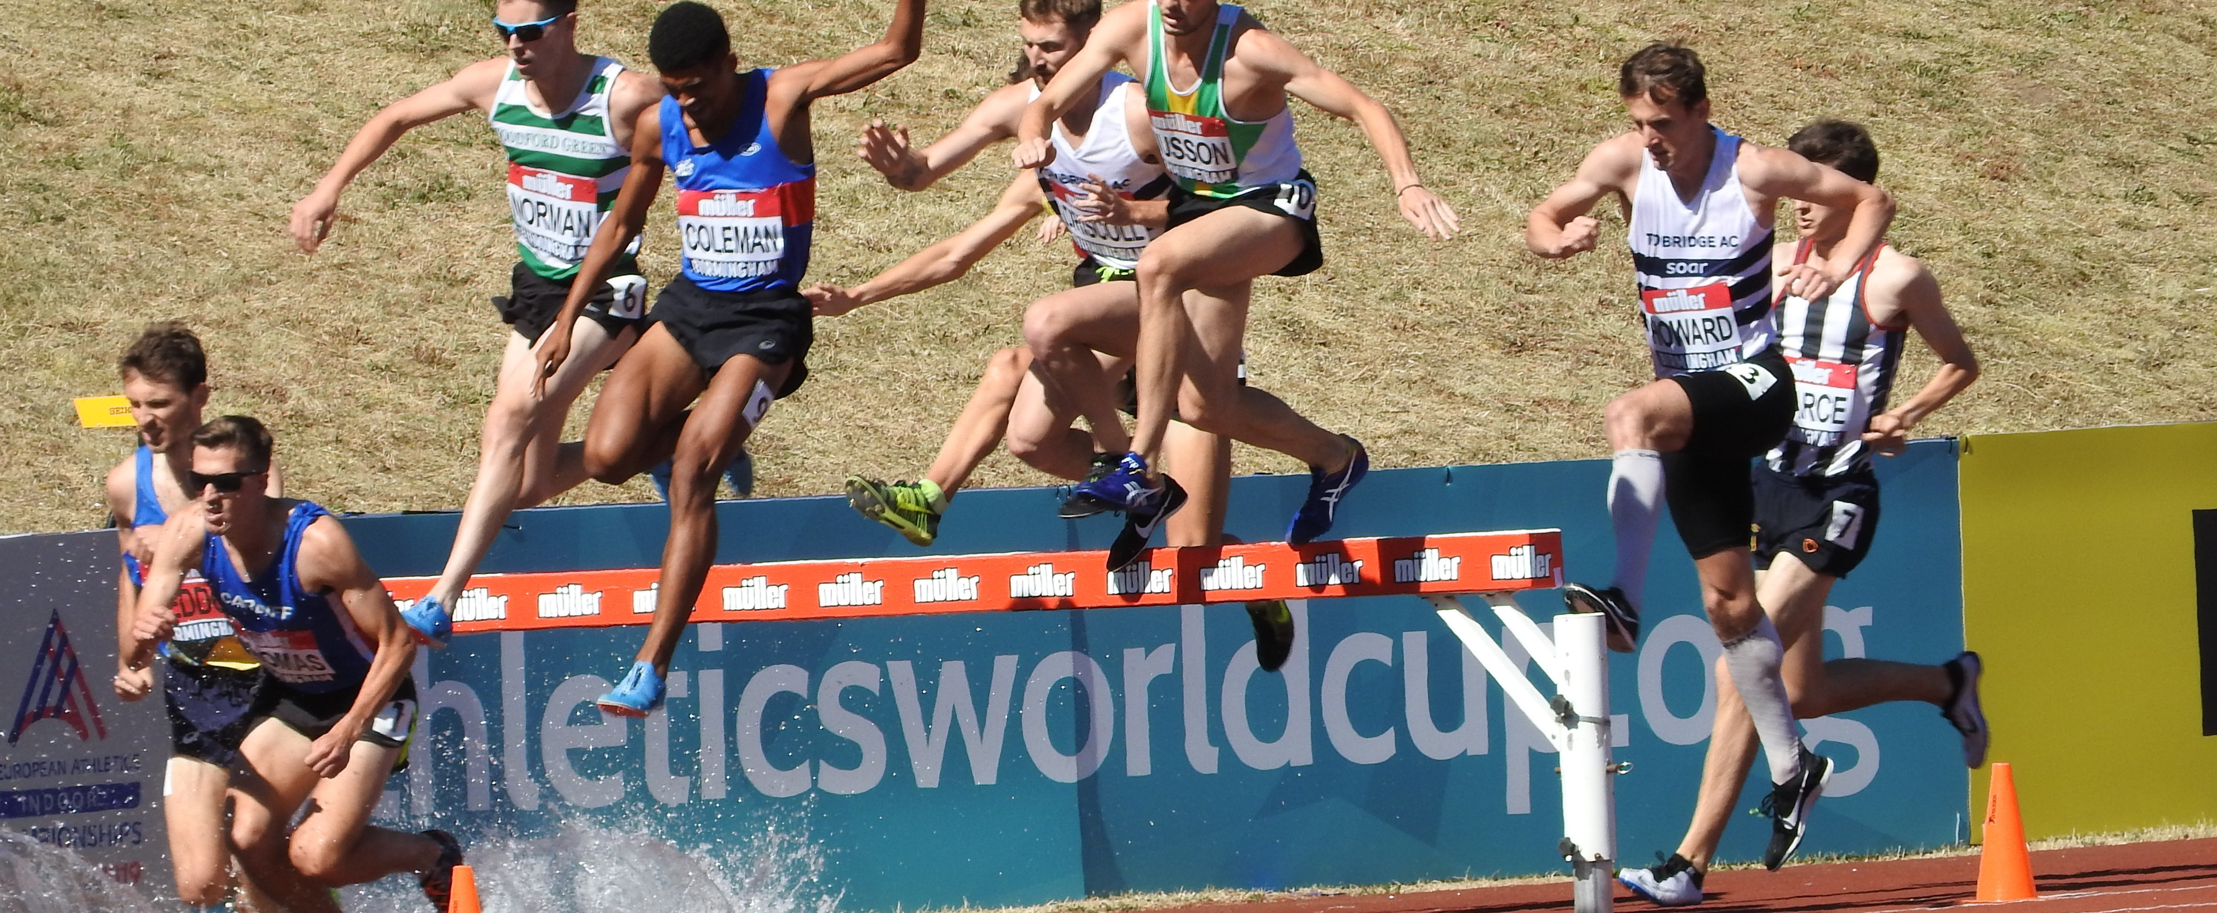
The Race in Progress- Correct Clearance of Water Jump
Clearance of Water Jump

Slide 24
failures in Steeple Chase
TR23.7.1 (169.7(a)) - Stepping beside the water jump
TR23.7.2 (169.7(b)) - Trailing leg at hurdle clearance below the horizontal
plane of the top of hurdle

Slide 25
Disqualification
Each athlete shall go over or through the water and shall go over each hurdle.
Failure to do so will result in a disqualification.
In addition, an athlete shall be disqualified, if:
They step to one side or other of the water jump, or
Their foot or leg is, at the instant of clearance, beside the hurdle (on either side), below the horizontal plane of the top of any hurdle.

Slide 26
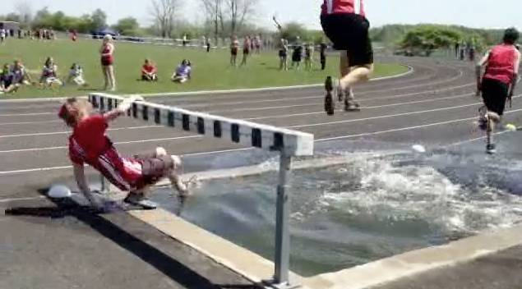
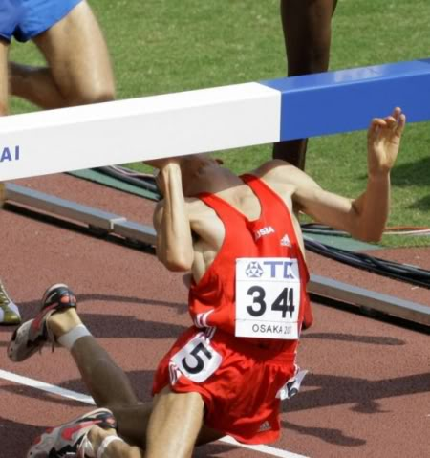
Non Clearance of hurdle (Failure)
Failure

Slide 27
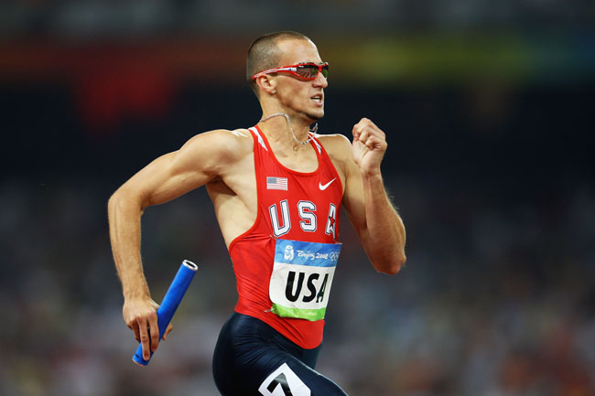
RELAY Races

Slide 28
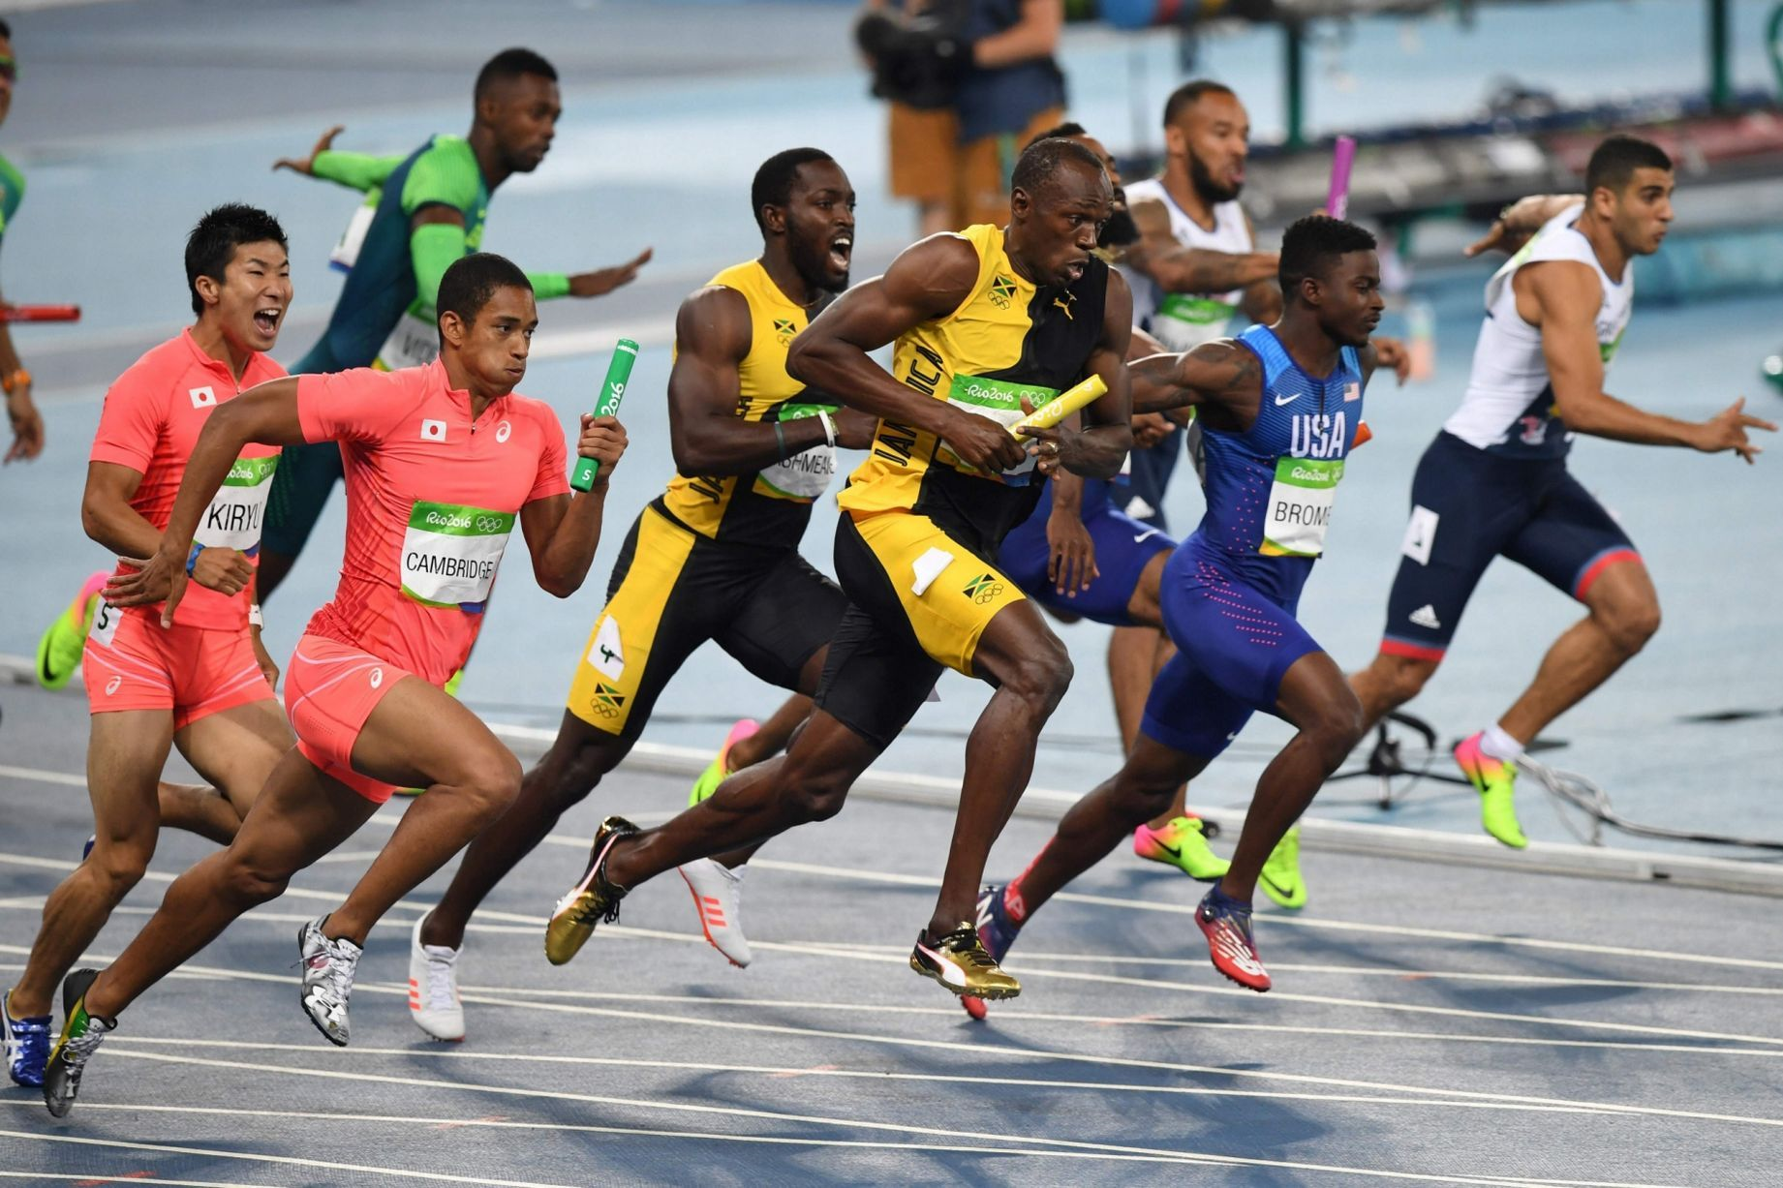
4 X 100M, 4 X 400M, 4 X 400M Mixed and Medley Relay Races
Lines 50mm wide shall be drawn across the track to mark the start of each leg distance (scratch line).
In the 4 x 100m ,and for the first and second changes in the Medley Relay, each takeover zone shall be 30m long, of which the scratch line is 20m from the start of the zone.
For the third change in the Medley Relay and in the 4 x 400m and longer relays each takeover zone shall be 20m long of which the scratch line is the centre.
The zones shall start and finish at the edges of the zone nearest the start line in the running direction.
For each takeover conducted in lanes, a designated official shall ensure that the athletes are correctly placed in their takeover zone.

Slide 29
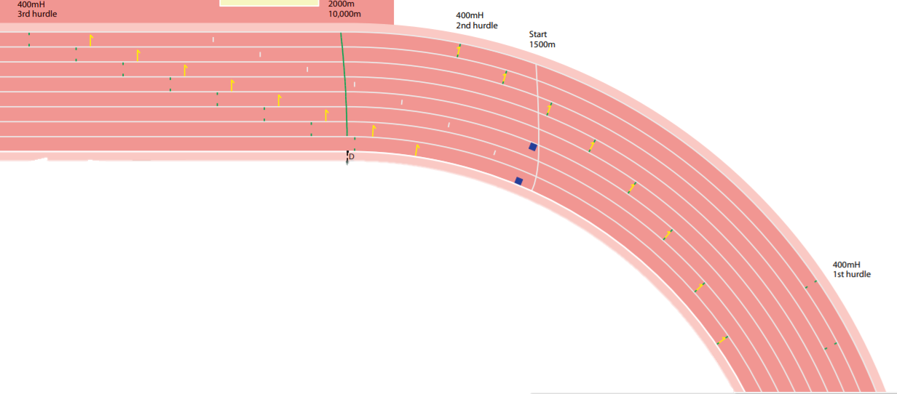
1st Exchange zone of
4 x 100m Relay Race

Slide 30
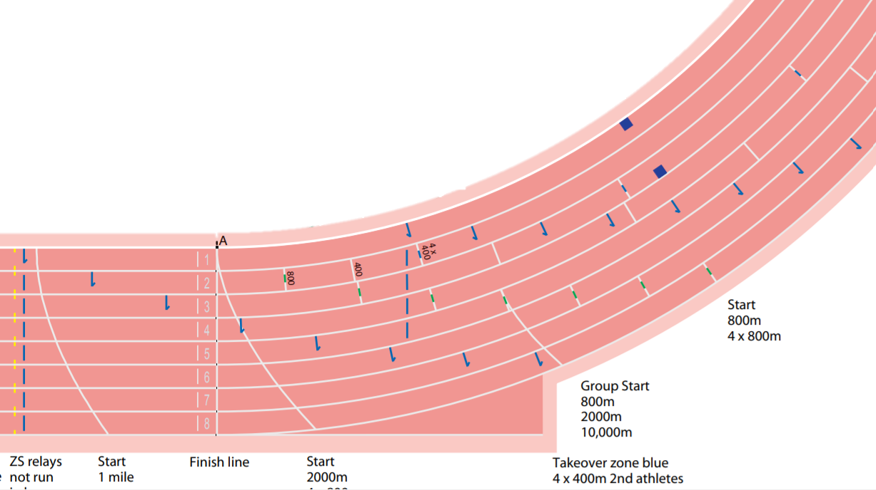
1st Exchange zone of
4 x 400m Relay Race

Slide 31

The Check Marks
When all or the first portion of a Relay Race is being run in lanes, an athlete may place one check-mark on the track within their own lane, by using adhesive tape, maximum 0.05m × 0.40m, of a distinctive colour which cannot be confused with other permanent markings.
8 checkmarks
each 0.05 X 0.40m
(image not to scale)
Checkmarks for red coloured synthetic track to be supplied by Call Room or Zone Umpires and suitable for 4x100m

Slide 32
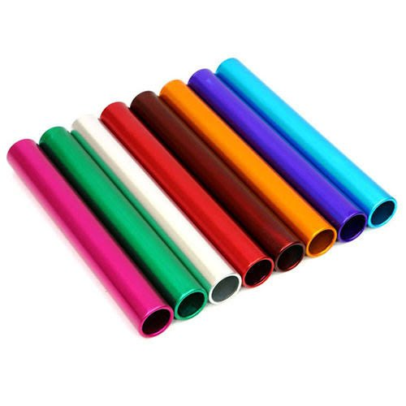
The Relay Baton
The relay baton shall be a smooth hollow tube, circular in section, made of wood, metal or any other rigid material in one piece, the length of which shall be 0.28m to 0.30m. Weight of the baton shall not be less than 50g.The outside diameter shall be 40mm±2mm
Athletes are not permitted to wear gloves or to place material or substances on their hands in order to obtain a better grip of the baton.

Slide 33
failures in Relay Races
TR24.6.1 (170.6(a)) - running without the baton / finishing the race without the baton
TR24.6.2 (170.6(b)) - fault at carrying the baton (e.g. using gloves or substances on hand)
TR24.6.3 (170.6(c)) - fault at recovering a dropped baton
TR24.7 (170.7) - passing the baton outside the takeover zone (early / late takeover)
TR24.8 (170.8) - infringement of TR17.3. (Rule 163.3) / impediment at takeover
TR24.9 (170.9) - taking the baton from another team
TR24.10 (170.10) - running more than one leg / using more than four substitutes
Continued…

Slide 34
failures in Relay Races
TR24.11 (170.11) - late confirmation / changing team composition and/or running order
TR24.13 (170.13) - leaving the assigned lane before the break line.
TR24.14 (170.14) - leaving the assigned lane early before the break line
TR24.15 (170.15 - leaving the assigned lane early before the break line
TR24.16.1 (170.16(a)) - leaving the assigned lane early before the break line
TR24.19 (170.19) - starting outside the takeover zone
TR24.20 (170.20) - exchanging positions before takeover (Medley, 4 × 400m)
TR24.21 (170.21) - jostling / obstruction at takeover

Slide 35
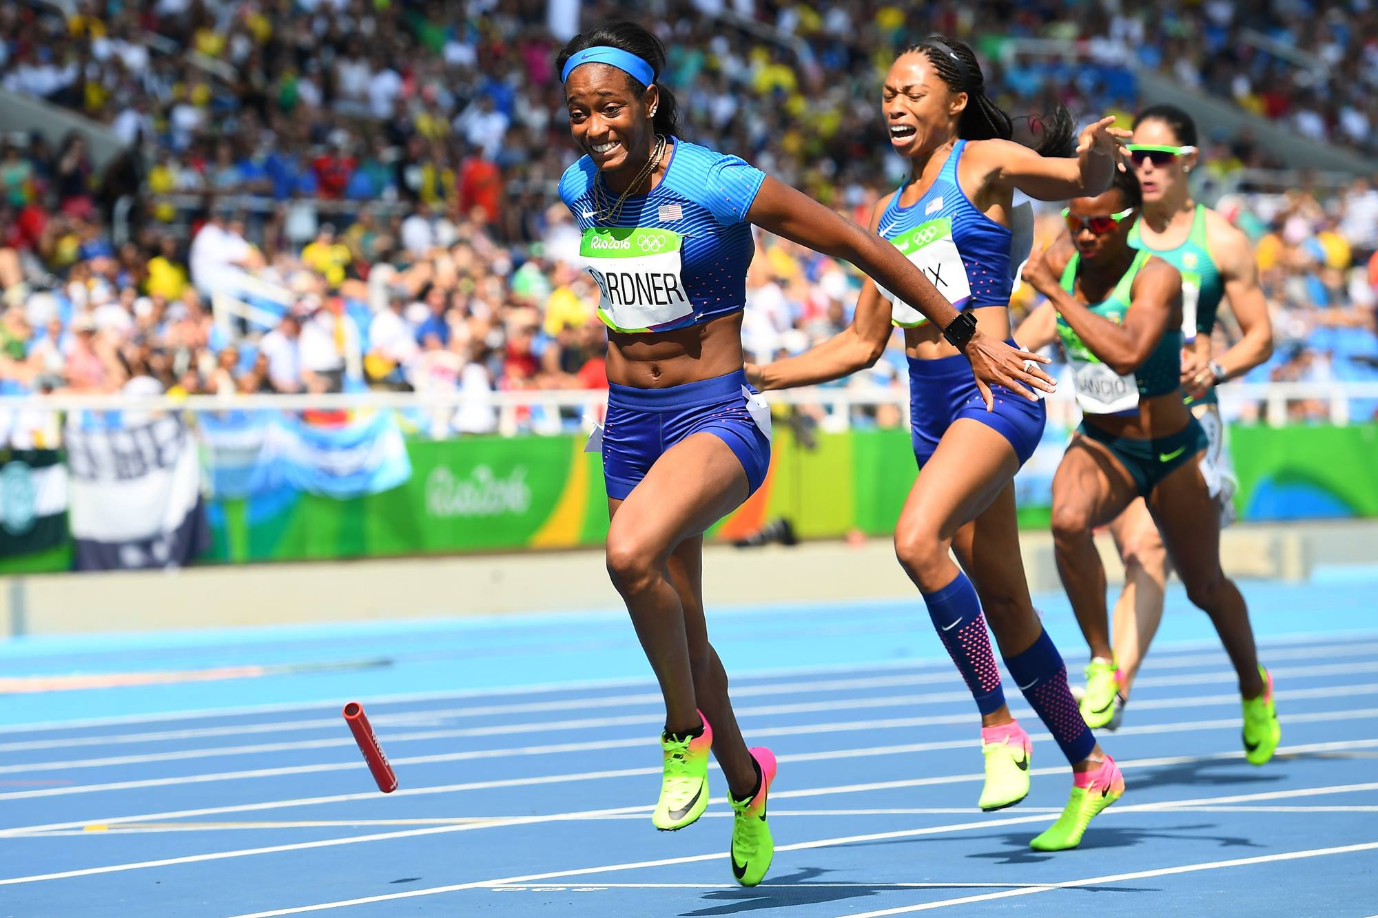
Retrieving of Baton
(Allowed)
If dropped, the baton shall be recovered by the athlete who dropped it.
They may leave their lane to retrieve it provided that, by doing so, they do not lessen the distance to be covered.
In addition, where the baton is dropped in such a way that it moves sideways or forward in the direction of the athlete who dropped it, after retrieving it, must return at least to the point where it was last in their hand, before continuing in the race.
Provided these procedures are adopted where applicable and no other athlete is impeded, dropping the baton shall not result in disqualification.
If an athlete does not follow this Rule, their team shall be disqualified.

Slide 36
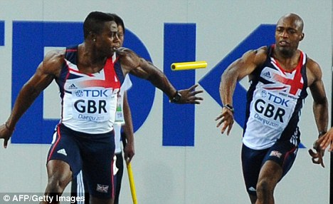
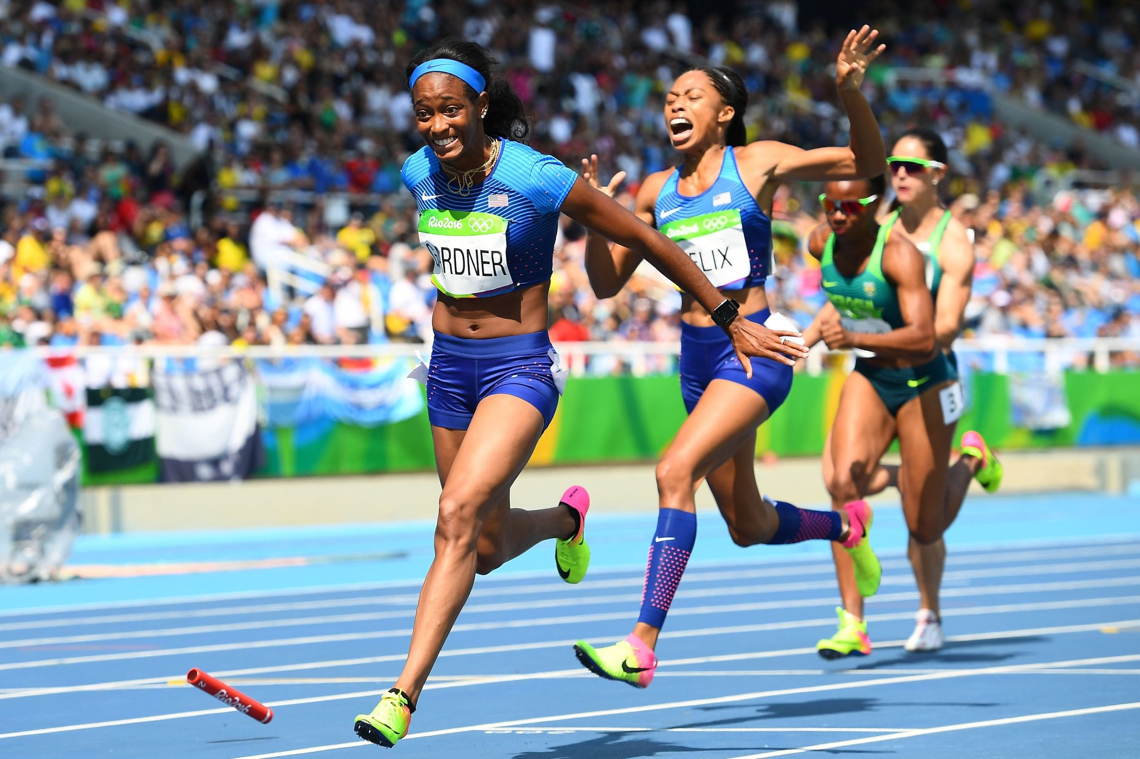

Slide 37
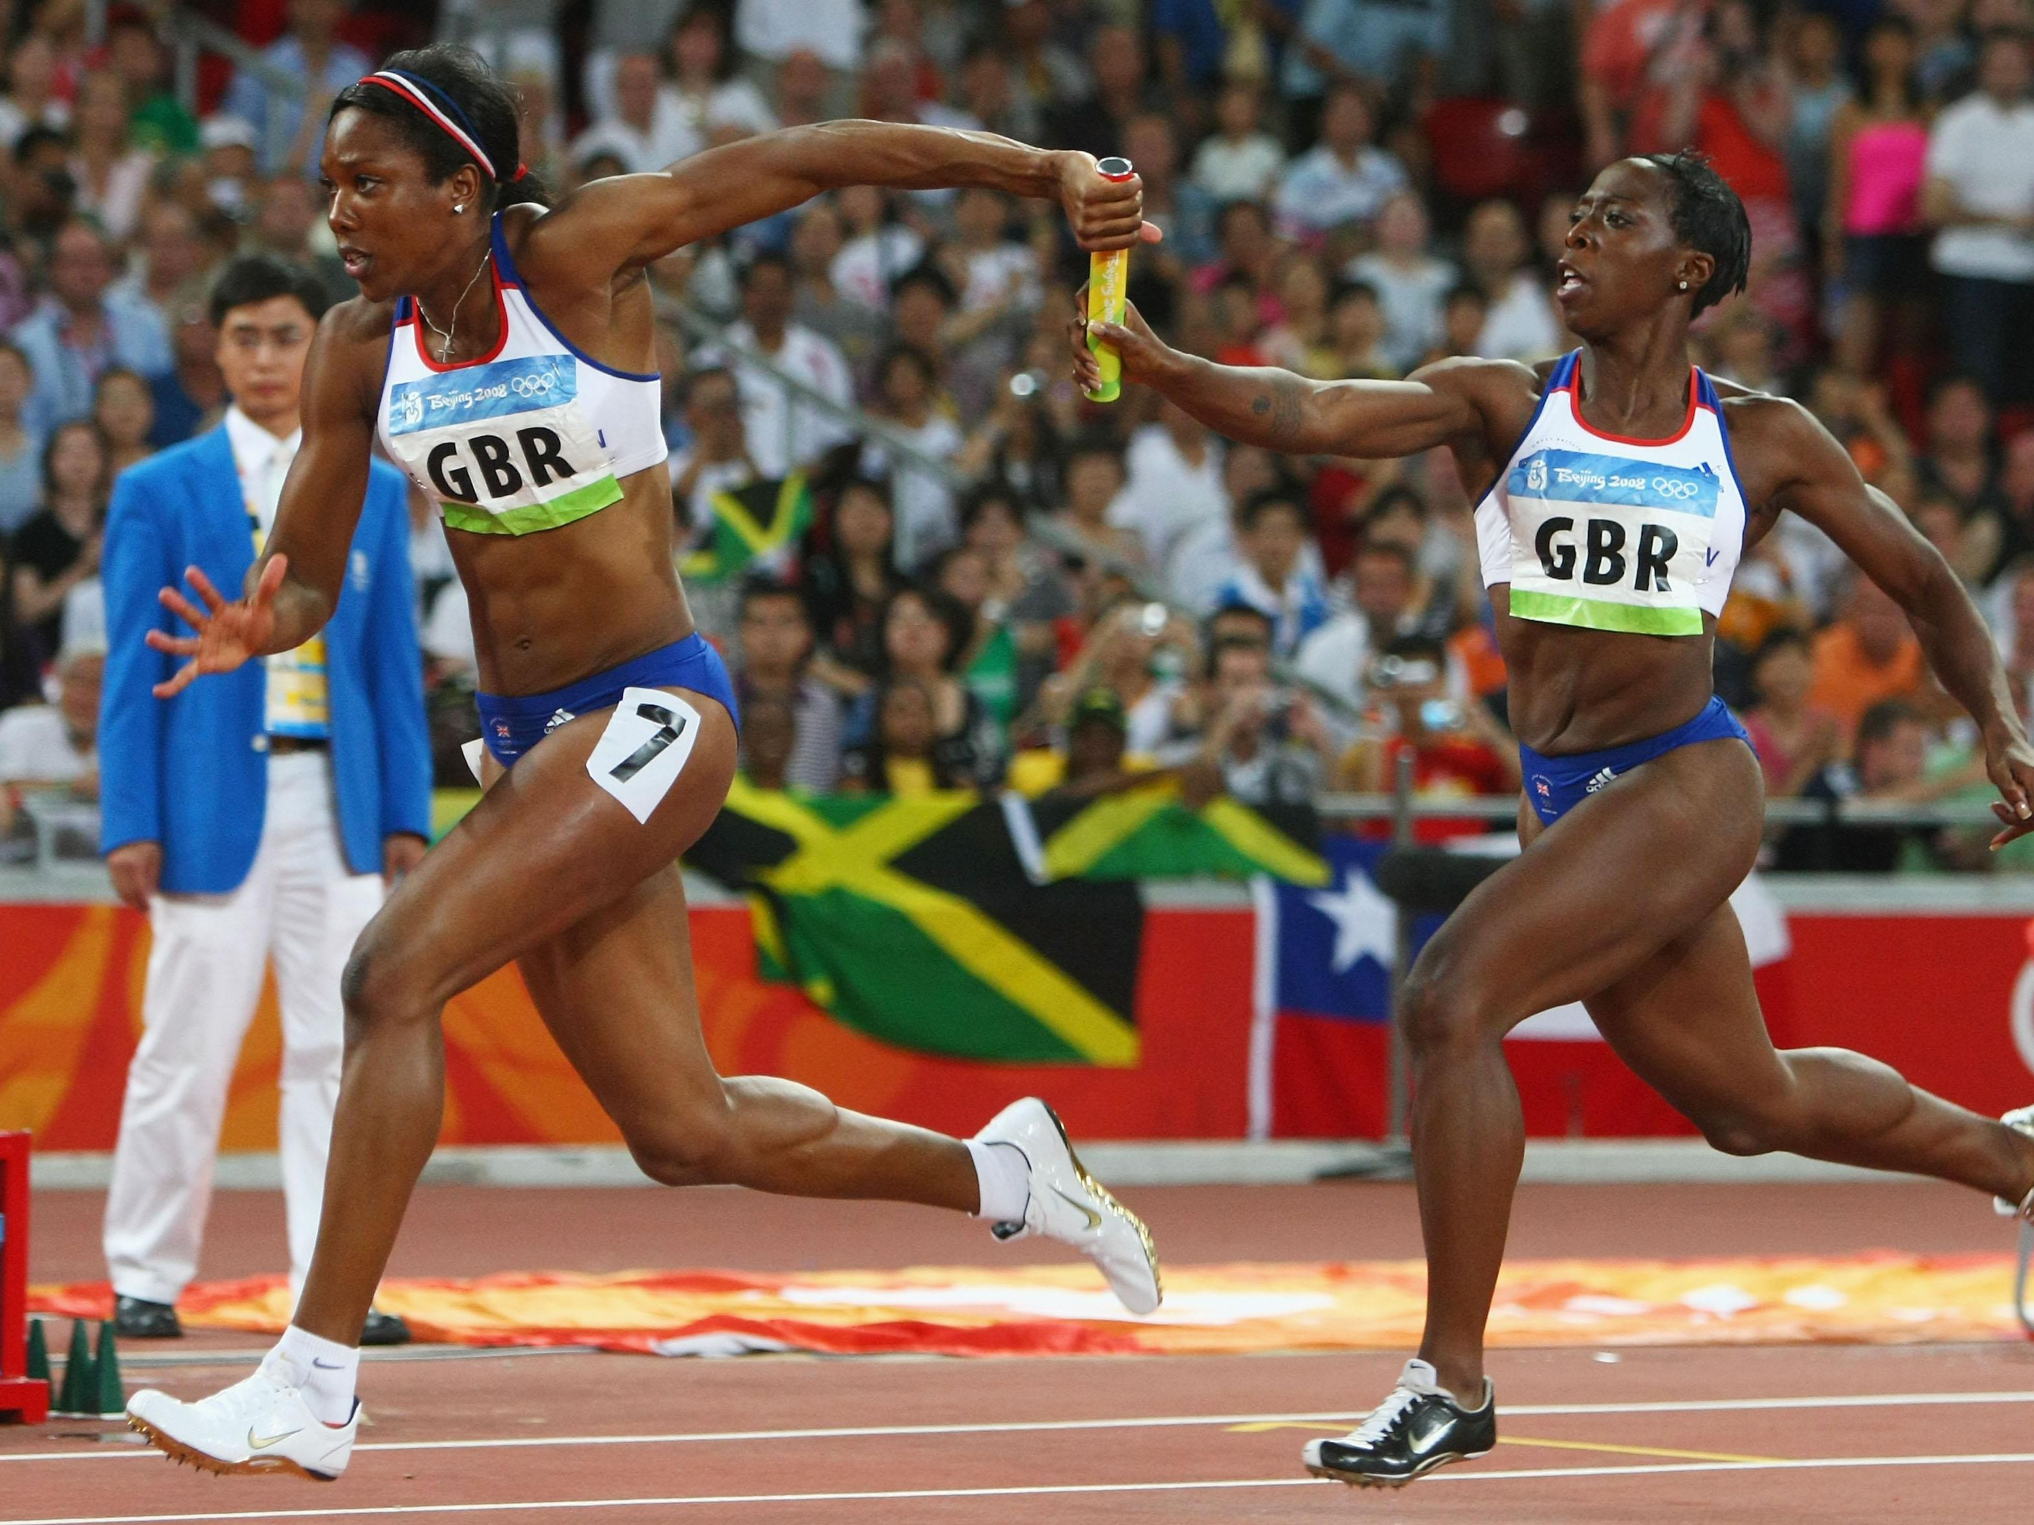
Passing of the baton
The baton shall be passed within the takeover zone.
The passing of the baton commences when it is first touched by the receiving athlete and;
It is completed the moment it is in the hand of only the receiving athlete.
In relation to the takeover zone, it is only the position of the baton which is decisive. Passing of the baton outside the takeover zone shall result in disqualification.

Slide 38
Laned or Non-Laned Race
The 4 × 100m race shall be run entirely in lanes.
The Medley Relay race should be run in lanes for the first two legs, as well as that part of the third leg up to the nearer edge of the break line ,where athletes may leave their respective lanes (two bends in lanes).
Medley relay is included in U16(Boys & Girls)and U18 (Boys & Girls) in AFI National Level Competitions.
The 4 ×400m shall be run in lanes for the first leg, as well as that part of the second leg up to the nearer edge of the brea kline, where athletes may leave their respective lanes.
When less than 4 teams are participating in 4 ×400m,in lanes for the first leg up to the nearer edge of the break line, where athletes may leave their respective lanes (one bend in lanes).

Slide 39
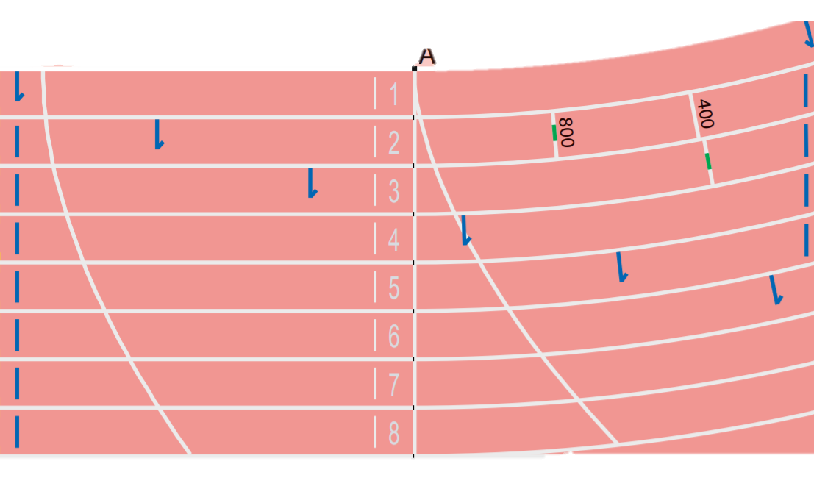
2nd and 3rd exchange zone of 4x400m Relay Race

Slide 40
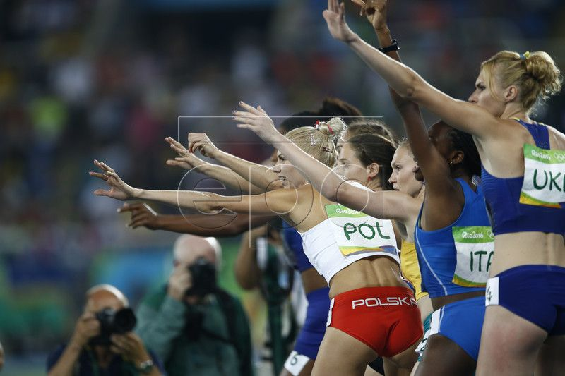
2nd and 3rd Exchange in 4×400m
In the 4 × 400m race, the athletes running the third and fourth legs shall, under the direction of a designated official, place themselves in their waiting position in the same order (inside to out) as the order of their respective team members as they enter the last bend.
Once the incoming athletes have passed this point, the waiting athletes shall maintain their order, and shall not exchange positions at the beginning of the takeover zone. If an athlete does not follow this Rule, their team shall be disqualified.

Slide 41
Thanks for Watching
Questions from you will be highly appreciated

