Slide 1
VERTICAL JUMPS
Prepared by
Dr. J. GLORY DARLING MARGARET

Slide 2
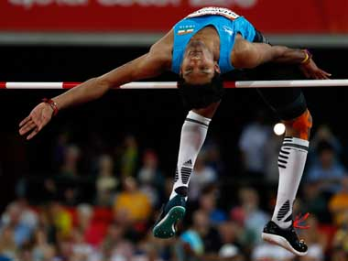
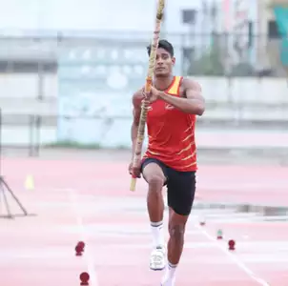
VERTICAL JUMPS
VERTICAL JUMPS
RULES & INTERPRETATION
HIGH JUMP
POLE VAULT
Tejaswin Shankar
Rakesh Gond

Slide 3
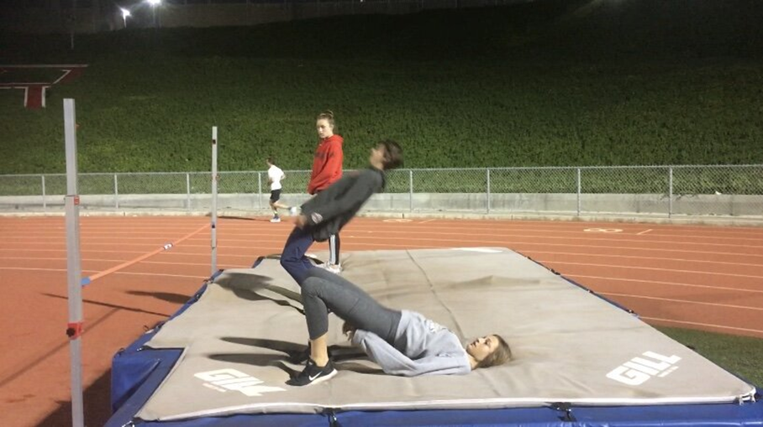
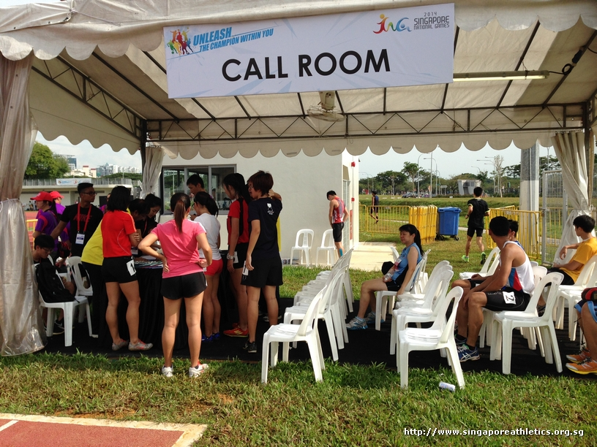
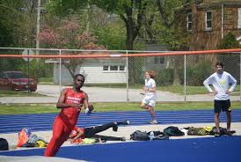
FLOW OF PARTICIPATION
Warm up call room Field of play

Slide 4
VERTICAL JUMPS
GENERAL CONDITIONS
TRIALS
HEIGHT MEASUREMENT
CROSS BAR
PLACINGS
TIE- JUMP OFF
SCORE SHEET & RESULT CARD

Slide 5
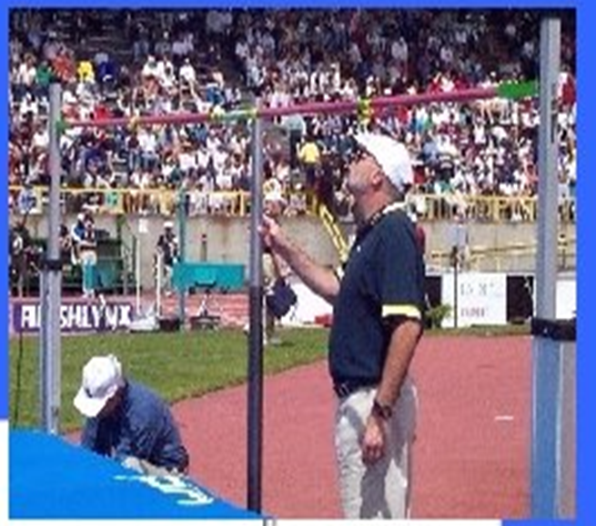
VERTICAL JUMPS –
GENERAL CONDITIONS
Before the competition begins, Referee or the Chief Judge shall:
announce to the athletes the starting height & subsequent heights to which the bar will be raised at the end of each round of trials, until there is only one athlete remaining and has won the competition or there is the tie for first place.

Slide 6
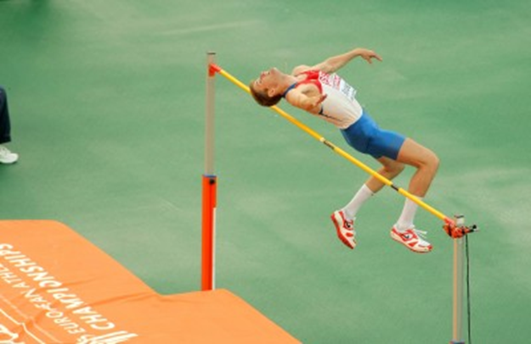
VERTICAL JUMP - TRAIL
Trail
3 attempts each height
Jump / vault at any height
‘Pass’, -athlete may pass their second or third trial at a particular height (after failing first or second time) and still jump / vault at a subsequent height.
If an athlete passes a trial at a certain height, they may not make any subsequent trial at that height, except in the case of a jump-off for first place.
even after all the other athletes have failed, an athlete is entitled to continue jumping until they have forfeited their right to compete further.( until 3 continuous failure )

Slide 7
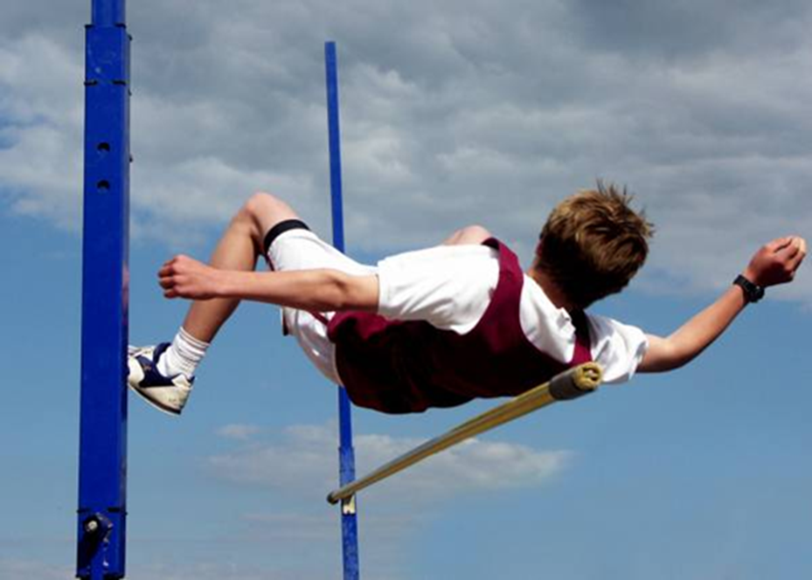
TRIAL - DISQUALIFICATION
Three consecutive failures regardless of the height at which any of such failures occur, leads to disqualification from further jumping or vaulting (except in the case of a tie for first place.)

Slide 8
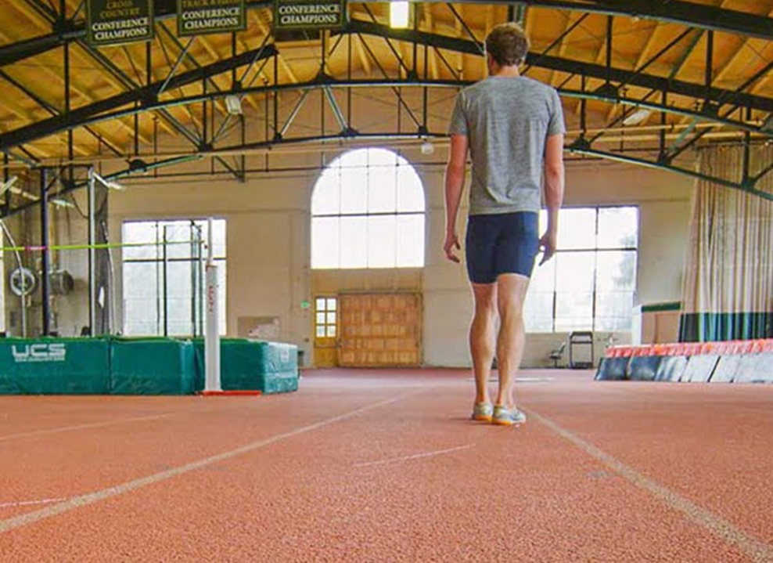
ABANDONED THE COMPETITION
In the case of the High Jump and Pole vault, if an athlete is not present when all other athletes who are present have completed the competition, the Referee shall deem that such athlete(s) has abandoned the competition, once the period for one further trial has elapsed.

Slide 9
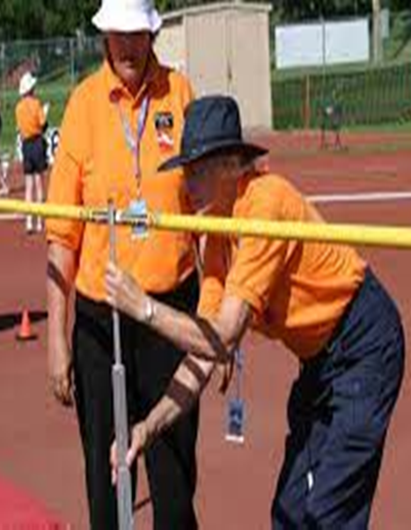
VERTICAL JUMP- RAISING THE BAR
After each round of trials the bar shall be raised by
2cm minimum - High Jump
5cm minimum - Pole Vault
Combined events - uniformly
3cm – High Jump
10 cm – Pole vault
After an athlete has won the competition
heights to which the bar is raised shall be decided by the athlete, in consultation with the relevant Judge or Referee.
(This rule does NOT apply for Combined Events Competition ).

Slide 10
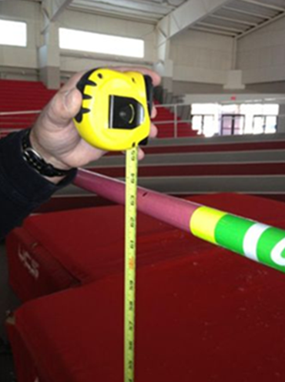
HEIGHT MEASUREMENT
In all vertical jumping events, measurements shall be made,
in whole centimeters, perpendicularly from the ground to the lowest part of the upper side of the bar.
Any measurement of a new height shall be made before athletes attempt such height. A re-measurement should be made if the bar has been substituted.
In all cases of Records, the Judges shall also re-check the measurement before each subsequent Record attempt if the bar has been touched since last measured

Slide 11
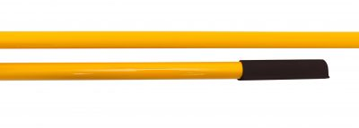
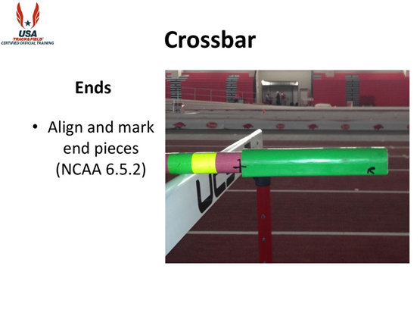
CROSSBAR
The crossbar shall be made of fiber-glass, or other suitable material but not metal, circular in cross-section except for the end pieces. It shall be colored so as to be visible to all sighted athletes.
The overall length of the crossbar
High Jump - 4.00m ± 0.02m ( 3.98- 4.02 m )
Pole vault - 4.50m ± 0.02m in. (4.48- 4.52 m)
Weight of the crossbar
The maximum shall be
High Jump- 2kg
Pole vault- 2.25kg
Ends – Align and mark end pieces

Slide 12
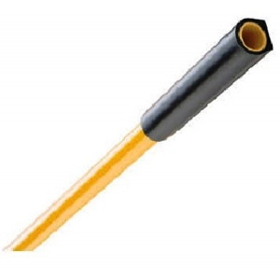
CROSS BAR
The diameter of the circular part of the crossbar shall be 30mm ± 1mm.
The crossbar shall consist of three parts –
the circular bar
and two end pieces, each 30mm-35mm wide and 0.15m- 0.20m long for the purpose of resting on the supports of the uprights.
These end pieces shall be circular or semi-circular with one clearly defined flat surface on which the bar rests on the crossbar supports. This flat surface may not be higher than the centre of the vertical cross section of the crossbar. The end pieces shall be hard and smooth

Slide 13

PLACINGS
The procedure to decide the place, when 2 or more athletes clear same final height
Athletes with less failures at the tied height , awarded higher place.
If equal, then the Athlete with lowest total number of failures throughout the competition including height last cleared shall be awarded higher place.
If still equal , same place shall be awarded same place unless it concerns the first place.

Slide 14
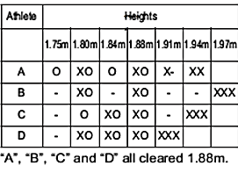
VERTICAL JUMP- TIE BREAK
Heights shall be announced by the chief judge at the beginning of the competition
Step – 1
Athletes with less failures at the tied height (1.88 m ) , awarded highest place

Slide 15
VERTICAL JUMP- TIE BREAK
TOTAL
Step -2
If equal , total number of failures throughout the competition including height last cleared (1.88ss m)

Slide 16
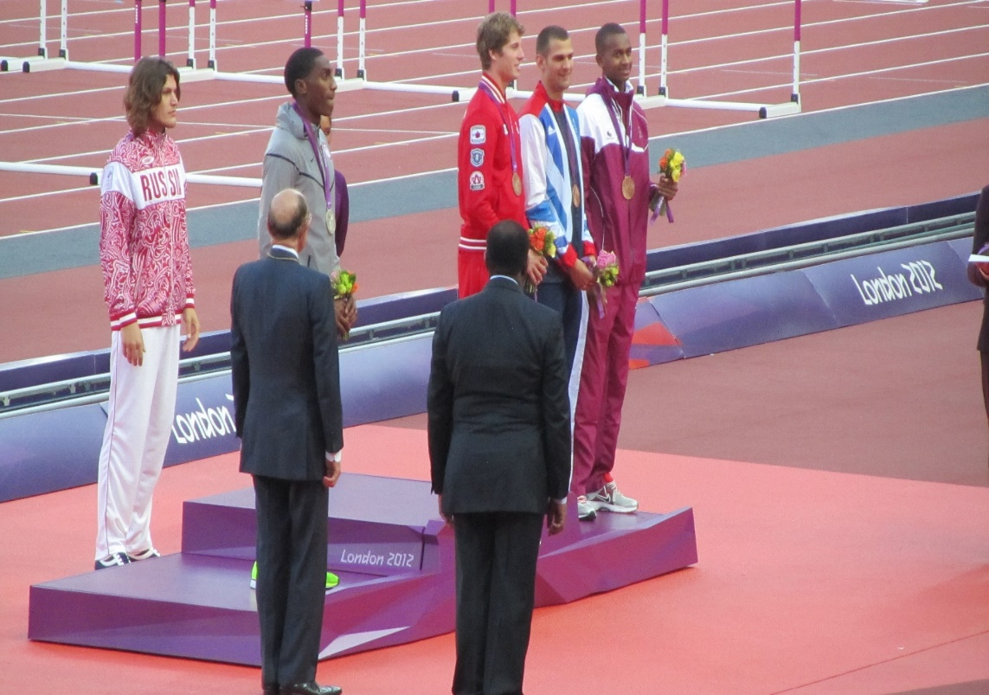
VERTICAL JUMP- TIE BREAK
STEP - 3
If still equal , same place shall be awarded unless it concerns the first place
For FIRST PLACE – JUMP OFF
Athletics at the 2012 Summer Olympics – Men's high jump

Slide 17
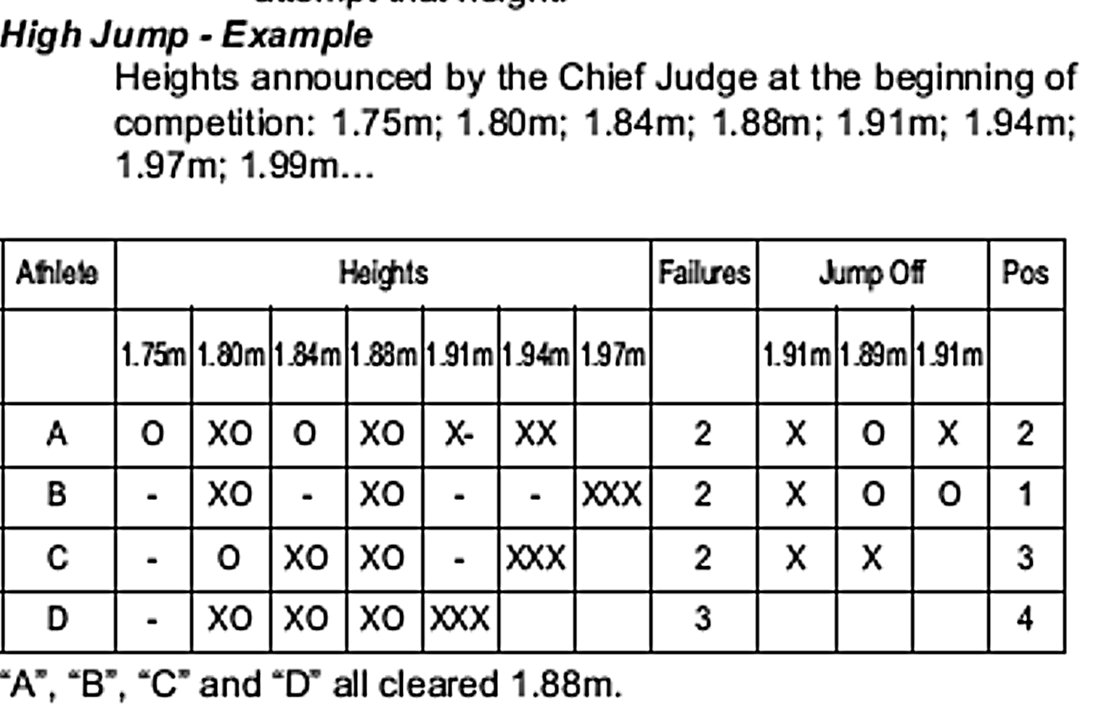
JUMP OFF
For FIRST PLACE – JUMP OFF
If jump off is accepted by the athletes concerned ,
Athletes concerned must jump until tie resolves or decide not to jump further
Each athlete shall have one jump at each height ( all cleared 1.88 m so one jump at 1.91 m)
Raise bar if cleared & lower the bar if failed by 2cm for High jump and 5 cm for pole vault
If an athlete is not jumping , automatically forfeit claim for first place
“A “ failed in 1.91 m – so 2nd Place
“D” did not take attempt – so 4th PLACE
“B “ CLEARED in 1.91 m – so 1st Place
“C’ Failed in 1.89 m – so 3rd PLACE

Slide 18

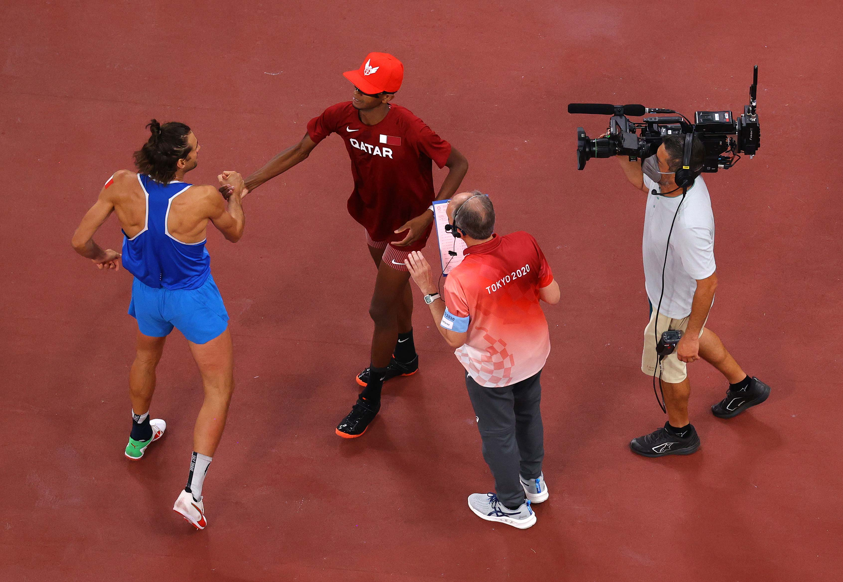
TERMINATING THE JUMP OFF
By provision in advance of the competition set out in the regulations.
Decision by TD (or Referee if there is no TD) during competition.
Decision by the athletes not to jump further prior to or at any stage of competition.
Mutaz Essa Barshim of Qatar
Gianmarco Tamberi of Italy

Slide 19
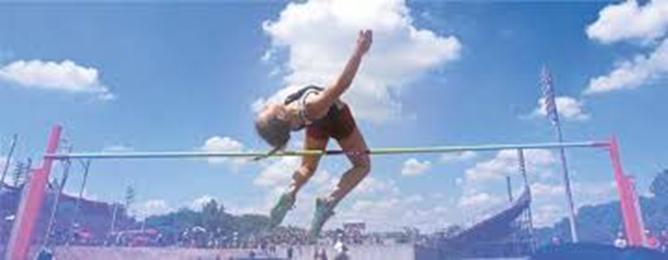
Extraneous Forces
When it is clear that the bar has been displaced by a force not associated with an athlete (e.g. a gust of wind)
if such displacement occurs after an athlete has cleared the bar without touching it, then the trial shall be considered successful,
if such displacement occurs under any other circumstance, a new trial shall be awarded

Slide 20
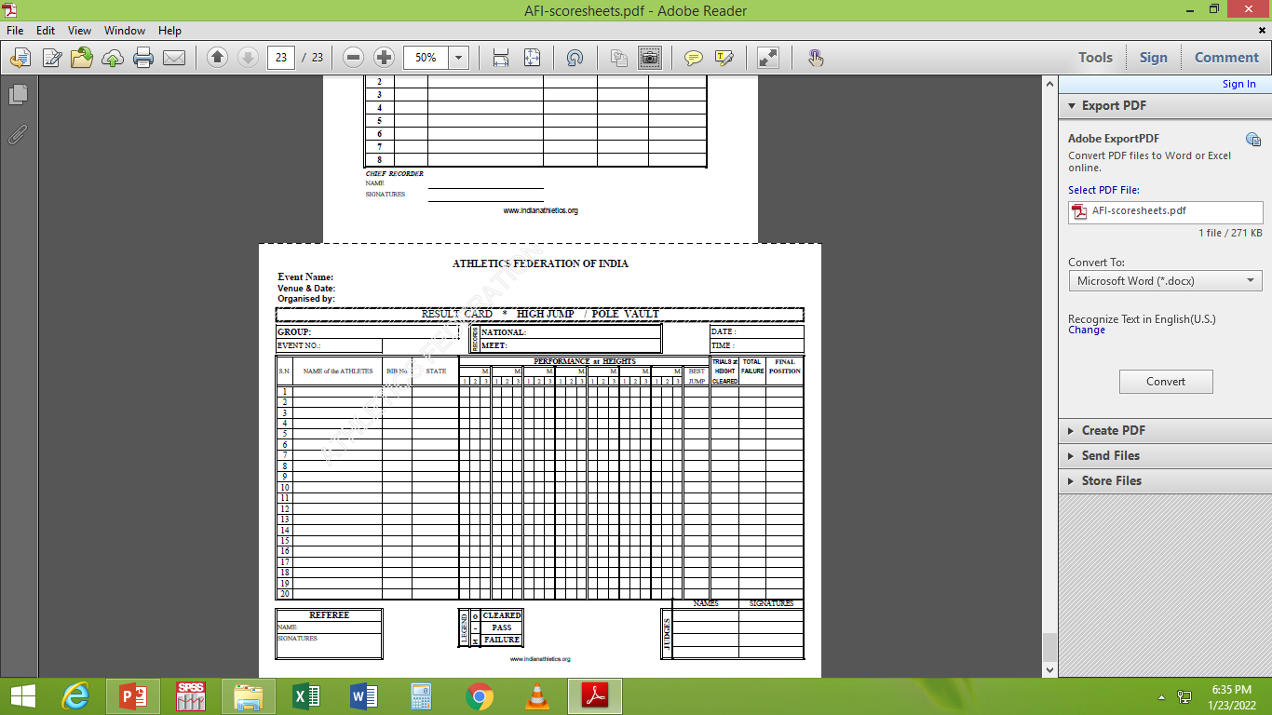
SCORE SHEET – VERTICAL JUMP

Slide 21
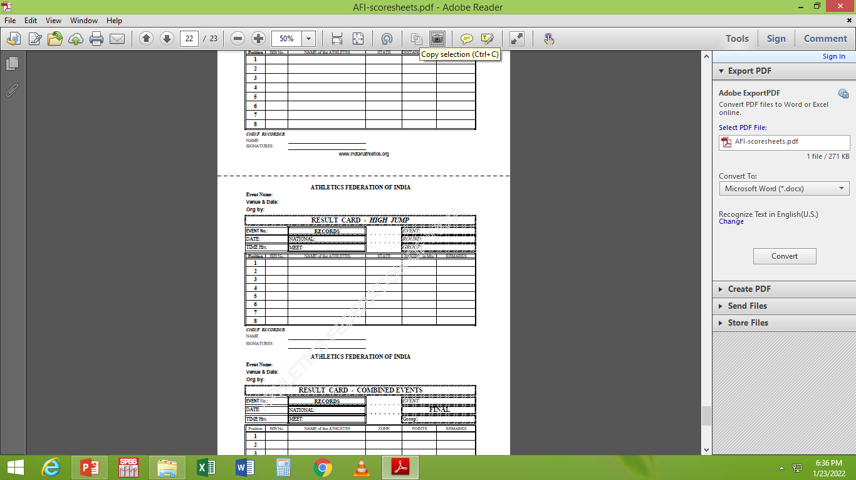
RESULT CARD – VERTICAL JUMP

Slide 22
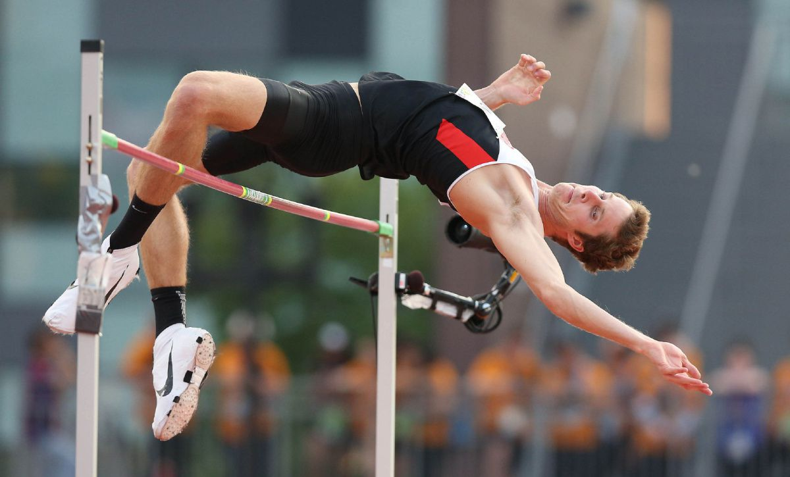
HIGH JUMP
    RUNWAY AND TAKE-OFF AREA
    APPARATUS
    LANDING AREA
    FAILURES

Slide 23
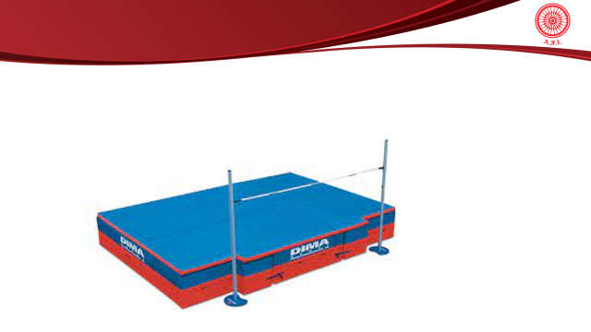
RUNWAY – HIGH JUMP
Minimum width of the runway - 16m
Minimum length - 15m
International Competition
Minimum length - 25m.

Slide 24
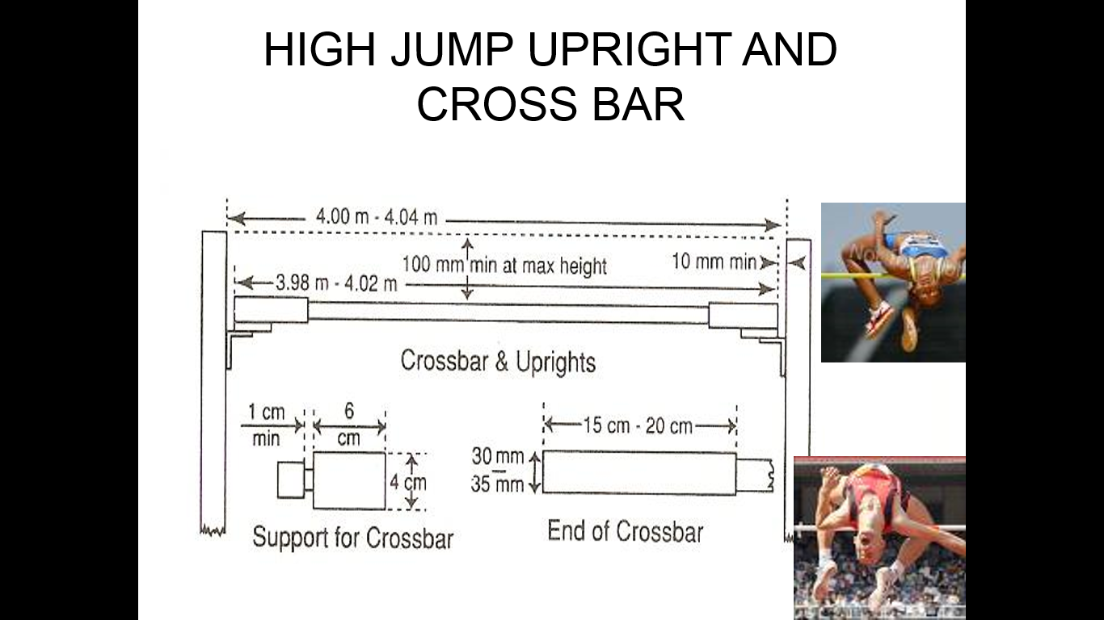
APPARATUS
Any style of uprights or posts may be used, provided they are rigid.
They shall have supports for the crossbar firmly fixed to them.
They shall be sufficiently tall as to exceed the actual height to which the crossbar is raised by at least 0.10m.

Slide 25
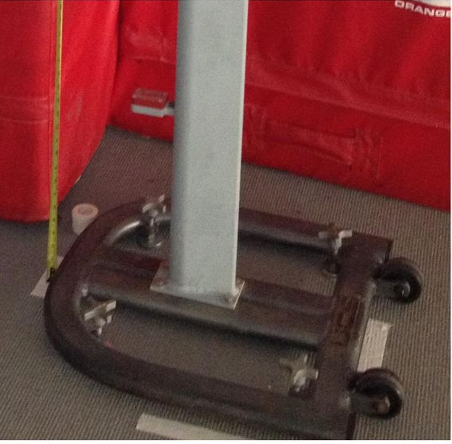
UPRIGHTS
The uprights or posts shall not be moved during the competition unless the Referee considers that either the take-off or landing area has become unsuitable. In such a case, the change shall be made only after a round of trials has been completed.
Once the standards are adjusted and properly spaced, mark their position on the ground.

Slide 26
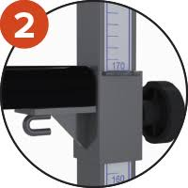
SUPPORTS
Flat & Rectangular (4cm x6 cm )
Fixed to uprights & immoveable
Surface of the uprights should be smooth ( not covered with rubber or spring )
Face the opposite upright
Ends of the cross bar should rest on it , if touched by athlete , easily fall to the ground
Supports should be of same height at each end of the crossbar

Slide 27
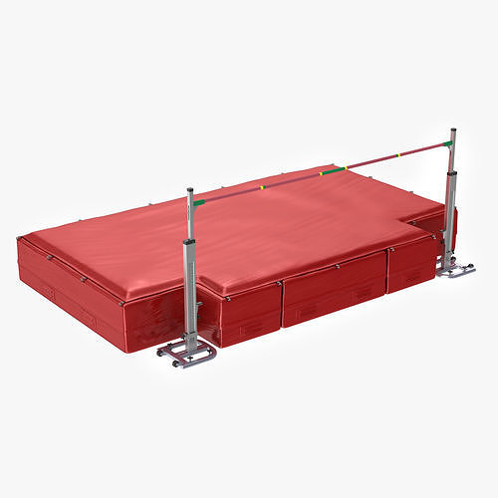
LANDING AREA
International Competition, the landing area shall be not smaller than 6m long x 4m wide x 0.7m high behind the vertical plane of the crossbar.
For other competitions, the landing area should measure not less than 5m long x 3m wide x 0.7m high.
There shall be a space of at least 10mm between the ends of the crossbar and the uprights.

Slide 28
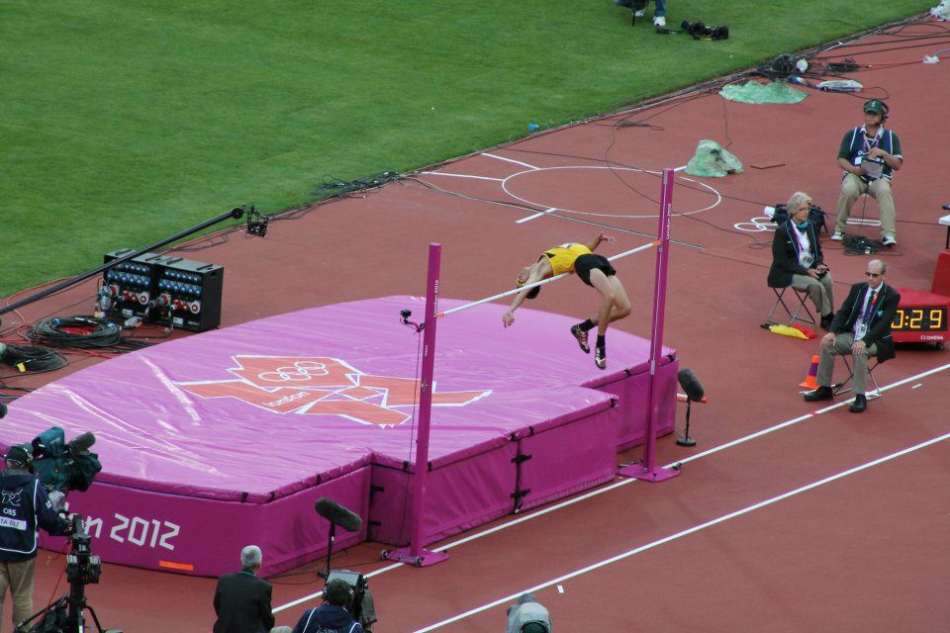
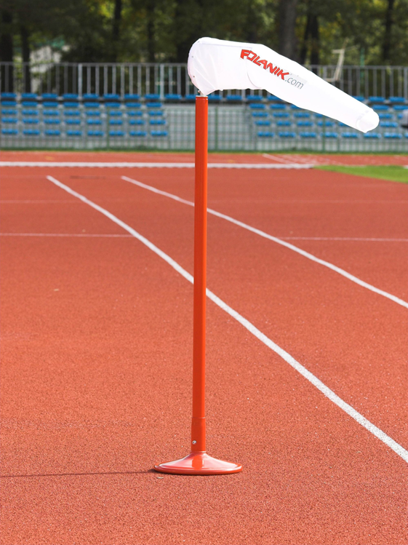
50 MM WIDE LINE & WIND - SOCK
A white line 50 mm wide line drawn on the ground And extends for 3 meters on either sides of the uprights . ( The edge of the line nearest to the take off area is drawn along the vertical plane through the edge of the crossbar nearest to the take off area )
A space must be reserved for a wind-sock to indicate the wind direction and strength.

Slide 29
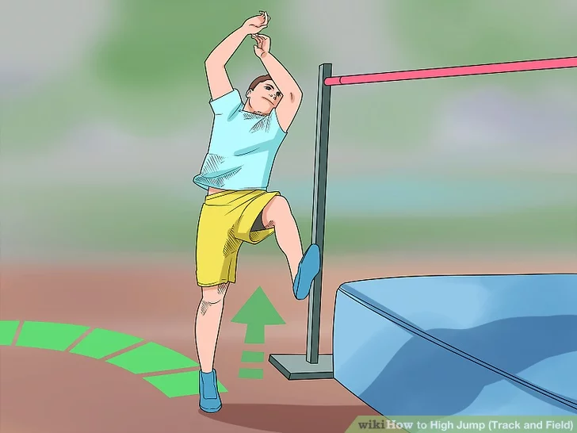
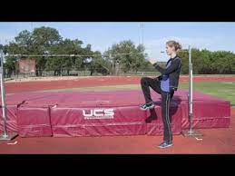
HIGH JUMP - COMPETITION
An athlete shall take off from one foot

Slide 30
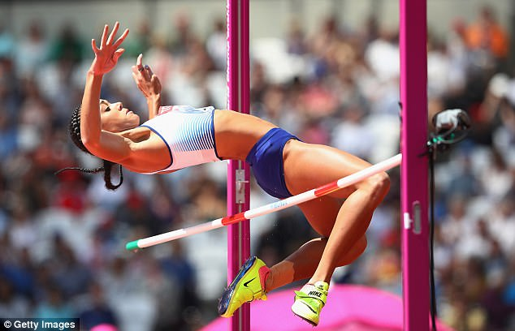
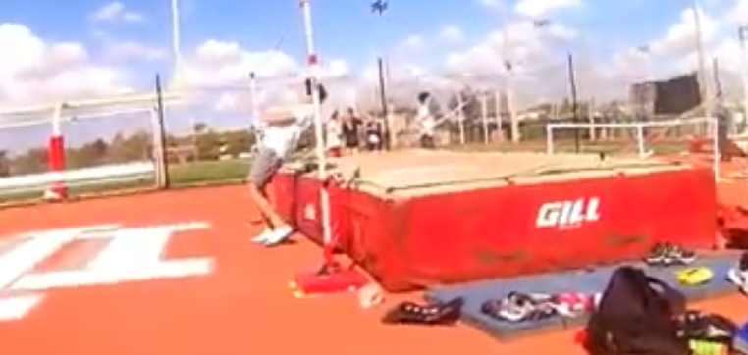
HIGH JUMP- FAILURE
An athlete fails if:
After jumping, the bar does not remain on the supports due to the action of the athlete while jumping.
They touch the crossbar or the vertical section of the uprights when running up without jumping.

Slide 31
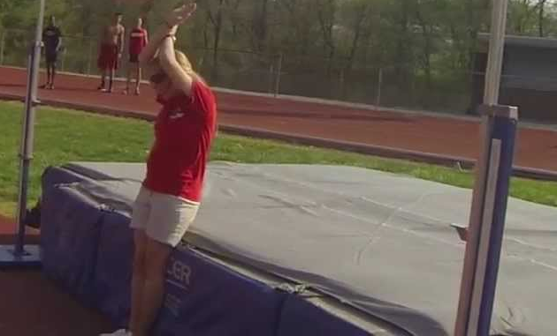
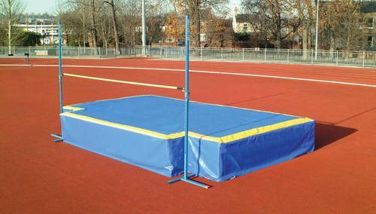
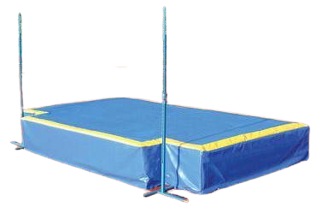
HIGH JUMP- FAILURE
An athlete fails if:
Athlete touch the ground including the landing area beyond the vertical plane through the nearer edge of the crossbar, either between or outside the uprights with any part of their body, without first clearing the bar.
To assist in implementing this rule a white line of 50mm wide shall be drawn (Usually by adhesive tape or similar material) between the points 3m outside of each upright.

Slide 32
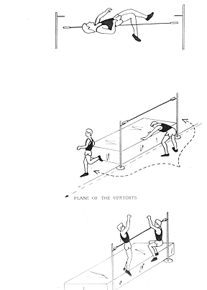
HIGH JUMP- FAILURE
Cross bar does not remain on the support
Taking off on both legs
Athlete touches the ground beyond the vertical plane through the nearer edge of crossbar, between the uprights or out side the uprights

Slide 33
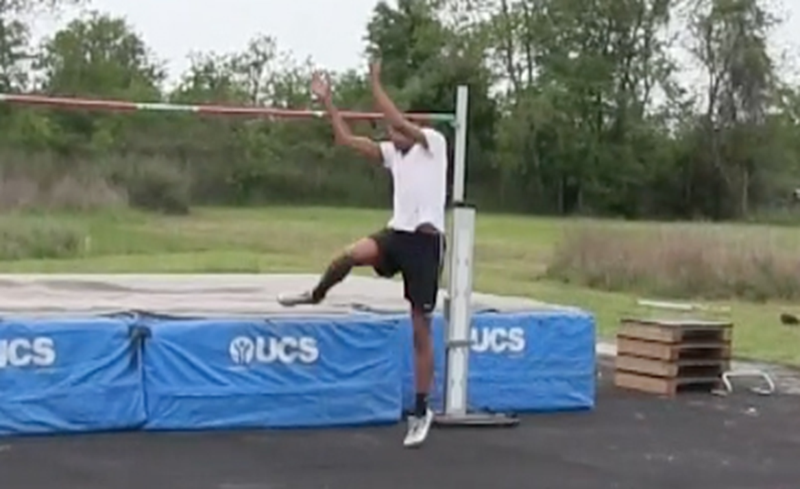
HIGH JUMP-NOT A FAILURE
However, if when they jump, an athlete touches the landing area with their foot and in the opinion of the Judge, no advantage is gained, the jump for that reason shall not be considered a failure.

Slide 34
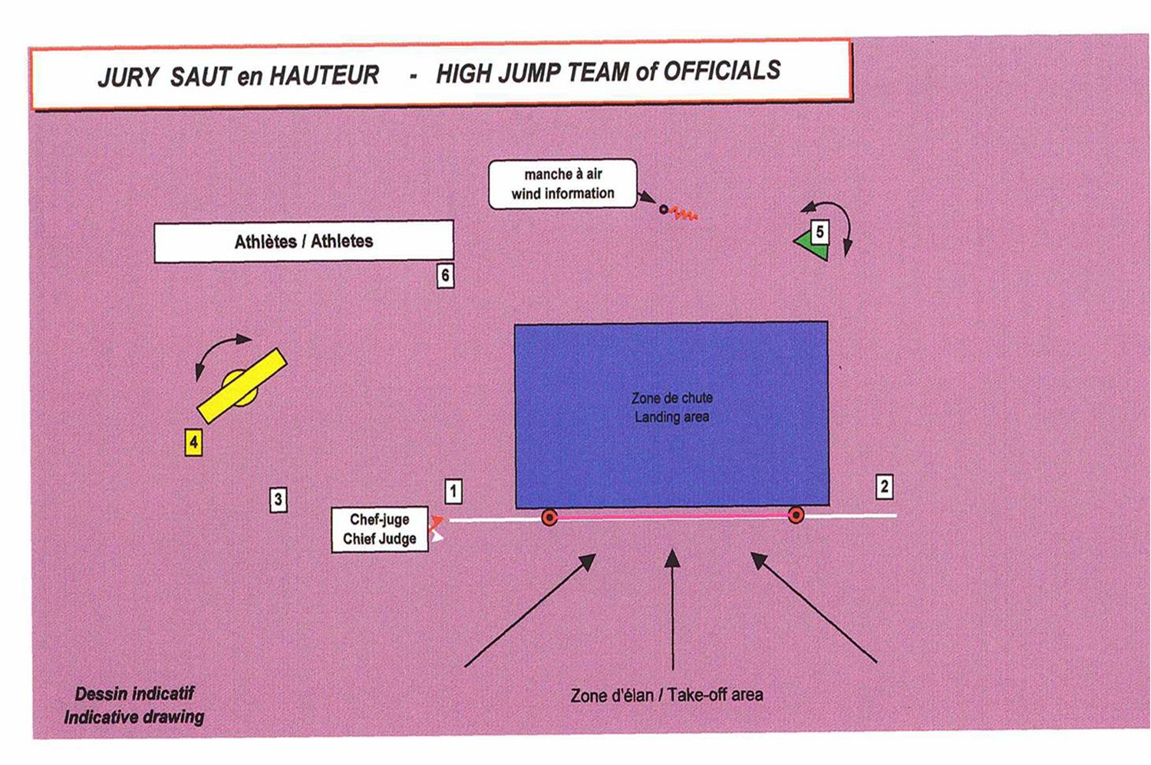
HIGH JUMP-TEAM OF OFFICIALS

Slide 35
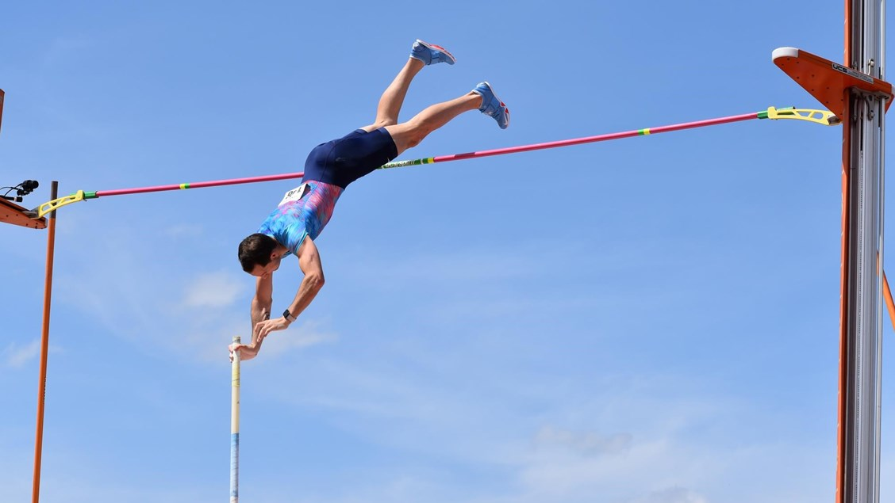
POLE VAULT
    RUNWAY AND TAKE-OFF AREA
    ZERO LINE
    APPARATUS
    LANDING AREA
    FAILURES
    SCORESHEET

Slide 36
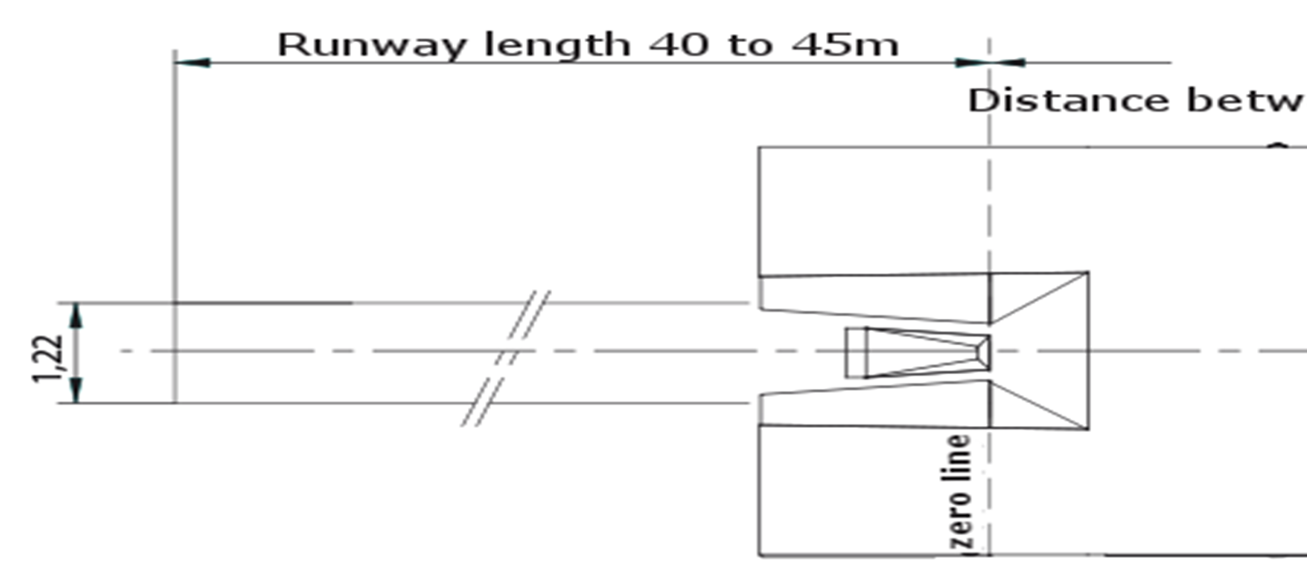
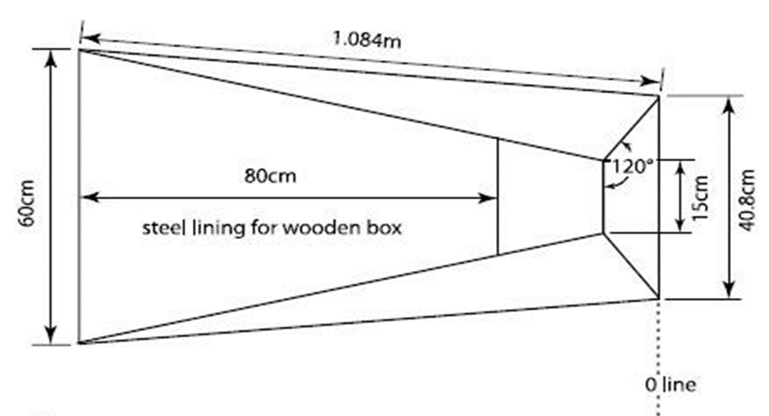
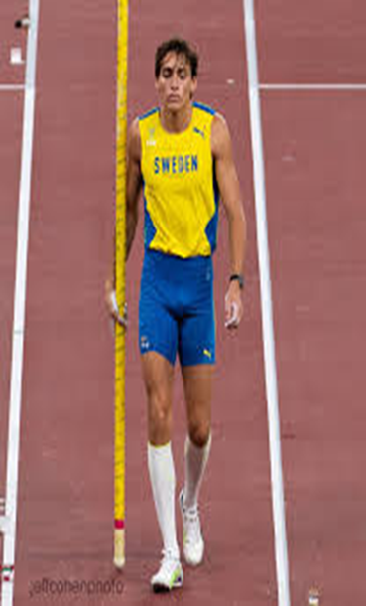
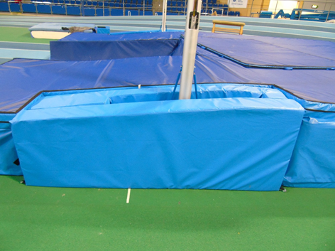
POLEVAULT – RUNWAY & ZEROLINE
Length of the runway, measured from the “zero” line 40m - 45m. width - 1.22m by white lines 50mm in width.
Zero line - PURPOSE
It is used to determine the distance the crossbar travels towards the back of the landing surface.
To check and fix the starting point of the runway
To identify the proper placement of the landing surface
The vaulter or pole must touch beyond the zero point to count as failure
Zero line

Slide 37
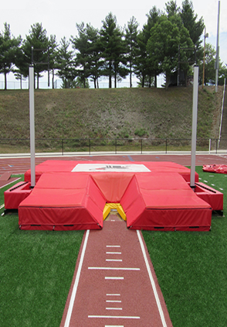
POLE VAULT- RUNWAY
Markings on the runway
For Pole vault, the Organizers should place suitable
and safe distance markers beside the runway at
each 0.5m between the points 2.5m to 5m from the
“zero” line and at each 1.0m from the 5m to the 18m
point.

Slide 38
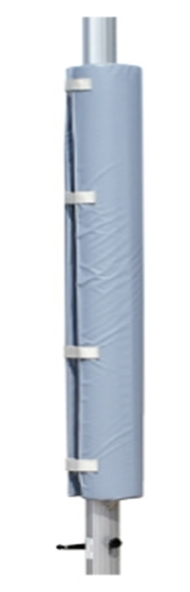
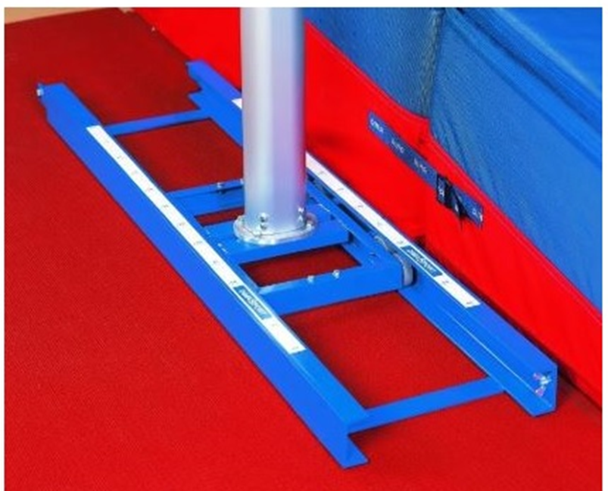
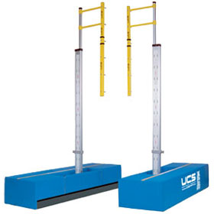
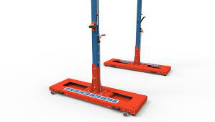
POLE VAULT – UPRIGHTS
Any style of uprights or posts may be used, provided they are rigid.
The metallic structure of the base and the lower part of the uprights above the landing area must be covered with padding of appropriate material in order to provide protection to the athletes and the poles.
CHECK THE ACCURACY OF STANDARDS
Move standards to ‘0 “
Put crossbar on pegs to be used
Center bar on pegs & check overlap of ends
4. Measure height and check

Slide 39
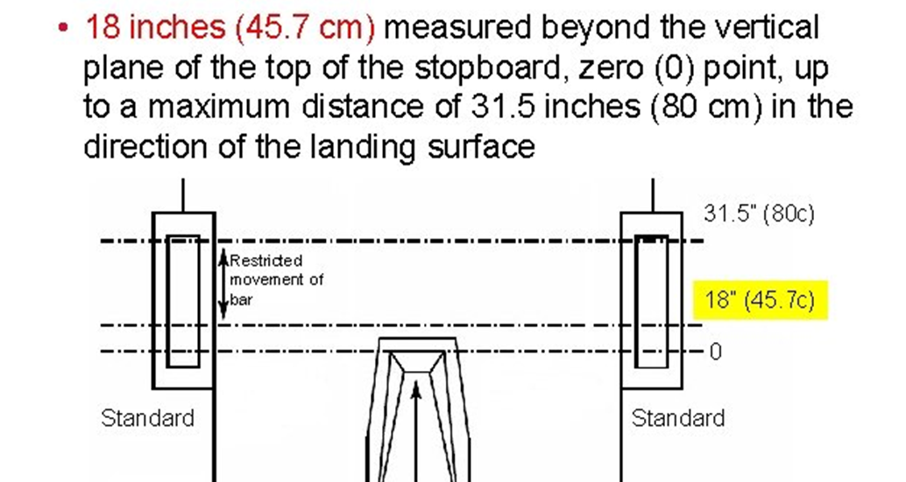

Fixing uprights – Pole vault
Place a permanent extended line 1cm wide drawn through the top (zero point) extending up to 3 meters on each side of the box.

Slide 40


VAULTING BOX
The take-off for the Pole Vault shall be from a box. rounded upper edges and shall be sunk level with the runway.
1.00 m in length 60cm in width at the front end and tapering to 15cm in width at the bottom of the stop board
The length of the box at runway level and the depth of the stop board are determined by the angle of 105° formed between the base and the stop board.

Slide 41


PADDING AROUND
THE VAULTING BOX
An athlete may place padding around the box for additional protection during any of their trials. The placement of such equipment shall be done within the time allowed for the athlete’s trial and shall be removed by the athlete immediately after their trial is completed.

Slide 42



PEGS / PEGS BACKINGS
The crossbar - rest on horizontal pegs - fall easily to the direction of the landing area
Pegs –
without notches -uniform thickness- smooth
diameter – 13 mm
length - 55 mm
Distance between peg – 4.28m- 4.37 m
Vertical peg backings-
extended - 35 mm – 40 mm ( on top )
Peg backings
The pegs should support the bar in the
middle of the end pieces

Slide 43



VAULTING POLES
Athletes may use their own poles , any material, any diameter or length but with smooth surface
Any tape at the grip end must be uniform
No restriction at the bottom end of the pole – any form of taping for protection is permitted without advantage to athletes.

Slide 44


POLE VAULT - LANDING AREA
International Competition
6m long (behind the zero line and excluding the front pieces) x 6m wide x 0.8m high. The front pieces must be at least 2m long.
The sides of the landing area nearest to the box shall be placed 0.10m to 0.15m from the box and shall slope away from the box at an angle of approximately 45°
(For other competitions, the landing area should measure not less than 5m long (excluding the front pieces) x 5m wide x 0.8m high.

Slide 45

POSITION OF THE CROSSBAR
Crossbar moved towards the direction of landing ( 80 cms )
Before start, athlete shall inform the official about the position of the crossbar require for the first trial and this position should be recorded.
If changes required, immediately inform the official, before the cross bar is set, otherwise it will lead to the start of their time limit.

Slide 46



Slide 47



POLE VAULT - FAILURE
After the vault, the bar does not remain on both pegs because of the action of an athlete whilst vaulting
Touch the ground, including the landing area, beyond the vertical plane through the back end of the box with any part of their body or with the pole, without first clearing the bar

Slide 48


POLE VAULT - FAILURES
Failure - During the vault, they steady or replace the bar with their hand(s).
Failure - After leaving the ground, they place their lower hand above the upper one or moves the upper hand higher on the pole

Slide 49

POLE VAULT - FAILURES
After the release of the pole, no one including the athlete shall be allowed to touch the pole unless it is falling away from the bar or uprights. If it is touched, and the Referee is of the opinion that, but for the intervention, the bar would have been knocked off, the vault shall be recorded
as a failure.

Slide 50




POLE VAULT – NOT FAILURES
Not Failure - Athletes may, during the competition, place a substance on their hands or on the pole, in order to obtain a better grip. The use of gloves is permitted. (without unfair assistance and monitored by referee)
It is not a failure if an athlete runs outside the white lines marking the runway at any point.
It is not a failure if the pole touches the landing mats, in the course of trial, after properly being planted in the box.

Slide 51


POLE VAULT – NOT FAILURES
Not Failure Fore arm covers may be worn by vaulter (for prevention of injuries)
The use of gloves is permitted.

Slide 52


REPLACEMENT TRIAL
If, in making a trial, an athlete's pole is broken, it shall not be counted as a failure and they shall be awarded a replacement trial.

Slide 53

POLE VAULT – TEAM OF OFFICIALS

Slide 54
THANK YOU

