Slide 1
Rule & Interpretation of Race Walking events
By - George Shinde I J
Notes:
1

Slide 2
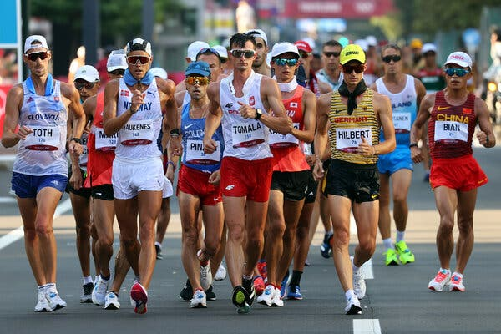
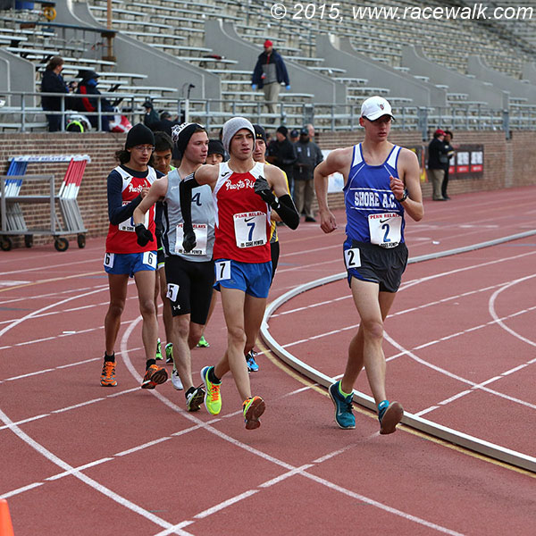
Race Walking

Slide 3
Standard Distances
DISTANCE ON TRACK
5000m
10,000m
20,000m
DISTANCE ON ROAD
10km
20km
35km
50km
DISTANCE INDOOR
3000m
5000m

Slide 4
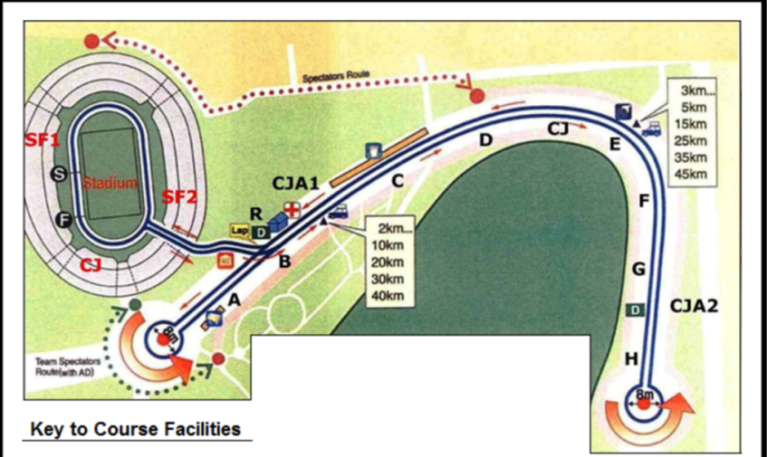
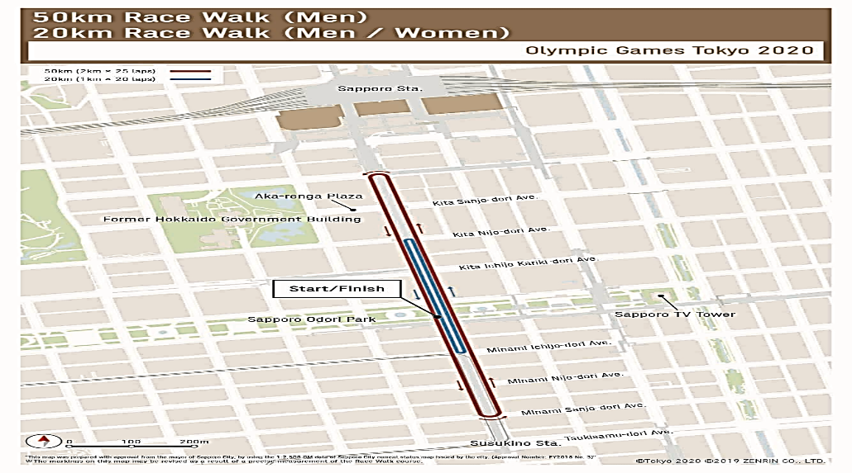
Road Course
The race circuit shall be 1 km to 2km.
The course shall be measured along the shortest possible route that an athlete could follow within the section of the road.
An out and back courses is only acceptable if held on a divided road without tight turns and a radius of at least 7.5 meters on turns.
For events that start and finish in the stadium, the circuit should be as close as possible to stadium.

Slide 5
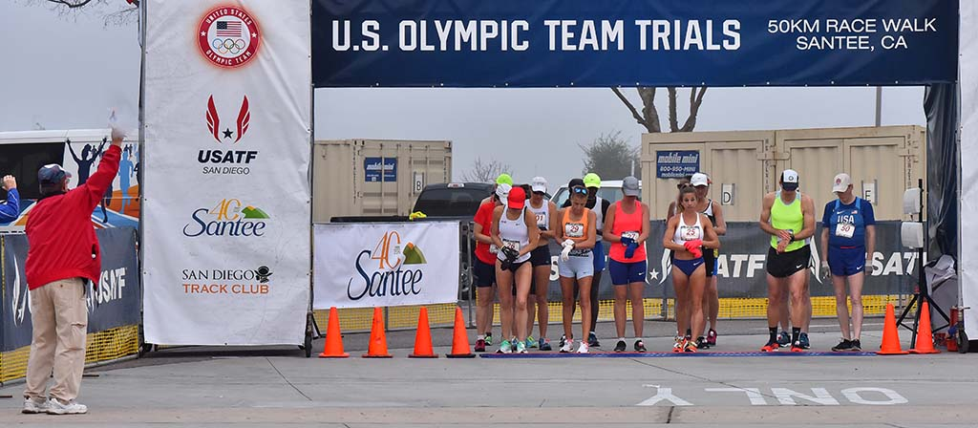
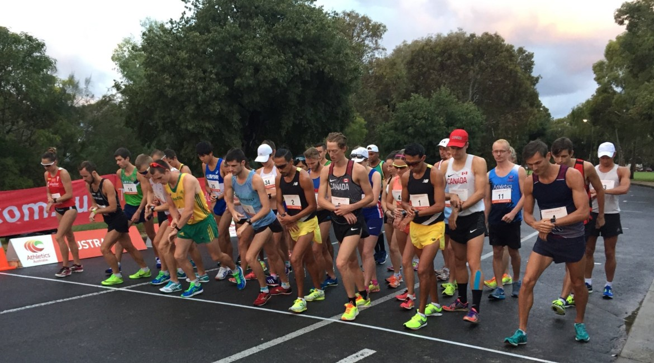
Start of the Race
The races shall be started by the firing of a gun, cannon, air horn or like device.
The commands for races longer than 400m shall be used
In races which include a large number of athletes, five-minute, three-minute and one-minute warnings before the start should be given.
On the command “On your marks", the athletes shall assemble on the start line in the manner determined by the organizers.
The starter shall ensure that no athlete has their foot touching the start line or in front of it, and shall then start the race.

Slide 6
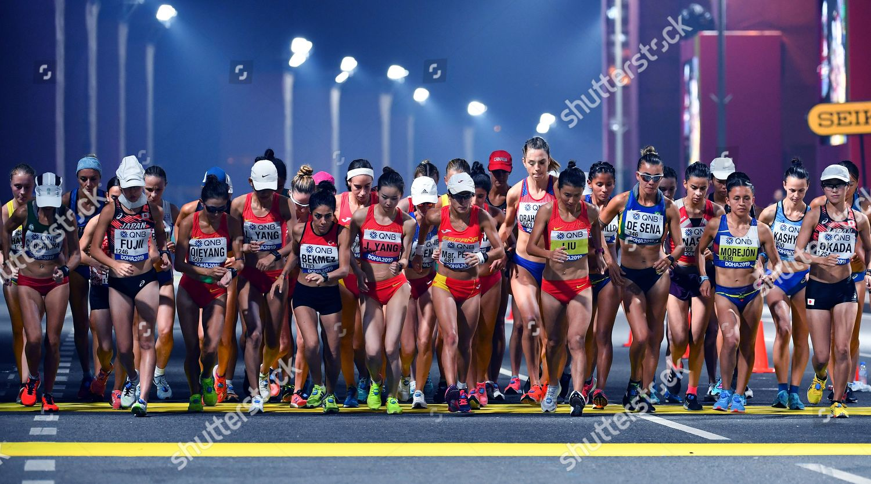
Start of the Race

Slide 7
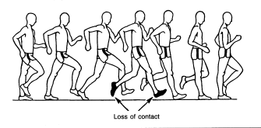
DEFENITION - Contact Rule
Race Walking is a Progression of steps so taken that the Walker makes contact with the Ground, so that no visible(to the human eye) loss of contact occurs.
Continued
Both feet are not in contact with the ground

Slide 8
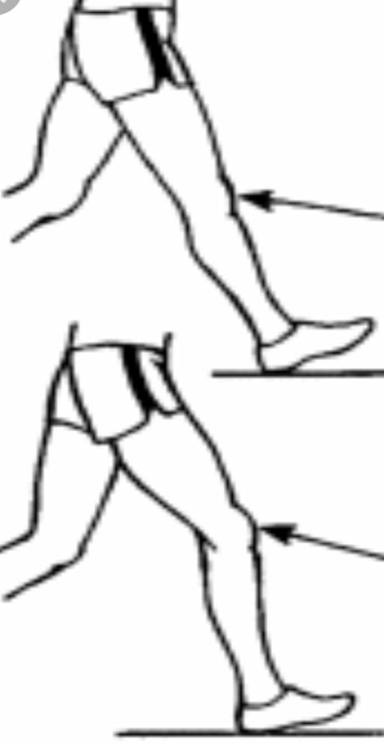
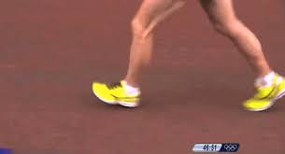
DEFENITION - Bend Knee Rule
The advance leg must be straightened (i.e. not bent at the knee) from the moment of first contact with the ground until the vertical upright position.

Slide 9
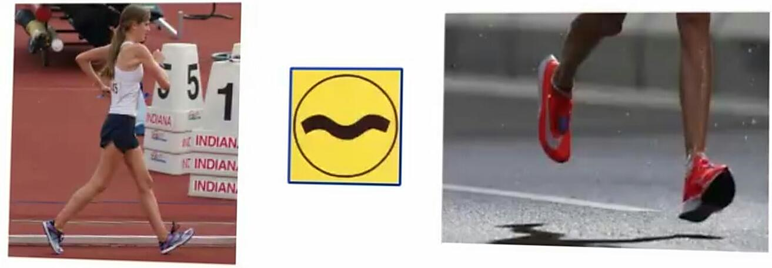

Continual contact with the Ground
Contact Rule
Both feet are not in contact with the ground
✓
X

Slide 10
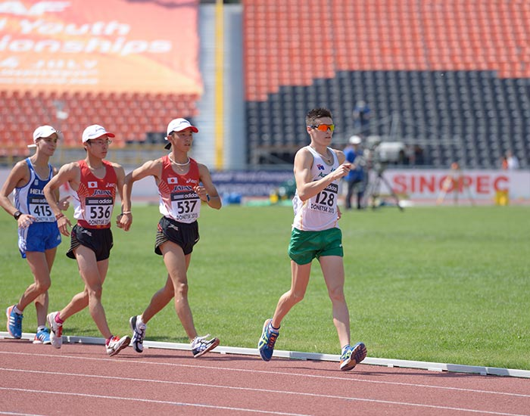
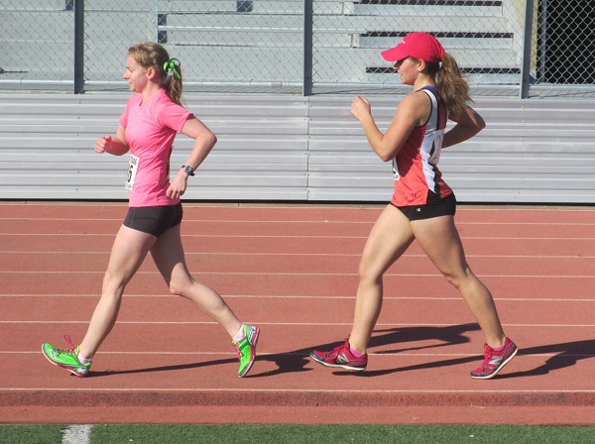

Straighten the Leg from the first contact with the ground, ie; not bend at knee.
Bend Knee Rule

Slide 11
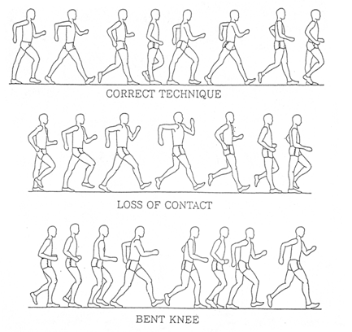
Overview of Race Walk Technique

Slide 12
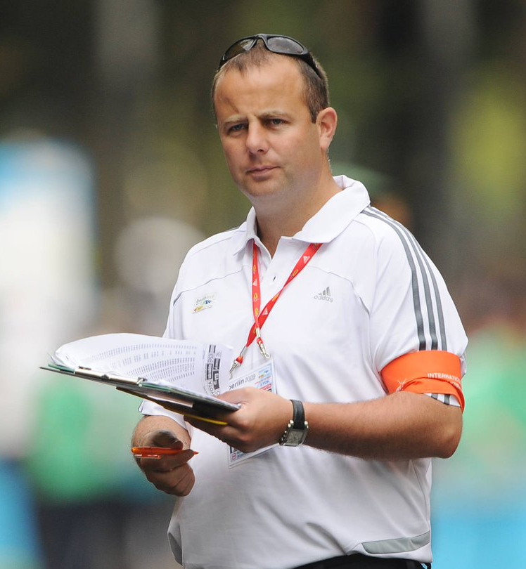
Judging
The appointed judges shall elect a chief judge, if one has not been appointed previously.
All the judges shall act in an individual capacity and based on observation made by the human eye.
In the competition held under technical rule 1.1 (Olympics & World Championships)all judges shall be International Race Walking Judges.

Slide 13
Judging
For Road Race, there should normally be a minimum of six to a maximum of nine judges including the Chief Judge.
For track races, there should normally be six Judges including the Chief Judge.
In competition held under rule 1.1 not more than one Judge from any country can officiate.
As far as possible in National Competition, Judges should not judge a race with a conflict of interest (coaching an athlete, family member etc.)
Notes:
13

Slide 14
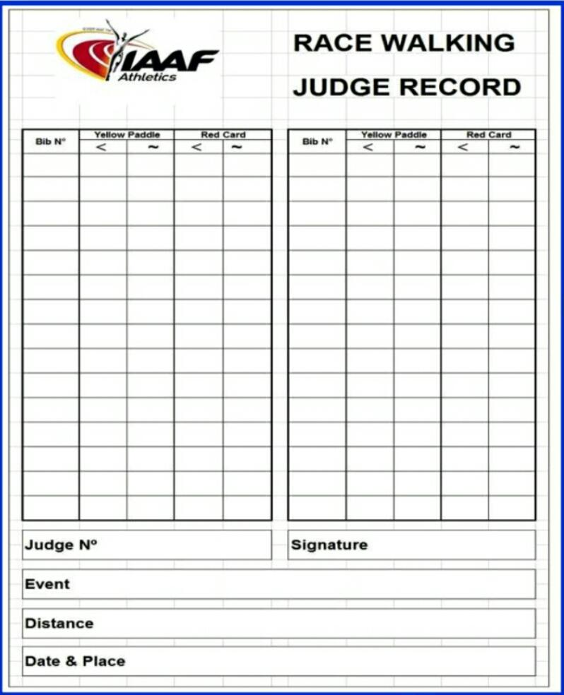
Individual Judge Record Sheet
Judging

Slide 15
Role of Judges
The Race Walking Judge has to ensure that a competitor is complying with the definition of Race Walking.
Each Judge must observe all competitors, ensuring that they are in a good viewing position to assess that each competitor is walking according to the Rule.
If, in the opinion of the Judge, based on his own observations, any competitor looks likely to violate Race Walk Rule, should show a yellow paddle.

Slide 16
Role of Judges
Report at least one hour prior to the scheduled start
Judge only in the area assigned.
Should not converse with others, except with the Chief Judge,
Should not leave without permission and should not assume the race is over till the last competitor has completed the race.
After the completion of the race, hand over the completed records to the Chief Judge who will inform when you can leave.
Must attend the post-race meeting conducted by the Chief Judge for a discussion and debriefing and address any issues or judging discrepancies.

Slide 17
Judging
A Judge must give a competitor a yellow paddle with the symbol of the offence on each side before issuing a red card, with the following exceptions:
An athlete obviously and absolutely break the rules and gain an unfair advantage
An athlete break the rule in the last part of the race where it is too late to show a yellow paddle

Slide 18
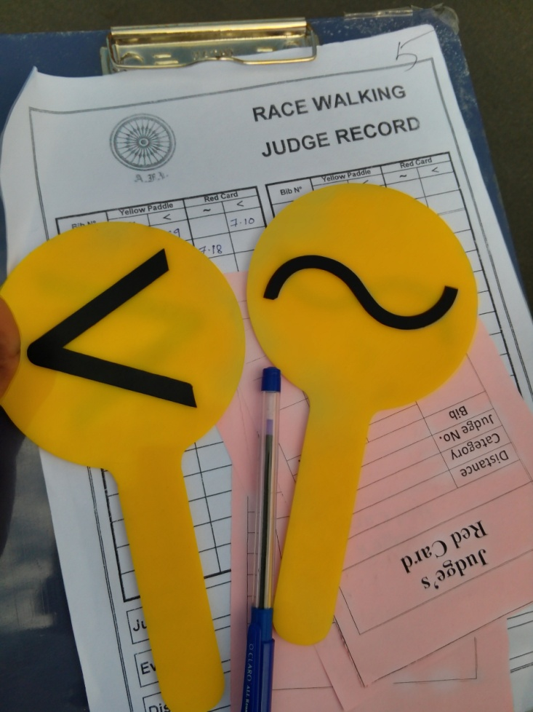
Judge’s Equipments
All Judges should be prepared with necessary equipment, i.e. uniform, badge or armband, record cards, red cards, yellow paddles and a suitable pen or pencil. In inclement weather, the means of keeping themselves and their documentation dry.

Slide 19
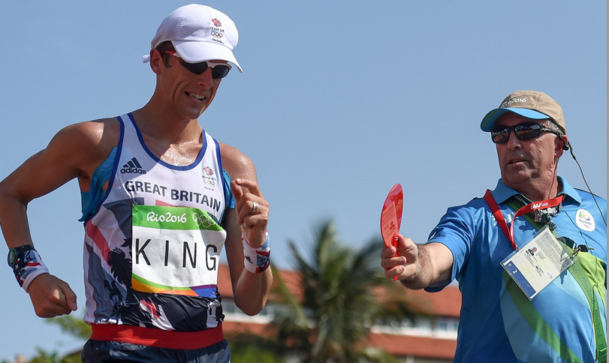
Chief Judge
The Chief Judge shall act as the supervising official for the competition, and act as a Judge only in the special situation.
The Chief Judge's Assistant(s) are to assist with the notification of disqualifications only and shall not act as Race Walking Judges.
The Chief Judge has the power to disqualify an athlete in the last 100m, when their mode of progression obviously fails to comply with Rules regardless of the number of previous Red Cards the athlete has received.

Slide 20
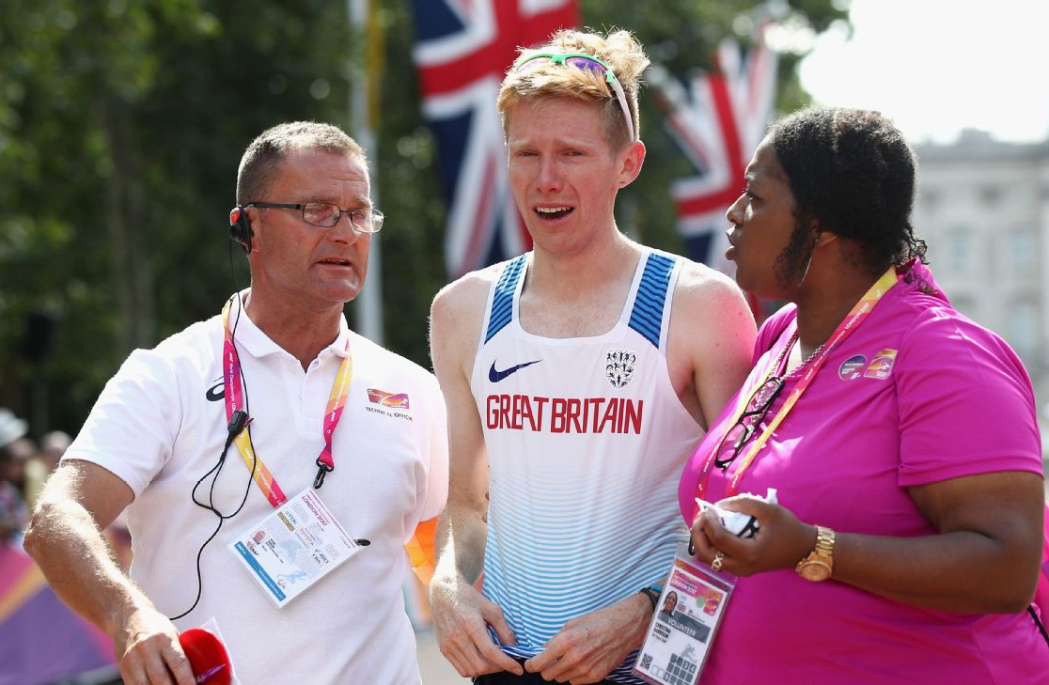
Chief Judge
An athlete who is disqualified by the Chief Judge under these circumstances shall be allowed to finish the race, and shall be notified of this disqualification showing a red paddle at the earliest opportunity after the athlete has finished the race.

Slide 21
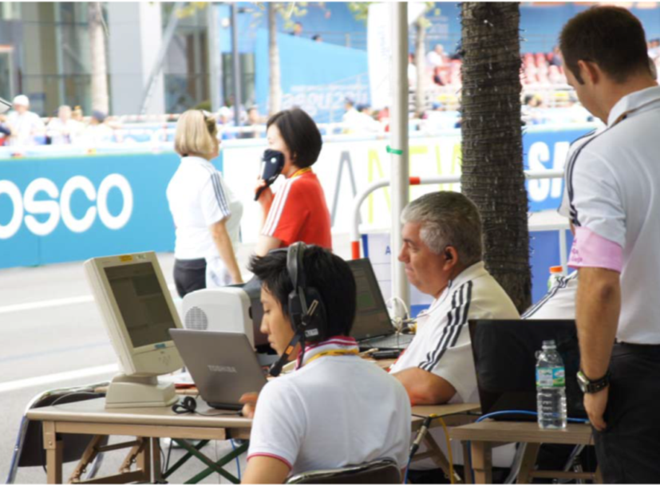
Recorder
The main functions of the Recorder are:
Collect the Judges’ red cards and record the information on the Judging Summary Sheet
The Judging Summary sheet is the official score sheet of the judging.
ACCURACY IS ESSENTIAL.

Slide 22
Recorder…..
Notify the Posting Board operator of Red Cards,
Immediately notify the Chief Judge and the official allotted at the Penalty zone, when three Red Cards from three different Judges have been received.
Immediately notify the Chief Judge when Fourth Red Card from a different Judge have been received.
At the end of the race, the individual Judge’s record cards are collected and all the yellow paddles and red cards are added to the Judging Summary Sheet.

Slide 23
Judging Summery Sheet

Slide 24
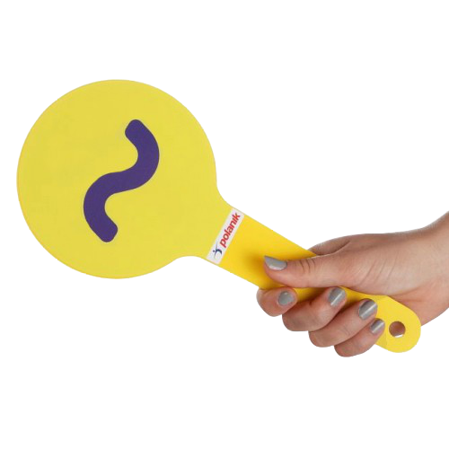
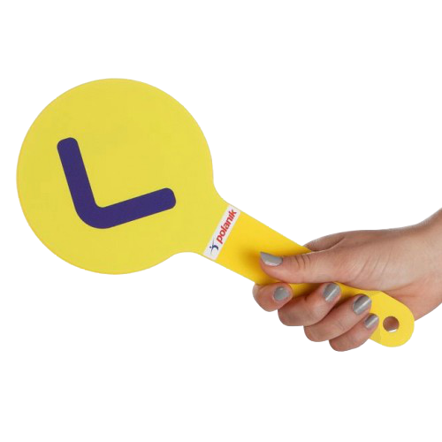
Yellow Paddle
An athlete cannot be shown a second yellow paddle by the same Judge for the same offence.
The individual judge shall record all yellow paddles given; showing the competitor’s number, offence and the time it was given.
A good judging position is one that allows a 45 degree horizontal viewing angle from the competitor as they are moving towards the Judge

Slide 25
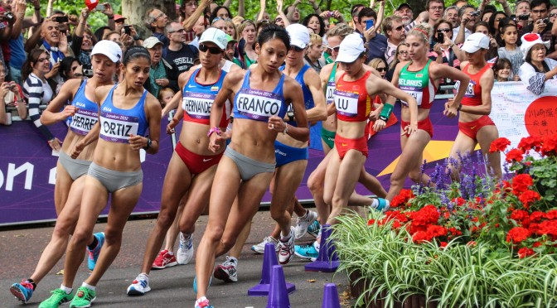
Yellow paddle
The key danger areas, where close attention should be paid, are:
during the acceleration at the start,
while passing another walker,
during the finishing straight,
in the middle of a group,
around turning points.
Aid and Refreshment areas

Slide 26
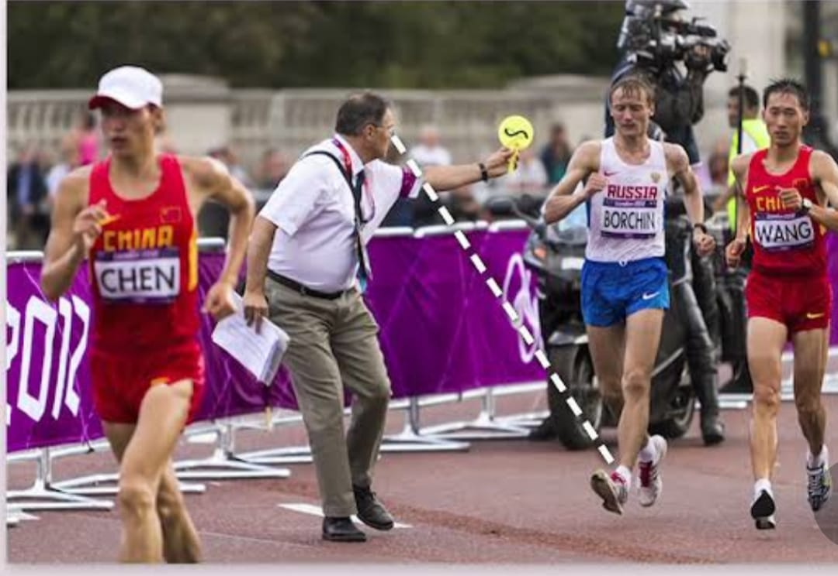
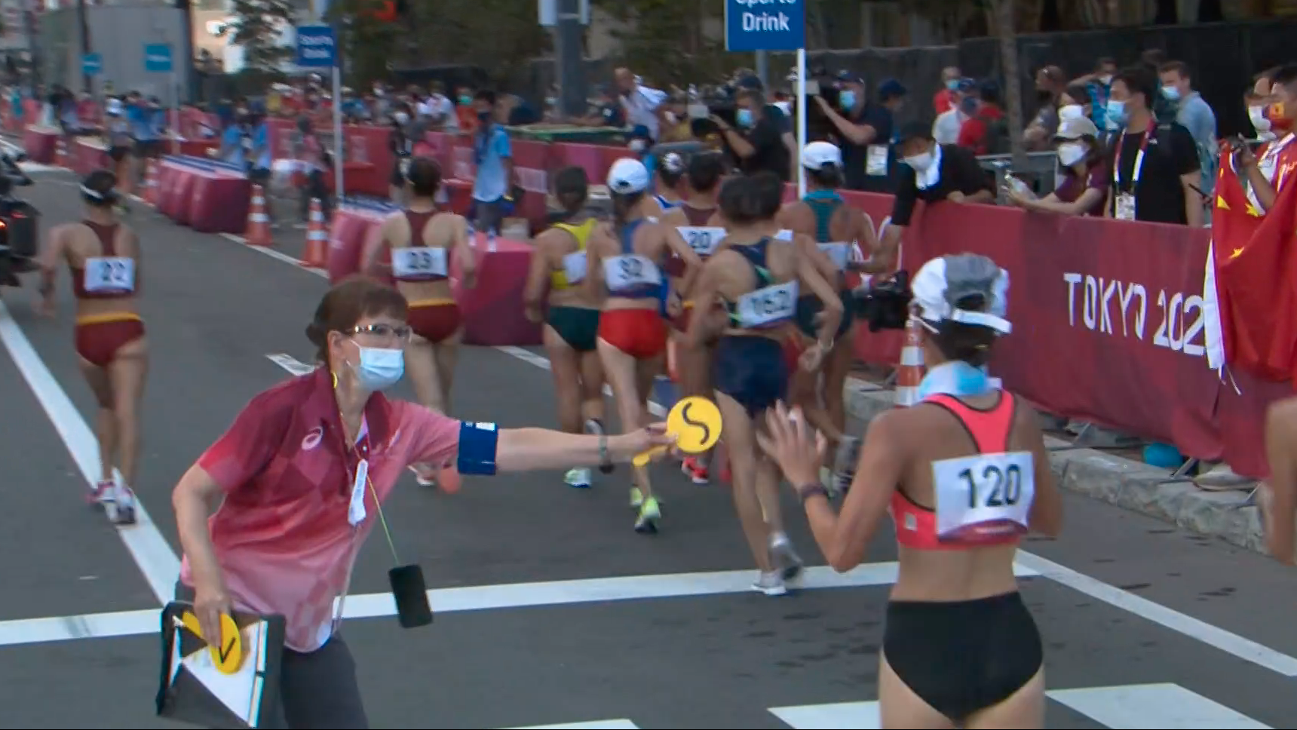
Race Walk Judge – Showing Yellow Paddle
Yellow Paddles

Slide 27
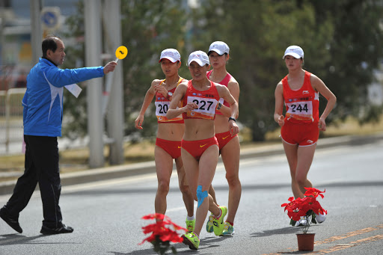
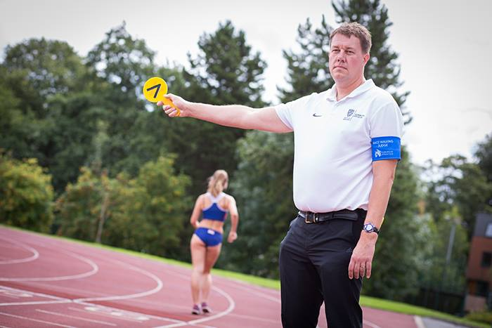
Indirectly assisting the Walker by Showing a Yellow Paddle
Yellow Paddles

Slide 28
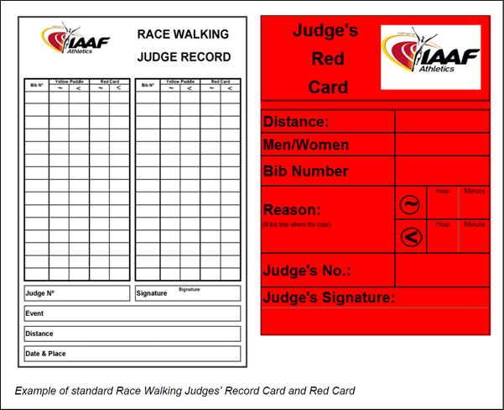
Red Card
When a Judge observes an athlete failing to comply with TR 54.2 by exhibiting visible loss of contact or a bent knee during any part of the competition, the Judge Shall send a Red card to Chief Judge or Recorder.
When issuing a Red Card there should not be any doubt in a judge’s mind about the decision.

Slide 29
Red Card
Judges should keep a record of all Red Cards they issue
Once a Judge has issued a Red Card on a competitor, then that competitor is no longer to be judged by that Judge.
The Judge cannot send a second Red Card on a competitor
To report to the chief Judge after the event and confirm that all red cards have been received.
To be available after the race to answer any question from the chief Judge.

Slide 30
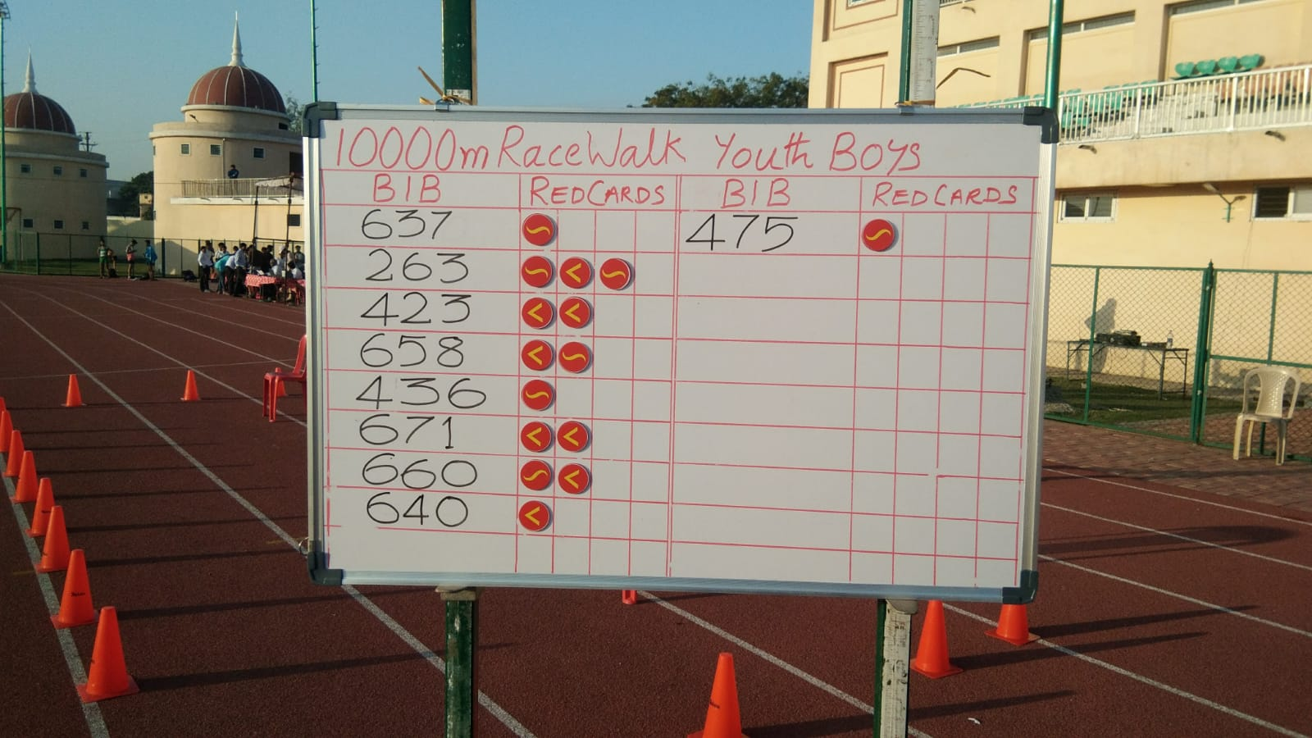
Posting (DQ) Board
The red card Posting Board is commonly referred to as the Disqualification or DQ Board.
The purpose of the board is, primarily, to keep competitors informed about the number of red cards that have been received by the recorder for each competitor.
In practice, board can be placed in such a position that all competitors can easily see the board and read what is in itr each time they pass.
The board must be completed by the Recorder, or by an appointed Posting Board Operator in collaboration with the Recorder, and checked by the Chief Judge.

Slide 31
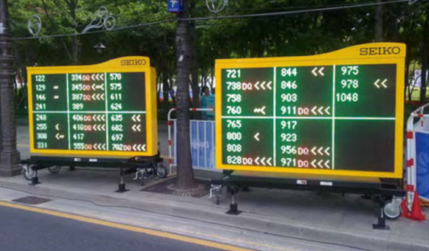
ELECTRONIC DATA COLLECTION AND POSTING BOARD
Electronics Posting Board
Judges hand – held Terminal

Slide 32
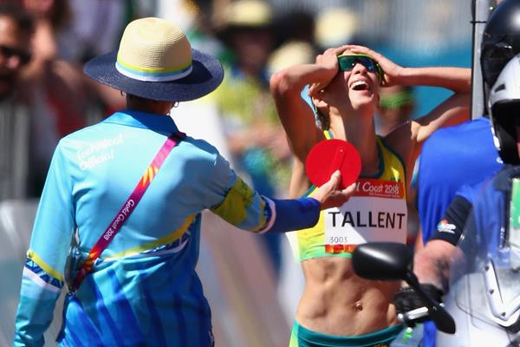

Disqualification
Except if Penalty Zone is used, three Red Cards from three different Judges have been sent to the Chief Judge on the same athlete, the athlete is disqualified and they shall be notified of this disqualification by the Chief Judge or a Chief Judge’s Assistant by being shown a red paddle.
The failure to give notification shall not result in the reinstatement of a disqualified athlete.

Slide 33
Disqualification
Before this notification takes place, the Chief Judge should receive the cards back from the Recorder to check the following points:
1- All cards are correctly completed.
2- All cards are for the same competitors.
3- No two cards are from the same Judge.
NOTE:
THE JUDGE CANNOT SEND A SECOND RED CARD ON A COMPETITOR

Slide 34
Disqualification
In Track Races, an athlete who is disqualified shall immediately leave the track.
In Road Races, athlete shall, immediately after being disqualified, remove the distinguishing bibs and leave the course.
Any disqualified athlete who fails to leave the course or track or comply with directions given to enter and remain for the required period in the Penalty zone may be liable to further disciplinary action.
Immediately after the race and as soon as the chief Judge is satisfied that no further cards will be coming in, The Chief Judge and Recorder should check the Judging Summary Sheet and all disqualification and Red cards reported.
The final result of the race should not be declared until this has happened.

Slide 35
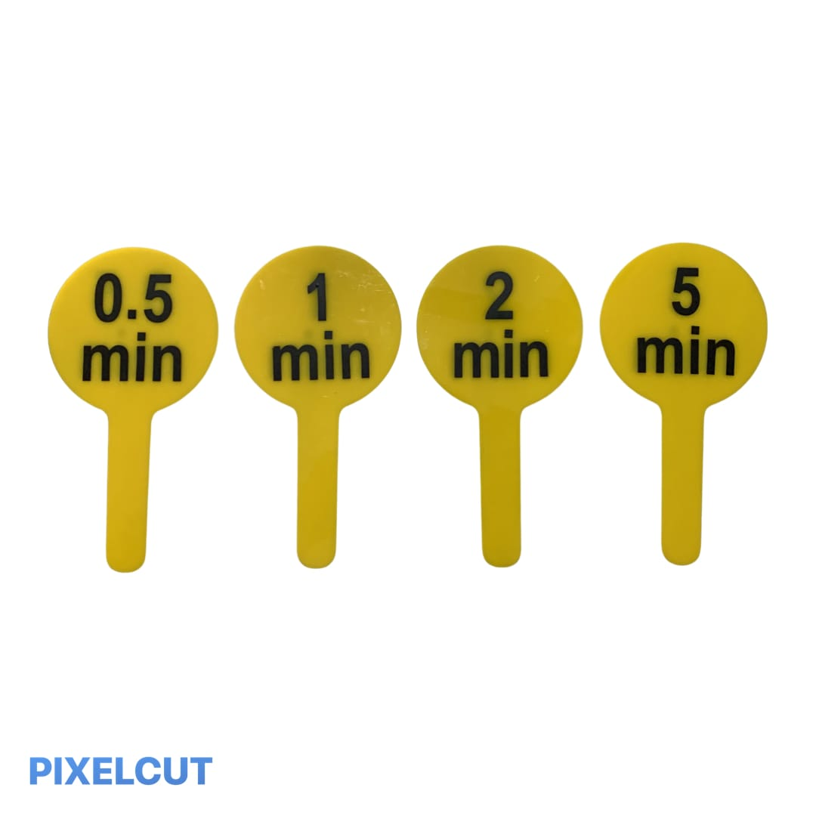
Penalty zone
The applicable period in the Penalty zone shall be as follows:
Races up to and including Time
5000m/5km 0.5 min
10,000m/10km 1 min
20,000m/20km 2 min
30,000m/30km 3 min
35,000m/35km 3.5 min
40,000m/40km 4 min
50,000m/50km 5 min
A Penalty zone shall be used for any race where an athlete will be required to enter and remain there for the applicable period once they have received three Red Cards.
If, at any time when Rule 54.7.3 of the Technical Rules applies, an athlete receives an additional Red Card from a Judge other than one of the three who had previously sent a Red Card, (ie; 4th Red Card From the 4th Judge) they shall be disqualified.

Slide 36
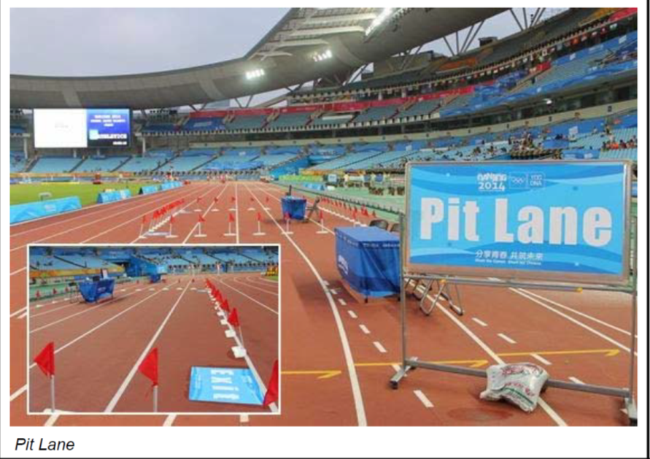
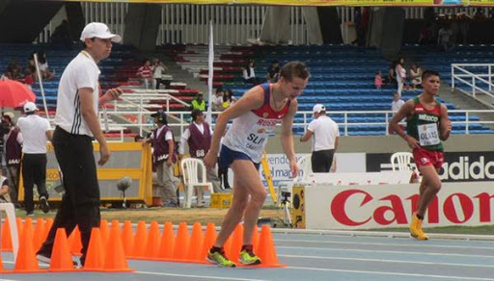
Penalty zone
PENALTY ZONE

Slide 37
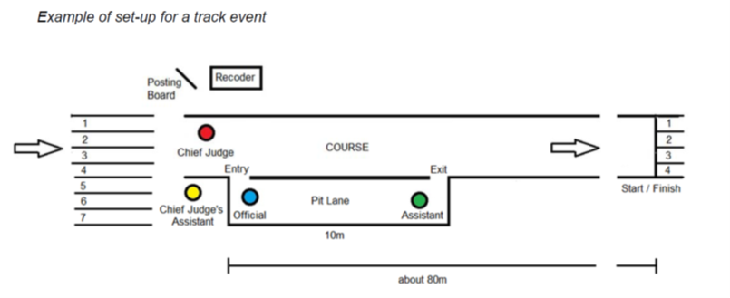
Penalty zone

Slide 38
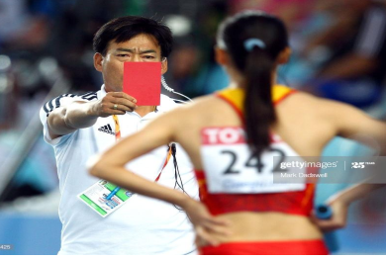
Penalty zone
An athlete who fails to enter the Penalty zone when required to do so, or remain there for the applicable period, shall be disqualified by the Referee.
An athlete receives a third Red Card and it is no longer practicable to direct them to enter the Penalty zone before the end of the race, the Referee shall add the time they would have been required to spend in the Penalty zone to their finishing time and adjust the finishing order as may be necessary.

Slide 39
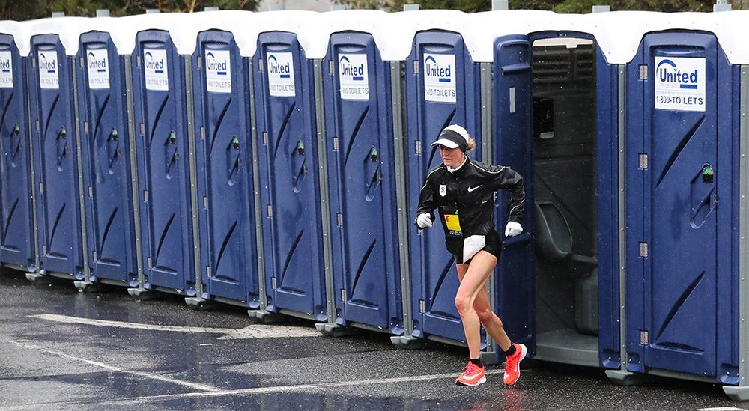
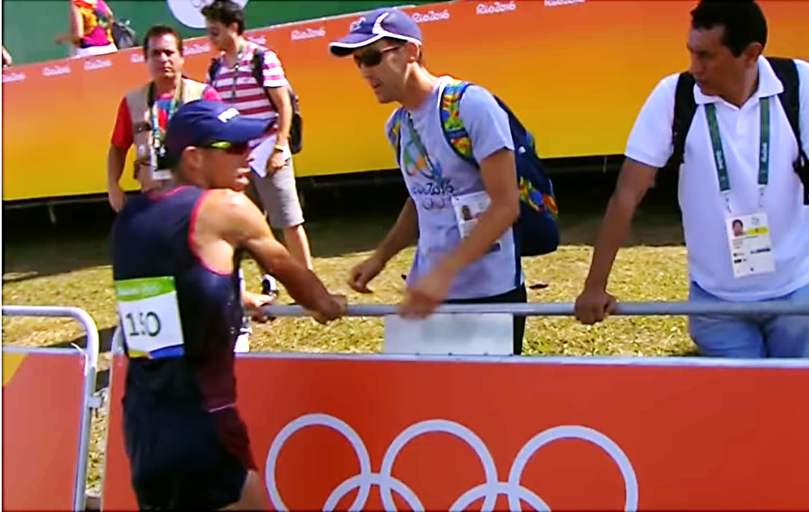
Race Conduct
An athlete may leave the marked course with the permission and under the supervision of an official, provided that by going off course they do not shorten the distance to be covered.
If the Referee is satisfied on the report of a Judge or umpire or otherwise that an athlete has left the marked course there by shortening the distance to be covered, they shall be disqualified.

Slide 40
Thank You
George Shinde I J
Level 1 Technical Official, Race Walk, AFI
Email: georgeshinde6@gmail.com
Phone: 9847949710

