Slide 1
TRACK & FIELD MARKING
Dr. Rajan Bhatia

Slide 2
RUNNING TRACK
2 Equal Straight & 2 Curves of equal radius
Straight
Curve
Curve
Straight

Slide 3
Standard Track (400 m)
Oval shape
2 Equal Straights and 2 Curves of equal radius
Number of lanes 8
Width of the lane = 1.22 m
Length of the Straight = 84.39 m x 2 = 168.78 m
Length of the track – length of the straights = total curve distance
400 – 168.78 = 231.22 m
Length of the one Curve = 231.22 / 2 = 115.61m
Width of the line = 5 cm

Slide 4
Now let us find out how to calculate curve radius?
(Running line radius)
231.22
r
m

Slide 5
RUNNING LINE RADIUS.
RAISED BORDER 30 CM
NON-RAISED BORDER
20 CM
36.80 m
115.61 meters
115.61 meters
36.50 m
Kerb Line ( Marking) RADIUS.

Slide 6
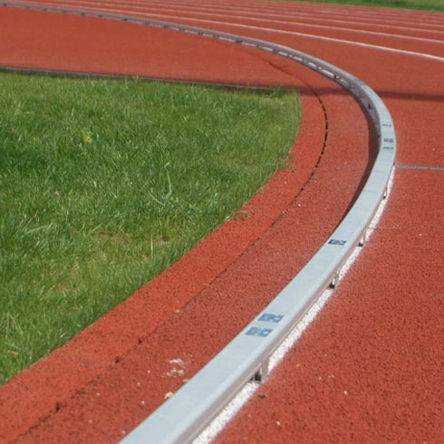
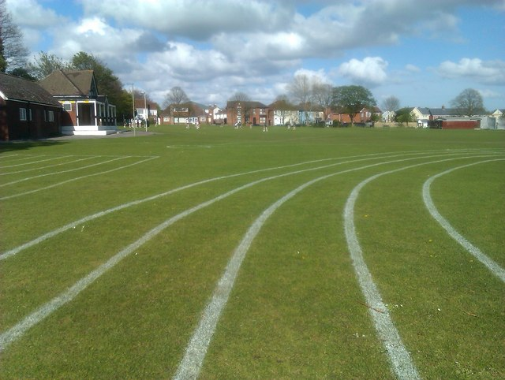
Height of 0.05m to 0.065m and a width of 0.05m to 0.25m.
Inner Border Standard Track
Inner Border Non Standard Track
30 cm from Kerb line Radius
20 cm from Inner Border

Slide 7
REQUIRED AREA FOR 400 M OF 8 LANES TRACK WIDTH WISE
5 m FREE SPACE
9.76 m (1.22 x 8 lanes)
36.50 m (CURVE RADIUS)
102.5 m
36.50 m (CURVE RADIUS)
9.76 m (1.22 x 8 lanes)
5 m FREE SPACE

Slide 8
REQUIRED AREA FOR 400 M TRACK OF 8 LANES LENGTH WISE
186.91 m
5 m
9.76 m
36.50 m
84.39 m
36.50 m
9.76 m
5 m

Slide 9
STEP – 1. Measure the length and width of the given area
105 m
190 m

Slide 10
STEP – 2. Find the center point of the given area by marking two diagonal lines from each corner of the field.
A
B
O
Center point
D
C

Slide 11
STEP – 3. Mark the straight line from the center point 42.195 meters towards each end.
A
B
42.195m
o
F
E
42.195 m
10 M
D
C

Slide 12
STEP – 4. Mark the straight line making 90 degree angle at each end of the straight line.
K
J
3M
H
I
F
E
4M
5M
H
L

Slide 13
STEP – 5. Mark the curve by taking the (Kerb line radius) marking radius. i.e. 36.50 meters.
36.50 m
36.50 m

Slide 14
Outer edge 36.50 m
36.50 m
Extension of tape from center to the kerb line radius
O

Slide 15
STEP – 6. Join both ends of the two curve.
84.39 meters
115.61 meters
115.61 meters
36.50 m
84.39 meters

Slide 16
STEP – 7. Increase the radius of curve by 1.22 meters and mark the second lane curve at both side and join the end of both the curves .
37.72 m
36.50 m

Slide 17
Outer edge to outer edge
Inner border
1.22 m
1.22 m
Lane 1
Lane 2
Width of the lane

Slide 18
STEP – 8. Increase the radius again by 1.22 meters and mark the curve of third lane and join their ends by straight line.
37.72m
36.50 m
38.94 m

Slide 19
STEP – 9. Mark other lanes similarly as previous lanes have been marked by increasing 1.22 meters in the radius of the previous lane.

Slide 20
STEP – 10. Extend the home straight for 100 meters and 110 meters run.
FINISH
Line extended for 100 m/ 110 m H/ assembly line

Slide 21
Finish Line
Start Line
100 m
0.00 m
Running Direction
Width of the line is 5 cm

Slide 22
For 400 m. Standard Track
Starts of 200 m. 400 m, 4 X 100 m Relay

Slide 23
EVENT | STAGGER
200 M | ½ STAGGER
400 M | FULL STAGGER
4X100 M RELAY | FULL STAGGER
800 M | ½ STAGGER + DD
4X400 M RELAY | 1½ STAGGER +DD

Slide 24
FORMULA FOR CALCULATING FULL STAGGER
RAISED BORDERED TRACK
W (n-1) - 0.1 x 2π
W = WIDTH OF THE LANE IN METRE
n = LANE NUMBER

Slide 25
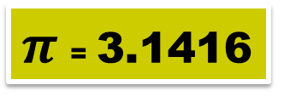
STAGGER FOR LANE No. 2
W (n-1) - 0.1 x 2π
W = 1.22 m
n = Lane Number
= ((1.22(2-1)) - 0.1) x 2 x 3.1416
= (1.22 - 0.1) x 6.2832
= 1.12 x 6.2832
= 7.037 m

Slide 26
Marking stagger
STEP - 1
Extension of tape
20 cm
7.037 m

Slide 27
Marking 400 meters staggers for lane 2. 3. and 4.
400 m start
22.38 m
14.71 m
7.04 m
o

Slide 28
STAGGER DISTANCES IN VARIOUS RACES IN STANDARD TRACK
Distance running | Bends run in lanes | L2 | L3 | L4 | L5 | L6 | L7 | L8
200 M | 1 | 3.519 | 7.351 | 11.184 | 15.017 | 18.850 | 22.682 | 26.515
400 M | 2 | 7.037 | 14.703 | 22.368 | 30.034 | 37.699 | 45.365 | 53.030
800 M | 1 | 3.526 | 7.384 | 11.259 | 15.151 | 19.060 | 22.987 | 26.930
4 X 400 M | 3 | 10.563 | 22.086 | 33.627 | 45.185 | 56.760 | 68.352 | 79.960

Slide 29
FORMULA FOR CALCULATING FULL STAGGER
FOR NONBORDERED TRACK
(W(n-1))X 2 
W = WIDTH OF THE LANE IN METERS
n = LANE NUMBER

Slide 30
STAGGER FOR LANE No. 2
(W(n-1))X 2 
W = 1.22
n = Lane Number
= (1.22(2-1)) x 2 x 3.1416
= 1.22 x 6.2832
= 7.665 m
Keep on adding 7.67 m on the stagger of the previous lane you will get the next lane stagger

Slide 31
Start for 800 m and 4 X 400 m Relay
For 800 m:- ½ Stagger + Diagonal Distance
For 4 X 400 m Relay:- 1½ Stagger + Diagonal Distance

Slide 32
Diagonal distance
C
1.22 m
2.34m
B
1.12 m
D
84.39 M
A
BD²= AB² + AD²
CD²= AC² + AD²
CD²= (2.34)² + (84.39)²
BD²= (1.12)² + (84.39)²
CD =84.4224
BD=√1.2544 + 7121.6721
BD =84.3974
CD=√5.4756 + 7121.6721
Diagonal Distance = CD - AD
Diagonal Distance = BD - AD
= .0324 m
DD= 84.3974 – 84.39
= .0074 m
DD= 84.4224 – 84.39

Slide 33
LANE NO. | DIAGONAL DISTANCE EXCESS
2 | 0.007 M
3 | 0.033 M
4 | 0.075 M
5 | 0.135 M
6 | 0.211 M
7 | 0.305 M
8 | 0.415 M

Slide 34
BREAK LINE
84.39 M
B
A

Slide 35
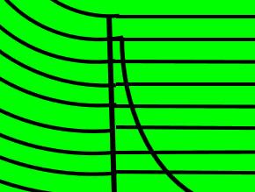
Placing cone just before the break line

Slide 36
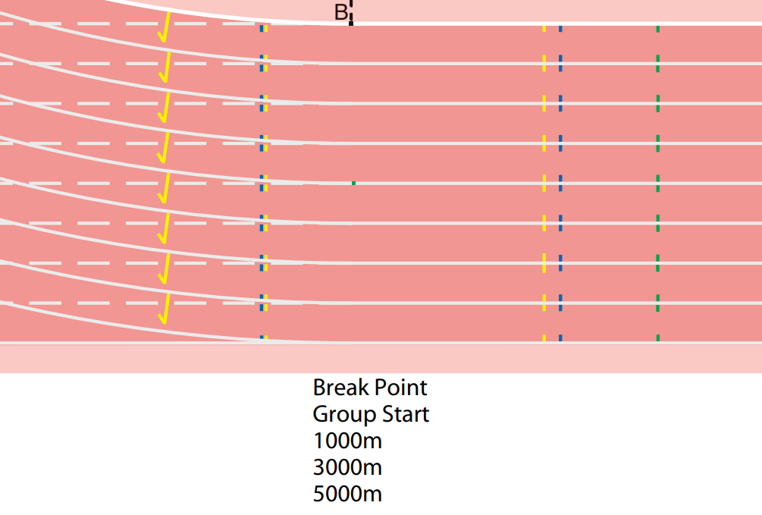
5 X 5 CM

Slide 37
Marking of 1500 m start line

Slide 38
Step - 1
30 cm

Slide 39
1500 M START LINE
AB =100 m
B
A
C

Slide 40
Starts of 3000 m, 5000 m, & 10000 m

Slide 41
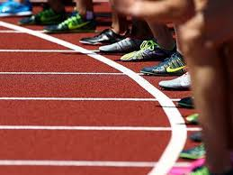

Slide 42
Radius of the Curved Start Line
Total curve distance divided by 8
Curve distance of lane 1 is 231.22 m
Radius of curve will be 231.22/8 = 28.90 m

Slide 43
STEP - 1
30 cm

Slide 44
C
STEP - 2
B
A
28.90 Meters
Start line for 10000 m race

Slide 45
Various type of markings and their colour
80 cm
Blue (4X400 m Relay common Takeover zone)
80 cm
Running Direction
Inner border
End of takeover zone
15 cm
Blue (4X400 m Relay first Takeover zone )
Start of takeover zone
80 cm

Slide 46
Green (Break line)
10 cm
Green (400 m Hurdles)
110 cm
End of Takeover zone
15 cm
Yellow (4X100 m Relay Takeover zone)
Start of Takeover zone
110 cm
12.5 cm X12.5 cm
Blue (Steeplechase Hurdle)

Slide 47
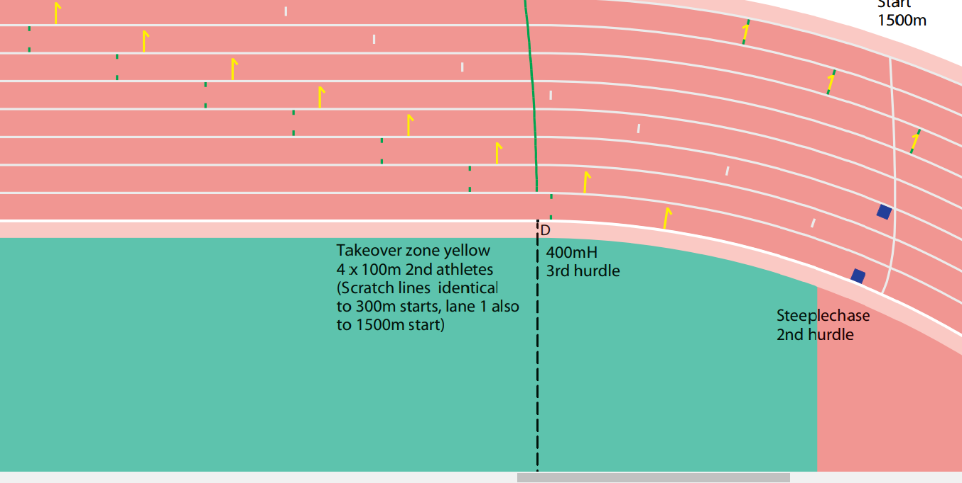
Break line
4X100 m 2nd runner Scratch Line
400 m Hurdles
4X100 m
Takeover zone
Steeplechase Hurdle

Slide 48
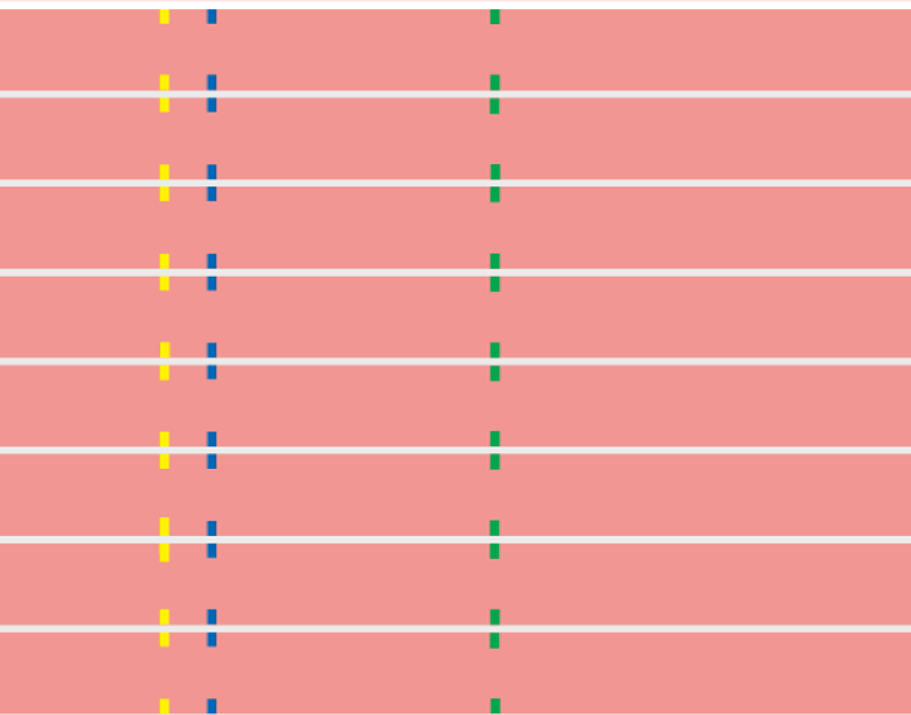
Hurdles Marking and their colour
400 m Hurdles
100 m Hurdles
110 m Hurdle

Slide 49
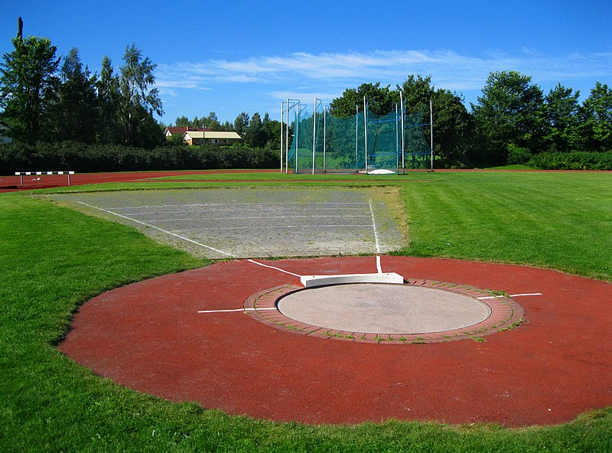
SHOT PUT/ HAMMER / DISCUS THROW SECTOR

Slide 50
DRAW A CIRCLE WITH THE RADIUS OF 1.0675 / 1.25 MTS.
1.0675 M/ 1.25 M
O

Slide 51
MARK 19.07 MTS POINT FROM THE CENTRE OF THE CIRCLE TOWARDS THROWING DIRECTION
E
5 M
3 M
OA = 19.07MTS
B
A
O
4 m
3 M
5 M
F

Slide 52
E
OA = 19.07MTS
B
A
O
F

Slide 53
5 CM
FRONT HALF
OA = 19.07MTS
A
O

Slide 54
B
OB = 20 MTS
6 MTS
OA = 19.07MTS
O
A
6 MTS
OC = 20 MTS
C

Slide 55
5 CM
5 CM
34.92⁰
O
75 CM

Slide 56
STOP BOARD ONLY FOR SHOT PUT
30 CM
1.20 – 1.22 M
34.92⁰
11.2 CM

Slide 57
Marking
of
Javelin / Ball throw sector

Slide 58
Javelin Marking
3 m
B
Reference Point
F
Draw a line AB of 4 meters with the help of reference Point
5 m
4 m
5 m
E
A
3 m

Slide 59
Javelin Marking
C
5 cm
4 m
75 cm
7 cm
G
F
B
4 m
O
8 m
28.96°
H
E
A
4 m
75 cm
General competition 30 m
International competition 33.50 m and it can be kept 36.50 m also
D

Slide 60
Javelin Marking
30 m
20 m
0
10 m
15 m
Rm/2
20 m
30 m

Slide 61
THANKS FOR THE PATIENCE YOU SHOWED

