Slide 1
COMBINED EVENTS

Slide 2
Combined events
Decathlon (10 events)
Heptathlon (7 events)
Pentathlon (5 events )
Hexathlon (6 events )
Triathlon (3 events)

Slide 3
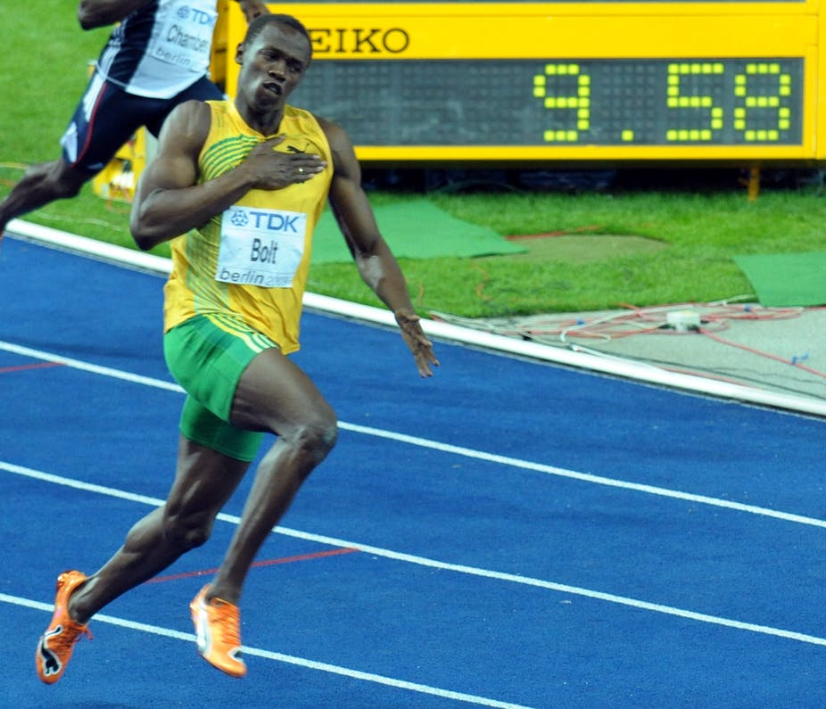
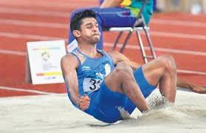
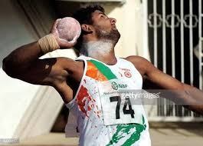
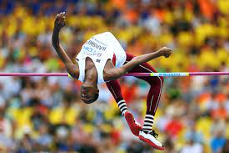
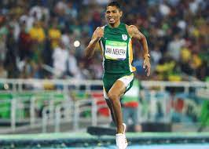
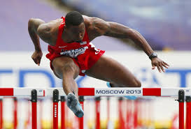
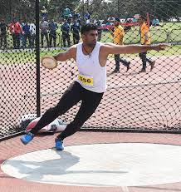
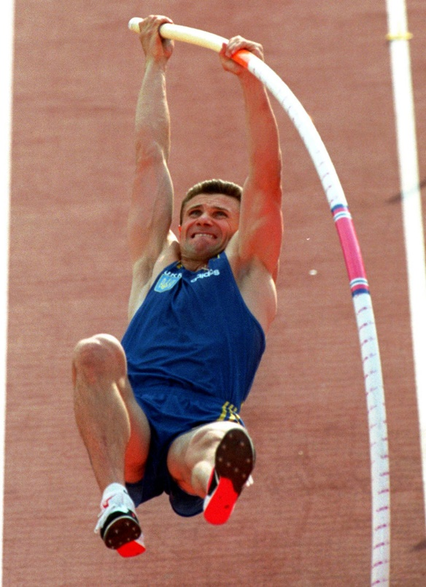
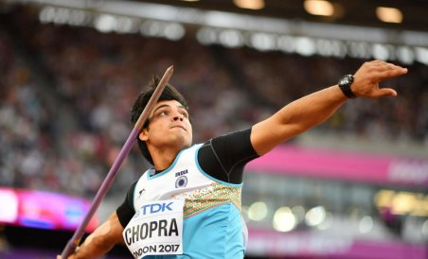
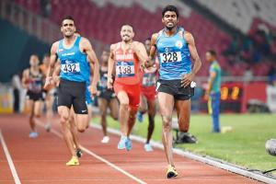
DECATHLON (MEN)
Events shall be held on Two consecutive 24 hrs period in following order
30 min
30 min
30 min
30 min
1
2
3
4
5
100 m
Long jump
Shot put
High jump
400 m
10 hours rest
30 min
30 min
30 min
30 min
6
7
8
9
10
110 m H
Discus
PV
Javelin
1500 m

Slide 4
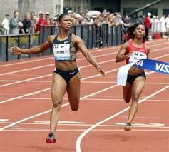
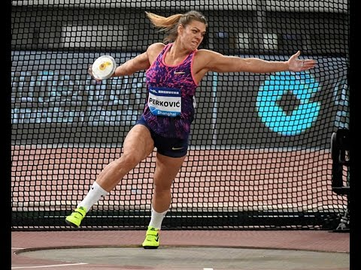
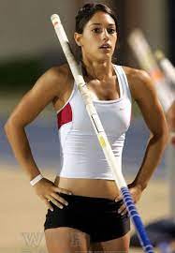
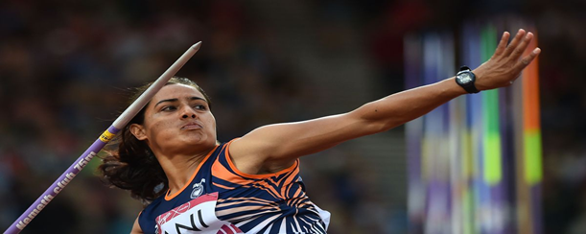
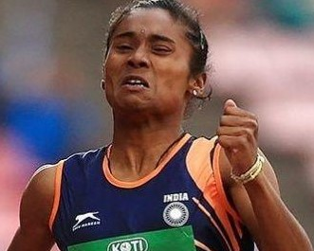
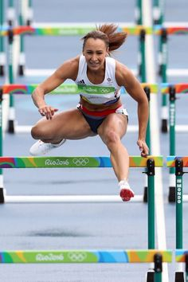
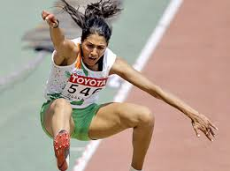
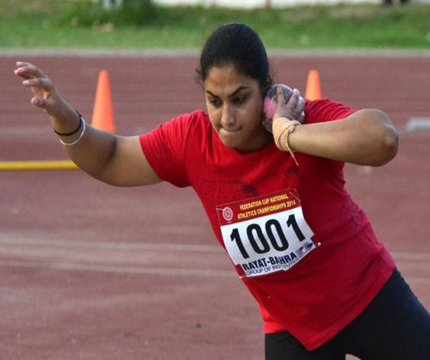
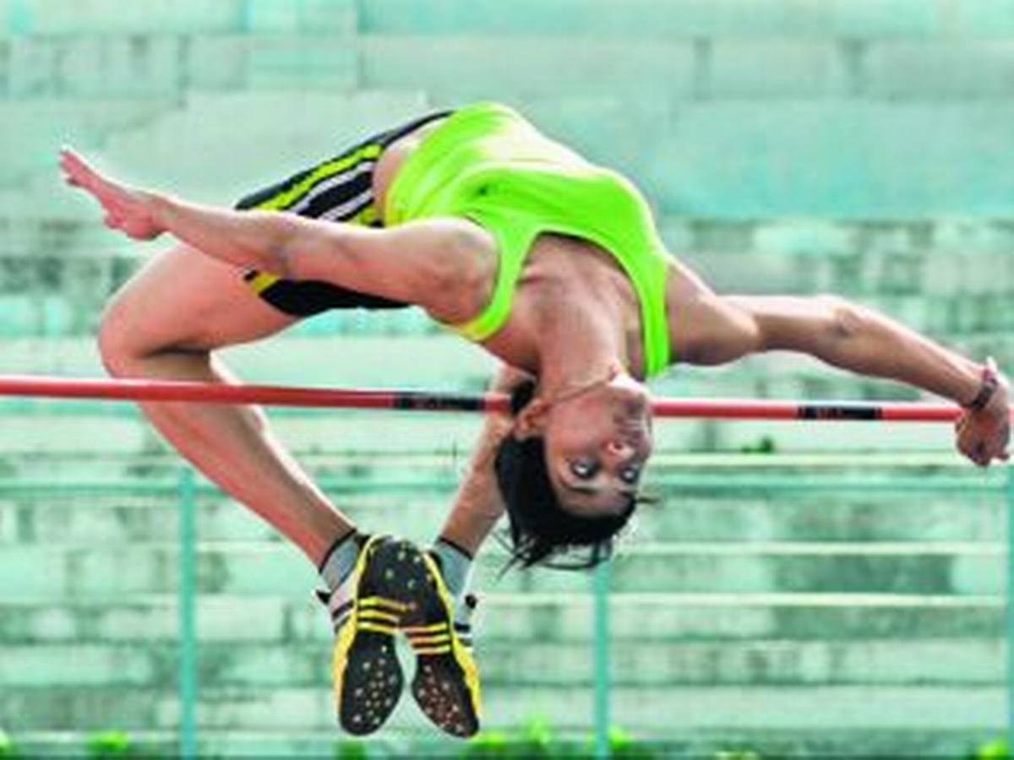
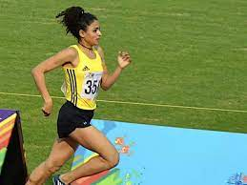
DECATHLON (WOMEN)
Events shall be held on Two consecutive 24 hrs period in following order
30 min
30 min
30 min
30 min
1
2
3
4
5
100 m
Discus
PV
Javelin
400 m
10 hours rest
30 min
30 min
30 min
30 min
6
7
8
9
10
100 m H
Long jump
Shot put
High jump
1500 m

Slide 5
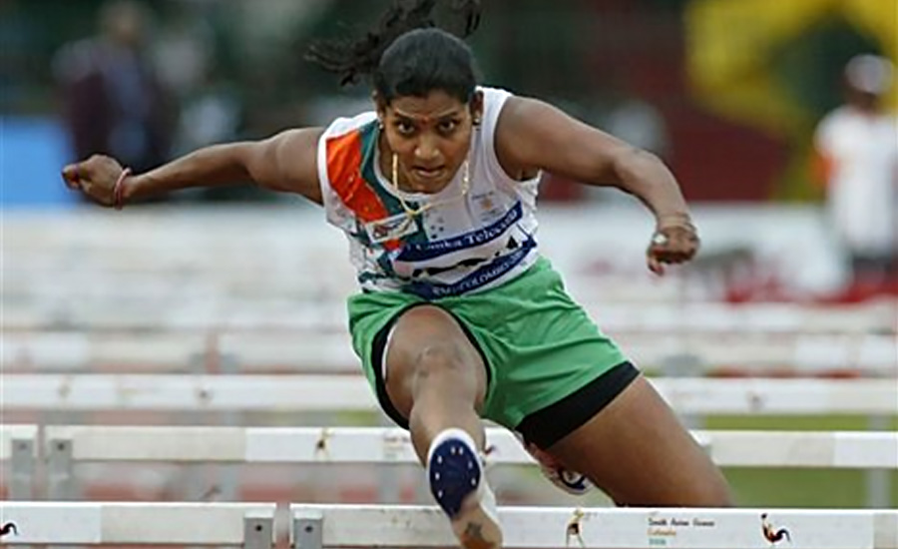
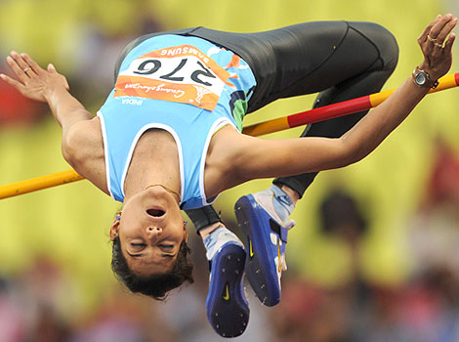
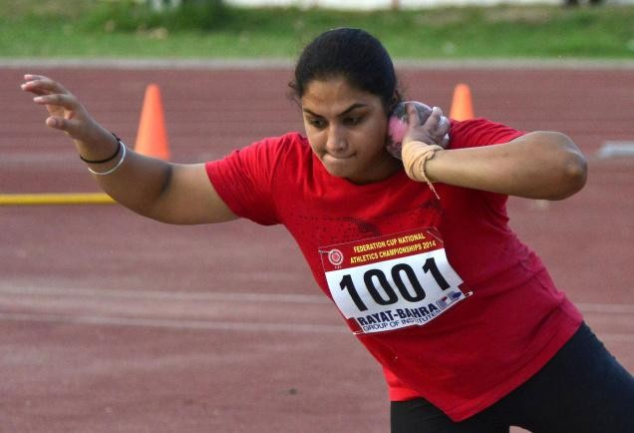
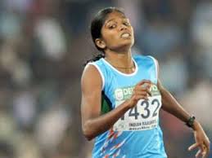
HEPTATHLON (WOMEN)
Events shall be held on Two consecutive 24 hrs period in following order
30 min
30 min
30 min
1
2
3
4
100 m H
High jump
Shot put
200 m
10 hours rest
30 min
30 min
5
6
7
Long jump
Javelin
800 m

Slide 6
HEXATHLON (GIRLS U16 YRS)
Events shall be held on Two consecutive 24 hrs period in following order
30 min
30 min
1
2
3
100 m
Long jump
Shot put
10 hours rest
30 min
30 min
4
5
6
High jump
Javelin
800 m

Slide 7
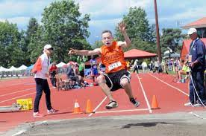
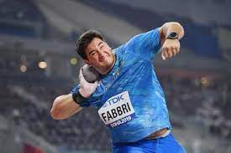
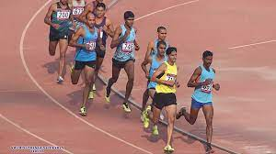
HEXATHLON (BOYS U16 YRS)
Events shall be held on Two consecutive 24 hrs period in following order
30 min
30 min
1
2
3
100 m
Long jump
Shot put
10 hours rest
30 min
30 min
4
5
6
High jump
Javelin
1000 m

Slide 8
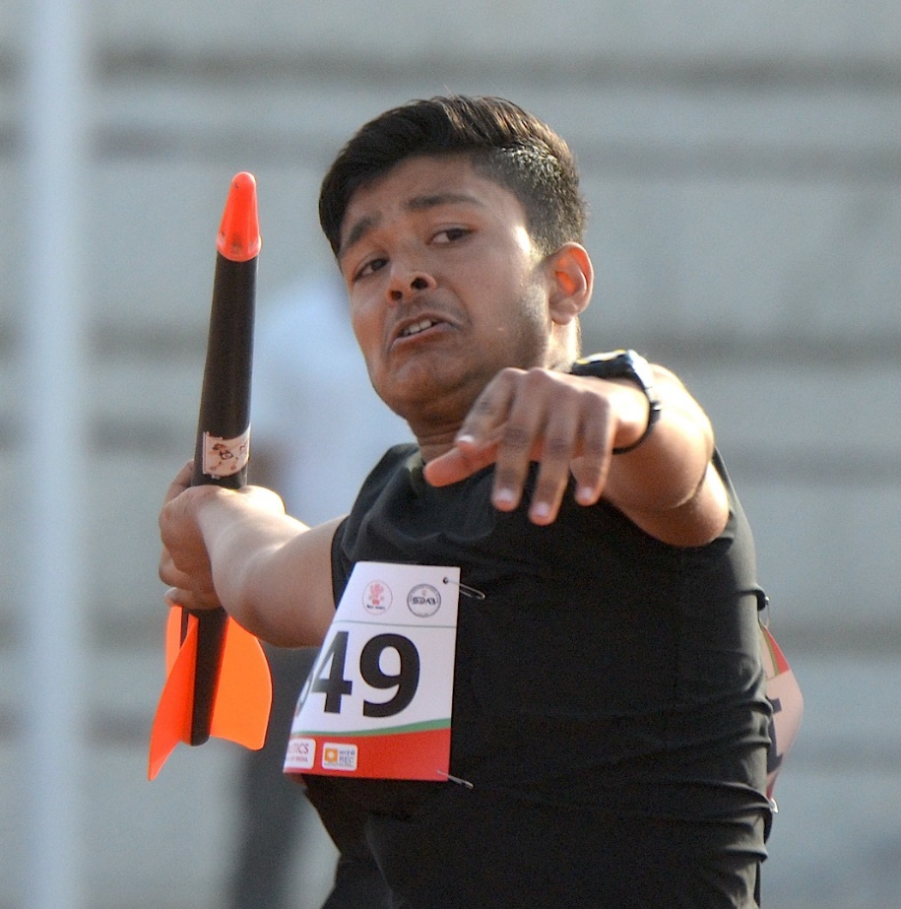
TRIATHLON (BOYS & GIRLS U14 YRS)
Events shall be held on a single day in following order
30 min
1
30 min
60 m
2
Long jump
3
Kids Javelin Throw

Slide 9
Question
How the winner is decided ?
Performance of all the events are added together. Athlete with Highest total score is the winner.

Slide 10
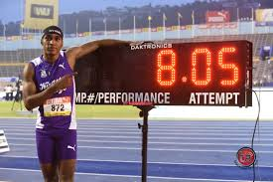
COMBINED EVENTS POINTS
HOW ARE THE PERFORMANCES OF EACH EVENTS ADDED?
+
Performance of all the events are converted into points with the help of the Points Table given by World Athletics

Slide 11
COMBINED EVENTS POINTS
Scoring Table Published by World Athletics

Slide 12
COMBINED EVENTS POINTS
100 m performance is 9.58 s
Long jump performance is 8.05 m
+
1202 Points
1073 Points
2275 Points after adding two events

Slide 13
TIE
What happens if the Points are TIED for two athletes after all the events ?
It’s a Tie
Give both the athletes same place

Slide 14
ABSENT FOR ANY EVENT
What happens if an athlete is absent in any one event ?
He/She is out of the competition
The athlete will not be allowed to participate in the remaining events of that combined event and shall not be displayed in the result.

Slide 15
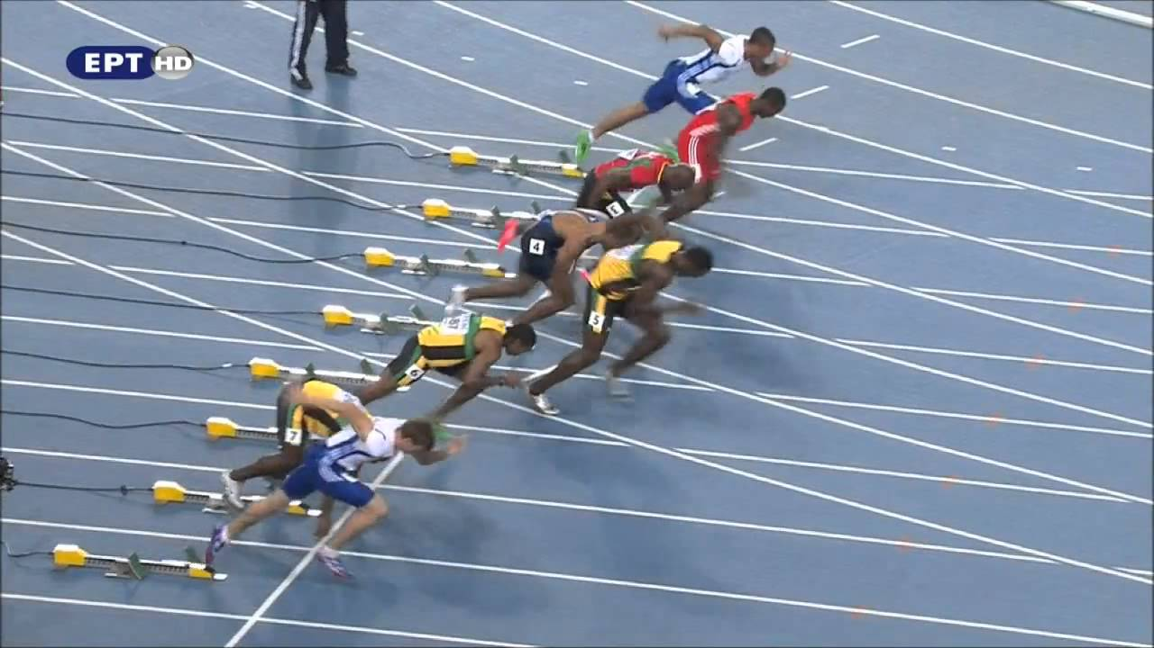
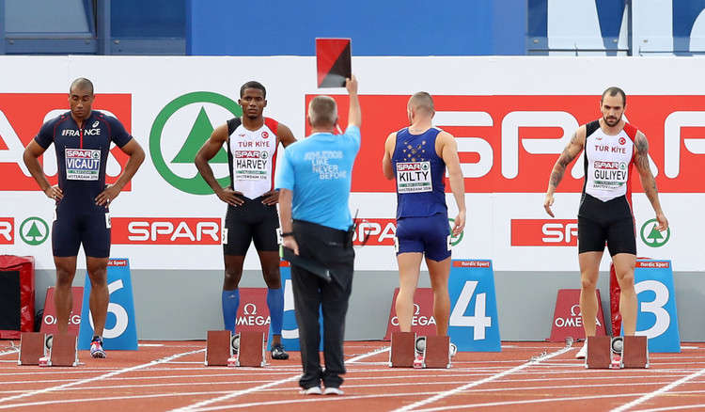
FALSE START
Any difference in rules between combined event and regular event ?
One false start per race is allowed

Slide 16
FALSE START - DISQUALIFICATION
What happens if an athlete is disqualified in track event due to false start?
He can continue in rest of the events

Slide 17
TIMING
Which type of Timing system should be used?
Only one system of timing may be applied throughout each individual event.
Either Hand Timing
or
Fully Automatic Photo Finish Timing system

Slide 18
HAND TIMING
How many timekeepers should time each athlete, if Hand timing system is used?
Each athlete’s time shall be taken by three Timekeepers independently

Slide 19
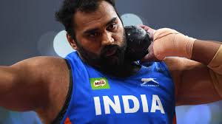
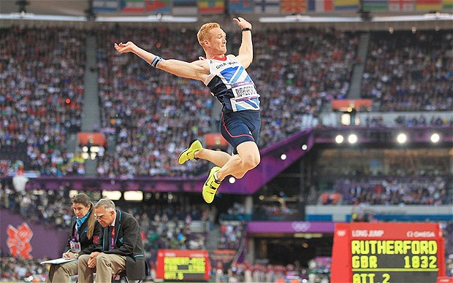
TRIALS – FIELD EVENTS
(Shot Put, Discus, Javelin, Long Jump)
Only three trial in field events

Slide 20
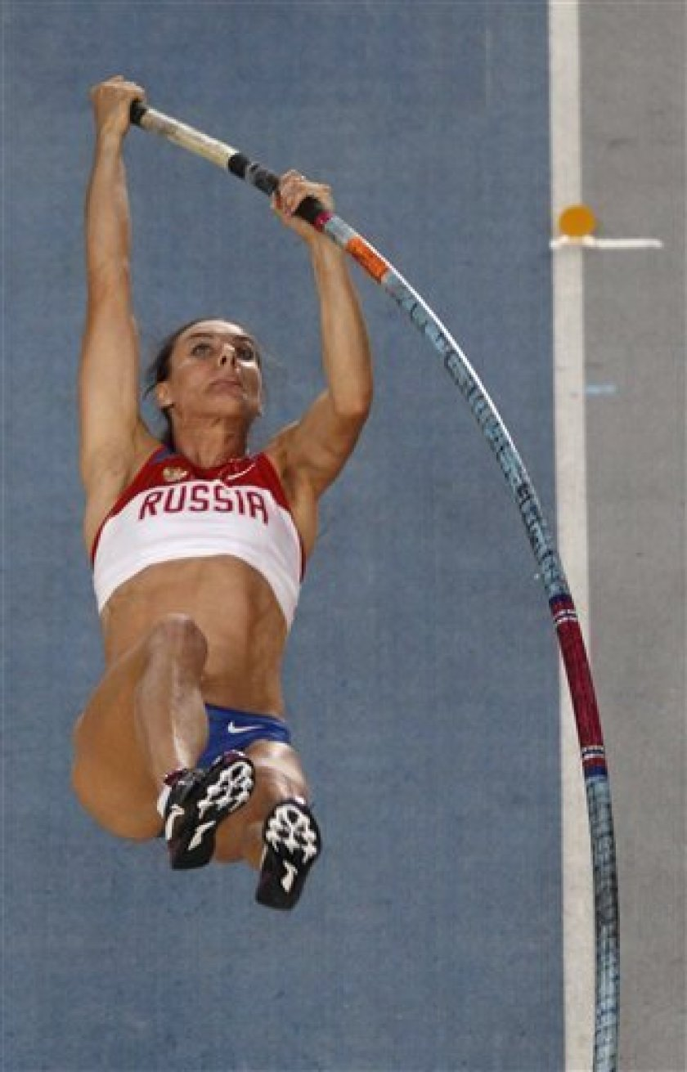
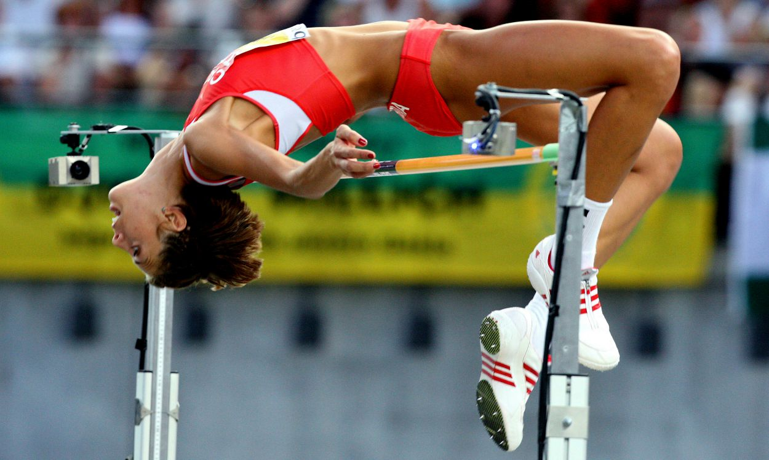
INCREMENT OF HEIGHT
(High Jump & Pole Vault)
Bar will be raised uniformly throughout the vertical jump events
3 cm for high jump and 10 cm for pole vault

Slide 21
SCORING
If the performance given by an athlete is not mentioned in the scoring table?
The next lower performance mentioned in the scoring table will be awarded
Example: For the women’s Javelin Throw there is no points score shown for a distance of 45.82m. The nearer shorter distance listed in the table is 45.78m for which there is a score of 779 points.

Slide 22
REPORTING
Will the athletes come from the call room for every event ?
Only for the first event of the day all the athletes will come from call room and for rest of the events they will report to the Combined Event Referee Directly.

Slide 23
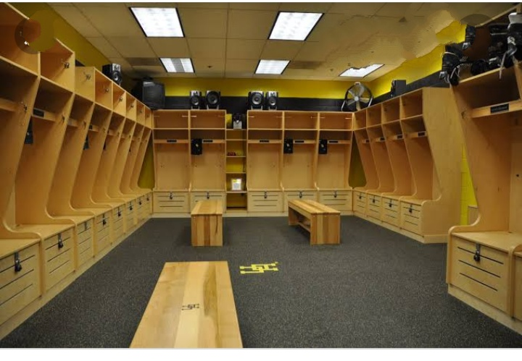
COMBINED EVENTS - RESTING AREA
Athletes will have events throughout the day so where will they take rest?
There is separate rest room for the Combined Event Athletes with lockers, refreshments, water, massage Table and beds etc.

