Slide 1
COMPETITION RULES
INTRODUCTION TO ATHLETICS,
OFFICIALS & THEIR DUTIES

Slide 2
TOPICS TO BE COVERED
TOPICS
History of Athletics
Brief Introduction of athletics
Information About the Rule Book (CR/TR)
Official of the meet and their duties in brief

Slide 3
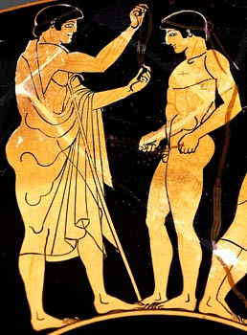
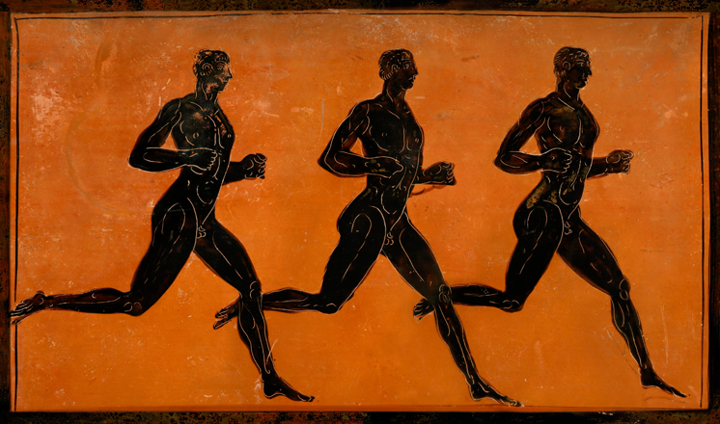
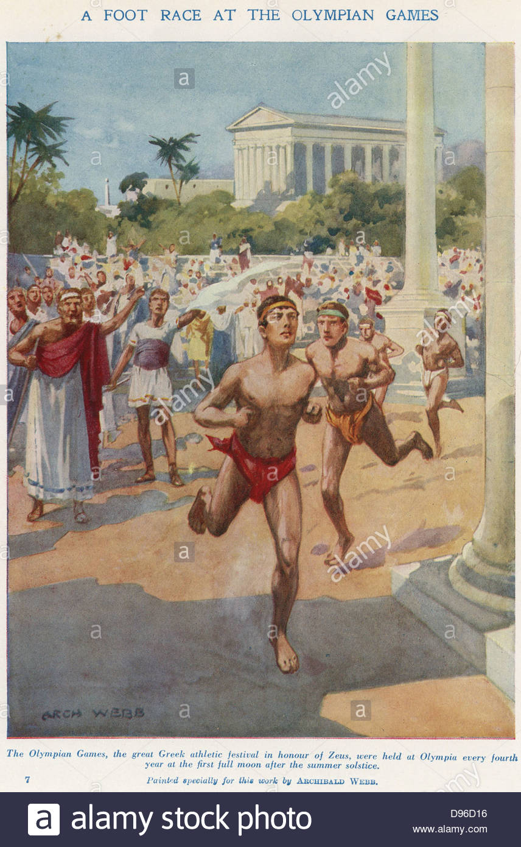
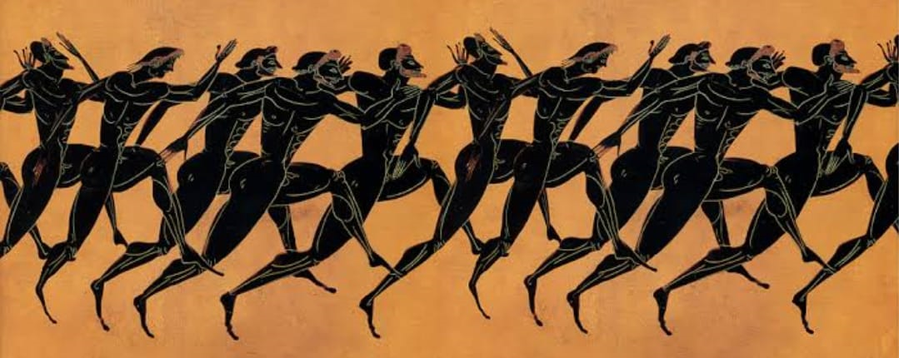
HISTORY OF ATHLETICS
Greeks introduced Athletics in the year 776 B.C. The event was Naked Straight footrace. In 1896 1st Modern Olympic flourish athletics.

Slide 4
DEFINITION OF ATHLETICS
Athletics is a group of competitive sporting events that involve running, jumping, throwing, and walking. The most common types of athletics competitions are track and field, road running, cross-country running, race walking and mountain & trail running.

Slide 5
INTRODUCTION
Athletics is a combination of Different Events. These are:-
Track-100,200,400,800,1000,1500,3000,5000,10000m run, Hurdles Race, Relay Race, Steeple Chase etc.
Jumping-Long Jump, Triple Jump, High Jump, Pole Vault
Throwing-Shot Put, Discus Throw, Hammer Throw, Javelin Throw
Combined Event -Decathlon, Heptathlon, Pentathlon, Hexathlon
Road Race -Marathon Race, Different Distance Race
Race Walking- Walking competition of Various Distance
Cross-country Race -Race in mixed surface
Mountain Running & Trail Running

Slide 6
STRUCTURE OF GOVERNING BODIES
REGULATING ATHLETICS
WA - World Athletics, (Formerly - IAAF – International Association of Athletics Federations)
AAA - Asian Athletics Association
AFI - Athletics Federation of India
State Athletics Associations
District Athletics Associations

Slide 7
INFORMATION ABOUT RULE BOOK (CR/TR)
In WA new rule Book 2022 edition available on www.worldathletics.org
CR - COMPETITION RULES – Duties & Responsibilities' of Technical Officials CR1-CR30, World Records CR31-CR36
TR - TECHNICAL RULES – Rules , Regulation & Specification of All the Events, Implements & equipments.

Slide 8
RULE BOOK (2022 EDITION)
FRONT COVER
BACK COVER
www.worldathletics.org
@WorldAthletics
6-8, Qual Antoine 1er, BP 359
MC 98007
Monaco Cedex
World Athletics 2021 All rights reserved

Slide 9
OFFICIALS OF THE MEET
& THEIR DUTIES
INTERNATIONAL OFFICIALS
Organisational Delegate(s)
Technical Delegate(s)
Medical Delegate
Anti-Doping Delegate
International Technical Officials
International Race Walking Judges
International Road Course Measurer
International Starter
International Photo Finish Judge
Jury of Appeal
MANAGEMENT OFFICIALS
Competition Director
Meeting Manager
Technical Manager
Event Presentation Manager
COMPETITION OFFICIALS
Referee Call Room
Referee Track
Referee Field
Referee Combined Events
Referee Outside stadium Events
Starter, Re-caller, Starter’s Assistant
Video Referee
Timekeepers
Photo Finish Judge
Chief Judge, Judges
Walking Judges
Recorder
Umpire
Lap scorer
Competition Secretary
Marshal
Wind Gauge Operator
ADDITIONAL OFFICIALS
Announcers
Statisticians
Advertising Commissioner
Official Surveyor
Doctors
Stewards
Photographers

Slide 10
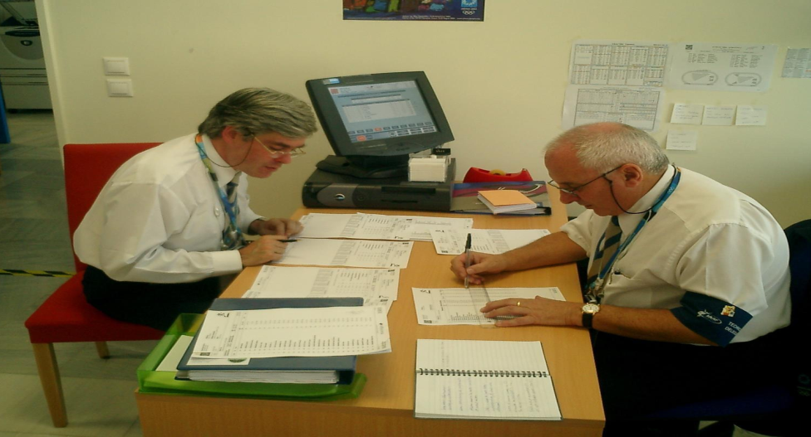
INTERNATIONAL OFFICIALS
Organisational Delegates
Work with LOC at all times & Report regularly to the AFI
Deal with financial matters & responsibilities of LOC and cooperate with the T.D.
Technical Delegates
Ensure that all technical arrangements are in complete conformity with WA Technical Rules,
Submit proposals for the timetable of events, entry standards, implements list, determine the qualifying standards for Field Events, control the entries , arrange heats, rounds and groups.
Report regularly to appointing Authority
Chair Technical Meeting .

Slide 11
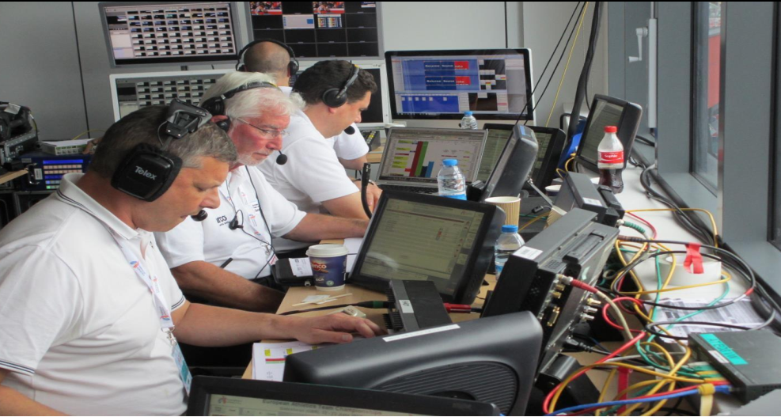
MANAGEMENT OFFICIALS
Competition Director
Shall plan the technical organization and Resolve any technical problems together with TD.
Keep in touch with all Key Officials.
Meeting Manager
Responsible for correct conduct of the Competition.
Check all the officials have reported for duty, appoint substitutes if required, authority to remove any official who is not abiding by the Rules.

Slide 12
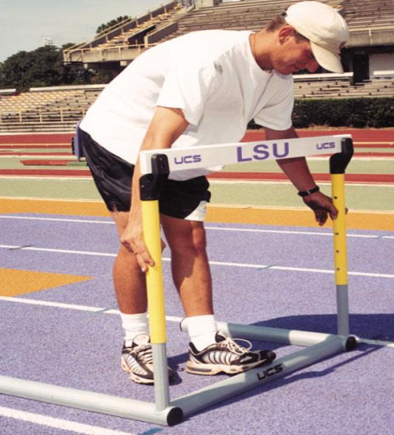
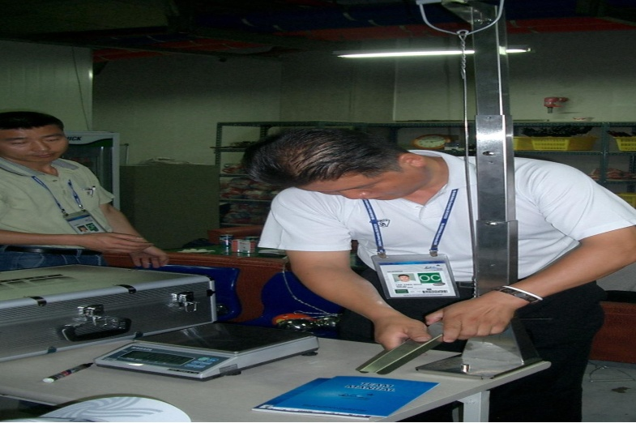
MANAGEMENT OFFICIALS
Technical Manager
Responsible for:-
Ensuring the track, runways, circles, arcs, sectors, landing areas for Field Events and all equipment and implements are in accordance with the Rules.
Placement and removal of equipment and implements.
Checking and marking any personal implements permitted according to Rule.

Slide 13
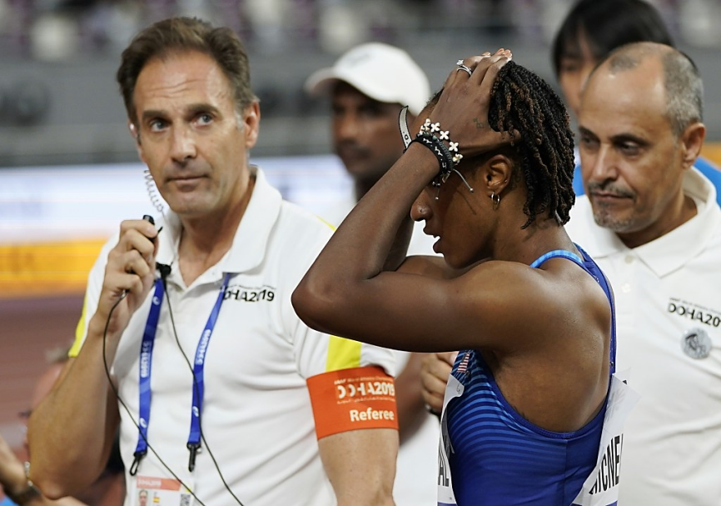
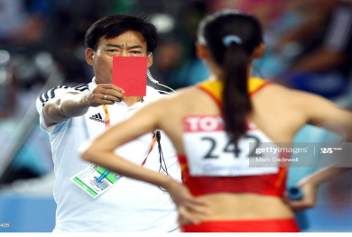
COMPETITION OFFICIALS
Referees
Entire control of the event up to victory ceremony.
Supervise record performance, check all result and sign the score sheets,
Decide disputed matters,
Can warn & exclude an athlete.
Reconsider a decision, can order for rerun of a race.

Slide 14
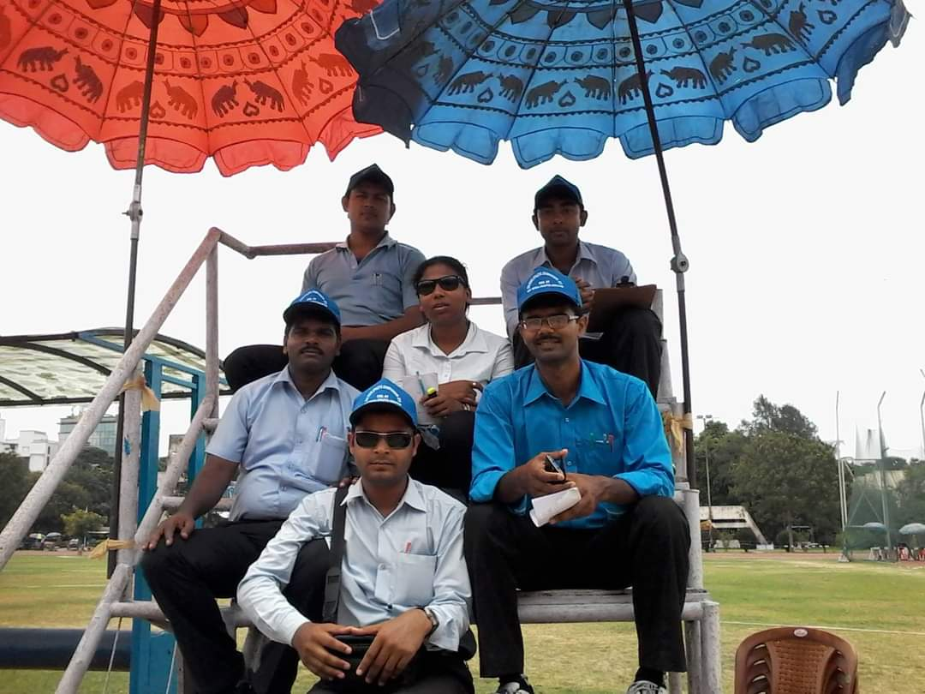
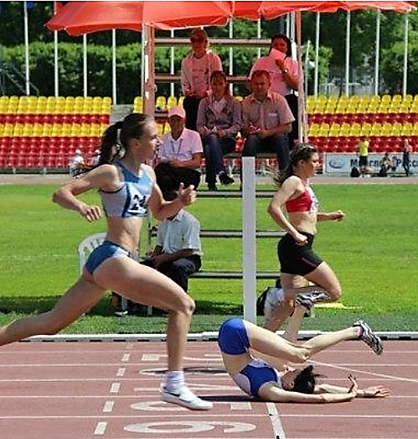
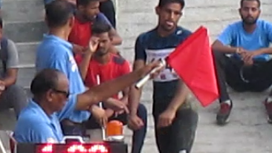
COMPETITION OFFICIALS
Judges
Chief Judge Allocate the duties.
Judges Decide the finished order, Record & measure each valid trial in Field Event, indicate validity or non-validity, time elapsed.
benefit of doubt goes in the favor of athlete.

Slide 15
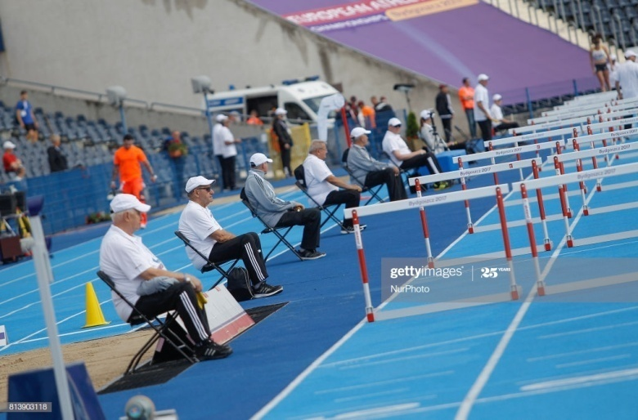
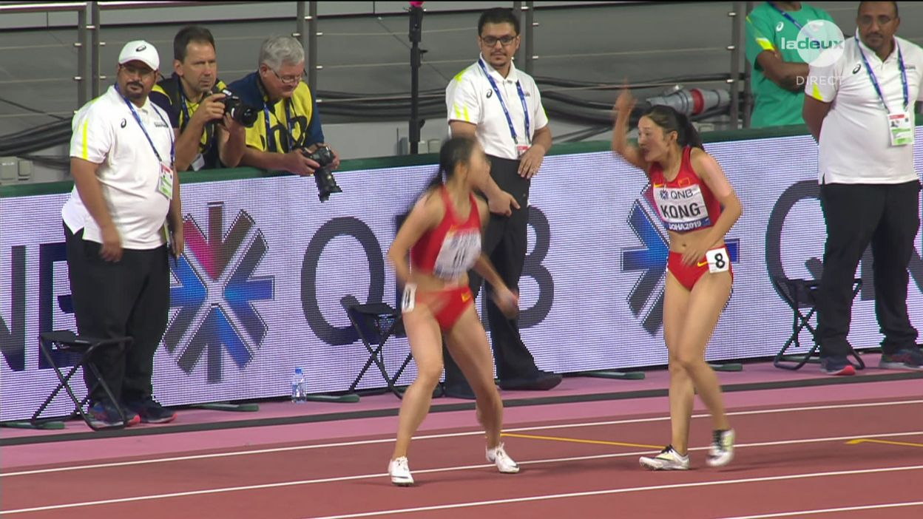
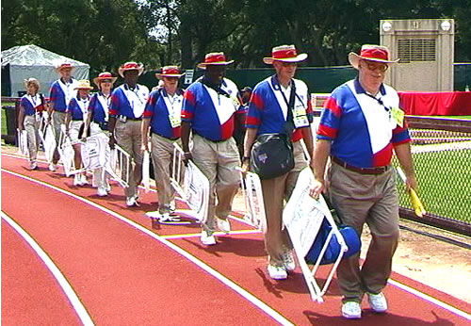
COMPETITION OFFICIALS
Umpires
(Running and Race Walking Events)
Umpires are the eyes of Referee, without authority to make final decisions
In case of any violation or breach of rules, Communicate immediately by raising an yellow flag & written report to referee

Slide 16
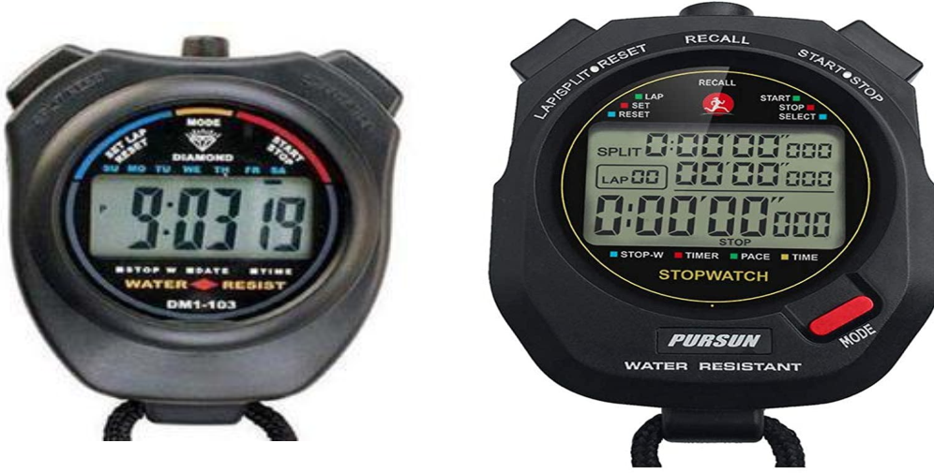
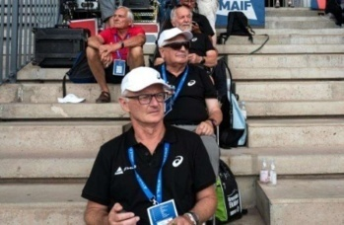
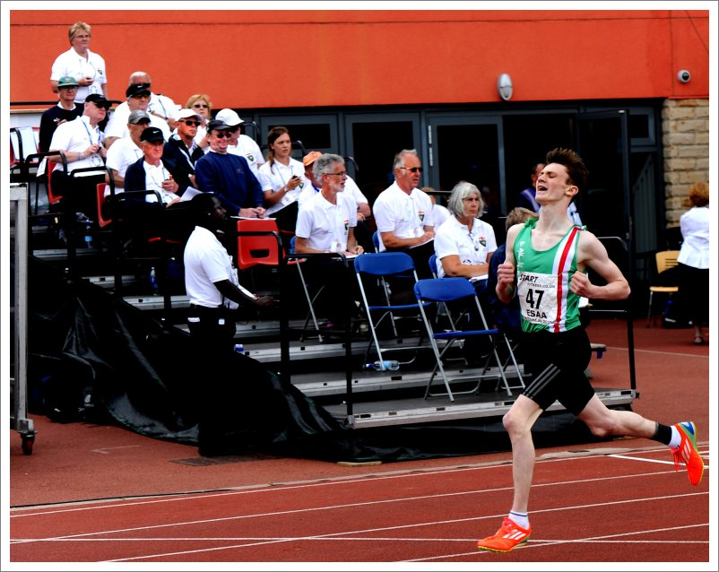
COMPETITION OFFICIALS
Timekeepers Judges
Timekeepers record time of a race using digital stop watches.

Slide 17
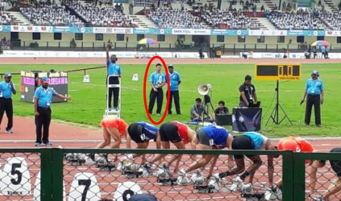
COMPETITION OFFICIALS
Start Coordinator
Allocate duties, Supervise duties, keep all papers, inform starter to start.
Starter
Start the race, decide who takes false start.

Slide 18
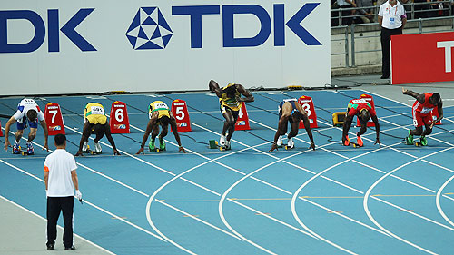
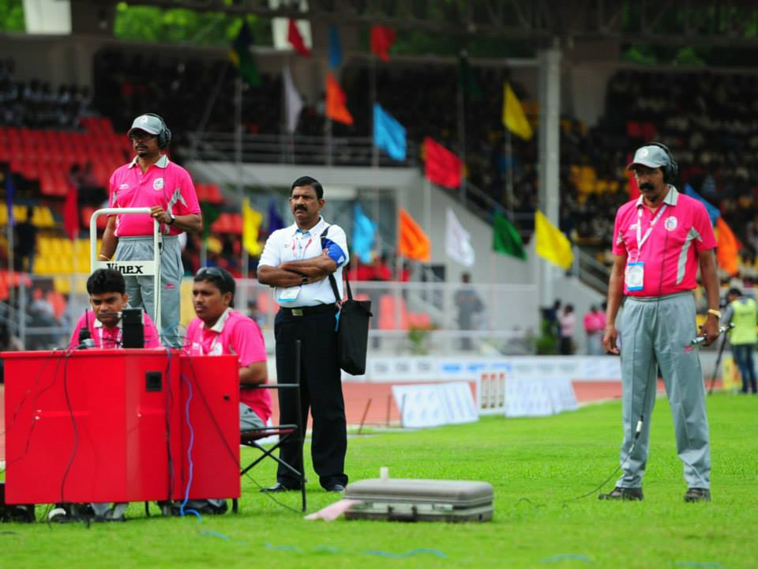
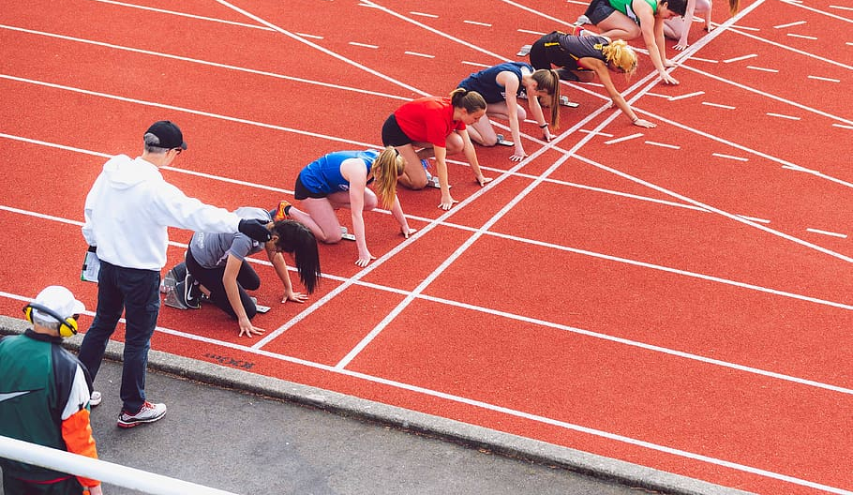
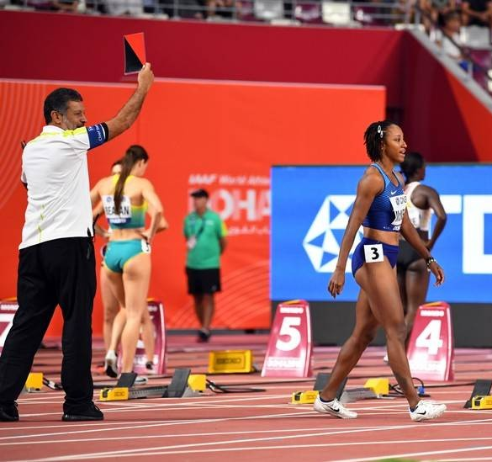
COMPETITION OFFICIALS
Recallers
Recall the race & inform to starter.
Starter’s Assistants
Place athletes in correct heat & lane on assembly line.
Check BIBs are worn correctly .
Readiness of baton in relay race.

Slide 19
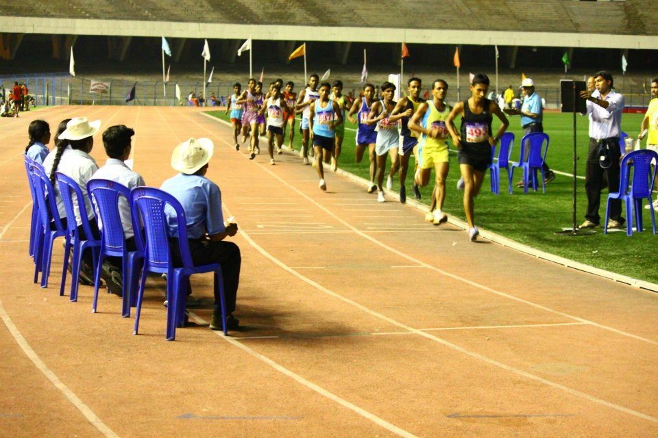
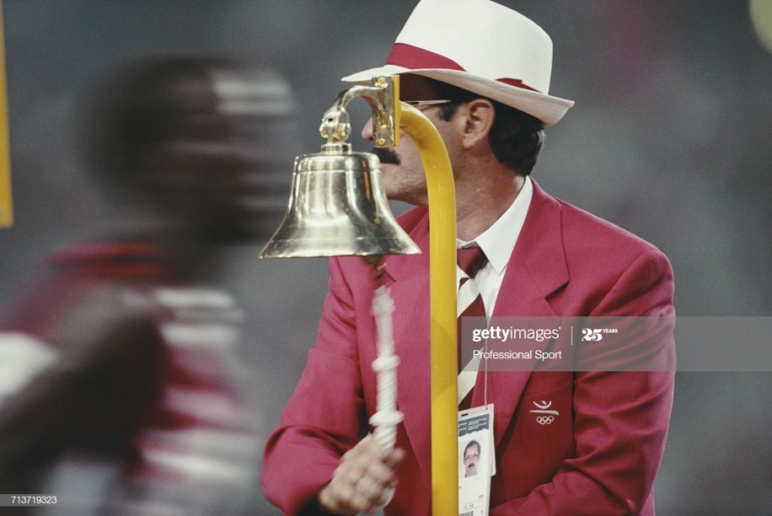
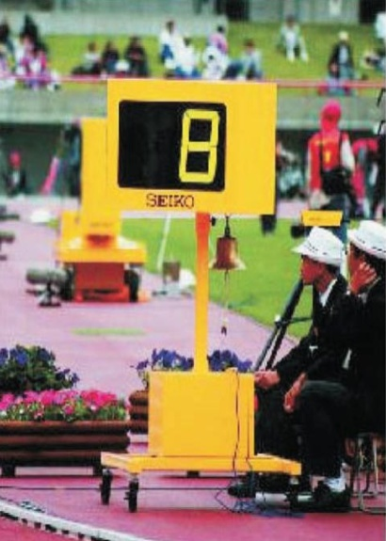
COMPETITION OFFICIALS
Lap Scorers
Keep record of laps, maintain lap display board and Final lap signaled by ringing bell.
One lap scorer can take lap count of up to four Athletes in Running Races and up to six in Race Walking
LAP SCORER

Slide 20
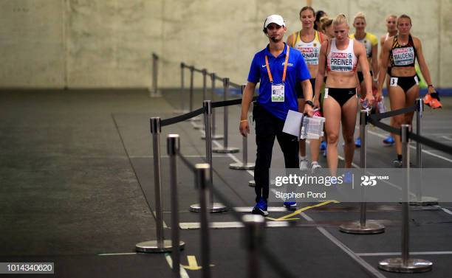
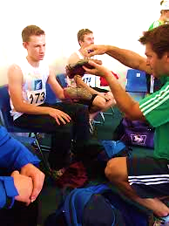
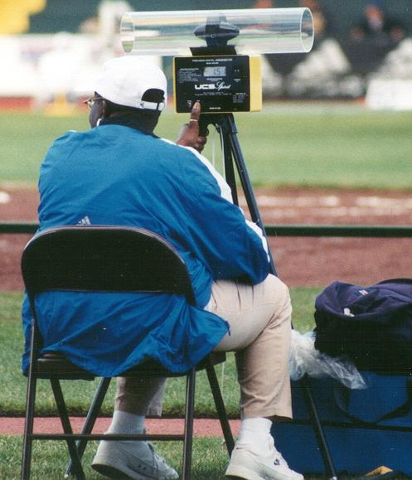
COMPETITION OFFICIALS
Call Room Judges
Ensure athletes are wearing officially approved national or club uniform.
Bibs are worn correctly and correspond with start lists, Check shoes, number and dimension of spikes, advertising on clothing and athletes bags comply with Rules & Regulations and no unauthorized material is taken into the arena.
Wind Gauge Operator
Place gauge & record wind velocity in the running direction.

Slide 21
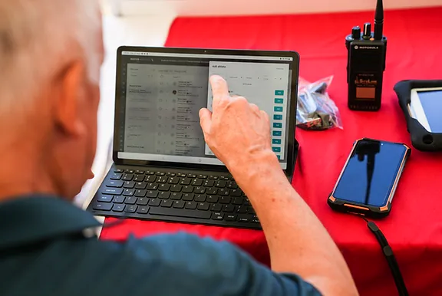
COMPETITION OFFICIALS
Competition Secretary
Collect full results, relay to announcer, keep records & convey result card to Competition Director

Slide 22
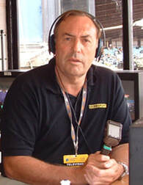
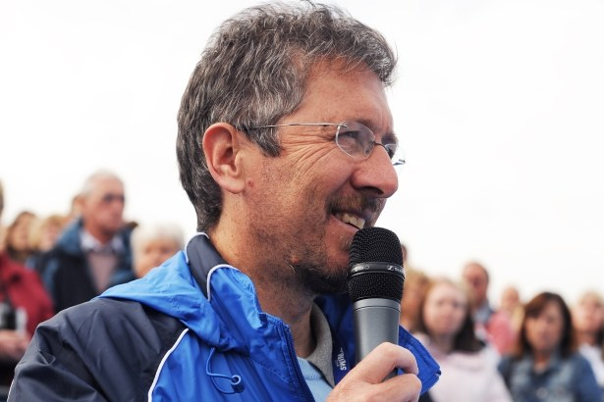
ADDITIONAL OFFICIALS
Announcer
Inform public sufficient information.

