Slide 1
GENERAL TECHNICAL RULES

Slide 2
AGE GROUPS
&
EVENTS IN INDIA

Slide 3
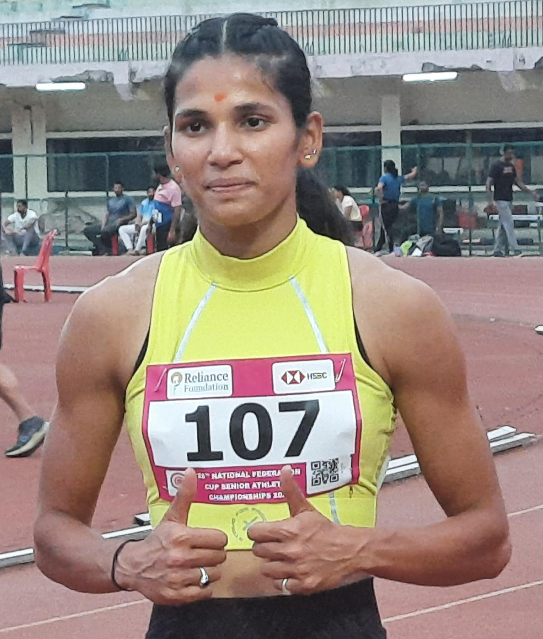
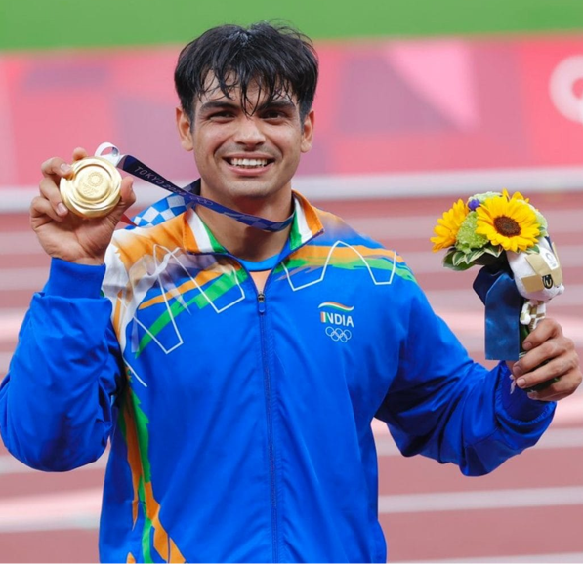
AGE GROUPS
MEN
U23 MEN
U20 MEN
U18 MEN
U16 BOYS
U14 BOYS
WOMEN
U23 WOMEN
U20 WOMEN
U18 WOMEN
U16 GIRLS
U14 GIRLS

Slide 4
AGE GROUPS
AGE for JUNIOR ATHLETES
The date of reckoning the age for athletes participating in age group Competitions in India will be as on the last date of the Competition. This will be valid for all Age Group Competitions.

Slide 5
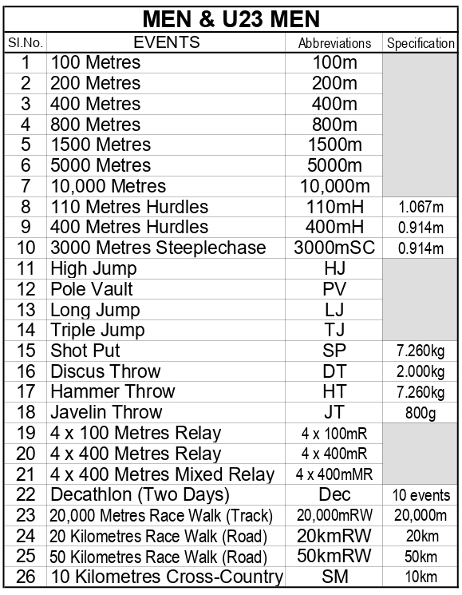
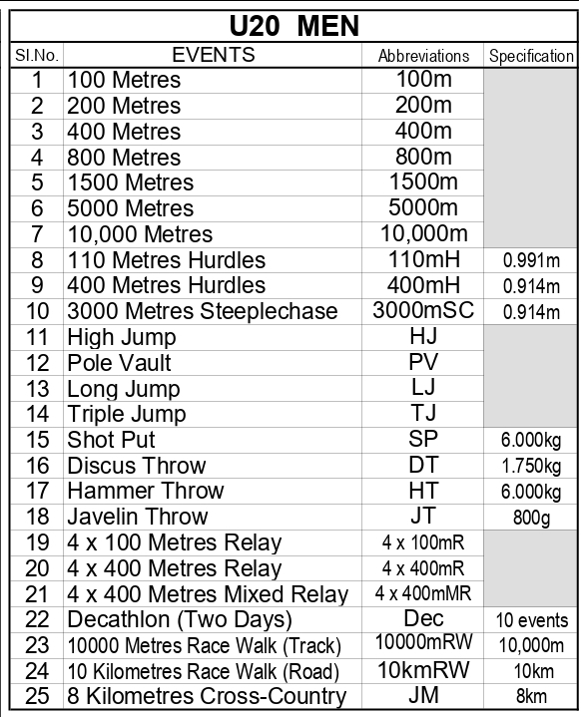
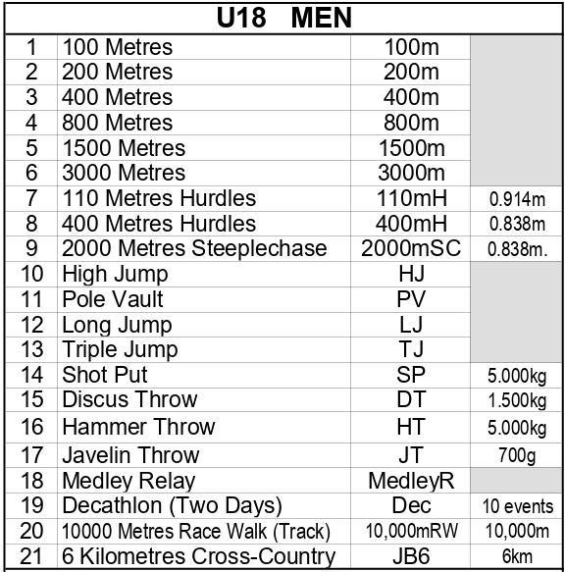
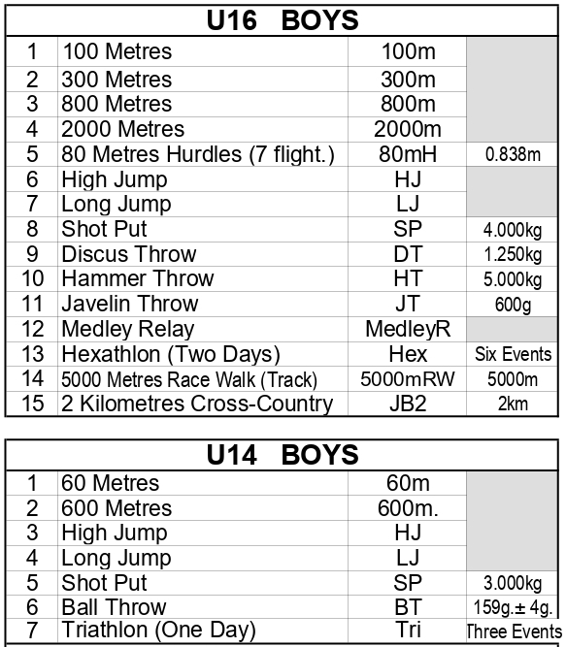


GROUPWISE EVENTS (MEN & BOYS)

Slide 6
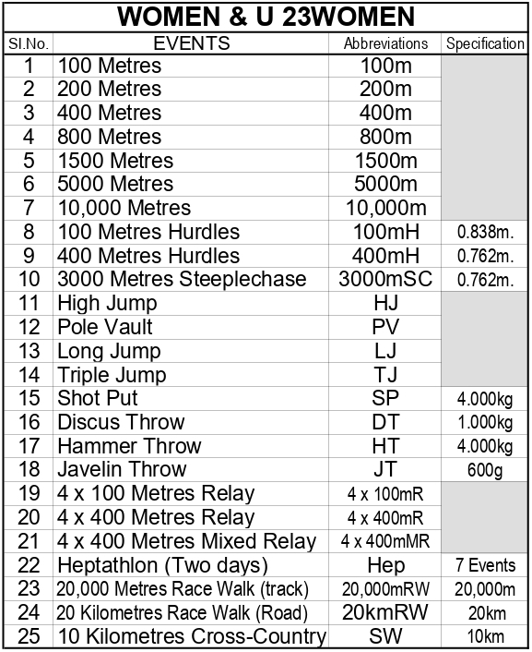
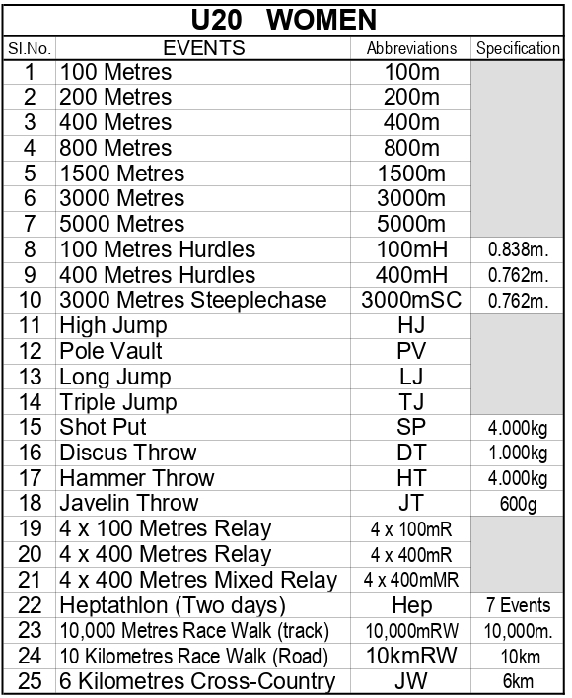
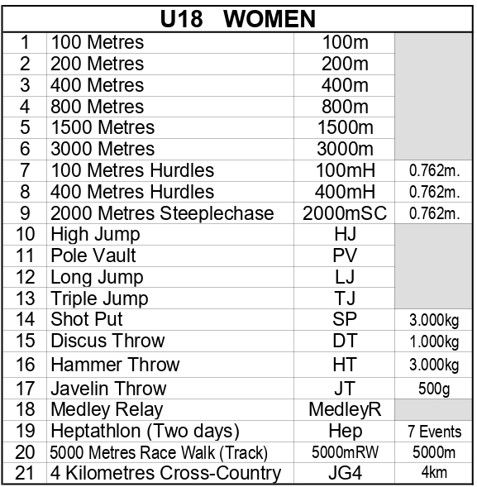
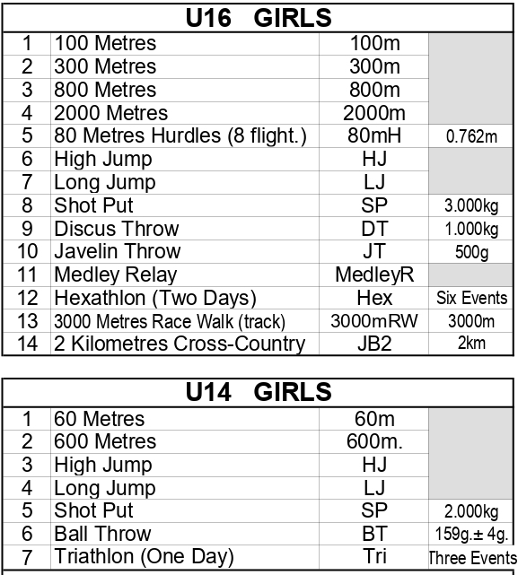
GROUPWISE EVENTS (WOMEN & GIRLS)

Slide 7
CLOTHING, SPIKES & BIBS

Slide 8
CLOTHING, SPIKES & BIBS
CLOTHING
Clothing must be clean, and designed and worn so as not to be objectionable.
The clothing must be made of a material which is non-transparent even if wet.
An athlete must not wear clothing, which could impede the view of the judges.
The victory Ceremony and any lap of honour are considered to be the part of the competition for this purpose.

Slide 9
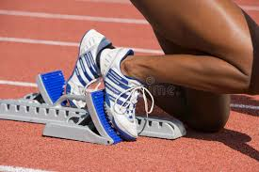
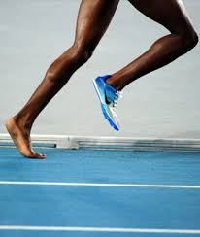
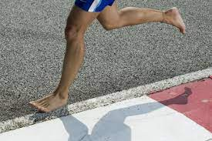
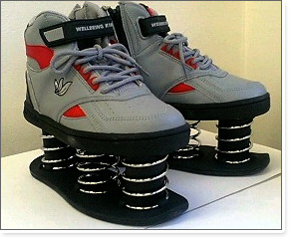
CLOTHING, SPIKES & BIBS
SHOES
Athletes may compete barefoot or with footwear on one or both feet.
The purpose of shoes for competition is to give protection and stability to the feet and a firm grip on the ground.
They must not give athletes any unfair assistance or advantage.

Slide 10
CLOTHING, SPIKES & BIBS
BARE FEET RUNNING
No Athlete will be allowed to participate bare foot in any Athletics Competitions as per the Regulations of AFI.
û
û

Slide 11
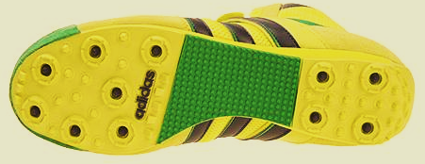
CLOTHING, SPIKES & BIBS
NUMBER OF SPIKES
The sole and heel of the shoes may be so constructed as to provide for the use of up to 11 spikes. Any number of spikes up to 11 may be used but the number of spike positions shall not exceed 11.

Slide 12
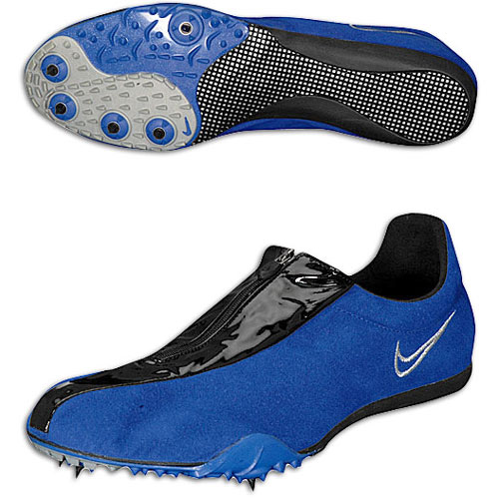
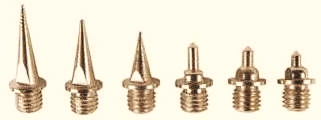
CLOTHING, SPIKES & BIBS
DIMENSIONS OF THE SPIKES
FOR HIGH JUMP AND JAVELIN :
The part of each Spike which projects from the Sole or heel shall not exceed 12mm.
FOR OTHER EVENTS
Sole or heel shall not exceed 9mm.
The spike must be so constructed that it will, at least for the half of its length closest to the tip, fit through a square sided 4mm gauge.
It may be lesser maximum if track manufacturer or stadium operator mandates

Slide 13
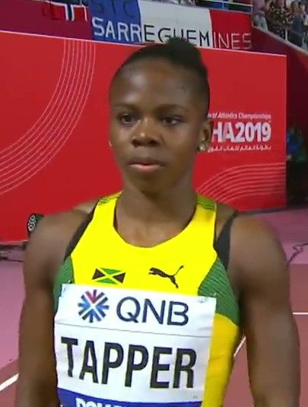
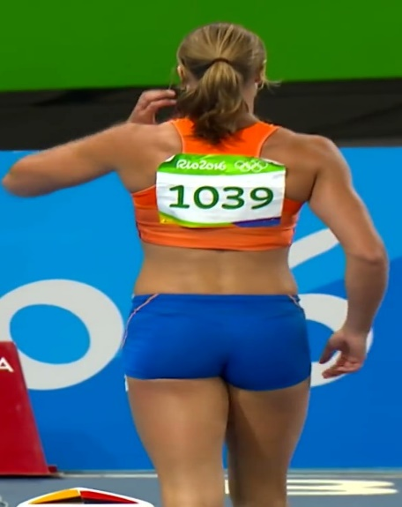
CLOTHING, SPIKES & BIBS
ATHLETE BIBS
Every athlete shall be provided with two bibs which, during the competition, shall be worn visibly on the front of the torso and back.
In jumping events, Athlete can compete with one bib worn either on the front or back.
These bibs must be worn as issued and may not be cut, folded or obscured in any way. In running or walking events of 10,000 metres and longer, the bibs may be perforated to assist the circulation of air, but the perforation must not be made on any of the lettering or numerals appear on them.

Slide 14
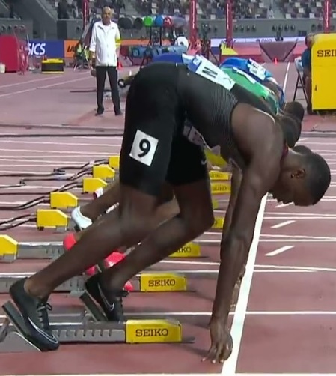
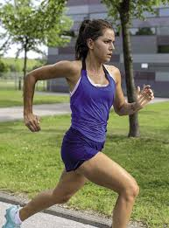
CLOTHING, SPIKES & BIBS
ATHLETE BIBS
Where a Photo Finish system is in operation, the Organisers may require athletes to wear additional number identification of an adhesive type on the side of their shorts or lower body.
No athlete shall be allowed to take part in any competition without displaying the appropriate bib(s) and/or identification. If an athlete does not follow this, they shall be disqualified

Slide 15
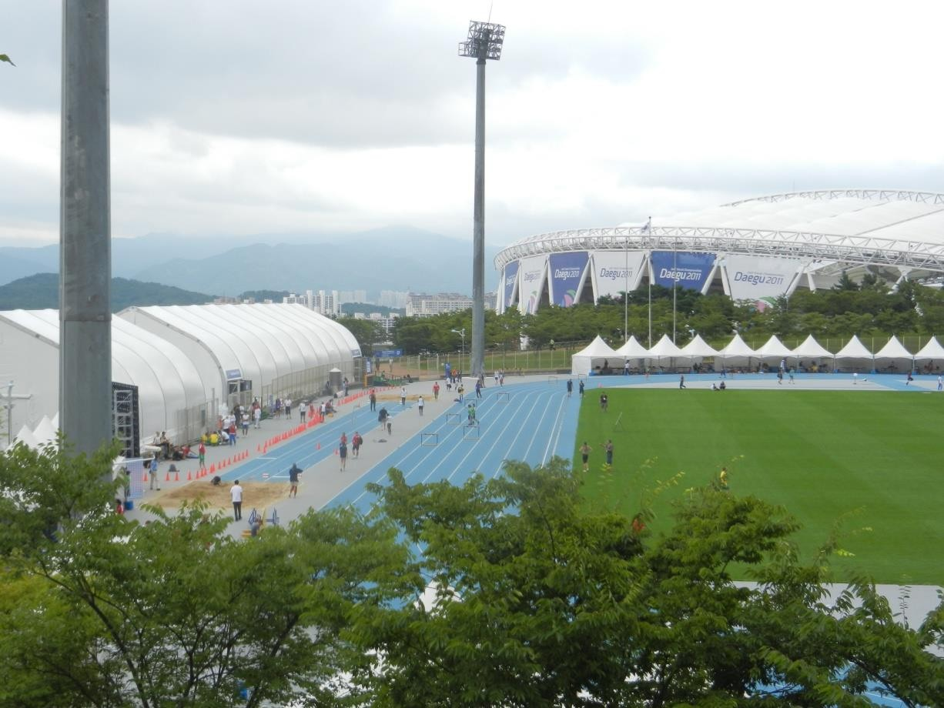
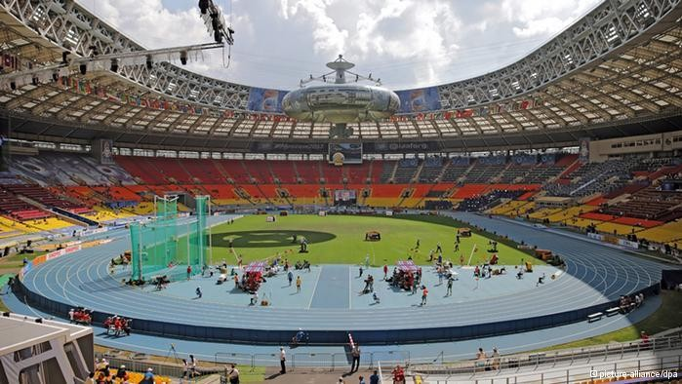
FLOW OF ATHLETES
Warm Up
First Call Room
Warm Up Area
First Call Room
Final Call Room
Competition venue
Final Call Room
Competition Venue
Mixed Zone
Post Event Area
Mixed Zone
Post Event Area

Slide 16
ASSISTANCE TO ATHLETES

Slide 17
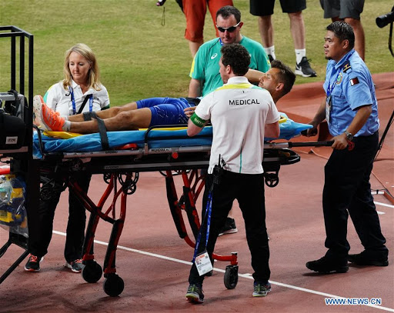
ASSISTANCE TO ATHLETE
MEDICAL EXAMINATION AND ASSISTANCE
Medical examination / treatment and/or physiotherapy may be provided either on the competition area itself by official medical staff appointed by Organisers and identified by armbands, vests or similar distinctive apparel or in designated medical treatment areas outside the competition area by accredited team medical personnel specifically approved by medical or Technical delegate(s).
such attendance or assistance by any other person, whether immediately before competition, once athletes have left the Call Room or during competition, is assistance.

Slide 18
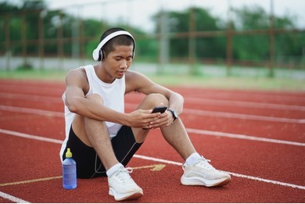

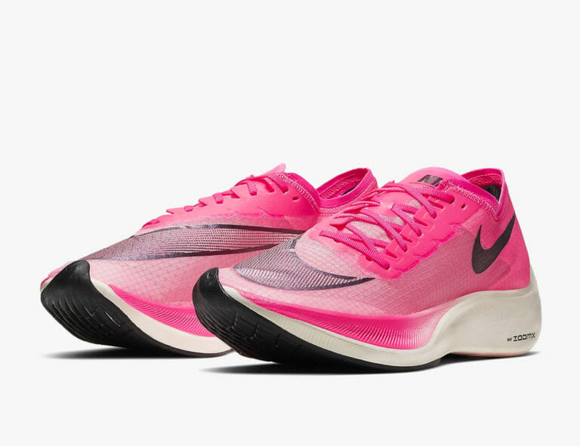
ASSISTANCE NOT ALLOWED
Pacing by persons not participating in the same race, by athletes lapped or about to be lapped or by any kind of technical device (other than those permitted under Rule 6.4.4 of the Technical Rules).
Possession or use of video recorders, radios, CD, radio transmitters, mobile phone or similar devices in the competition area.
Except for shoes complying with Rule 5 of the Technical Rules.

Slide 19
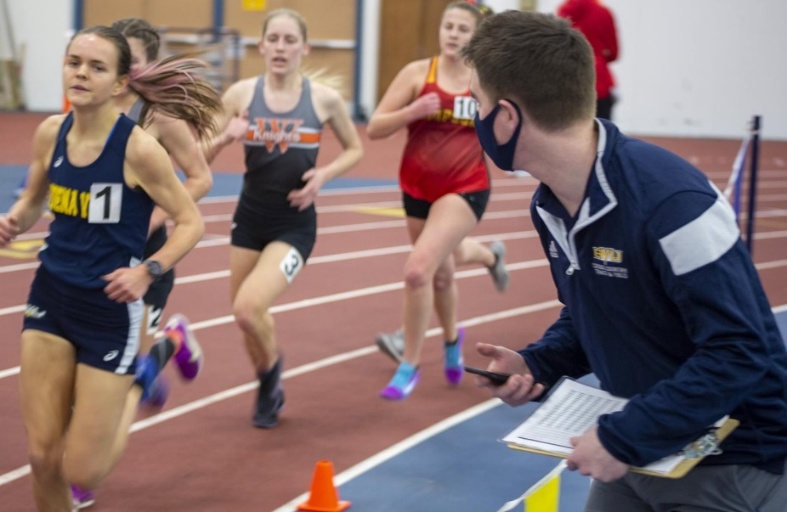
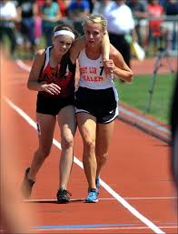
ASSISTANCE NOT ALLOWED
Provision of advice or other support by any official of the competition not related to or required by their specific role in the competition at the time (e.g., coaching advice, indication of the take-off point in a jumping event except to indicate a failure in Horizontal Jumps, time or distance gaps in a race etc.).
Receiving physical support from another athlete (other than helping to recover to a standing position) that assists in making forward progression in a race.

Slide 20
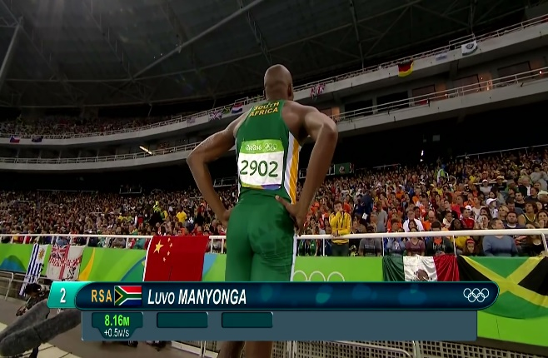
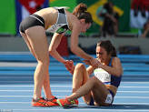
ASSISTANCE ALLOWED
Communication between the athletes and their coaches not placed in the competition area.
Receiving physical support from an official or other person designated by the organisers to recover to a standing position or to access medical assistance.

Slide 21
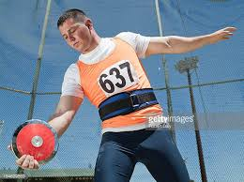
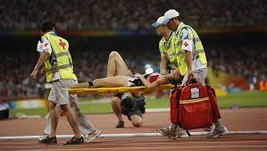
ASSISTANCE ALLOWED
Any kind of personal safeguard (e.g. bandage, tape, belt, support, wrist cooler, breathing aid etc.) for protection and/or medical purposes.
Medical examination / treatment and/or physiotherapy necessary to enable an athlete to participate or continue participation once on the competition area under Rule 6.1 of the Technical Rules.

Slide 22
PROTESTS AND APPEALS

Slide 23
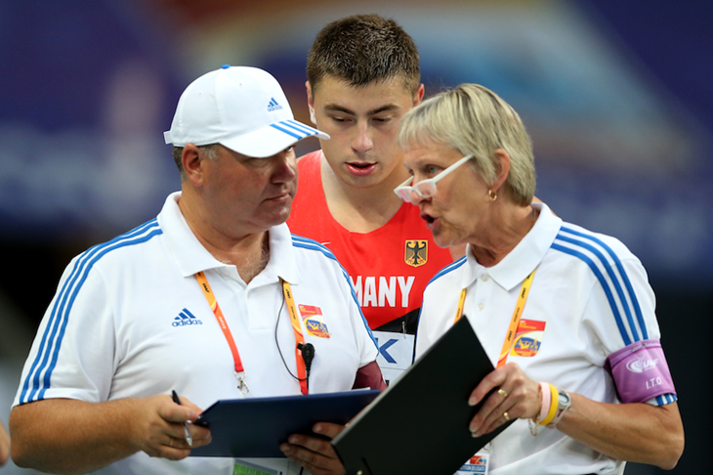
PROTESTS AND APPEALS
ORAL PROTEST TO REFEREE
APPEAL TO JURY OF APPEAL

Slide 24

PROTESTS AND APPEALS
PROTEST
CONCERNING THE STATUS OF AN ATHLETE
CONCERNING THE RESULT OR CONDUCT OF AN EVENT

Slide 25
PROTESTS AND APPEALS
PROTEST
CONCERNING THE RESULT OR CONDUCT OF AN EVENT
AFTER ANNOUNCEMENT OF RESULT
IMMEDIATE ORAL PROTEST

Slide 26
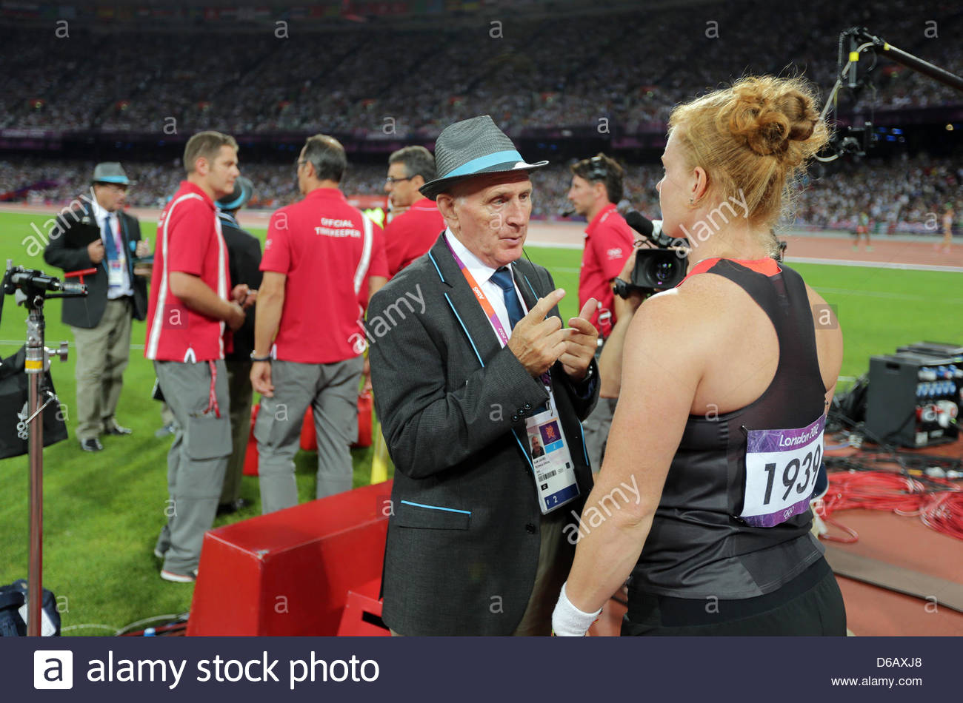
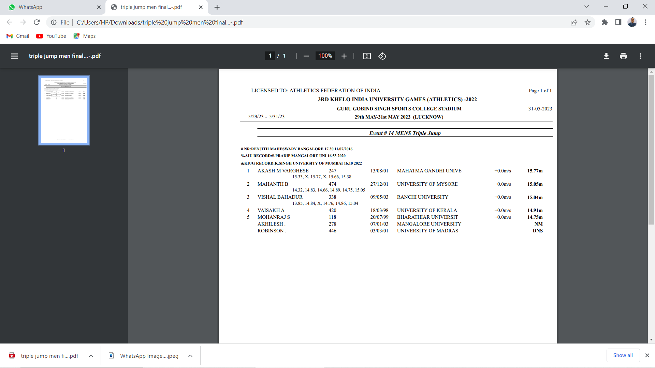
PROTESTS AND APPEALS
PROTEST
AFTER ANNOUNCEMENT OF RESULT
TO WHOM PROTEST SHALL BE MADE
Any protest shall be made orally to the Referee
CONDITION
Protests concerning the result or conduct of an event shall be made within 30 minutes of the official announcement of the result of that event.
Result announced at 11:27am

Slide 27
PROTESTS AND APPEALS
PROTEST
AFTER ANNOUNCEMENT OF RESULT
WHO CAN PROTEST?
An athlete
Someone acting on their behalf
An official representative of a team, if they are competing in the same round of the event to which the protest (or subsequent appeal) relates.
Or competing in a competition in which team points score is being considered).

Slide 28
APPEAL TO THE JURY

Slide 29
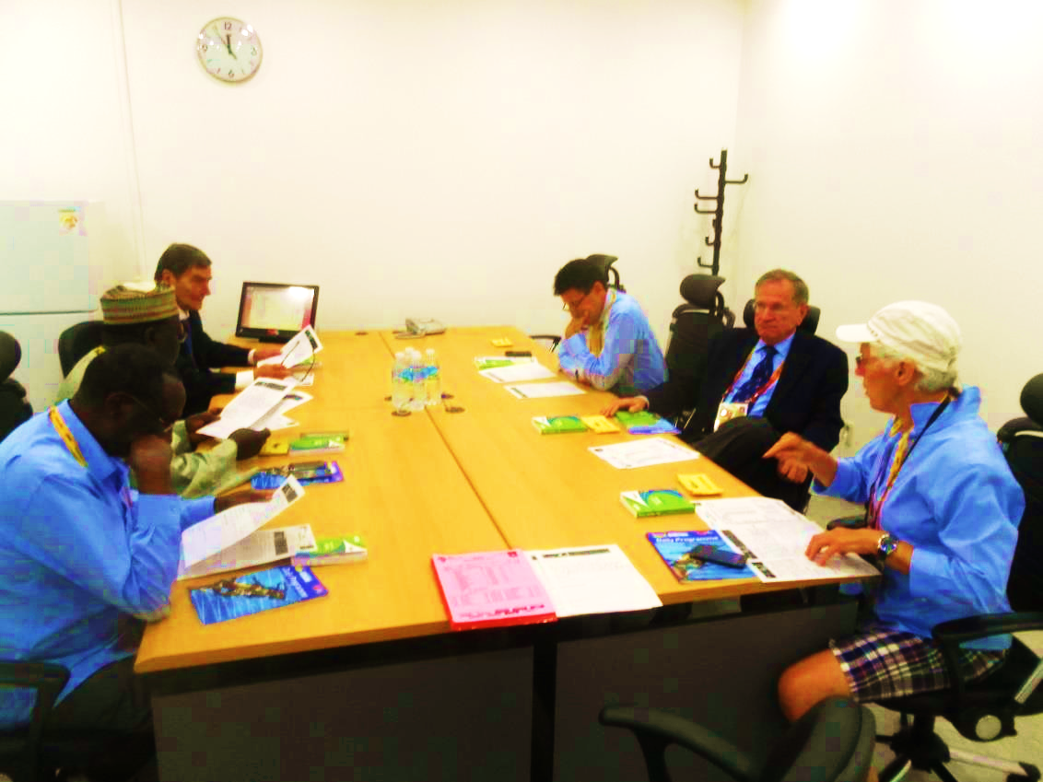
PROTESTS AND APPEALS
JURY OF APPEAL
In the interest of the proper conduct of the competitions, a Jury of Appeal should be appointed at all competitions.
It normally consist of three, five or seven persons.
One of the member shall be the Chairman.
Another one shall be the secretary. (If appropriate he may be a person not included in the jury).
If an appeal related to Race Walking then one of the Jury member shall be a Race walking Judge.

Slide 30
PROTESTS AND APPEALS
JURY OF APPEAL
The primary functions of the Jury of Appeal
To deal with all appeals under Rule 8 of the Technical Rules, and with any matters arising during the course of the competition which are referred to it for decision.

Slide 31

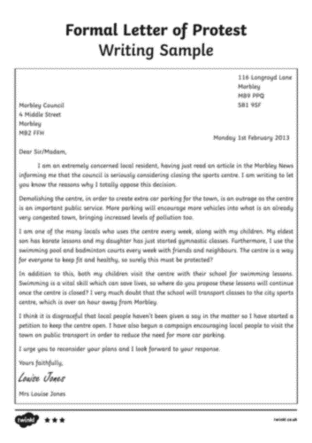
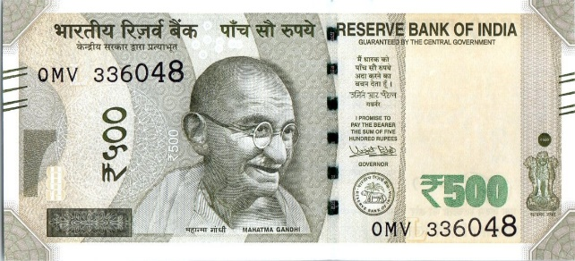

PROTESTS AND APPEALS
AN APPEAL TO THE JURY OF APPEAL
CONDITIONS
An appeal to the Jury must be made within 30 minutes:
Of the official announcement of the amended result of an event arising from the decision made by the Referee,
OR
Of the advice being given to those making the protest, where there is no amendment of any result.

Slide 32
PROTESTS AND APPEALS
WHO CAN APPEAL?
An athlete
Someone acting on their behalf
An official representative of a team, if they are competing in the same round of the event to which the protest (or subsequent appeal) relates.
Or competing in a competition in which a team points score is being conducted).

Slide 33


