Slide 1
HORIZONTAL JUMPS

Slide 2
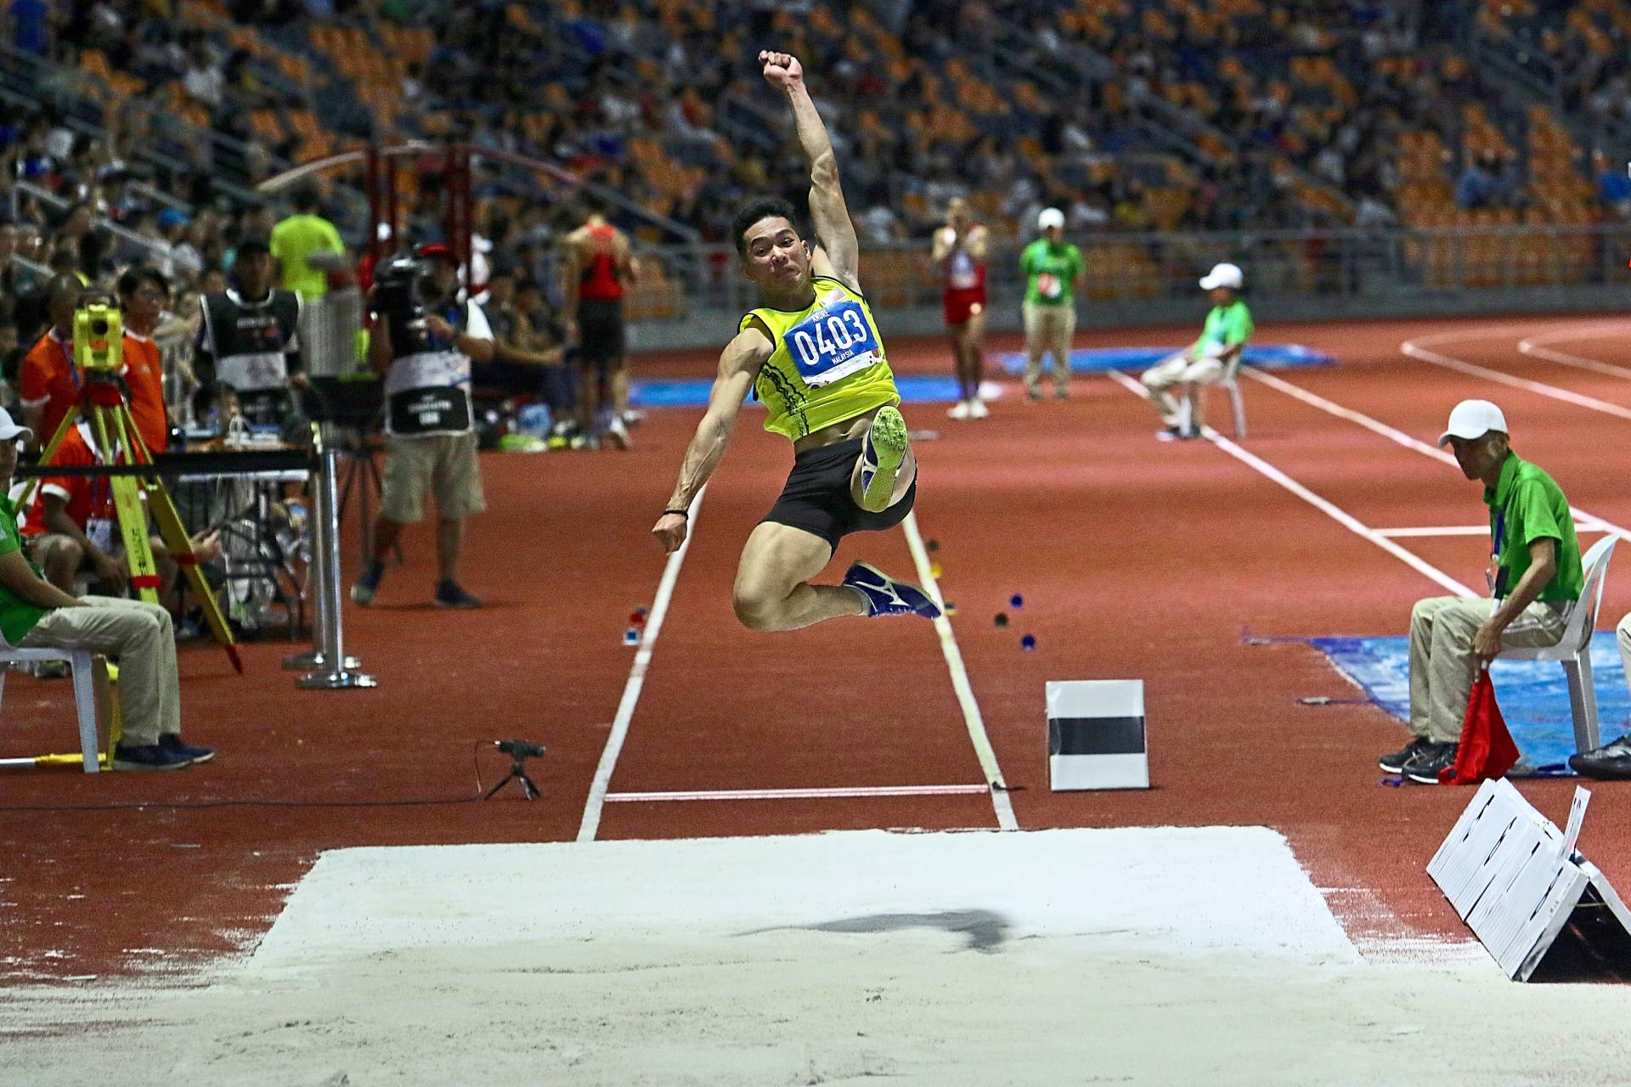
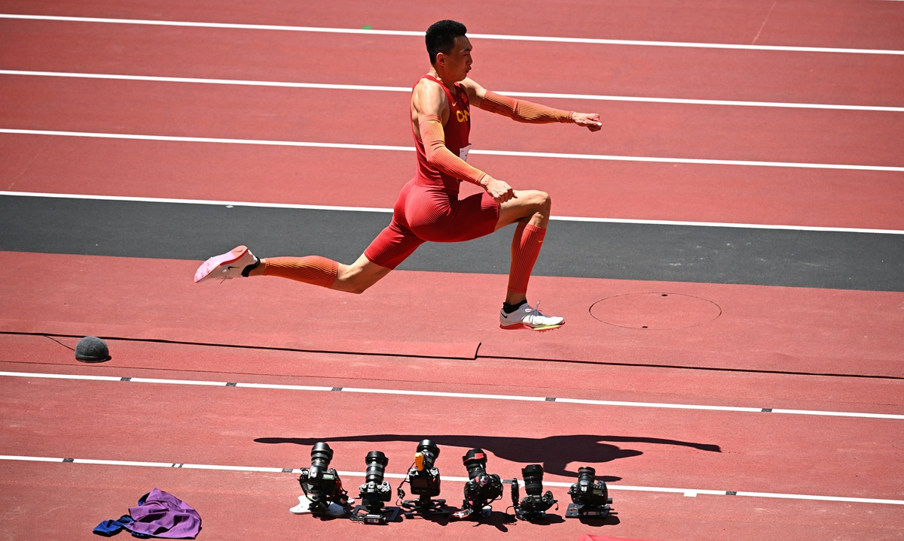
HORIZONTAL JUMPS
LONG JUMP
TRIPLE JUMP

Slide 3
HORIZONTAL JUMPS
TOPICS:
RUNWAY, TAKEOFF BOARD & LANDING AREA
COMPETING ORDER, NUMBER OF TRIALS
FAILURES – BASIC RULES
MEASURMENT & RECORDING ( SCORE SHEET )
TIES
TIME ALLOWED FOR TRIALS
MARKERS

Slide 4

LONG JUMP – RUNWAY, TAKE-OFF BOARD AND LANDING AREA
Plasticine Indicator
0.10m width, length 1.22m,
7mm higher than the take-off board
90°angle
Colour should be contrasting
Long Jump Take Off Board
Length 1.22 m Width 20 Cm
Deep 10 Cm
Colour should be white
1.22m
Take-off Line
(Imaginary line between the take-off board and Plasticine board)
Landing Area
Filled with soft
Damp sand
2.75m to 3m
At least 10m
From the take-off line
Runway 40m minimum
If Condition permit then 45m
Nearer end of Landing area to Take-off line is 1m-3m

Slide 5

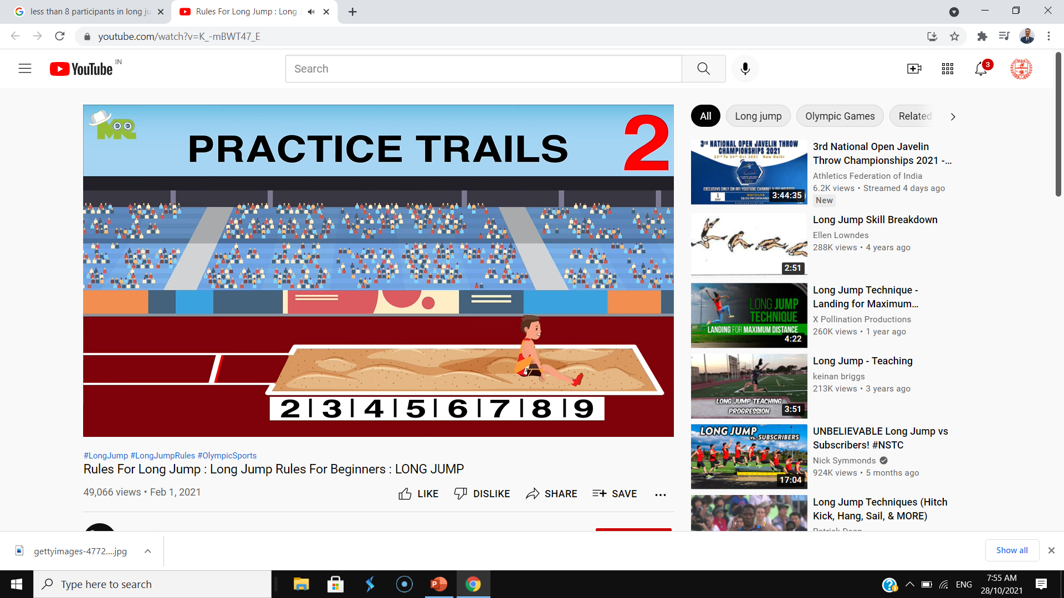
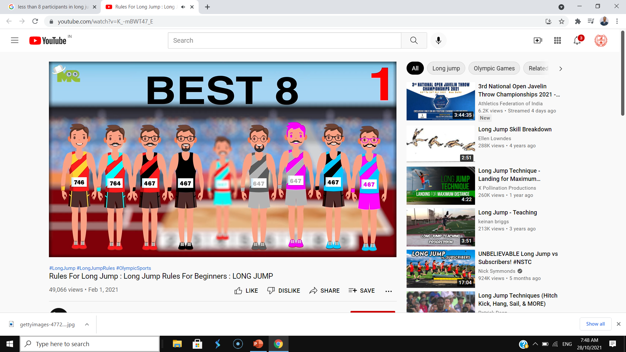
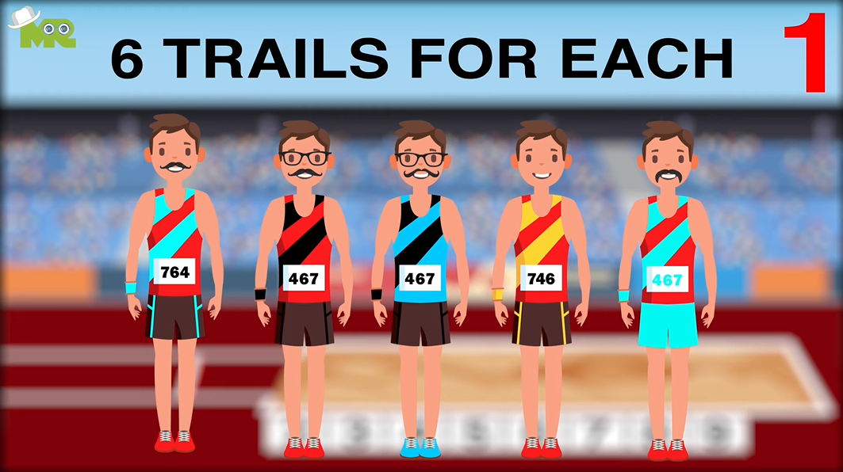
COMPETING ORDER
If more than 8
Competing Order Drawn by Lot.
All the Athletes may have practice trial before start of the event.
During competition
if there are more than 8 athletes, 3 trials should be given to each athlete and 8 athletes with best valid performance to be given 3 additional trials.
If there are less than 8 athletes then all athletes get 6 trials.
The competition order shall be in reverse ranking order recorded after first three rounds. Also they are reverse ranked after fifth jump (As per regulations of AFI).
If 8 or less than 8

Slide 6
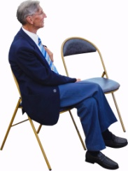

VALID JUMP
Jumper can jump from Take Off Board or before (must be within 1.22m width of runway) without touching Take Off Line or beyond.
Leaving the landing area is also important for Validity of Jump.

Slide 7
LONG JUMP - FAILURES
An athlete fails if:
They while taking off, break the vertical plane of the take-off line with any part of their foot / shoe, whether running up without jumping or in the act of jumping.
They take-off from outside either end of the board, whether beyond or before the extension of the take-off line.
They apply any form of somersaulting while running up or in the act of jumping.
After taking off, but before their first contact with the landing area, they touch the runway or the ground outside the runway or outside the landing area.
In the course of landing (including any overbalancing), they touch the border of, or the ground outside, the landing area closer to the take-off line than the nearest break made in sand.

Slide 8




LONG JUMP - FAILURES

Slide 9
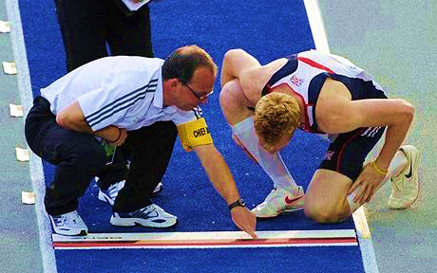
NOT AN ASSISTANCE
If the Athlete wants to know where is the fault occurred then the officials must show him.

Slide 10
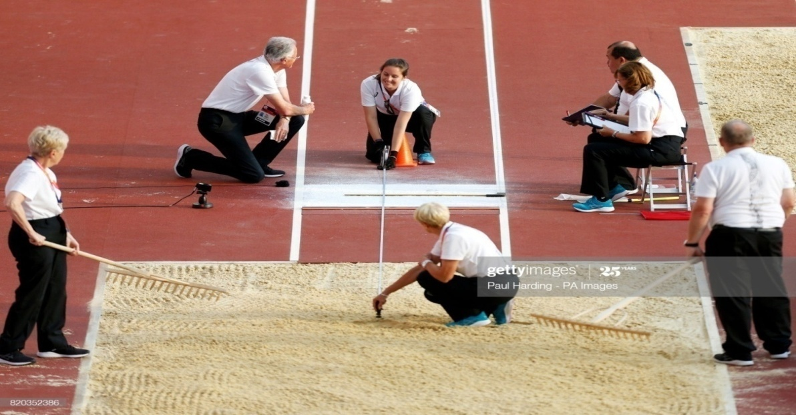
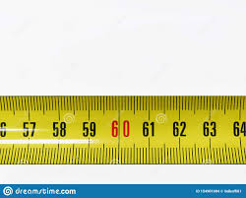
DISTANCE MEASUREMENT
The measurement of each jump shall be made immediately after each valid trial from the nearest break in the landing area made by any part of the body, or anything that was attached on the body at the time it made the mark, to the take-off line or the tak-off line extended.
6.59m
In all horizontal jumping events, distance shall be recorded to the nearest 0.01m below the distance measured if distance measured is not a whole centimeter.

Slide 11
DISTANCE MEASUREMENT

Slide 12
TIE
IF THE BEST PERFORMANCE OF TWO OR MORE ATHLETES ARE SAME - IT IS CALLED AS A TIE.
HOW TO BREAK THE TIE?:
CHECK THE SECOND BEST PERFORMANCE OF THE ATHLETES WHO HAVE A TIE .
IF TIE CANNOT BE SOLVED –
CHECK THE THIRD BEST PERFORMANCE, THEN FOURTH BEST AND SO ON
IF STILL THE TIE CANNOT BE SOLVED THEN THE TIE REMAINS.

Slide 13
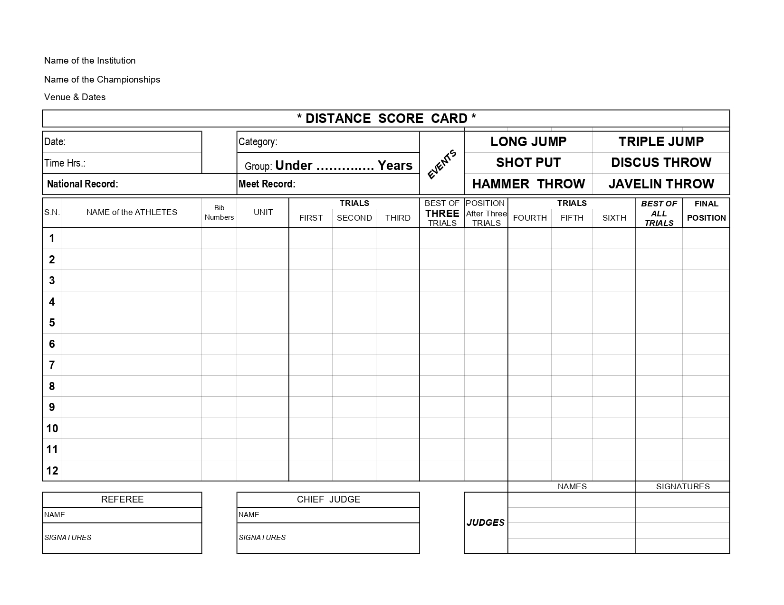
LONG JUMP – SCORE CARD
ATHLETICS FEDERATION OF INDIA
59TH NATIONAL INTER STATE SENIORS ATHLETICS CHAMPIONSHIP
LUCKNOW, 27TH TO 30TH AUGUST 2019
30/08/2019
MEN
17:15 Hrs
SENIOR
M. Sreeshankar , 8.20m
K. Premkumar , 8.00m
SAHIL MAHABALI
312
HAR
7.23
7.20
7.24
7.24
7
7.28
7.35
7.24
7.35
5
SANDEEP
314
HAR
7.21
7.26
7.18
7.26
6
7.21
7.23
7.18
7.26
7
SAMSHEER E.
370
KAR
7.00
7.20
7.27
7.27
5
---
X
7.37
7.37
4
FEBI
423
KER
7.28
7.16
7.22
7.28
4
7.30
7.21
7.20
7.30
6
SHREESANKAR M.
424
KER
7.64
7.83
X
7.83
1
7.76
X
X
7.83
1
MUHAMMED YAHIYA
425
KER
X
7.20
7.10
7.20
9
7.20
9
ASHISH PATRA
523
OR
7.10
X
X
7.10
11
7.10
11
JAGROOP
569
PUN
7.20
X
7.23
7.23
8
7.20
X
X
7.23
8
BIKRAMJIT SINGH
570
PUN
X
7.13
7.05
7.13
10
7.13
10
SUBHASH
614
RAJ
6.70
X
6.80
6.80
12
6.80
12
RISHABH RISHISHWAR
720
UP
7.11
7.38
7.38
7.38
3
X
7.83
X
7.83
3
721
UP
7.40
7.23
X
7.40
2
7.83
X
5.32
7.83
2
Name of CHIEF JUDGE
Name of JUDGE 1
Signature Judge 1
Name of REFEREE
Name of JUDGE 2
Signature Judge 2
Signature of REFEREE
Signature of CHIEF JUDGE
Name of JUDGE 3
Signature Judge 3
Name of JUDGE 4
Signature Judge 4

Slide 14

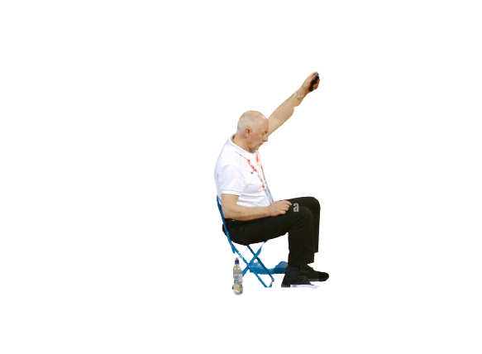

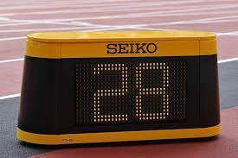
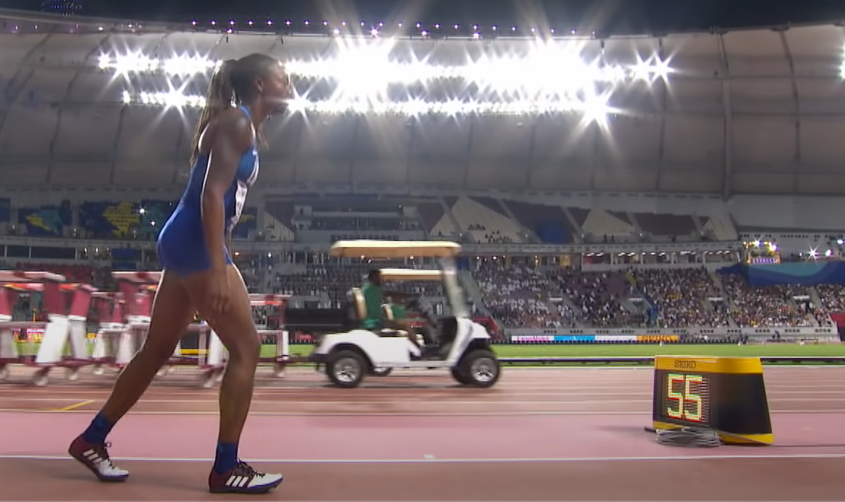
TIME ALLOWED
Time Allowed for initiating Trials
Condition
Horizontal jumps
A clock showing the remaining time allowed for trial should be visible to the athlete. In addition an official shall raise and keep raised, a yellow flag, or otherwise other indicate, during final 15 seconds of the time allowed.
More than 3 athletes
(or for first trial of each athlete)
1 minute
2 to 3 athletes
1 minute
1 athlete
-
Consecutive trials
2 minutes

Slide 15
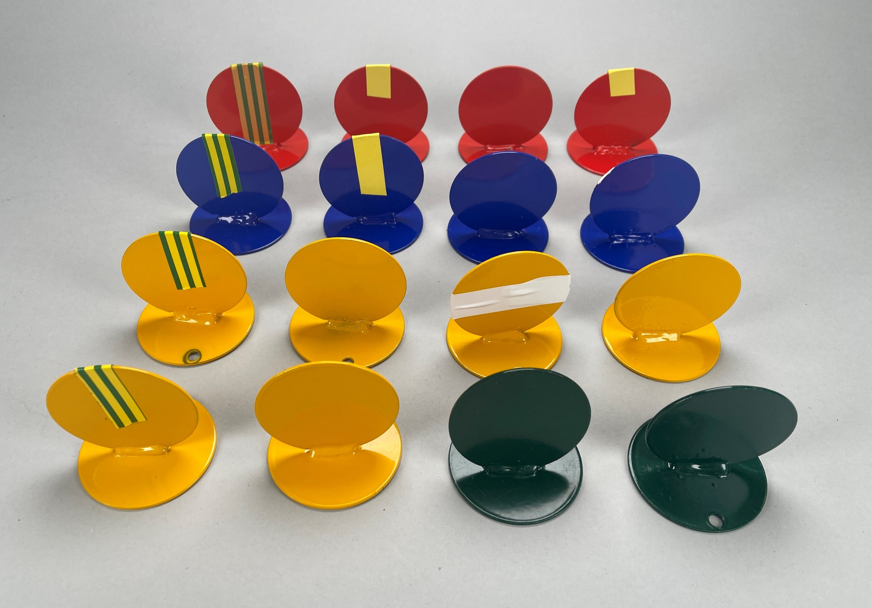
MARKERS
Athlete may use one or two markers along side the runway provided by the organizers

Slide 16
TRIPLE JUMP – RUNWAY, TAKE-OFF BOARD AND LANDING AREA
Plasticine Indicator
0.10m width, length 1.22m,
7mm higher than the take-off board
90°angle
Colour should be contrasting
Triple Jump Take Off Board
Length 1.22 m Width 20 Cm
Deep 10 Cm
Colour should be white
1.22m
Take-off Line
(Imaginary line between the take-off board and Plasticine Indicator board)
Landing Area
Filled with soft
Damp sand
2.75m to 3m
At least 21m
From the take-off line
Runway 40m minimum
If Condition permit then 45m
Nearer end of Landing area to Take-off line is 11m for women & 13m for men

Slide 17
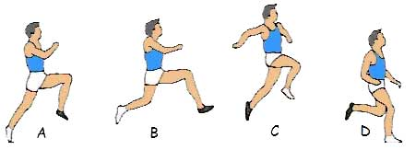
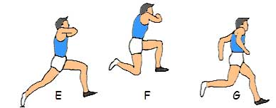
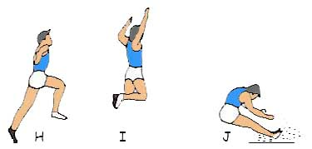
TRIPLE JUMP – VALID JUMP
THE TRIPLE JUMP CONSIST OF –
A HOP, A STEP & A JUMP
THE HOP SHALL BE MADE SO THAT THE ATHLETE LANDS ON THE SAME FOOT ON WHICH THEY HAVE TAKEN OFF
IN STEP THEY SHALL LAND ON THE OTHER FOOT
THEN THE JUMP IS PERFORMED
IF THE ABOVE SAID SEQUNCE IS NOT FOLLOWED IN ORDER THEN THE JUMP IS TREATED AS A FAILURE

Slide 18
TRIPLE JUMP
ALL OTHER RULES OF TRIPLE JUMP ARE SAME AS OF LONG JUMP i.e.
Competing order
Number of trials
Time allowed for trials
Marker
Measuring procedure
Records & Ties
Failures

Slide 19
POSITIONS OF JUDGES
Referee - 1
Chief Judge - 1
Measurement Judge - 2
Athlete Control Judge - 1
Count Down Timer - 1
Plasticine Repairing Judge - 1
Sand Leveler - 1
Recorder - 2
Count Down Timer
Chief Judge
Sand Leveler
Landing Pit
Measurement Judge
Measurement Judge
Athlete Control Judge
Recorder
Referee
Sitting Area of Athletes
Plasticine Repairing Judge

Slide 20


