Slide 1
HURDLES, STEEPLECHASE
AND RELAY RACES

Slide 2
HURDLE RACES

Slide 3
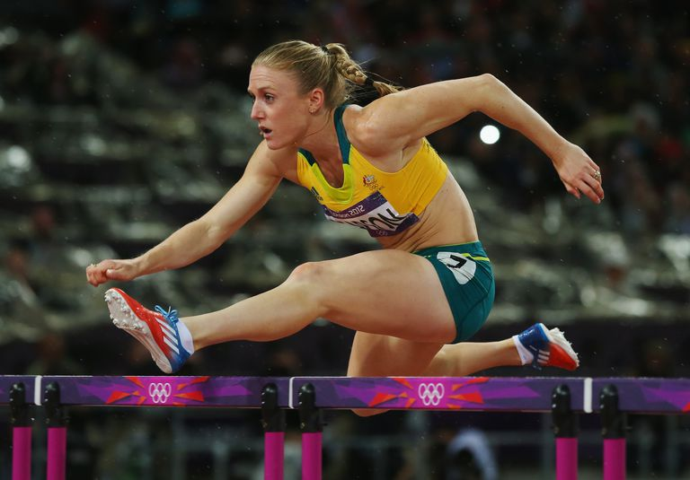
HURDLE RACES
AGE CATEGORIES & EVENTS
The standard distances shall be:
Men, U23 Men, U20 Men and U18 Men: 110m, 400m
Boys U16: 80 m
Women, U23 Women, U20 Women and U18 Women: 100m, 400m
Girls U16: 80 m
There shall be ten flights for 100mH, 110mH and 400mH
In 80mH Boys U16, there are 7 flights.
In 80mH Girls U16, there are 8 flights.

Slide 4
DISTANCES & HEIGHTS OF HURDLES
GROUP WISE DISTANCES & HEIGHTS OF HURDLES
DISTANCE OF RACE | MEN & U23 MEN | U20 MEN | U18 MEN | WOMEN / U23 & U20 WOMEN | U18 WOMEN | BOYS U16 | GIRLS U16
110M | 1.067M | 0.991M | 0.914M | ----- | ----- | ----- | -----
100M | ----- | ----- | ----- | 0.838M | 0.762M | ----- | -----
400M | 0.914M | 0.914M | 0.838M | 0.762M | 0.762M | ----- | -----
80M | ----- | ----- | ----- | ----- | ----- | 0.838M | 0.762M
DISTANCE BETWEEN THE HURDLES
DISTANCE OF RACE | DISTANCE FROM START LINE TO FIRST HURDLE | DISTANCE BETWEEN THE HURDLES | DISTANCE FROM LAST HURDLE TO FINISH LINE
110M | 13.72M | 9.14M | 14.02M
100M | 13.00M | 8.50M | 10.50M
400M | 45.00M | 35.00M | 40.00M
80M BOYS (7 FLIGHTS) | 13.50M | 8.60M | 14.90M
80M GIRLS (8 FLIGHTS) | 12.00M | 8.00M | 12.00M

Slide 5
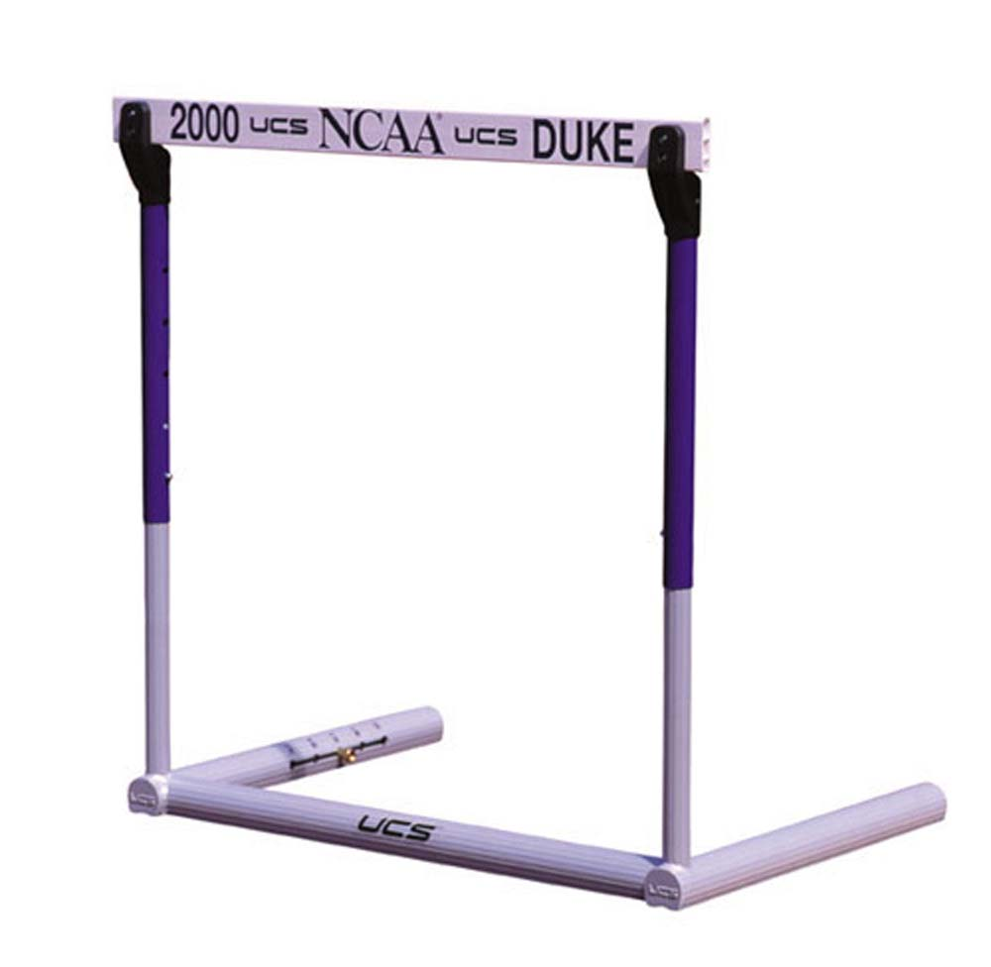
HURDLE RACES
THE TOP BAR
The height of the top bar shall be 70mm ± 5mm.
The thickness of this bar should be between 10mm and 25mm, and the top edges should be rounded.
The bar should be firmly fixed at the extremities.
The top bar should be painted with white and black stripes,
or with other strong distinctive contrasting colours (and also in contrast with the surrounding environment),
such that the lighter stripes, which should be at least 0.225m wide are on the outside.
It shall be coloured so as to be visible to all sighted athletes.

Slide 6
HURDLE RACES

Slide 7
110m Hurdle in Beijing World Athletics Championship
HURDLE RACES

Slide 8
HURDLE RACES
DISQUALIFICATION
To avoid disqualification, the athletes shall run in their allotted lanes throughout and each athlete shall go over each hurdle.
They will be disqualified if:
their foot or leg is, at the instance of clearance, beside the hurdle (on either side) or below the horizontal plane of the top of any hurdle.
they knock down or displace any hurdle by hand, body or the upper side of lead leg.
they directly or indirectly knock down or displace a hurdle in their or in another lane in such a manner that there is effect or obstruction upon any other athlete(s) in the race,

Slide 9
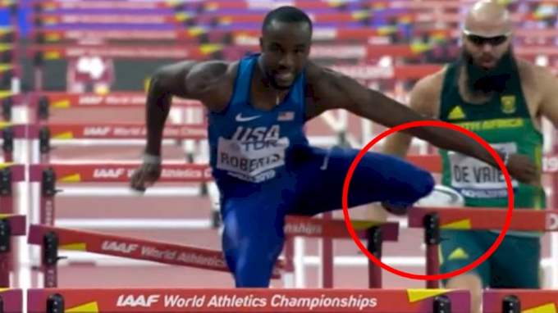
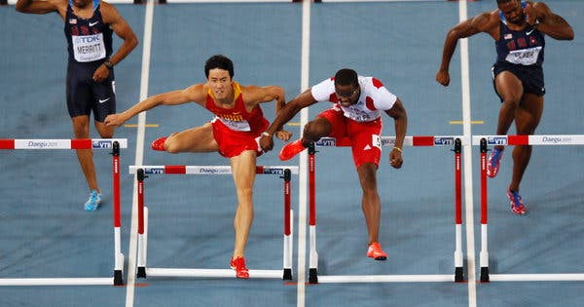
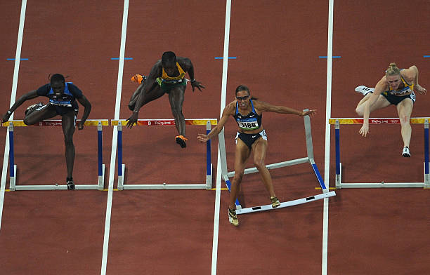
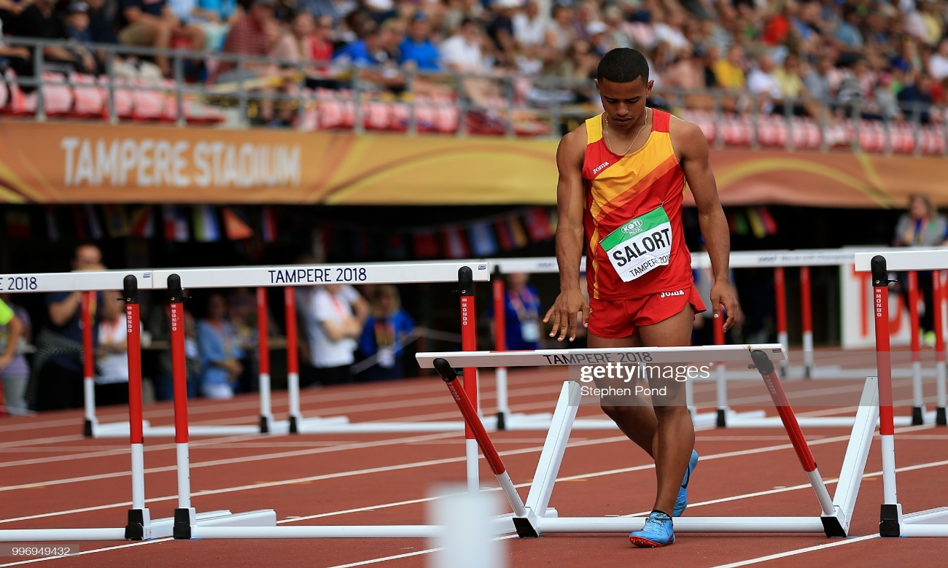
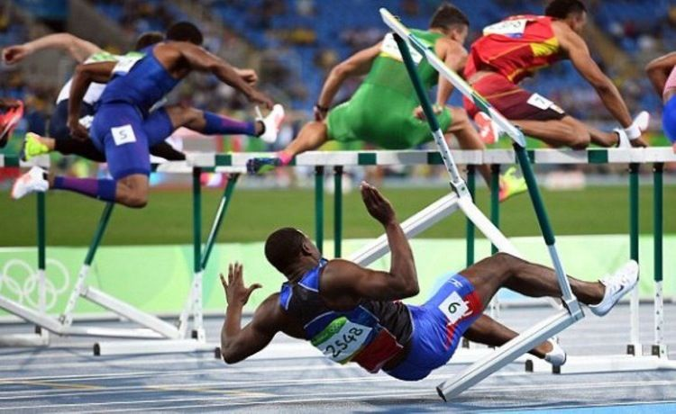
HURDLE RACES - FAILURES

Slide 10
STEEPLECHASE RACES

Slide 11
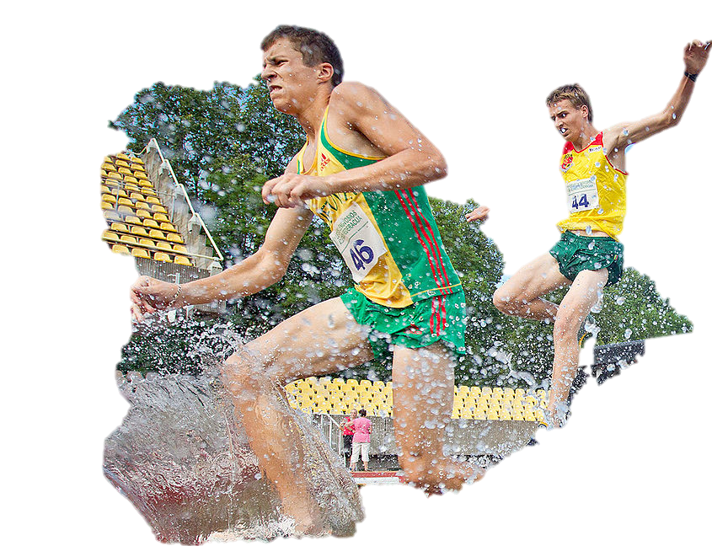
STEEPLECHASE RACES
The standard distances shall be: 2000m and 3000m.
For the 3000m, there shall be 28 hurdle jumps and 7 water jumps.
The distance from the start to the beginning of the first lap shall not include any jumps, the hurdles being removed until the athletes have entered the first lap.
For the steeplechase events, there shall be five jumps in a complete lap, with the water jump as the fourth.
The jumps should be evenly distributed, so that the distance between the jumps shall be approximately one fifth of the nominal length of the lap.

Slide 12
STEEPLECHASE RACES
For the 2000m event:
there shall be 18 hurdle jumps and 5 water jumps.
The first jump is at the third hurdle of a lap.
The previous hurdles shall be removed until the athletes have passed them for the first time.
Note: In the 2000m event, if the water jump is on the inside of the track, the finish line has to be passed twice before the first complete lap with five jumps.
In national level competitions, this event is held for Men U18 and Women U18.
The height of the hurdle for U18 Boys is 0.838m and for U18 Girls is 0.762m.

Slide 13
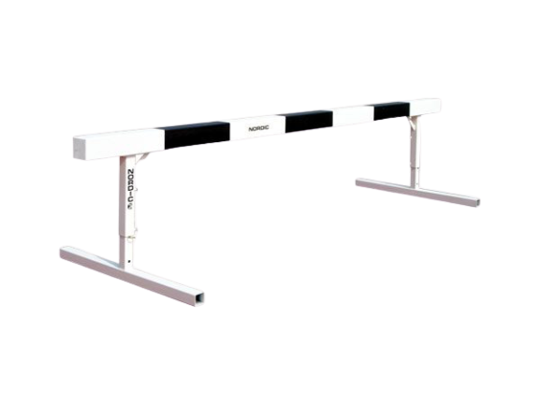
STEEPLECHASE RACES
THE TOP BAR
The top bars shall be made of wood or other suitable material
It should be painted with white and black stripes, or with other strong distinctive contrasting colours (and also in contrast with the surrounding environment),
The lighter stripes, which should be at least 0.225m wide, are on the outside and shall be coloured so as to be visible to all sighted athletes.
The hurdle shall be placed on the track so that at least 0.30m of the top bar will extend inside the inner edge of the track.

Slide 14
STEEPLECHASE RACES
THE DISTANCE AND Height of the top bar of Steeplechase Hurdle
The height of the hurdle in all categories of women events is 0.762m.
For Women, U23 Women and U20 Women, the distance is 3000m.
In U18 Girls, the distance is 2000m.
For Men, U23 Men and U20 Men, the height of the hurdle is 0.914m and the distance is 3000m.
In U18 Boys, the height of the hurdle is 0.838m and the distance is 2000m.

Slide 15
STEEPLECHASE RACES
Disqualifications
Each athlete shall go over or through the water and shall go over each hurdle. Failure to do so will result in a disqualification.
In addition, an athlete shall be disqualified, if:
They step to one side or other of the water jump,
Their foot or leg is, at the instant of clearance, beside the hurdle (on either side), below the horizontal plane of the top of any hurdle.

Slide 16
STEEPLECHASE RACES

Slide 17
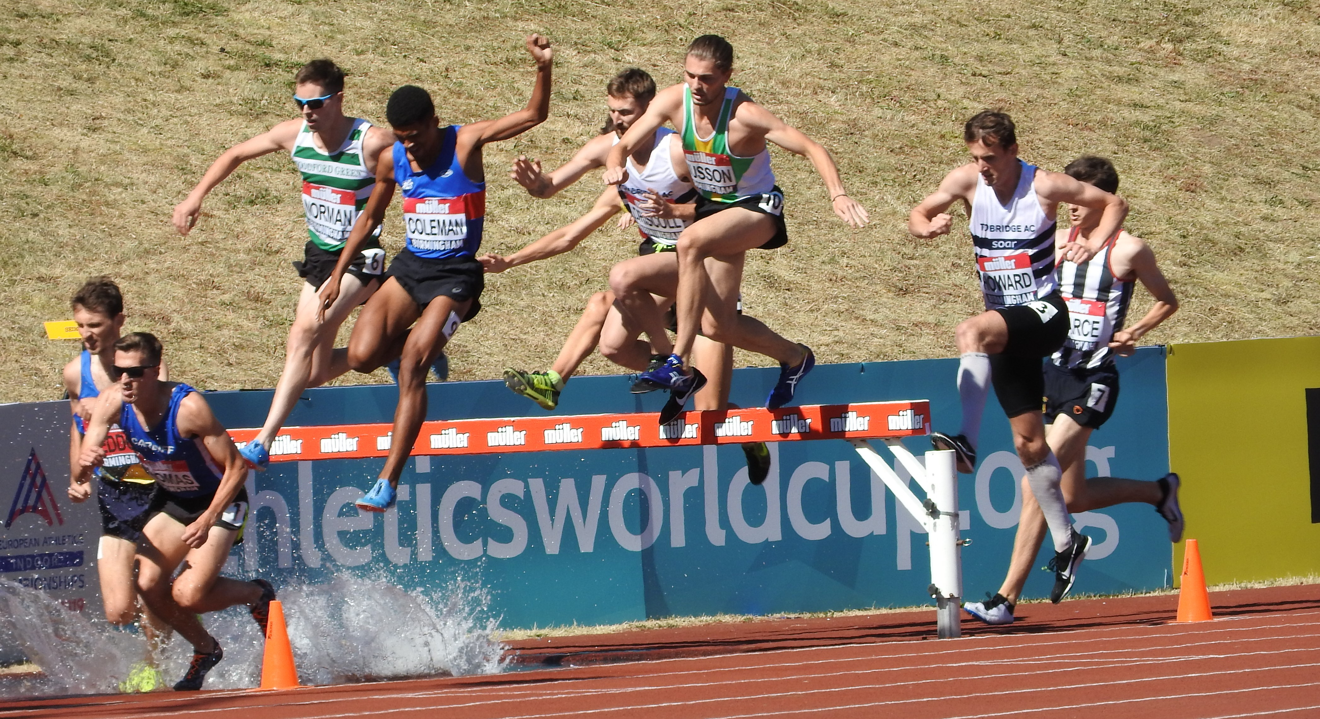
STEEPLECHASE RACES
STEEPLECHASE WATER JUMP

Slide 18
RELAY RACES

Slide 19
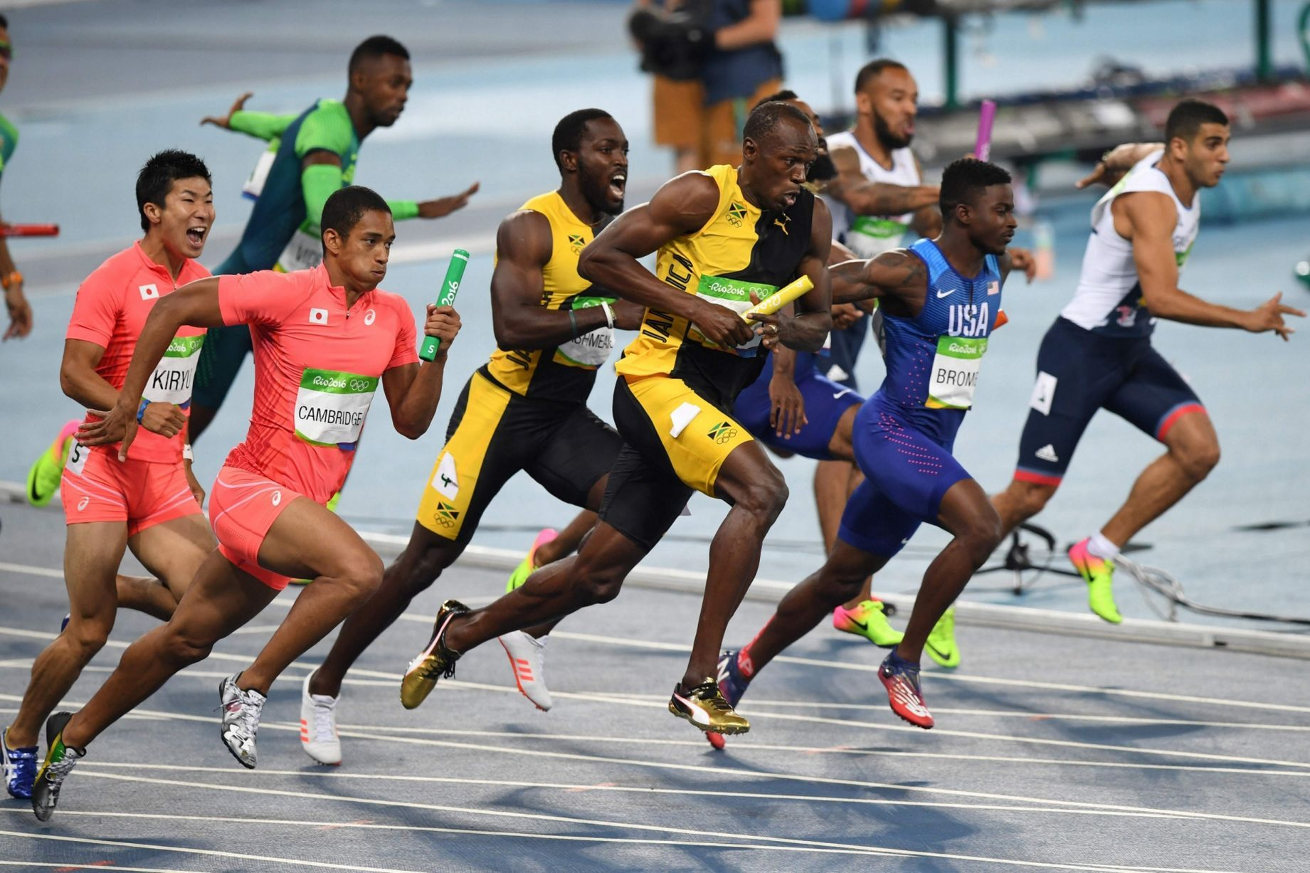
4 X 100M, 4 X 400M, 4 X 400M Mixed and Medley Relay Races
RELAY RACES
Lines 50mm wide shall be drawn across the track to mark the start of each leg distance (scratch line).
In the 4 X 100m, and for the first and second exchanges in the Medley Relay, each takeover zone shall be 30m long, of which the scratch line is 20m from the start of the Exchange Zone.
For the third exchange in the Medley Relay and in the 4x400m and longer relays each takeover zone shall be 20m long of which the scratch line is the centre.
The exchange zones shall start and finish at the edges of the zone nearest the start line in the running direction.
For each takeover done in lanes, a designated official shall ensure that the athletes are correctly placed in their takeover zone.

Slide 20
RELAY RACES
The Check Marks
When all or the first portion of a Relay Race is being run in lanes, an athlete may place one check-mark on the track within their own lane, by using adhesive tape, maximum 0.05m × 0.40m, of a distinctive colour which cannot be confused with other permanent markings.

Slide 21
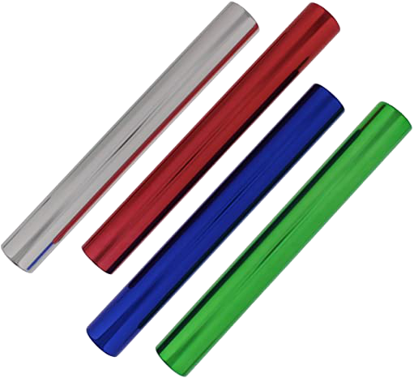
RELAY RACES
The Relay Baton
The relay baton shall be a smooth hollow tube, circular in section, made of wood, metal or any other rigid material in one piece, the length of which shall be 0.28m to 0.30m, weight not less than 50g and outside diameter 40 ± 2mm
Athletes are not permitted to wear gloves or to place material or substances on their hands to get a better grip on the baton.

Slide 22
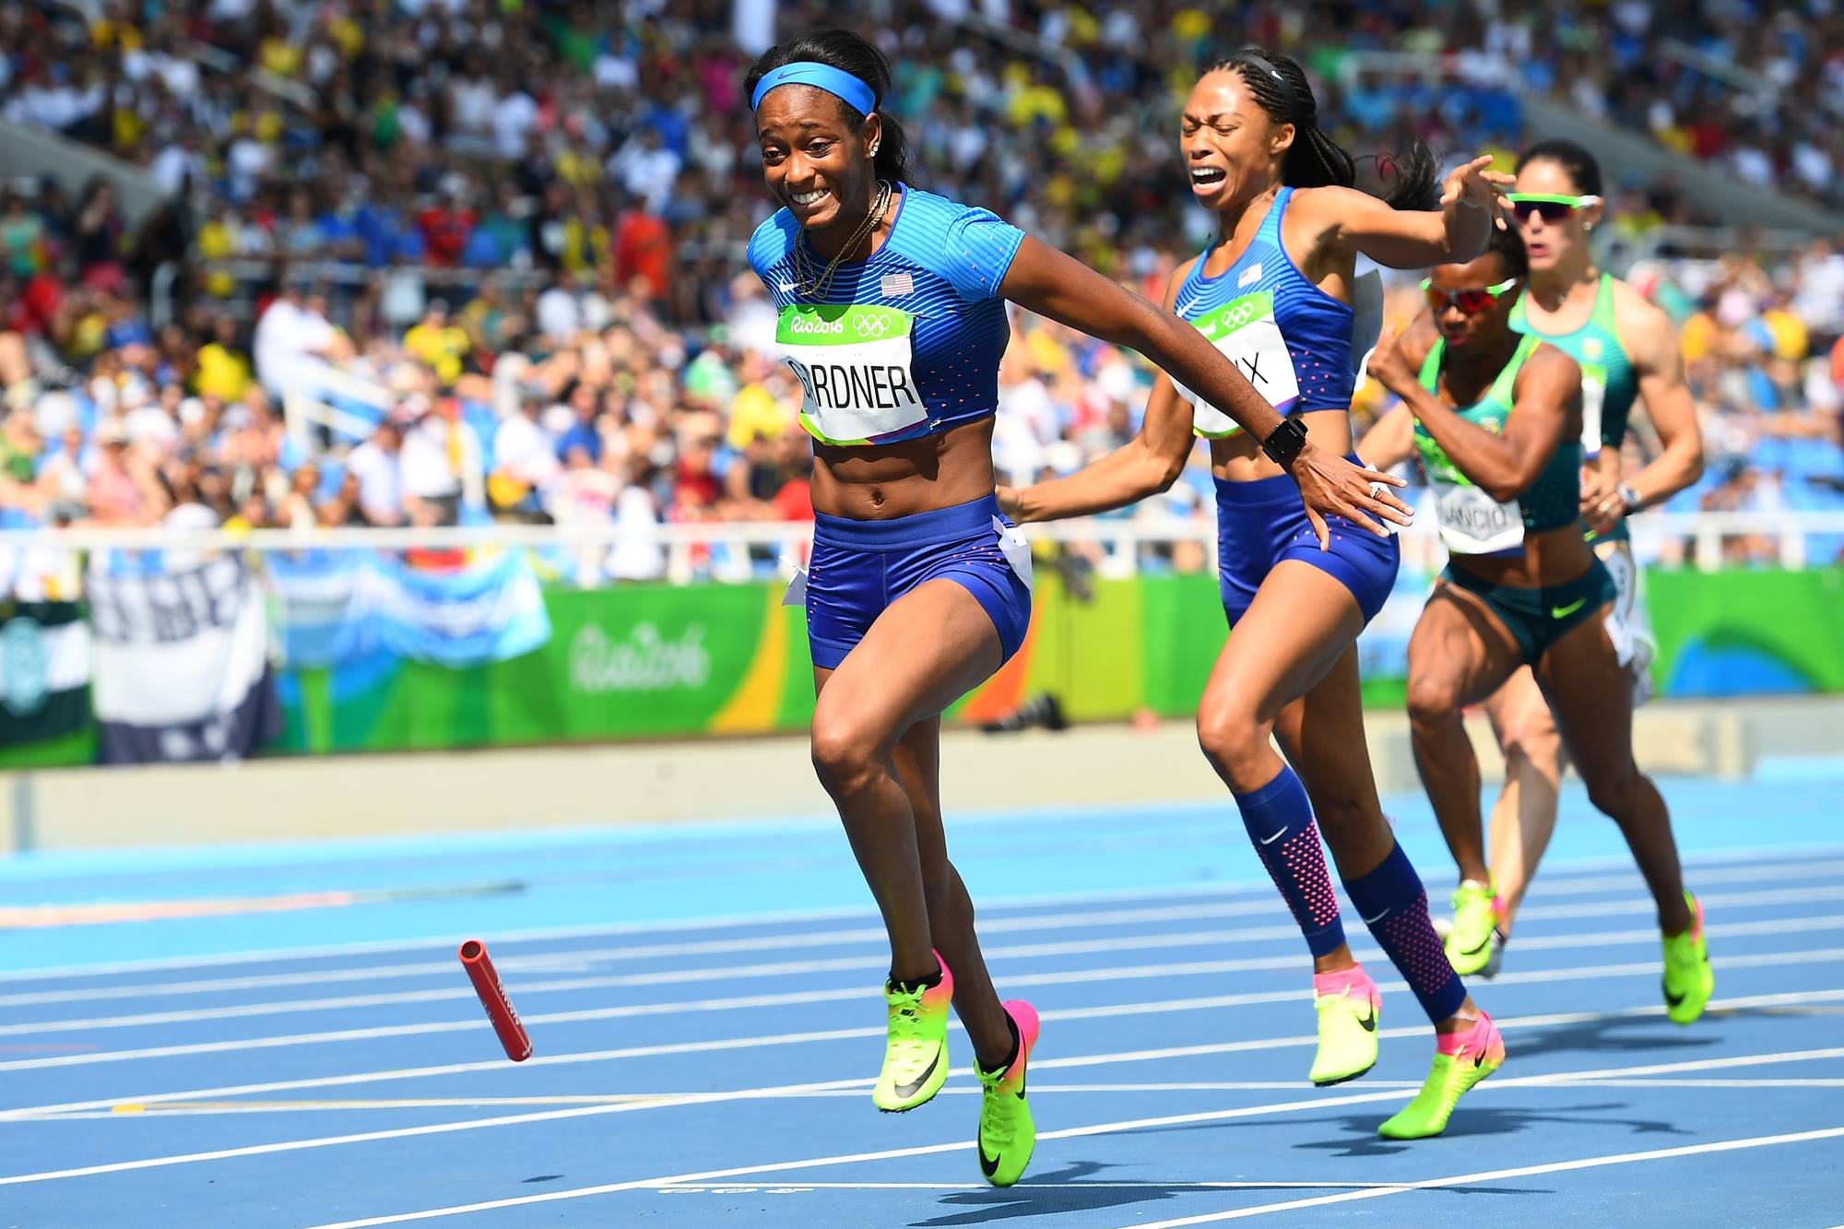
RELAY RACES
Retrieving of Baton
If dropped, the baton shall be recovered by the athlete who dropped it.
They may leave their lane to retrieve it provided that, by doing so, they do not lessen the distance to be covered.
In addition, where the baton is dropped in such a way that it moves sideways or forward in the direction of the athlete who dropped it, after retrieving it, must return at least to the point where it was last in their hand, before continuing in the race.
Provided these procedures are adopted where applicable and no other athlete is impeded, dropping the baton shall not result in disqualification.
If an athlete does not follow this Rule, their team shall be disqualified.

Slide 23
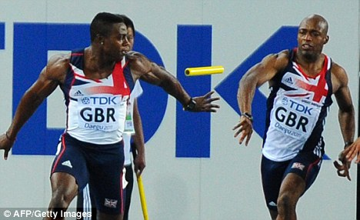
RELAY RACES

Slide 24
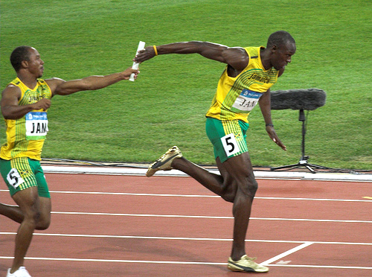
RELAY RACES
Passing of the baton
The baton shall be passed within the takeover zone.
The passing of the baton commences when it is first touched by the receiving athlete and completed at the moment it is in the hand of receiving athlete only.
In relation to the takeover zone, it is only the position of the baton which is decisive. Passing of the baton outside the takeover zone shall result in disqualification.

Slide 25
RELAY RACES
Laned or Non Laned Race
The 4 X 100m race shall be run entirely in lanes.
The Medley Relay race should be run in lanes for the first two legs, as well as that part of the third leg up to the nearer edge of the break line, where athletes may leave their respective lanes (two bends in lanes).
Medley relay is included in U16 (Boys & Girls) and U18 (Men & Women).
The 4 X 400m shall be run in lanes for the first leg, as well as that part of the second leg up to the nearer edge of the break line, where the athletes may leave their respective lanes.
When less than 4 teams are participating in 4 X 400m, in lanes for the first leg up to the nearer edge of the break line, where athletes may leave their respective lanes (one bend in lanes).

Slide 26
RELAY RACES
2nd & 3rd Exchange in 4×400m
In the 4 X 400m race, the athletes running the third and fourth legs shall, under the direction of a designated official, place themselves in their waiting position in the same order (inside to out) as the order of their respective team members enter the last bend.
Once the incoming athletes have passed this point, the waiting athletes shall maintain their order, and shall not exchange positions at the beginning of the takeover zone. If an athlete does not follow this Rule, their team shall be disqualified.

