Slide 1
RACE WALKING EVENTS

Slide 2
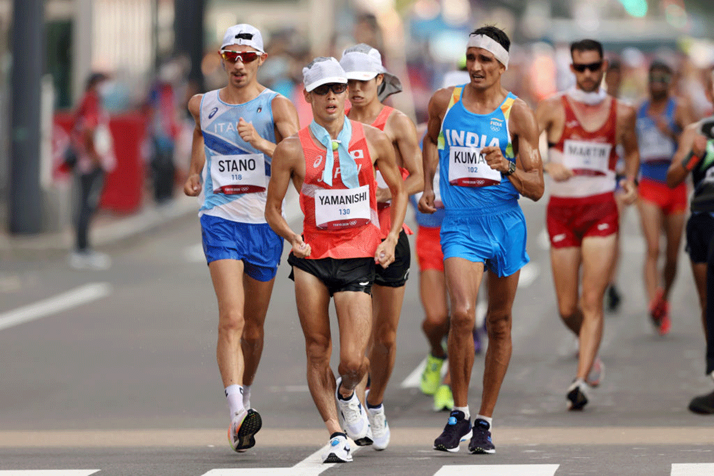
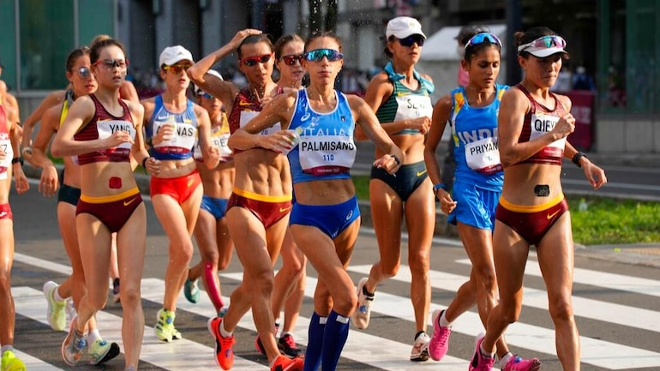
Rules & Interpretation of Race Walking Event

Slide 3
TOPICS TO BE COVERED
DEFINITION OF RACE WALKING
STANDARD DISTANCES
ROAD COURSE
START OF RACE WALKING EVENT
JUDGING
CHIEF JUDGE
WARNING – YELLOW PEDALS
RED CARD
POSTING BOARDS
DISQUALIFICATION – RED PEDAL
RACE CONDUCT
DO’S AND DONTS

Slide 4
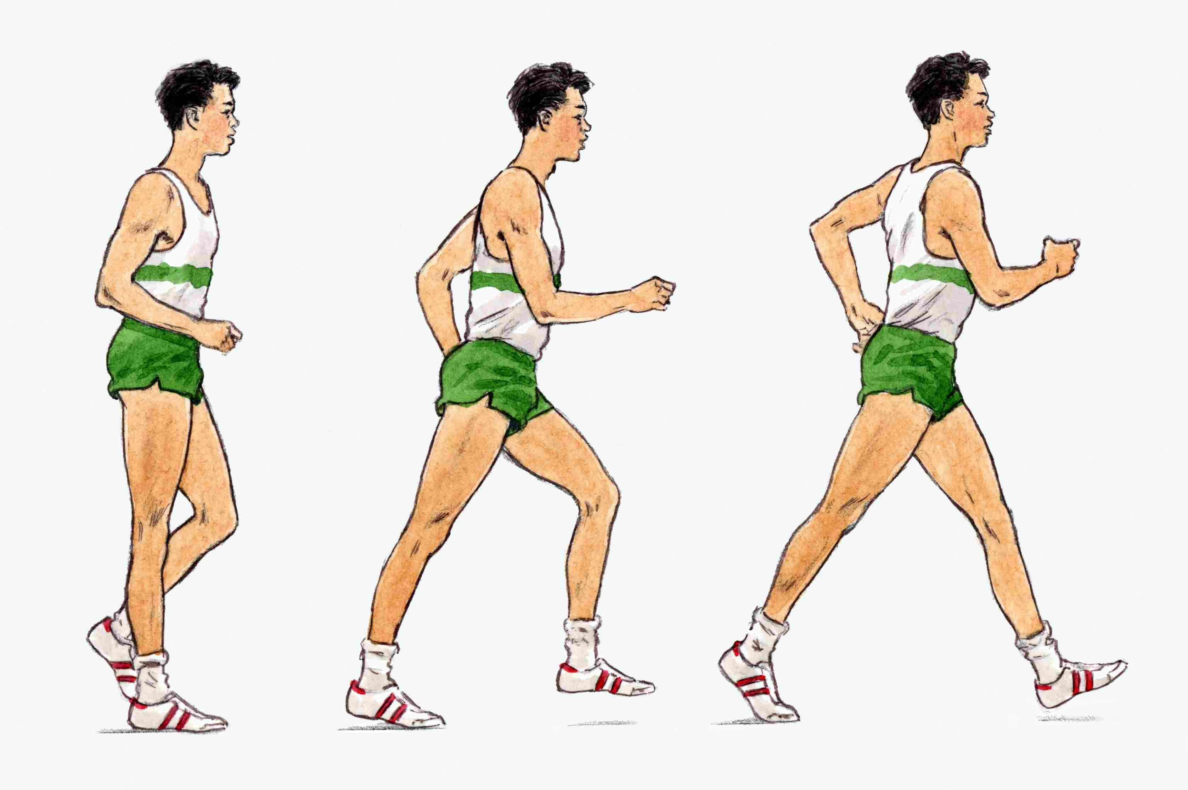
DEFINITION OF RACE WALKING
Race Walking is a progression of steps so taken that the walker makes contact with the ground, so that no visible (to the human eye) loss of contact occurs.
The advancing leg must be straightened (i.e. not bent at the knee) from the moment of first contact with the ground until the vertical upright position.

Slide 5
STANDARD DISTANCES
The standard distances shall be:
Indoor : 3000m, 5000m
Outdoor : 5000m, 10000m, 20000m, 35000m, 50000m (On Track)
10km, 20km, 35km, 50km (Partially or completely outside stadium)

Slide 6
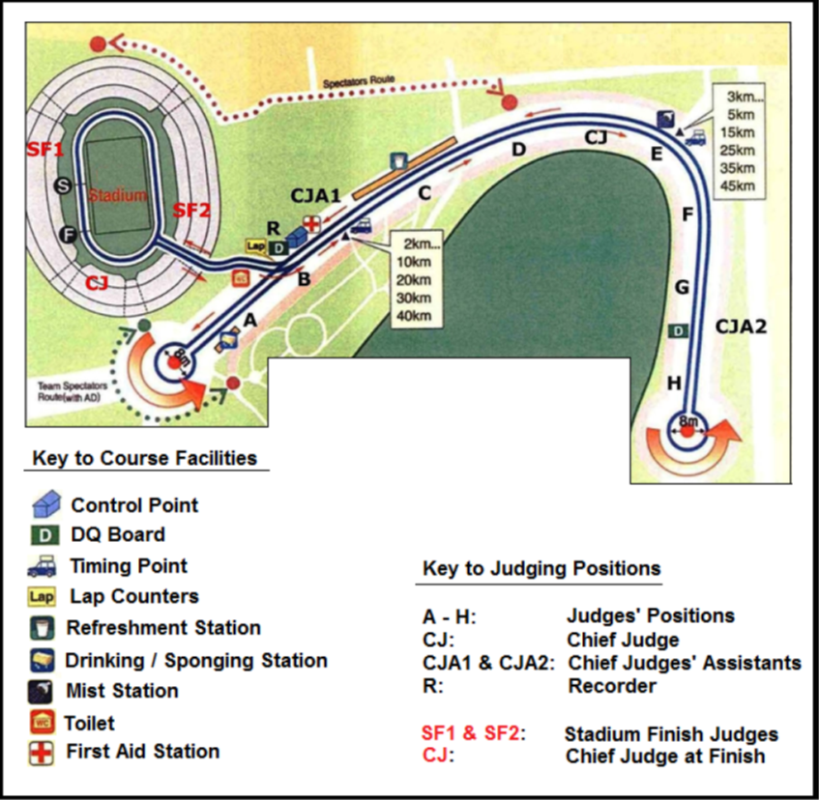
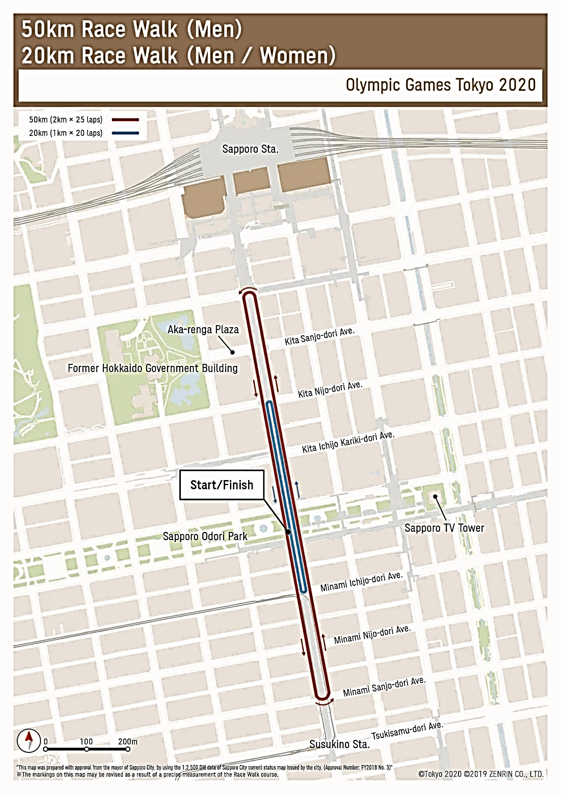
ROAD COURSE
The circuit shall not be shorter than 1Km and not longer than 2Km.
For the events that start and finish in a stadium, the circuit should be located as close as possible to the stadium.
Road courses shall be measured in accordance with the technical rules of route measurements.

Slide 7
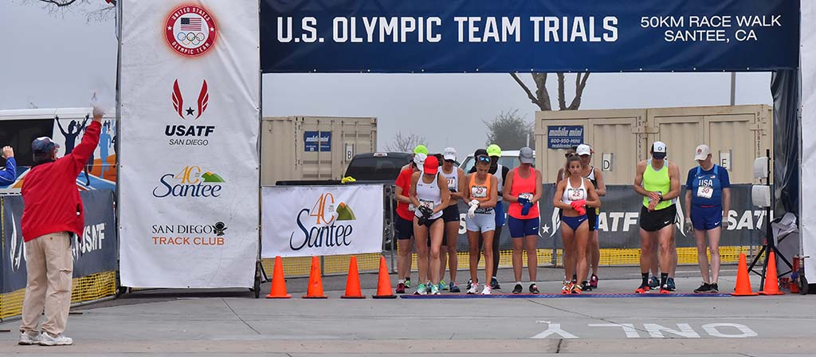
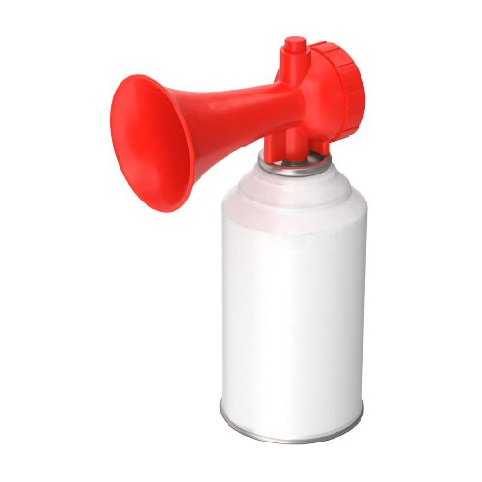
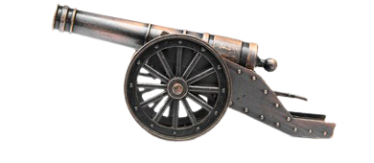
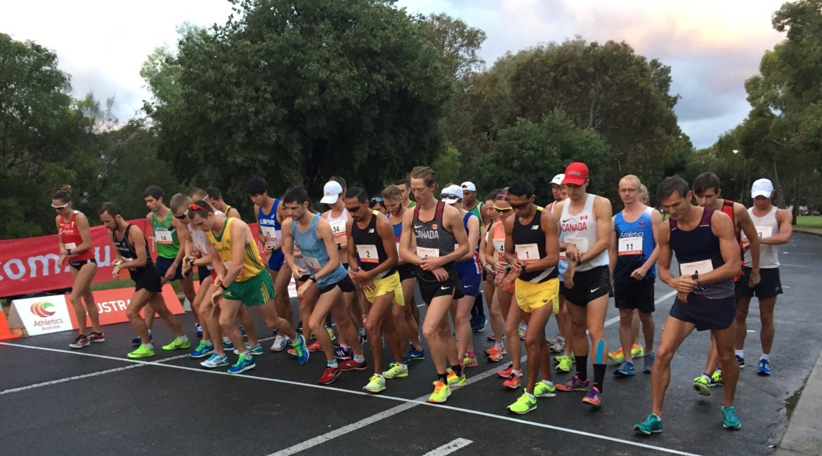
START – RACE WALKING EVENT
The race shall be started by firing a gun, cannon, air horn or like device.
The command for races longer than 400m shall be used.
ON YOUR MARKS – GUN FIRE
On the command “On Your Marks”, the athletes shall assemble on the start line.

Slide 8
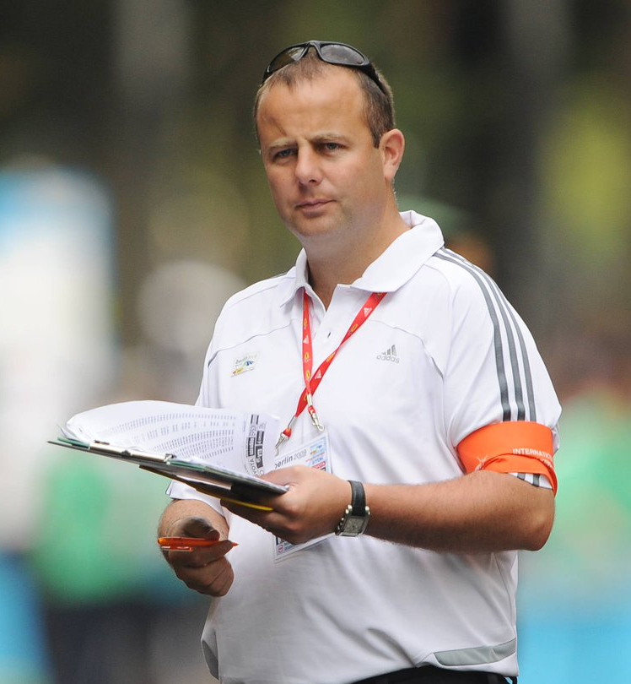
JUDGING
The appointed Judges of Race Walking shall elect a chief Judge, if one has not been appointed.
All the Judges shall act in an individual capacity and their judgements shall be based on observation made by human eye.
For Race Walk on Roads, there should normally be minimum of 6 (Six) to maximum of 9 (Nine) Judges including the Chief Judge.
For Track Races, there should normally be 6 (six) Judges including the Chief Judge.

Slide 9
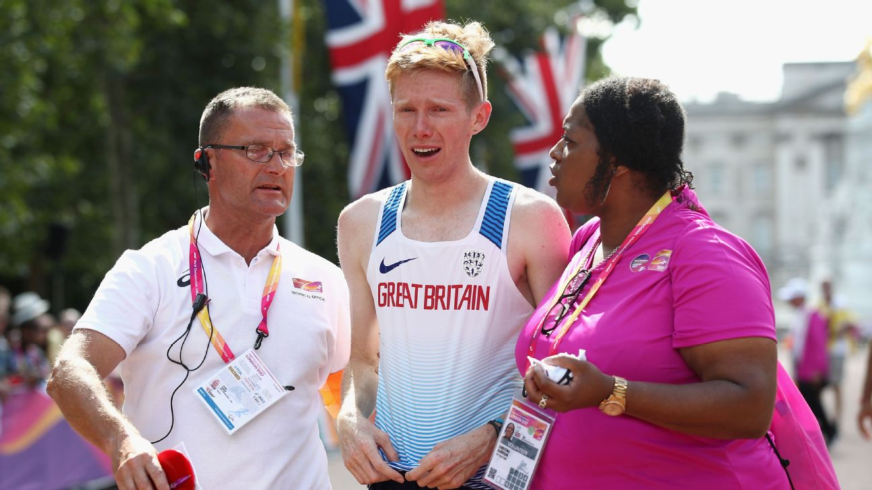
CHIEF JUDGE
The Chief Judge has the power to disqualify an athlete in the last 100m, when their mode of progression fails to comply with Technical Rules regardless of the number of previous Red Cards received on that athlete.
The athlete disqualified by Chief Judge in last 100m shall be allowed to finish the race. They shall be notified of disqualification by the Chief Judge or Chief Judge’s Assistant by showing Red paddle at the earliest after the athlete finishes the race.
An official in charge of Posting Board(s) and a Chief Judge’s Recorder shall be appointed.

Slide 10
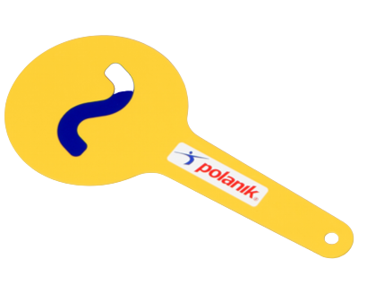
YELLOW PADDLE
If the Judge is not satisfied with the mode of progression, shall show Yellow paddle with the symbol of offence on each side.
An athlete cannot be shown a second Yellow paddle by the same Judge for the same offence.
If an athlete is shown a Yellow paddle, The Judge shall inform the Chief Judge of their action after competition.

Slide 11
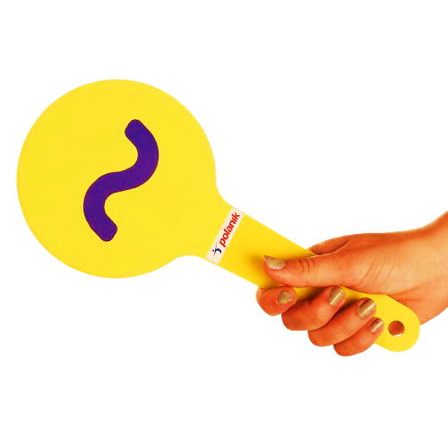
LOSS OF CONTACT

Slide 12
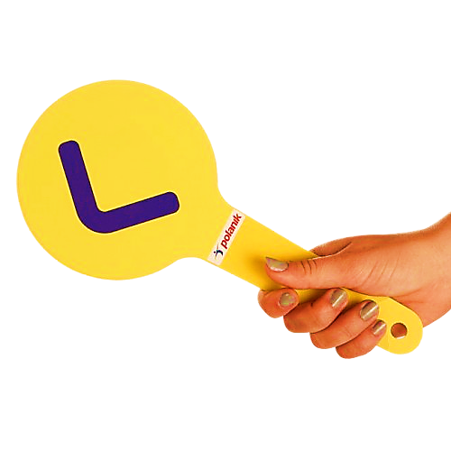
BENT KNEE

Slide 13
RED CARD
When a Judge observes an athlete failing to comply with the rule of race walking by exhibiting visible loss of contact or bent knee during the competition, the Judge shall send a Red Card to the Chief Judge.

Slide 14
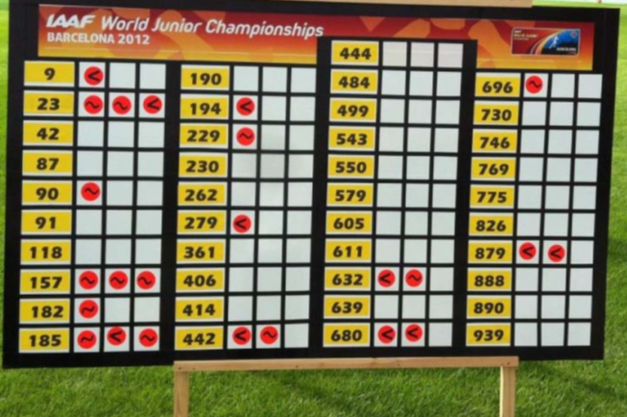
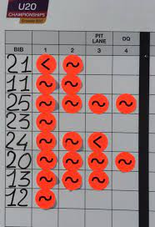
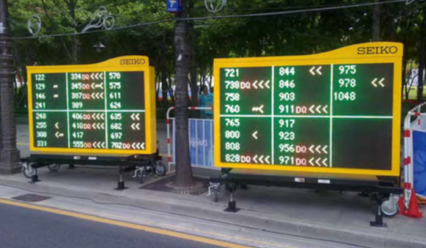
POSTING BOARDS
One or more Posting Boards shall be placed on course and near finish for athletes to know how many Red Cards have been sent to Chief Judge for each athletes.
The symbol of each offence should be indicated on the Posting Board.

Slide 15
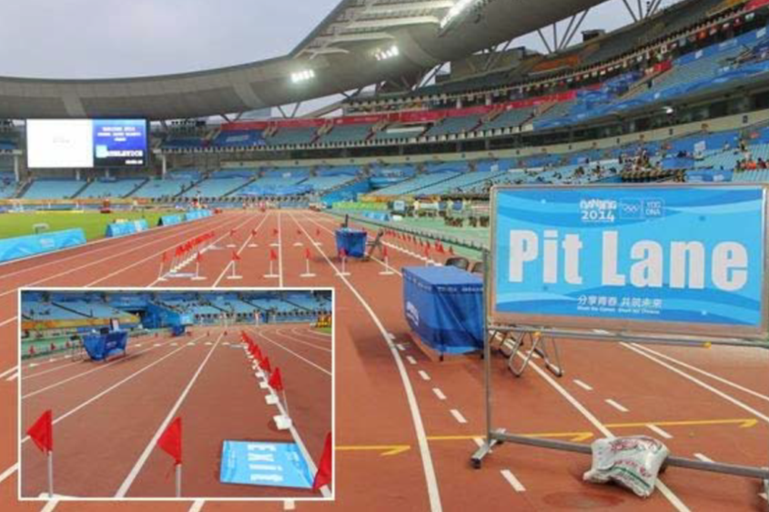
PENALTY ZONE
A Penalty Zone shall be used for any race where the applicable regulations for the competition so provide and may be used for other races as determined by the relevant governing body or Organizers.
In such cases, an athlete will be required to enter the Penalty zone and remain there for the applicable period once they have received three Red Cards and are so advised by the Chief Judge or someone delegated by them.
PENALTY ZONE

Slide 16
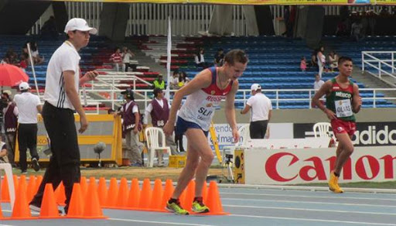
TIME TO BE SPENT IN PENALTY ZONE
The applicable period in Penalty Zone shall be as follows:
Races up to and including | Time
5000m / 5km | 0.5 min.
10,000m / 10km | 1 min.
20,000m / 20km | 2 min.
30,000m / 30km | 3 min.
35,000m / 35km | 3.5 min.
50,000m / 50km | 5 min.

Slide 17
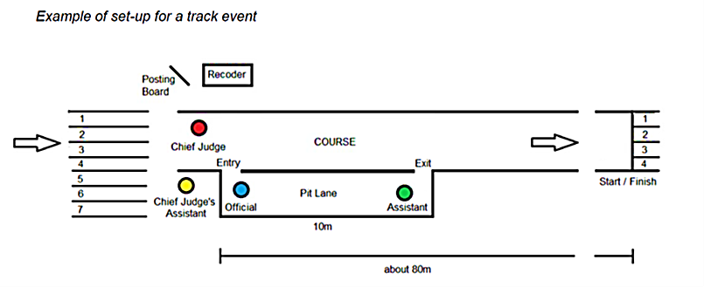
LAYOUT OF PENALTY ZONE
(FOR TRACK EVENT)
Penalty Zone

Slide 18
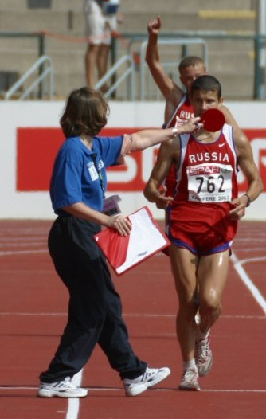
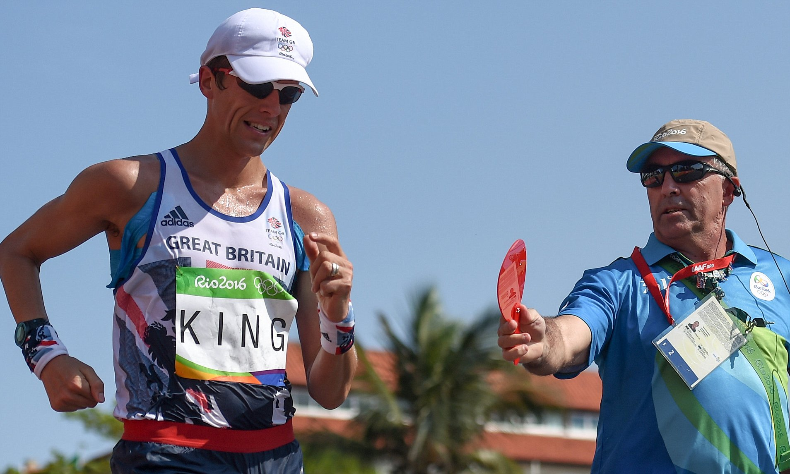
DISQUALIFICATION
When three Red Cards from three different Judges have been sent to Chief Judge on same athlete, the athlete is disqualified If there is no provision for Penalty Zone and they shall be notified by Chief Judge or Chief Judge’s Assistant by showing Red paddle.
If there is a provision for Penalty Zone, An athlete shall be disqualified after receiving four Red card from four different judges and they shall be notified by Chief Judge or Chief Judge’s Assistant by showing Red paddle.

Slide 19
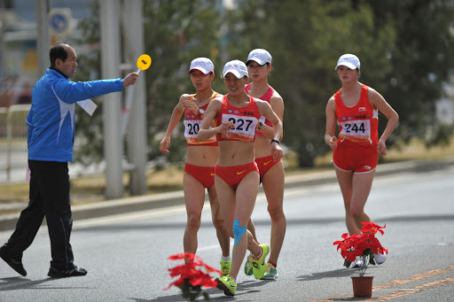
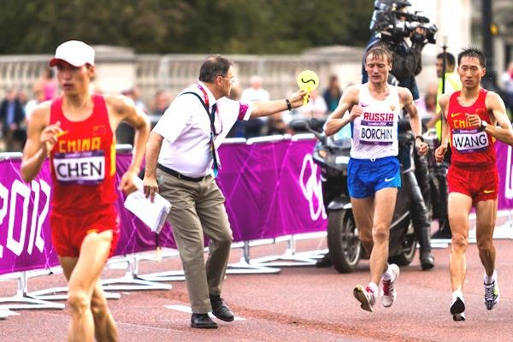
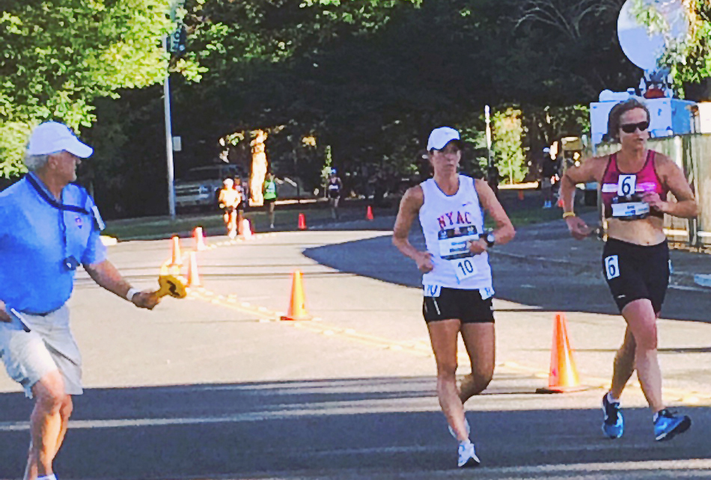
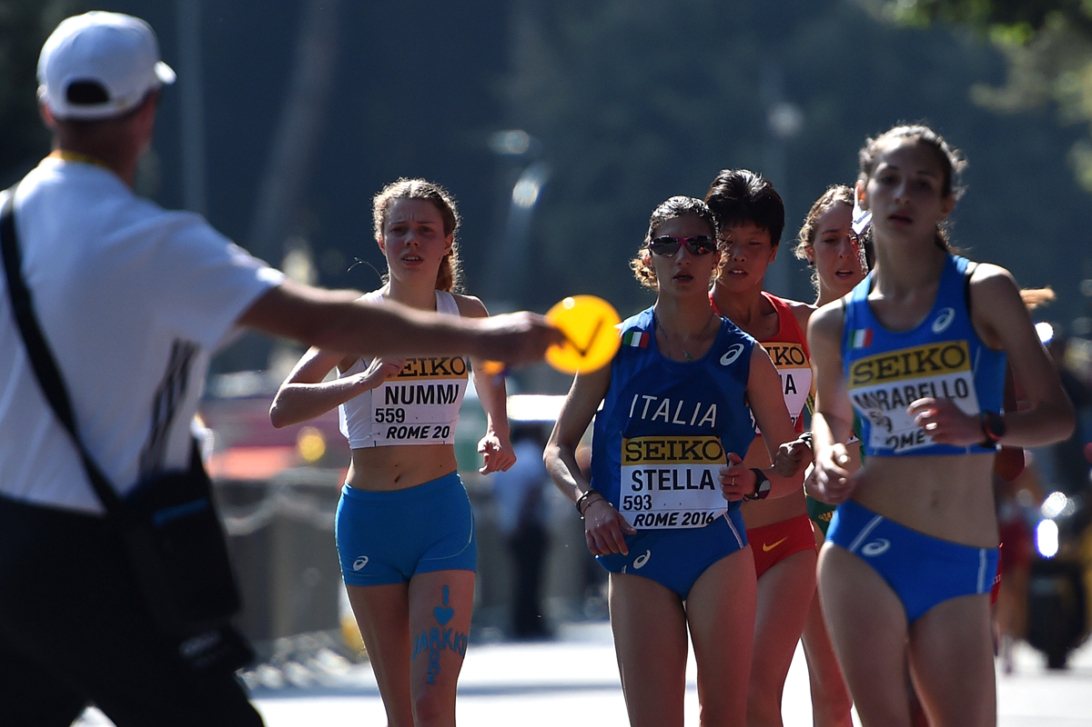
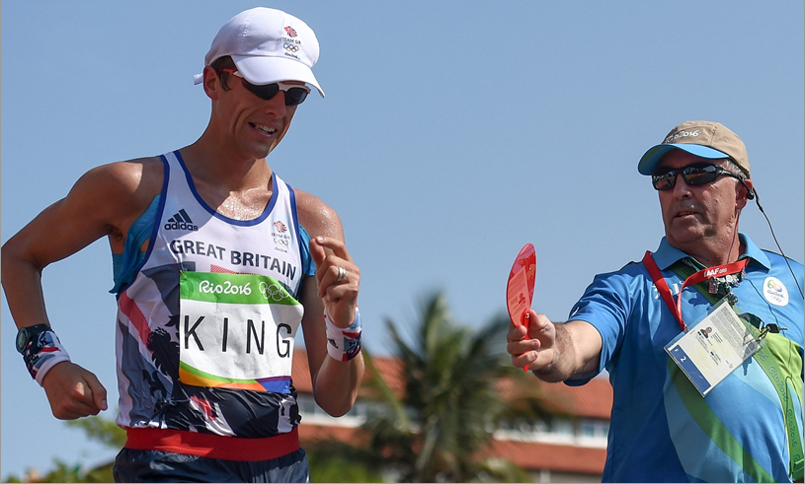
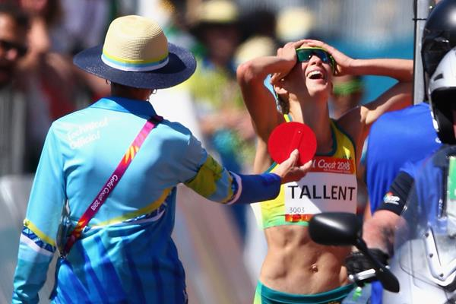
YELLOW PADDLES & DISQUALIFICATIONS

Slide 20
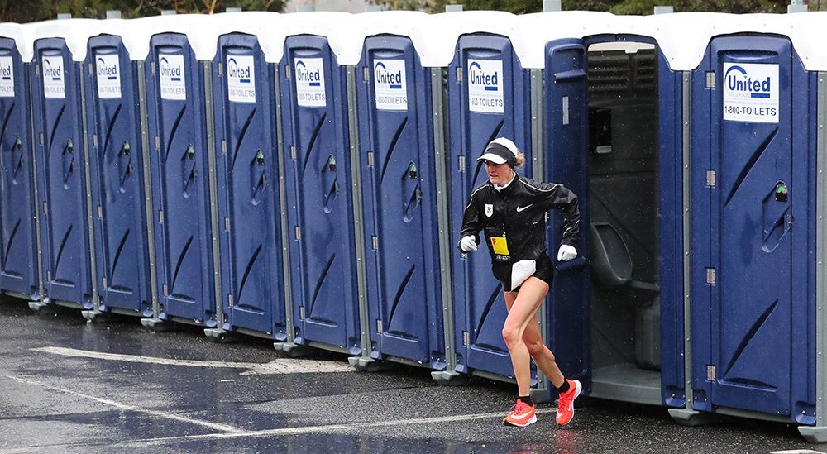
RACE CONDUCT
An athlete is allowed to leave the marked course with the permission and under the supervision of an official. They shall not shorten the distance to be covered by doing so.
If the Referee is satisfied on a report from a Judge or Umpire that an athlete left the marked course and thereby shortening the distance to be covered, they shall be disqualified.

Slide 21
DO’S AND DON’TS
If in doubt, give the benefit to the competitor. That is, only give red card when you are certain.
Do not believe that the proof of a good Judge lies in how many Red Cards they give. A good Judge can assist more competitors to finish by judicial use of a yellow paddle before an infringement of the rules takes place.
If you form an opinion, act on it immediately.
When a yellow paddle is shown to a competitor, make sure that they see your yellow paddle.
Do not judge from a moving vehicle.

Slide 22
DO’S AND DON’TS
Remember, how competitors walk today may not be how they walk next time. Do not prejudge them for the next race.
Do not be influenced by outside opinions. You are in control of your section of the course or track, so make your own decisions and stand by your reasoning.
Avoid getting into conversations during the race with other Judges or spectators. You are required to act independently.
Do not take an active interest in the positions or placing of members of any particular team.
Do not convey to any competitor information as to the progress of the race.

Slide 23
DO’S AND DON’TS
Do act impartially.
Mark your red card clearly, so there is no confusion when received by the Chief Judge or Recorder.
In track races, judge from the outside position where possible.
Do not judge by running alongside or physically interfering with the competitors.
Do not judge by lying down on the track or road.
Do not use any communication devices (e.g. mobile phone/camera or video), during the competition unless specifically issued for the event.

