Slide 1
THROWS FROM RUNWAY

Slide 2
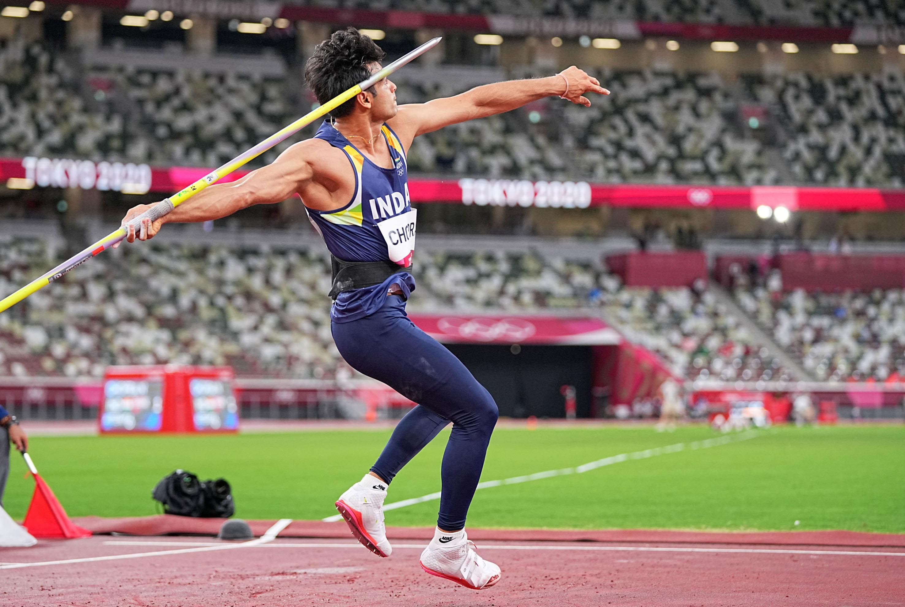
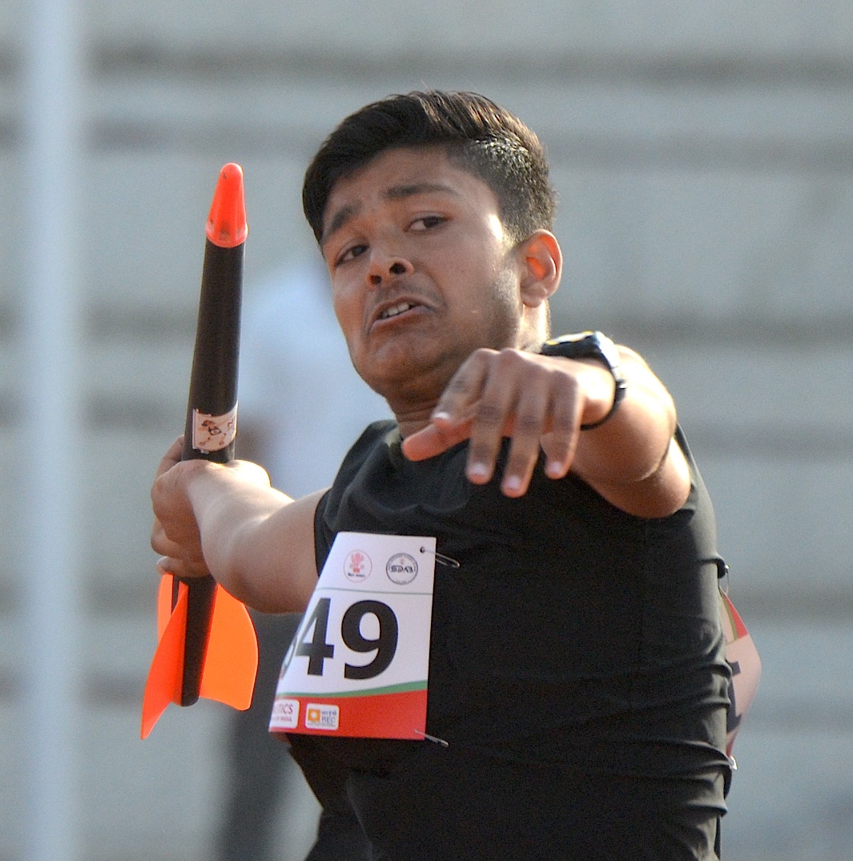
THROWS FROM RUNWAY
JAVELIN THROW
KIDS JAVELIN

Slide 3
JAVELIN THROW

Slide 4
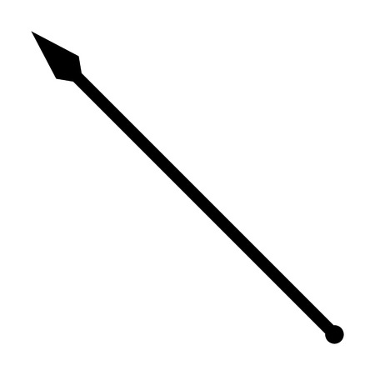
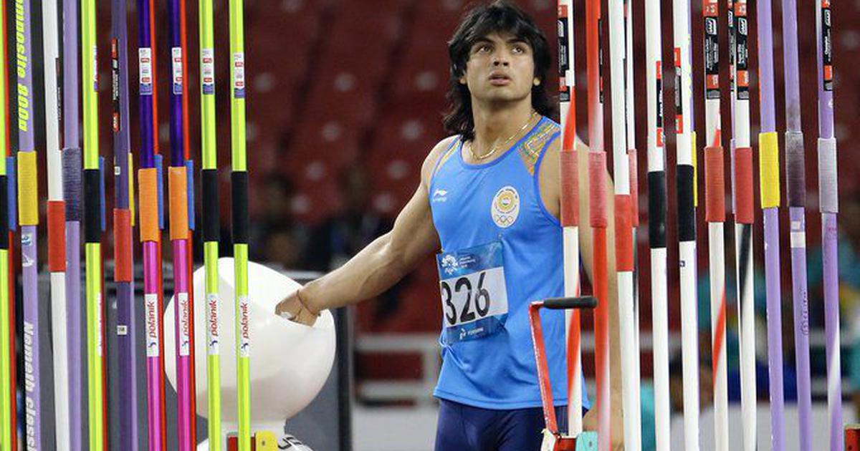
JAVELIN THROW
The origin of the javelin throw is obvious. The first throwers were primitive hunters seeking food.
The first known competitive use of a javelin occurred in the ancient Greek Olympics,
It has been part of the modern Olympic Games programme since 1908 for men, and 1932 for women.

Slide 5
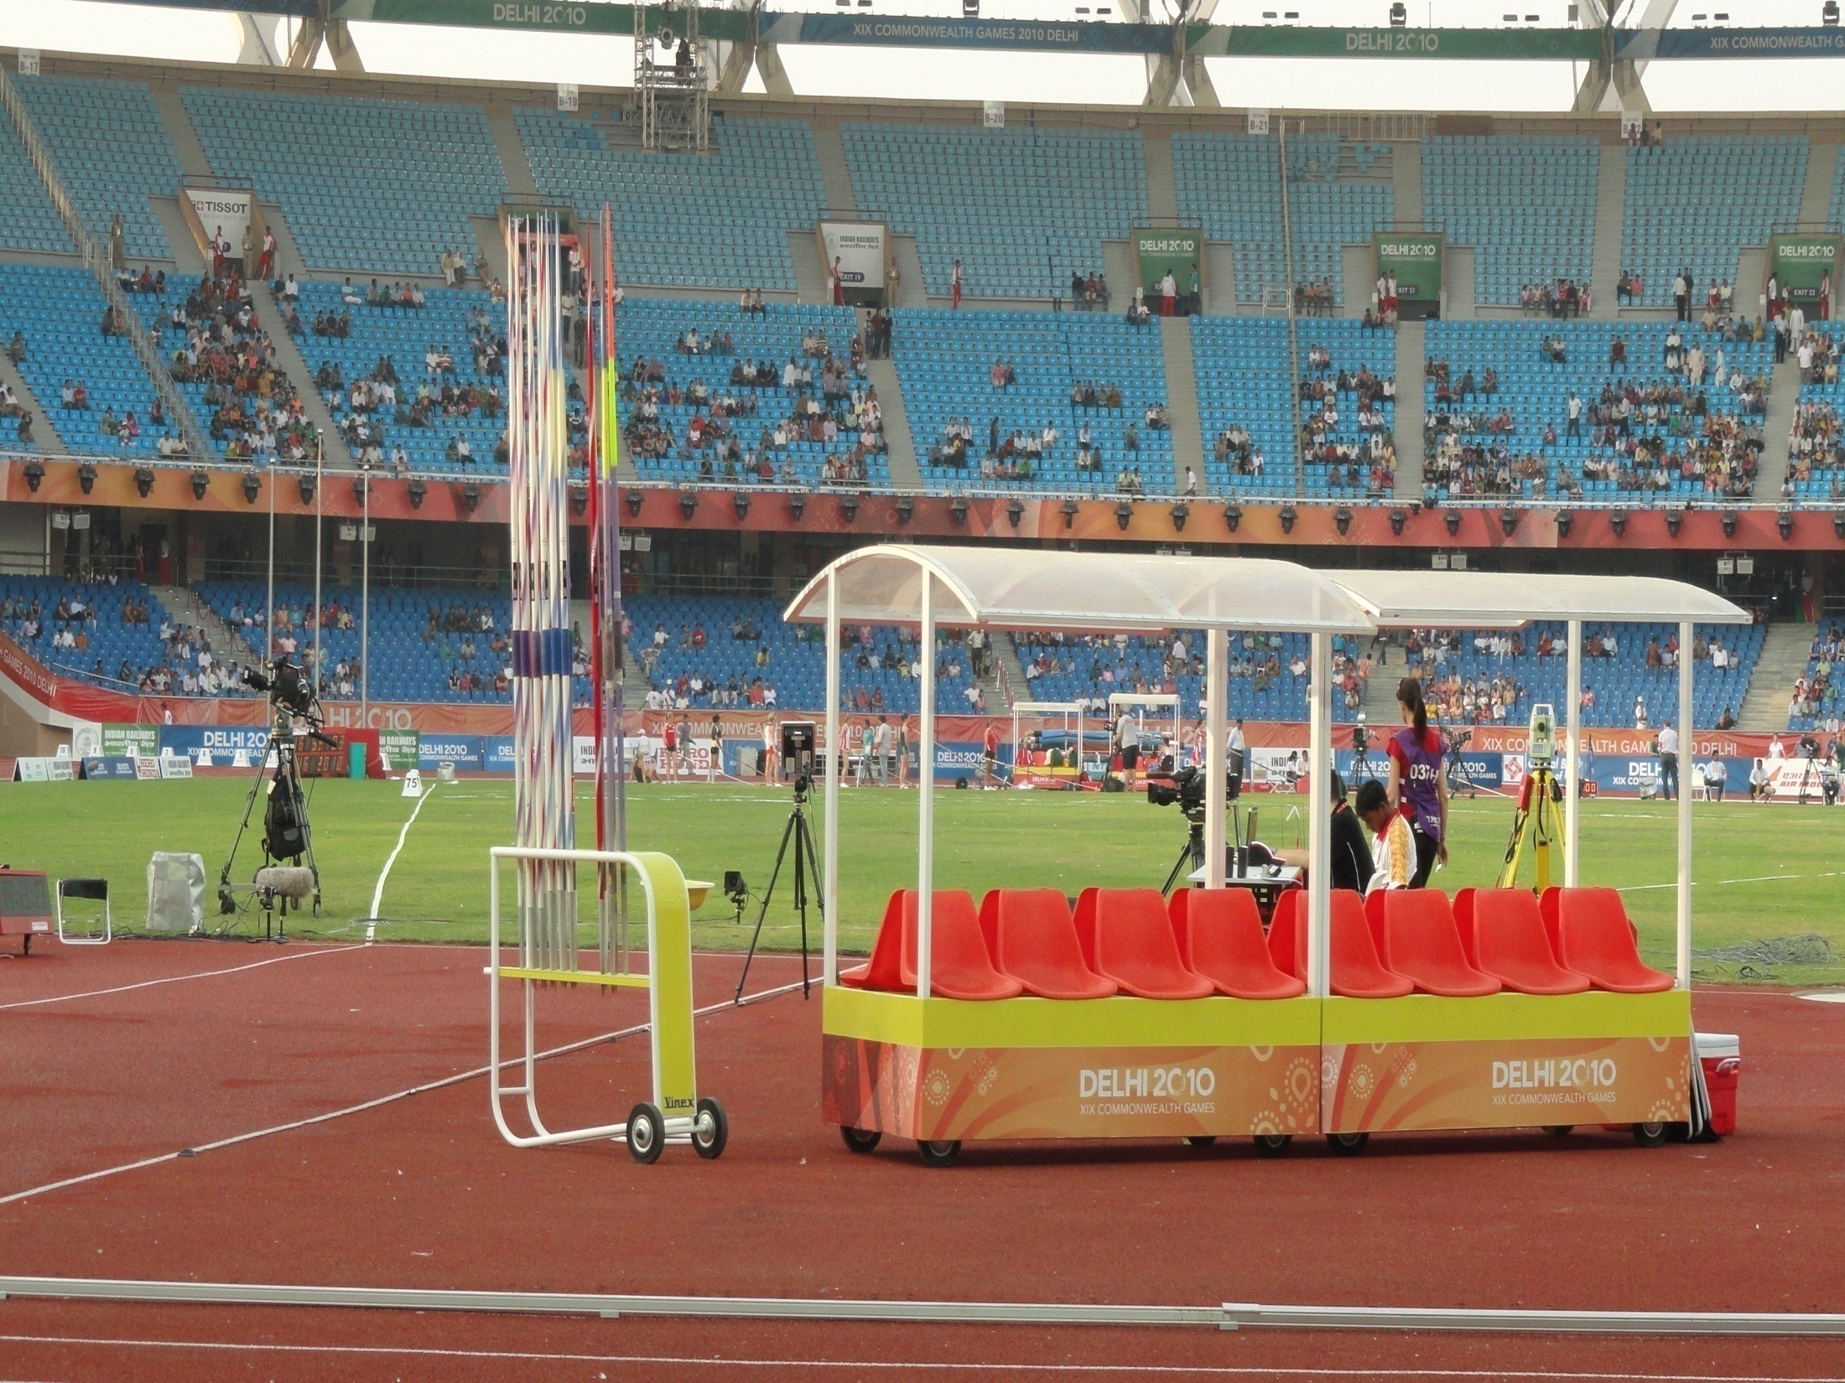
JAVELIN THROW
Runway and Sector
Specification of Implement's for different age groups in India
Failures-Basic rules
Rules about gloves and taping
Measurement and recording
Competing order, number of trials and breaking of ties
Time allowed
Number and placement of officials -recommended

Slide 6
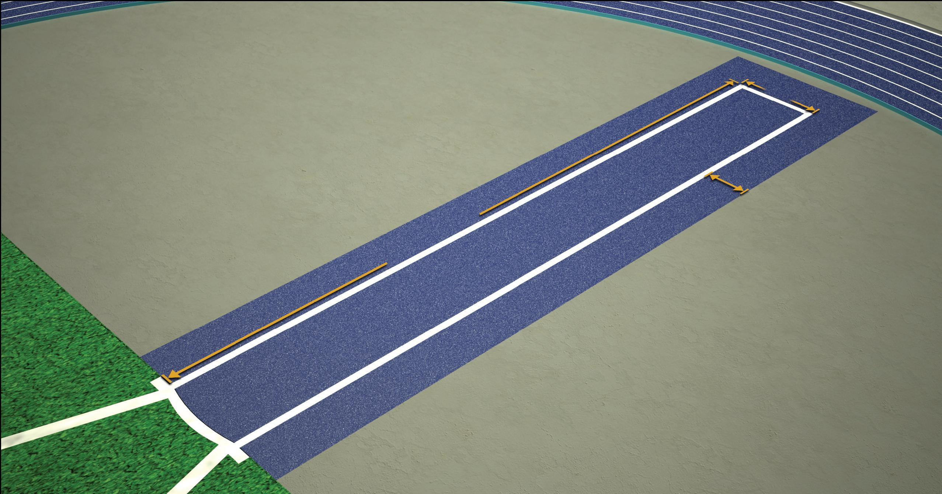
JAVELIN THROW - RUNWAY
Minimum 30m and 33.50m (where condition permit minimum length should be 36.50m)
Marked with 5cm white parallel lines 4m apart.
The arc is marked with 8m radius within the 4m parallel line.
The arc consists of a painted strip with 7cm width.
The arc is extended by 75cm outside & perpendicular to the parallel line,
The purpose of the “4m marks” is begin measuring the trial once the athlete retreats behind this point
30m and 36.5m
75cm
4mt
5cm
8 meter
Runway
4 meter
7cm
8 meter
4mt
75cm

Slide 7
JAVELIN THROW – RUNWAY & SECTOR
80m
50m
75cm
5cm
4m
5cm
Runway
40m
Runway
4 meter
28.96⁰
25m
4 meter
7cm
30m and 36.5m
4m
75cm
Sector Shall be cinders or grass, Marked with 5cm white lines
Has an angle of 28.96⁰
such that the inner edge of the lines, if extended, would pass through the two intersections of the inner edge of the arc and the parallel lines marking the runway and intersect at the centre of the circle of which the arc is part
The landing sector shall be of an even surface soft enough.

Slide 8
JAVELIN THROW
Generally speaking, the javelin shall consist of three parts:
A head
A shaft
A cord grip
The shaft shall be constructed completely of metal and shall have fixed to it a metal head terminating in a sharp point (the tip).
The surface of the shaft shall have no dimples, pimples, groves, ridges, holes, or roughness and the finish shall be smooth and uniform

Slide 9
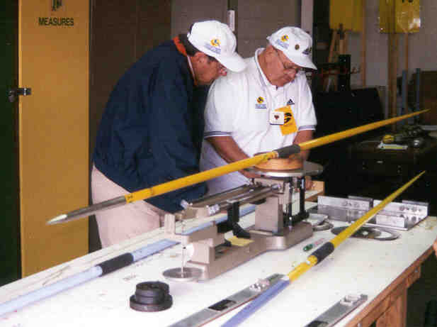
JAVELIN THROW
Category | U16 GIRLS U18 WOMEN | WOMEN U23 WOMEN U20 WOMEN U16 BOYS | U18 MEN | MEN U23 MEN U20 MEN
Minimum weight for admission to competition and acceptance of Record (inclusive of cord grip)
Javelin Weight | 500gm | 600gm | 700gm | 800gm
Overall length (l0): minimum
 | 2.00m | 2.20m | 2.30m | 2.60m
 | 2.10m | 2.30m | 2.40m | 2.70m

Slide 10
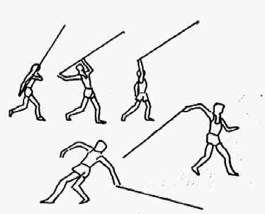
JAVELIN THROW - FAILURES
If not thrown over the shoulder or the upper part of the throwing arm and slung or hurled.
Non-orthodox styles are not permitted.
A throw without holding the javelin at grip.
Throw with both the arms.
In the process of throwing, turns completely around so that the thrower’s back is towards the throwing arc
After stepping in to the runway to make the trial, any part of the body touches the side lines or the ground outside
Fails to leave the runway correctly OR before the implement has landed

Slide 11
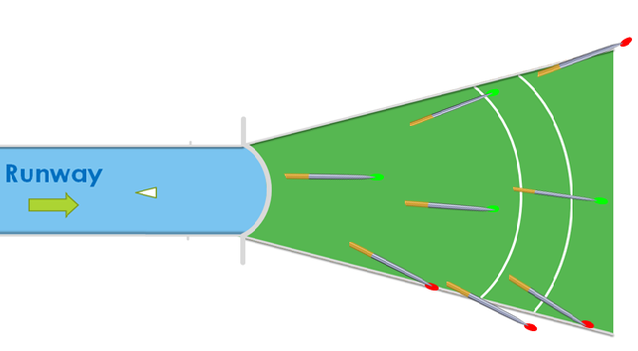
JAVELIN THROW - FAILURES
If the head of the javelin does not touch the ground before any other part of the implement
If the head of the javelin in contacting the ground when it first lands or touches the sector line or the ground outside
Infringes the “assistance” rules – such as use of illegal taping on the hands [any taping must be checked by the chief judge] or a glove on the throwing hand
Exceeds the time limit allowed for their trial
Breaches the clothing or footwear rules

Slide 12
GLOVES AND TAPING
Taping that does not contravene assistance (around wrist, single finger) is permitted (The Chief Judge must review) the taping prior to the start of the event
Taping two or more fingers together not allowed
Any kind of device during trial (i.e. weights attached to body) not allowed
The use of gloves in Javelin throw is not allowed

Slide 13
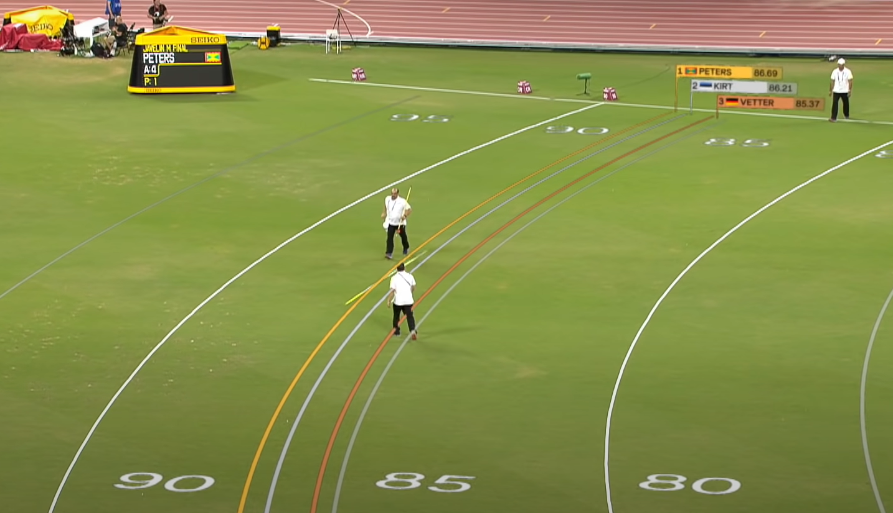
JAVELIN THROW - MEASUREMENT
The Chief Judge will watch over the whole of the event.
Two Judges checking whether the throw has been made correctly and measuring the trial.
One must be provided with two flags – white to indicate the valid trial and red to failure.
When the throw has been measured, it is advised that the Judge stands on the runway holding the red flag,
A cone may be placed on the runway instead.
One or two Judges immediately after the throw placing a marker indicating the point from which the trial is to be measured.
An appropriate indication is also required if these Judges determine that the implement has not landed “head first”.
No indication is required for a valid trial.

Slide 14
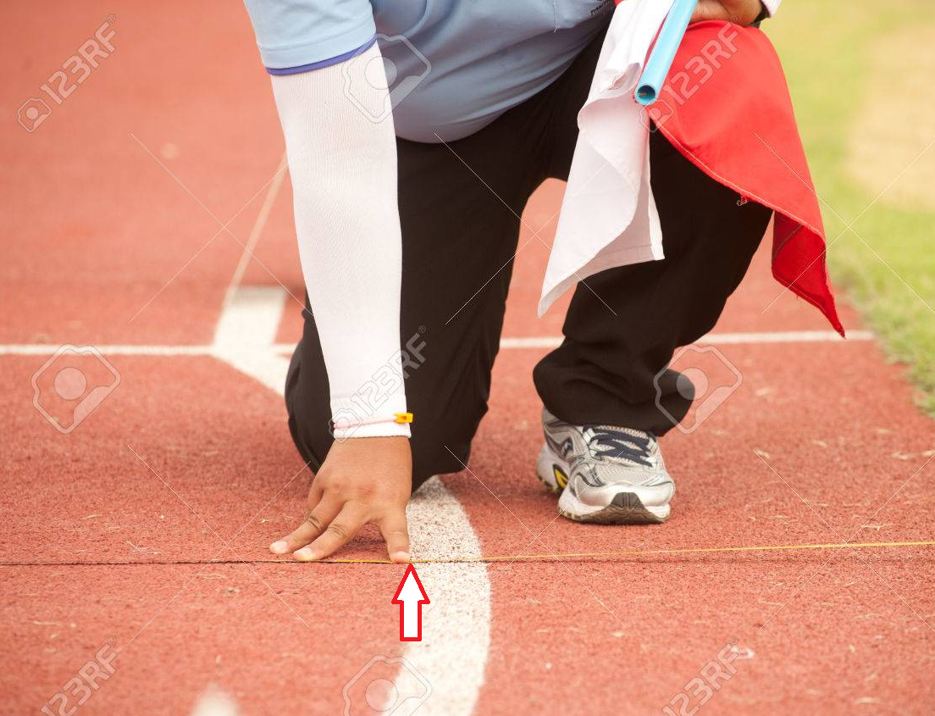
JAVELIN THROW - MEASUREMENTS
All measurements must be made with a:
Steel or fibre glass metre tape, or with a scientific measuring apparatus
The measurement of each throw shall be made from where the metal head first strikes the ground to the inside edge of the arc along a line from the point of landing to the centre of the circle of which the arc is part.
The selected point is marked by the spike and the zero end of the tape is held at the spike.
The tape is drawn tight through the centre of the circle of which the arc is a part (8 metres from the arc).
Each measurement is to the nearest centimetre below the distance thrown unless the reading is a whole centimetre.

Slide 15
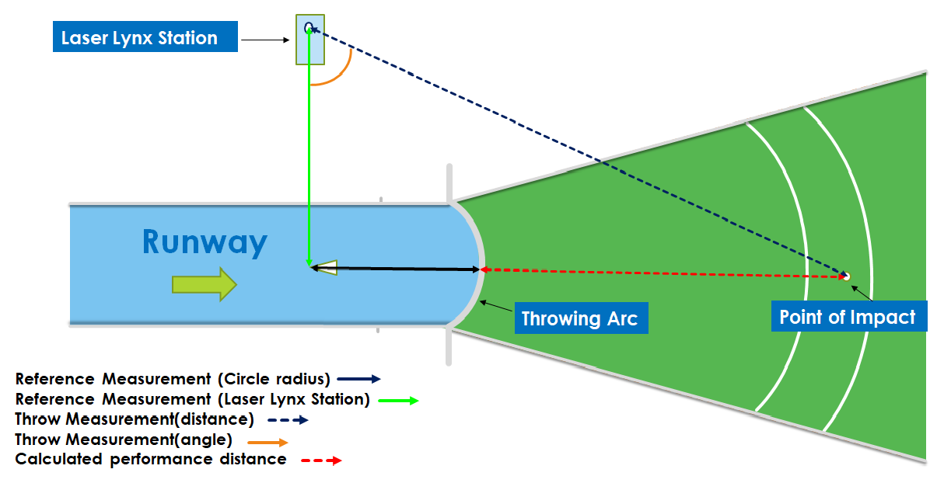
E.D.M. – ELECTRONIC DISTANCE MEASUREMENT

Slide 16
JAVELIN THROW – COMPETING ORDER
Athletes shall compete in an order drawn by lot.
Where athletes are competing in more than one event at the same time (simultaneous entries), the Referee may alter the order within that set of attempts but not in the last round
Practice Trials
At the competition area and before the beginning of the event, each athlete may have practice trials.
This should be In draw order and always under the supervision of the Officials
The current rule should be interpreted as allowing whatever number of practice trials that may be included in the warm-up time available
Once a competition has begun
Athletes are not permitted to use for practice purposes, as appropriate:
The runway , Implements and the ground within the sector with or without implements

Slide 17
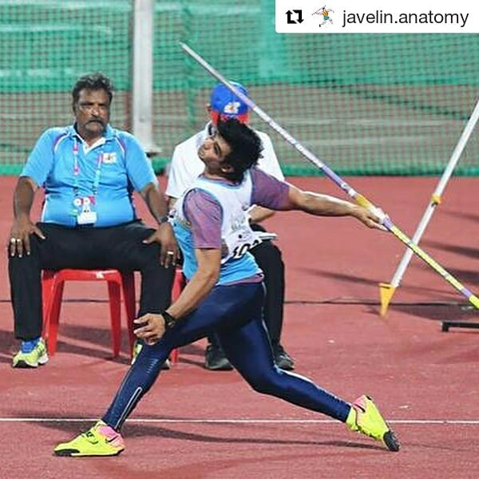
JAVELIN THROW – No. OF TRIALS
No athlete shall have more than one trial in any one round
Where there are more than 8 athletes, each athlete shall have 3 trials and the 8 athletes with the best valid performances shall be permitted 3 more trials
Where there are 8 or fewer athletes, each athlete shall be allowed 6 trials
In case of last qualifying place, if 2 or more athletes have the same best performances, their second best performance shall determine whether there has been a tie.

Slide 18
JAVELIN THROW – No. OF TRIALS
To break the tie:
Keep progressing through the performances to separate the athletes If the athletes are still equal it shall be a tie and the tying athletes shall be allowed 3 additional trials
Where there are 8 or fewer athletes, each athlete shall be allowed 6 trials. If more than one fail to achieve a valid trial during the first 3 rounds of trials, such athletes shall compete in subsequent round of trials before those with valid trials, in the same relative order according to the original draw

Slide 19
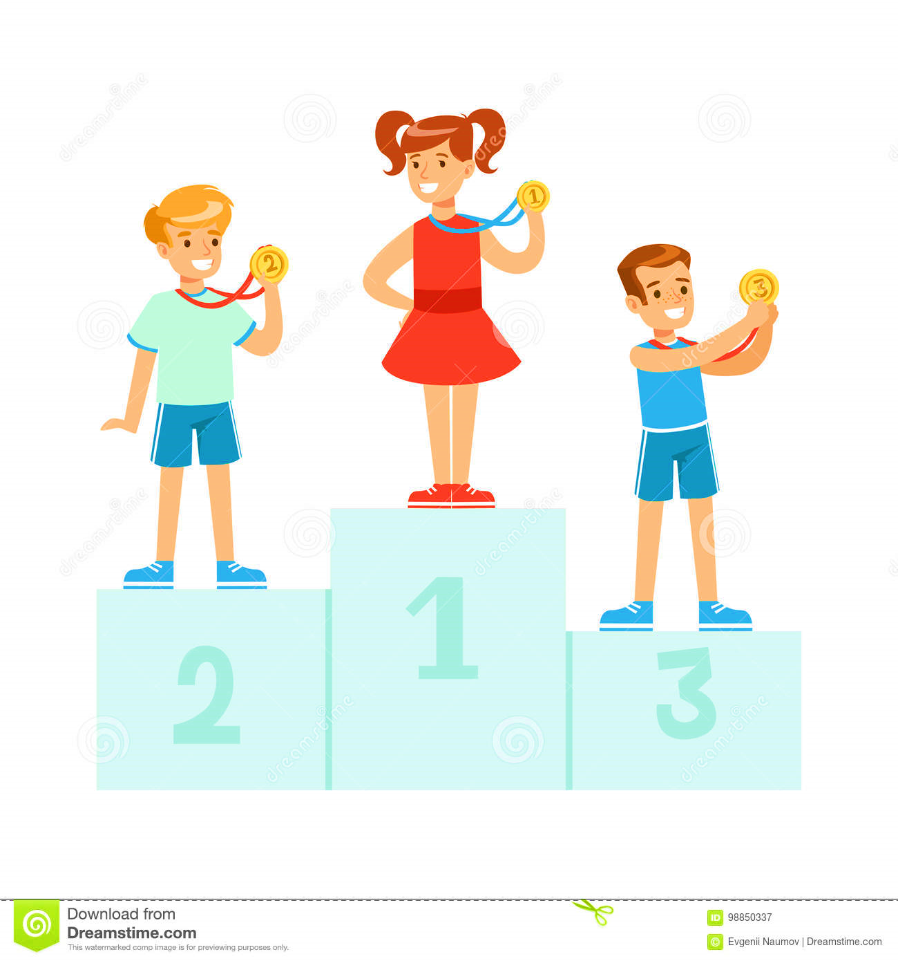
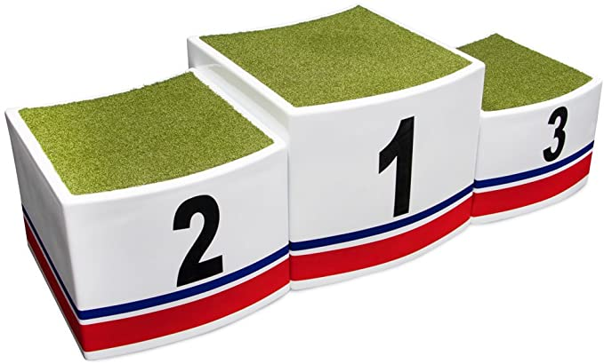
JAVELIN THROW – BREAKING OF TIES
If there are no ties, scoring Javelin events is fairly straight forward
The athlete with the longest throw is the winner
The next best distance is second; and so on
If two or more athletes’ best distances are identical then:
Compare the second best distance of the tied athletes
The athlete with the greatest second best distance is awarded the higher place
If still tied after this, then:
Compare the third best distance of the tied athletes and the athlete with the greatest third best distance is awarded the higher place And so on.
If the athletes are still equal following the application, it shall be determined to be a tie.

Slide 20
JAVELIN THROW – SCORE CARD
Each athlete’s vailed Performance is recorded in score sheet by official
On the sample sheet, each athlete’s best distance is highlighted.
Anoop clearly has the best throw of 61.13M in the competition and is awarded 1st place.
The next best distance is 60.85M by Rajesh and Ganesh.
Compare their second-best throws.
Since Ganesh 60.60M is better than Rajesh’s 60.32M, Ganesh is awarded 2nd place and Rajesh 3rd place
Name of the Institution – Raghuraj Higher Secondary School. Bhopal
Name of the Championships- District Athletics Championship Bhopal
Venue & Dates- Tatya Tope Nagar Athletics Stadium Bhopal
* DISTANCE SCORE CARD *
Date: 17 Aug 2020 |  |  |  | Category: Boys |  |  |  |  | EVENTS | LONG JUMP |  |  |  |  | TRIPLE JUMP
Time Hrs.: 10.30 am |  |  |  | Group: Under 16 Years |  |  |  |  |  | SHOT PUT |  |  |  |  | DISCUS THROW
National Record: 74.73m |  |  |  | Meet Record: ----- |  |  |  |  |  | HAMMER THROW |  |  |  |  | JAVELIN THROW
S.N. | NAME of the ATHLETES | Bib Numbers | Bib Numbers | UNIT | TRIALS |  |  |  | BEST OF Three Trial | POSITION after three Trial | TRIALS |  |  |  |  | BEST OF All Trial | FINAL POSITION
 |  |  |  |  | FIRST | SECOND | THIRD | THIRD |  |  | FOURTH | FIFTH | FIFTH | SIXTH | SIXTH
1 | Sonu Singh | 211 |  | RHS | 58.91 | X | 59.05 | 59.05 | 59.05 | 4 | 59.17 | X | F | 57.67 | 57.67 | 59.17 | 4
2 | Praveen | 231 |  | SSH | 57.50 | X | 58.98 | 58.98 | 58.98 | 5 | - | 57.98 | 57.98 | - | - | 58.98 | 5
3 | Utkarsh | 256 |  | DPS | 58.64 | 56.76 | 57.66 | 57.66 | 57.66 | 7 | X | 58.62 | 58.62 | 58.87 | 58.87 | 58.87 | 6
4 | Anoop | 121 |  | BBS | 59.98 | X | 60.93 | 60.93 | 60.93 | 1 | 61.13 | 60.97 | 60.97 | X | F | 61.13 | 1
5 | Sundar Kumar | 234 |  | HSS | 56.46 | 56.66 | 57.17 | 57.17 | 57.17 | 8 | - | - | - | 58.21 | 58.21 | 58.21 | 7
6 | Rajesh | 115 |  | APS | 60.32 | 59.95 | X | F | 60.32 | 2 | 58.25 | 60.85 | 60.85 | X | F | 60.85 | 3
7 | Dipendra | 298 |  | IPS | 57.71 | 57.40 | X | F | 57.71 | 6 | 57.34 | X | F | 57.06 | 57.06 | 57.71 | 8
8 | Ganesh | 103 |  | KNS | F | 59.43 | 59.04 | 59.04 | 59.43 | 3 | 60.85 | 60.60 | 60.60 | 59.98 | 59.98 | 60.85 | 2
9
REFEREE |  |  |  | CHIEF JUDGE |  |  |  |  |  | JUDGES | Jagdeesh
NAME- Sanjay kumar |  |  |  | NAME- Deepak Dund |  |  |  |  |  |  | Adil Khan
SIGNATURES |  |  |  | SIGNATURES |  |  |  |  |  |  | Ravindra

Slide 21
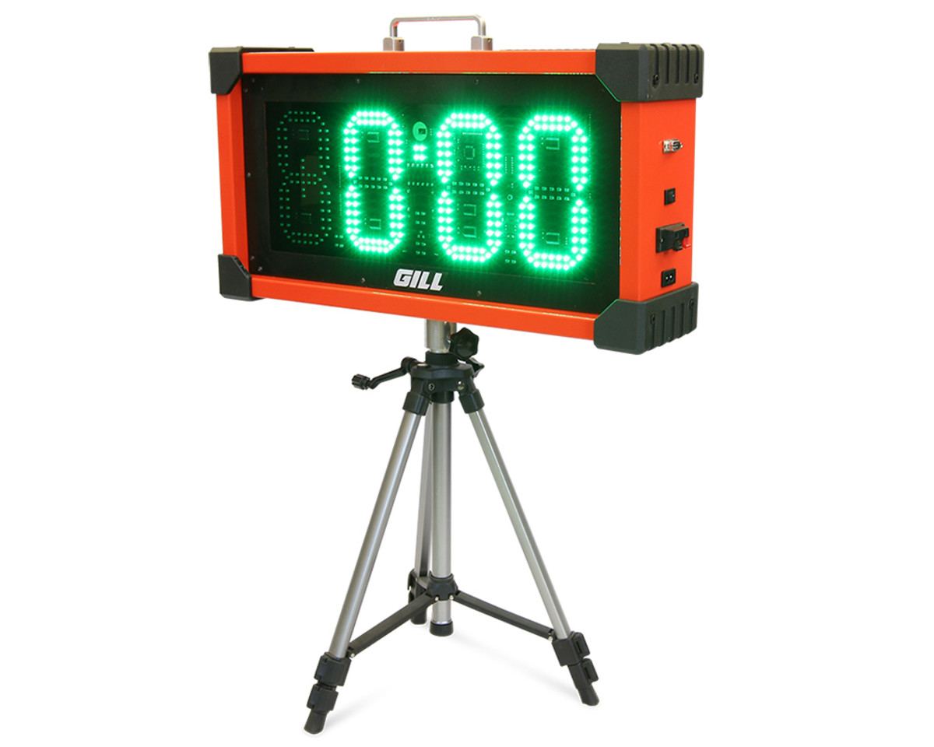
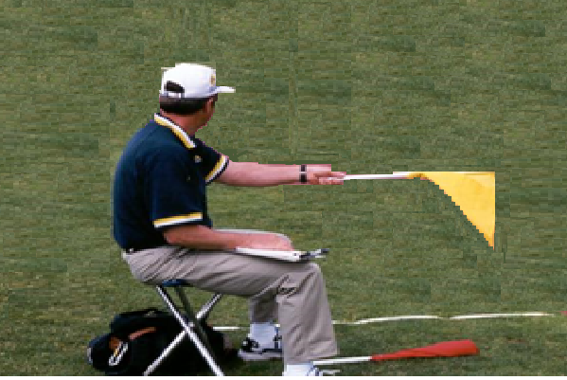
JAVELIN THROW – TIME ALLOWED
Time allowed for each trial is
A clock showing the remaining time left for a trial should be visible to the athlete
An Official shall also raise a yellow flag or otherwise indicate during the final 15 seconds of the time allowed
In the case of consecutive trials by the same athlete, the time will be 2 minutes.
If the time allowed elapses once an athlete has started his trial, that trial should not be disallowed.
 | More than 3 athletes (Or 1st Trial of each athlete) | 2 or 3 athletes | Consecutive trials by any athlete
Javelin | 1 min | 1 min | 2 min

Slide 22
JAVELIN THROW –
PLACEMENT OF OFFICIALS
Chief Judge
Arc Judge
Runway Judge (Tape) /EDM
Landing Sector Judge (Validity)
Landing Sector Judge
Landing Sector Judge
Landing Sector Judge (Spike/Prism)
Athlete Performance Marker
Recorder
Scoreboard Operator
Time Clock Operator
Athlete Control Judge
Implement Retrieval Judge
Implement Retrieval Judges

Slide 23
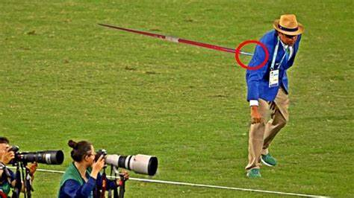
JAVELIN THROW - SAFETY
Be aware of safety at all times. Avoid two long range throw event at same time.
Always ensure the safety of athletes, Officials and spectators
Allow only competitors, Officials and other accredited personnel on to the field of play
Always have qualified medical personnel in attendance
Always look in both directions then move in field of play
Always take care when throwing objects, especially Javelin going on.
Use your common sense
Note:- Javelin throw is high probability, severe injury impact event.

Slide 24
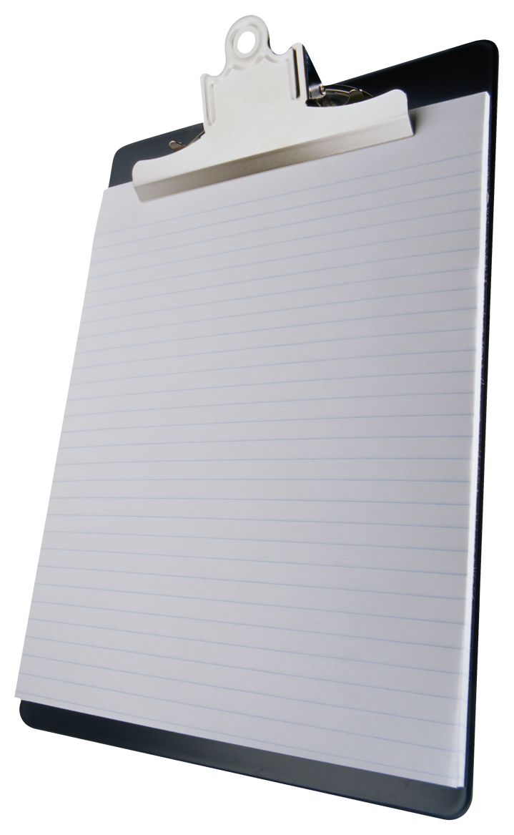
JAVELIN THROW
Javelins
Runsway/Landing/Sector
Tapes: 2x100m for Sector
Arc extension lines & pegs
Flags: Red, white, yellow
Broom / Mop /Cleaning Cloths
Cone
Stopwatch
Chalk
Javelin Storage Rack Spike
Coir Mat
Athlete Performance Markers
Measuring Tape: 100m
Recording Sheets
Clipboards Stationary
Athlete Benches/ Athlete Shelters
Chairs / tables for Officials
Shelter for Officials
Countdown Clock Record
Markers Scoreboard
EDM Equipment
Side safety net
Cone
Record Arcs
Runway markers

Slide 25
KIDS JAVELIN THROW

Slide 26
KIDS JAVELIN THROW - SPECIFICATIONS
This event is introduced by Athletics Federation of India for Junior Boys and Girls of age group under 14 years.
The Kids Javelin is made of Plastic material with an approximate weight of 285gm.
KIDS JAVELIN – 285 GMS

Slide 27
KIDS JAVELIN THROW
ALL RULES OF JAVELIN THROW
ARE APPLIED TO THE KIDS JAVELIN THROW EVENT TOO

