Slide 1
TRACK EVENTS

Slide 2
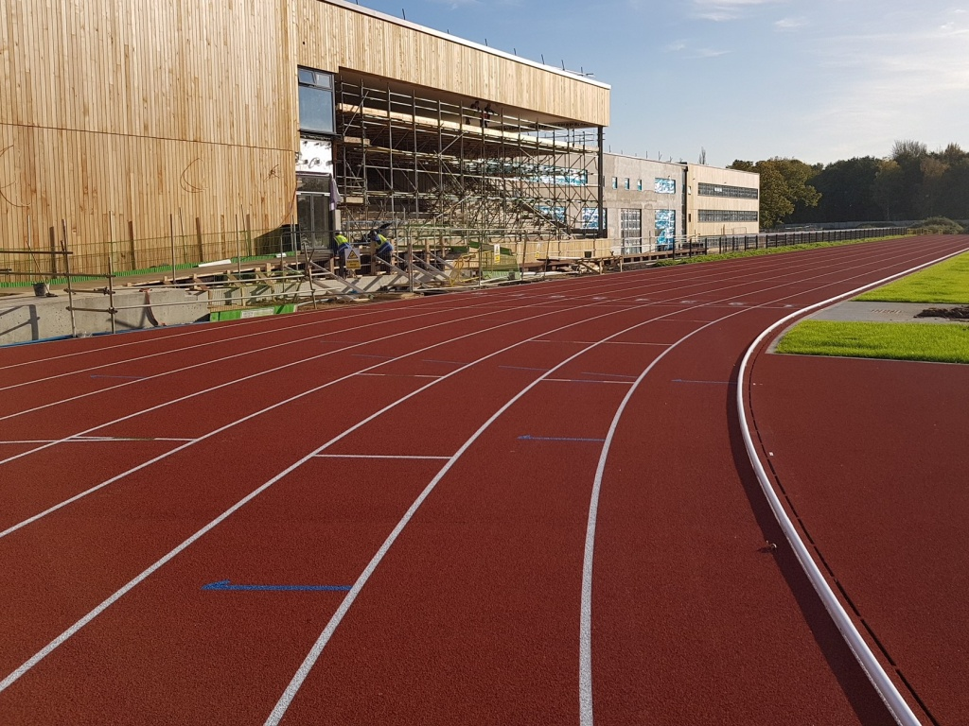
LINE, LANE AND TRACK
LINE
White in colour and 5cms thick.
LANE
Section marked by Lines.
Width of Lane is 1.22m +/- 0.01m
TRACK
All the Lanes together is called Track

Slide 3
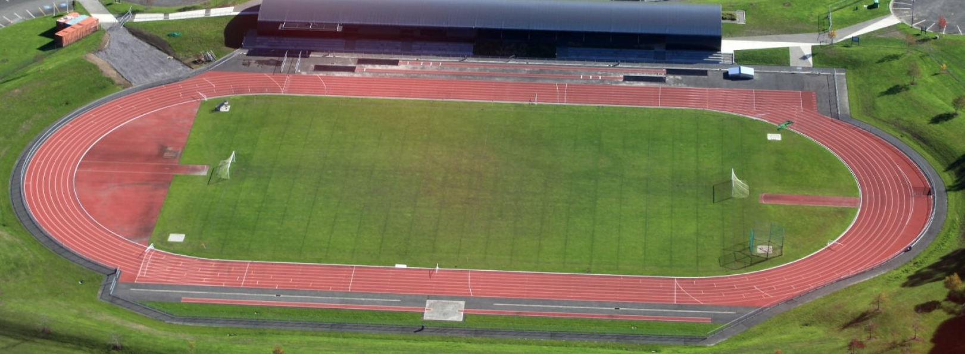
TRACK
The length of standard running track shall be 400m.
It shall consist of two parallel straight and two bends of equal radius.

Slide 4
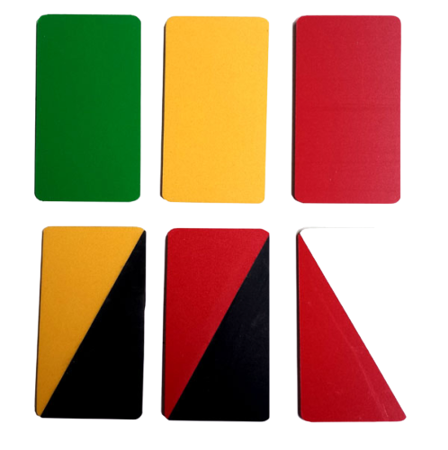
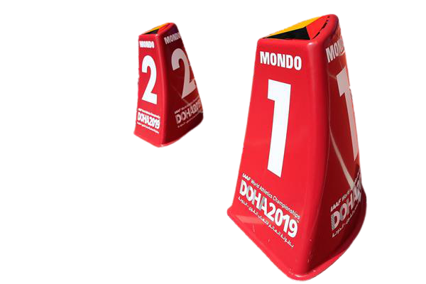
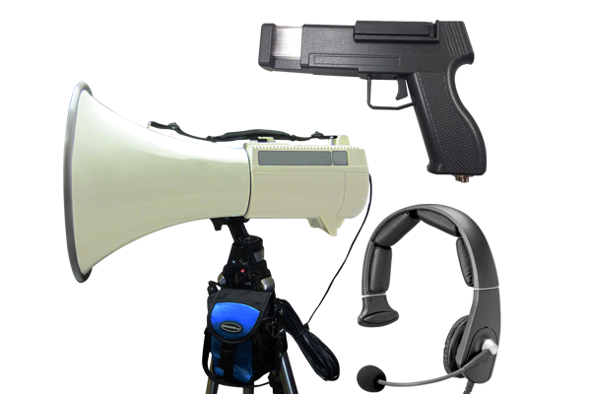
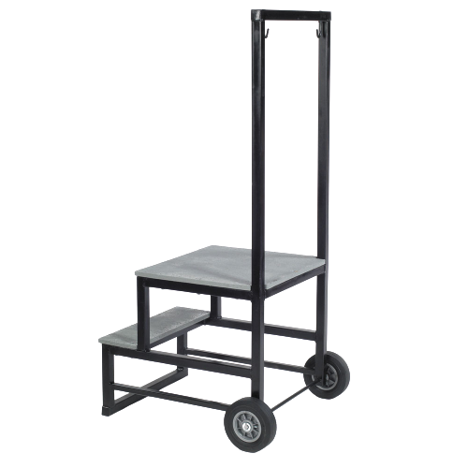
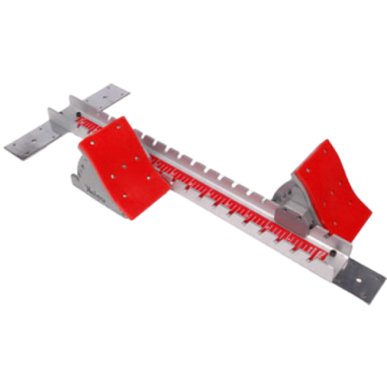
BASIC ITEMS & EQUIPMENTS
REQUIRED
CARDS
LANE MARKERS
STARTERS GUN, MICROPHONE & MEGAPHONE
STARTERS STAND
STARTING BLOCKS

Slide 5
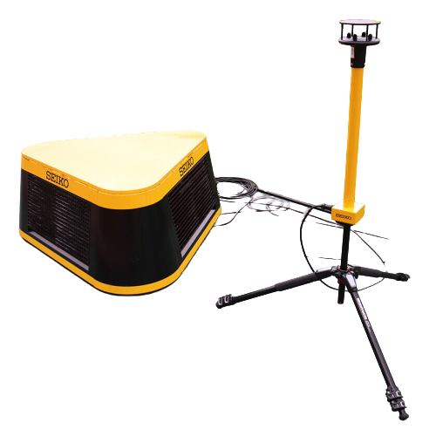
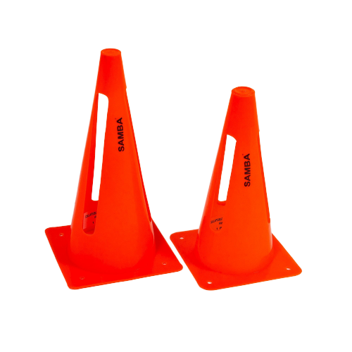



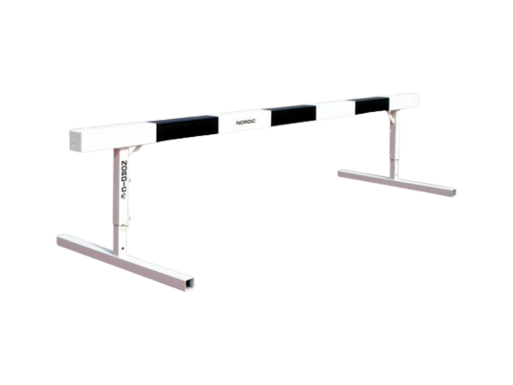
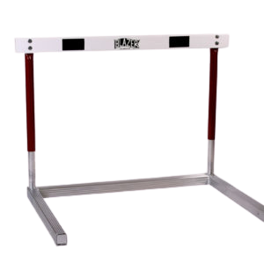
BASIC ITEMS & EQUIPMENTS
REQUIRED
CONES
FLAGS
WIND GAUGE
HURDLE
STEEPLECHASE HURDLE

Slide 6
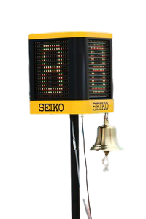
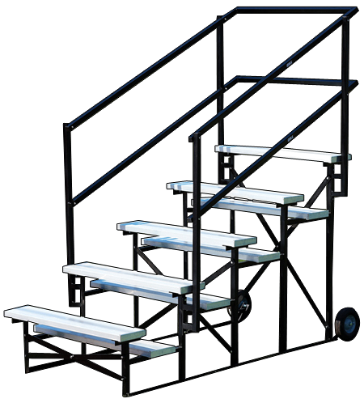
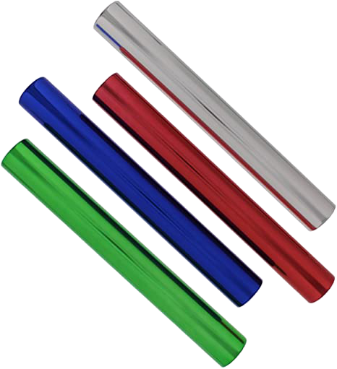
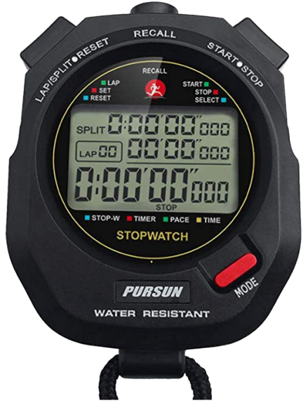

BASIC ITEMS & EQUIPMENTS
REQUIRED
RELAY BATONS
LAP COUNTER & BELL
JUDGES & TIMEKEEPER STAND
STOP WATCH
CLIPBOARD, SCORESHEETS & PEN

Slide 7
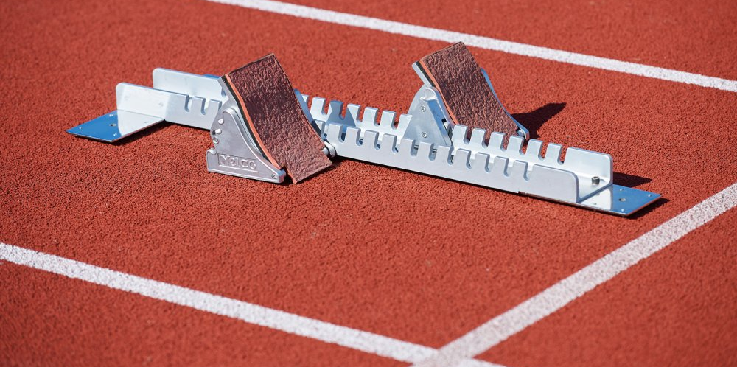
STARTING BLOCKS
It Shall be used only for all races up to and including 400m (including first leg of 4 x 100m Relay, Medley Relay, and 4 x 400m)

Slide 8
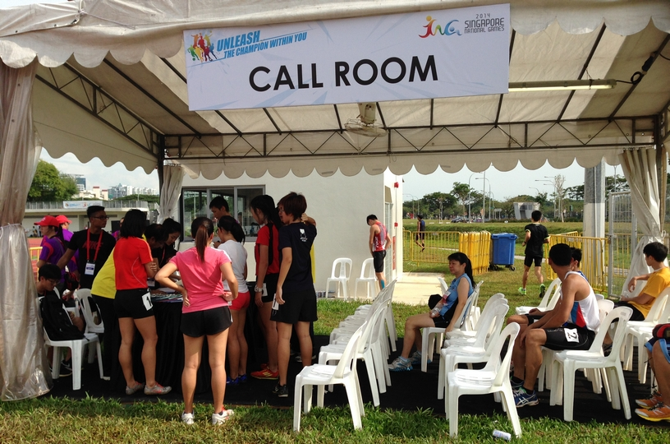
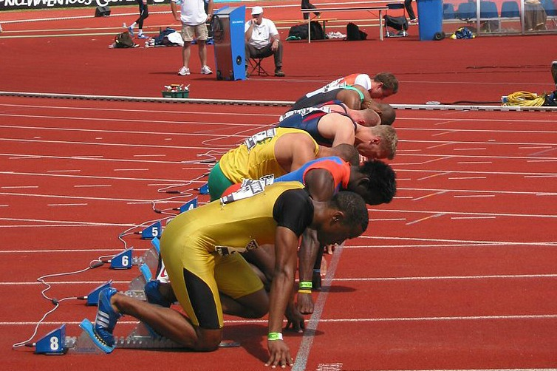
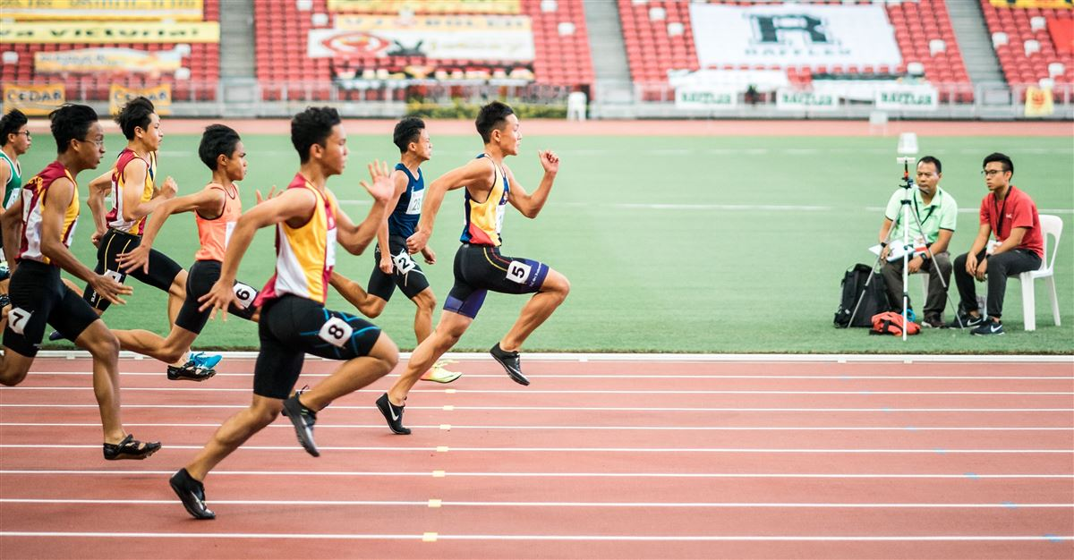
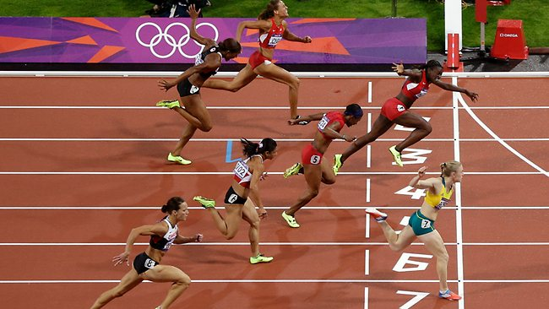
TRACK EVENTS – PROCESS FLOW
REPORTING
START
RUN
FINISH

Slide 9
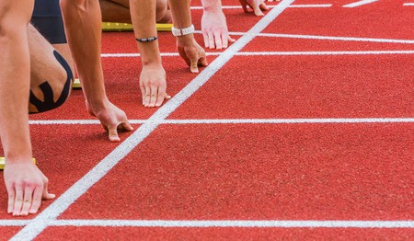
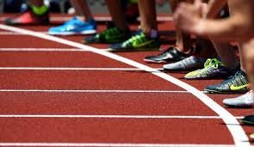
STARTING LINES
The start line of the race shall be denoted by a white line 50mm wide.
In all races not run in lanes, the start line shall be curved.

Slide 10
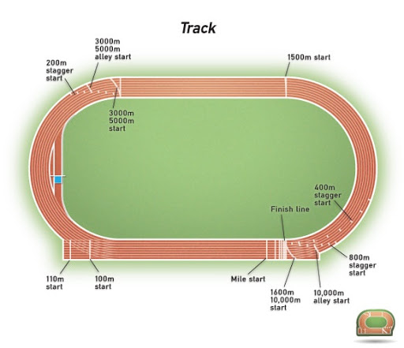
VARIOUS STARTING POINTS
Break line

Slide 11
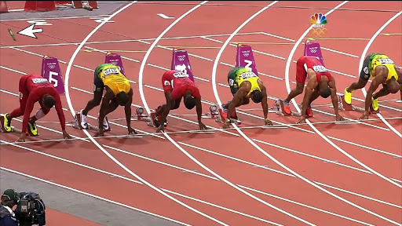
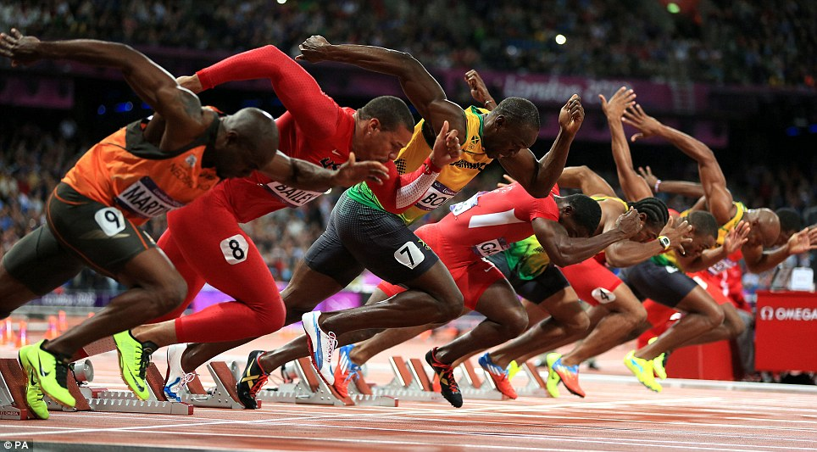
CROUCH START
In races up to and including 400m (including 4 x 100m, Medley Relay, 4 x 400m), a crouch start and use of starting blocks are compulsory.
ON YOUR MARKS
SET
GUN FIRE

Slide 12
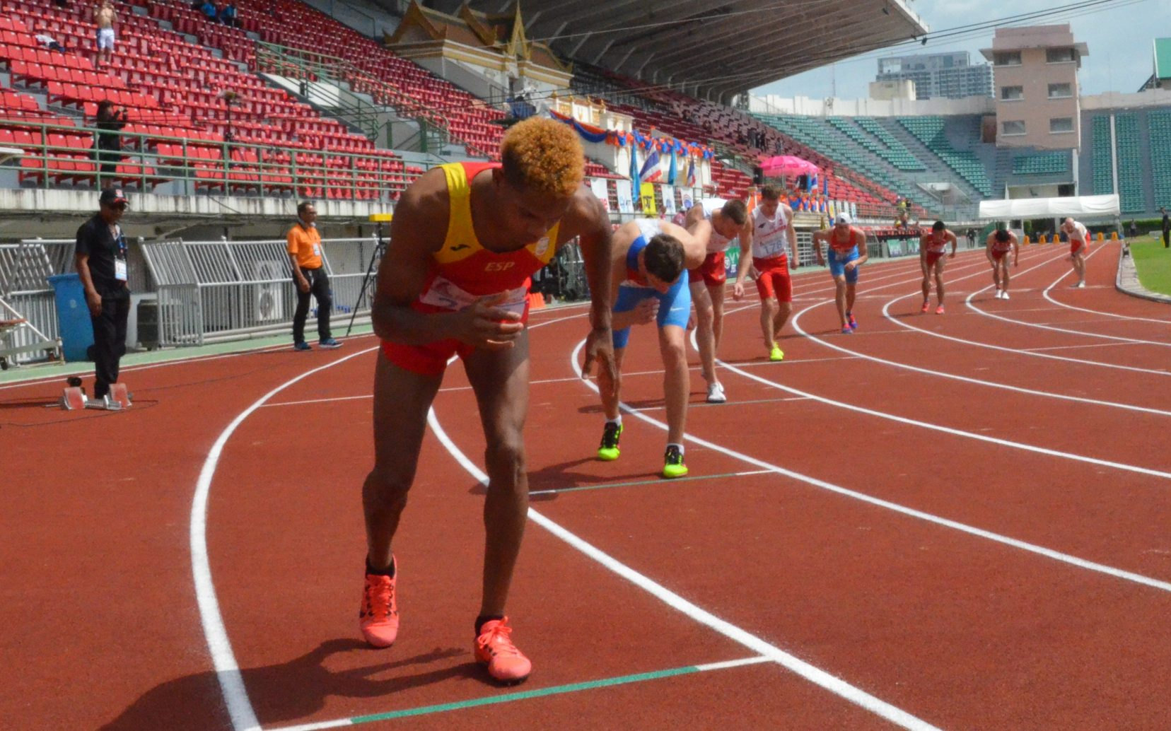
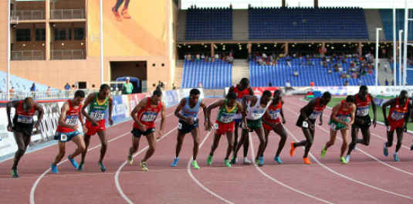
STANDING START
In races longer than 400m, starts shall be made from a standing position.
ON YOUR MARKS
GUN FIRE

Slide 13
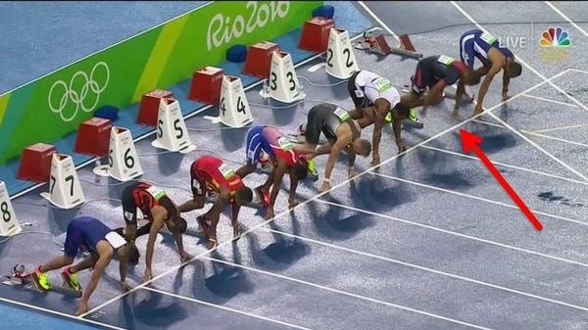
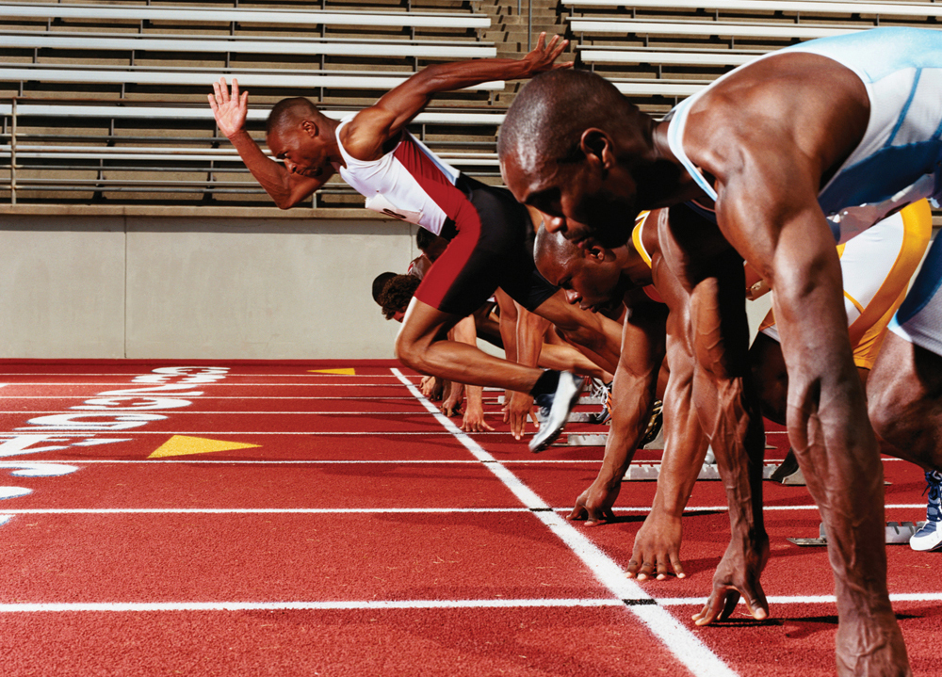
FALSE START
It should be a False Start if an athlete, commence the start before receiving the report of the gun.

Slide 14
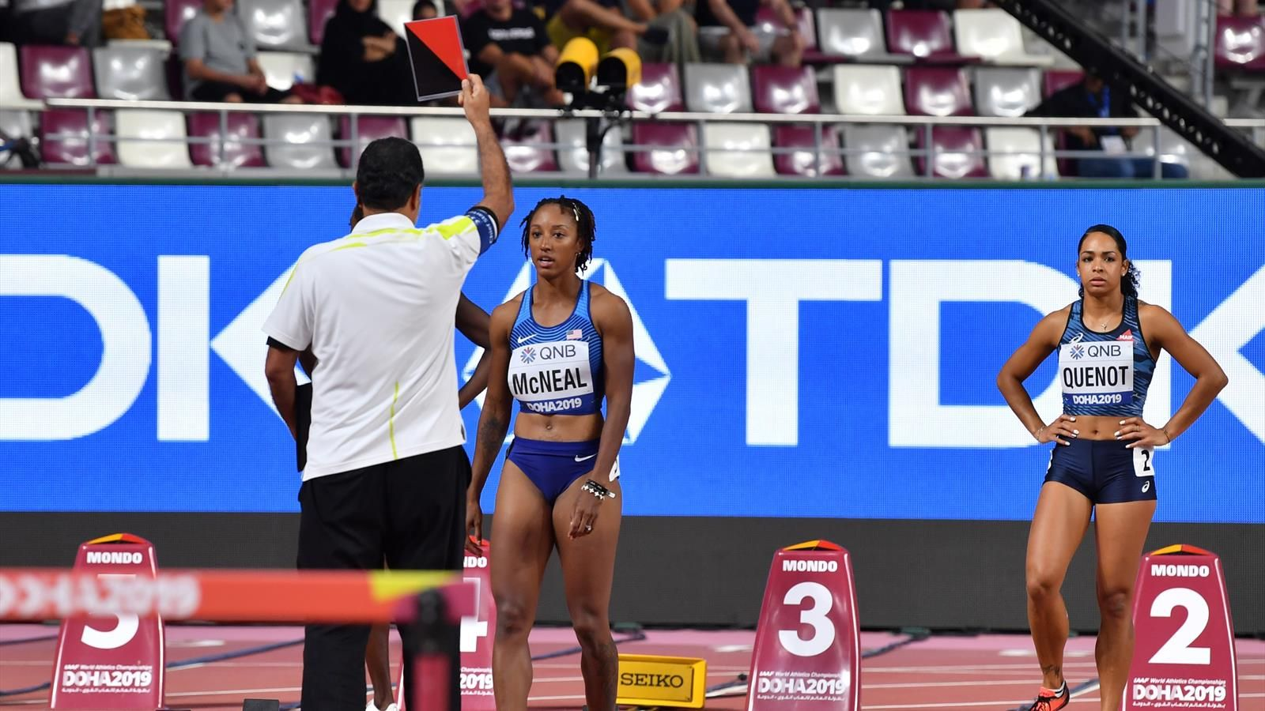


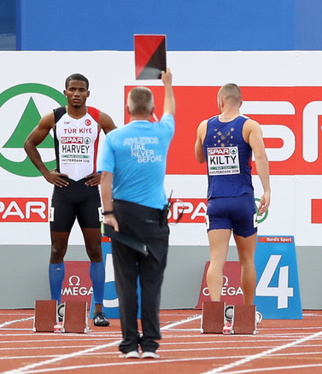
CARDS DISPLAYED ON FALSE START
Except in Combined Events, any athlete or team responsible for a false start shall be disqualified by showing RED and BLACK (diagonally halved) card.
In Combined Events, Warning by showing YELLOW and BLACK (diagonally halved) card. Any further false start shall lead to disqualification of the athlete responsible for it by showing RED and BLACK (diagonally halved) card.

Slide 15
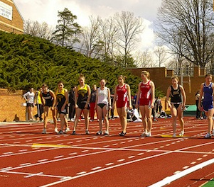

FALSE START
DUE TO TECHNICAL FAILURE
If no athlete is responsible for the false start or the start was recalled due to any technical problem A GREEN card should be shown.

Slide 16
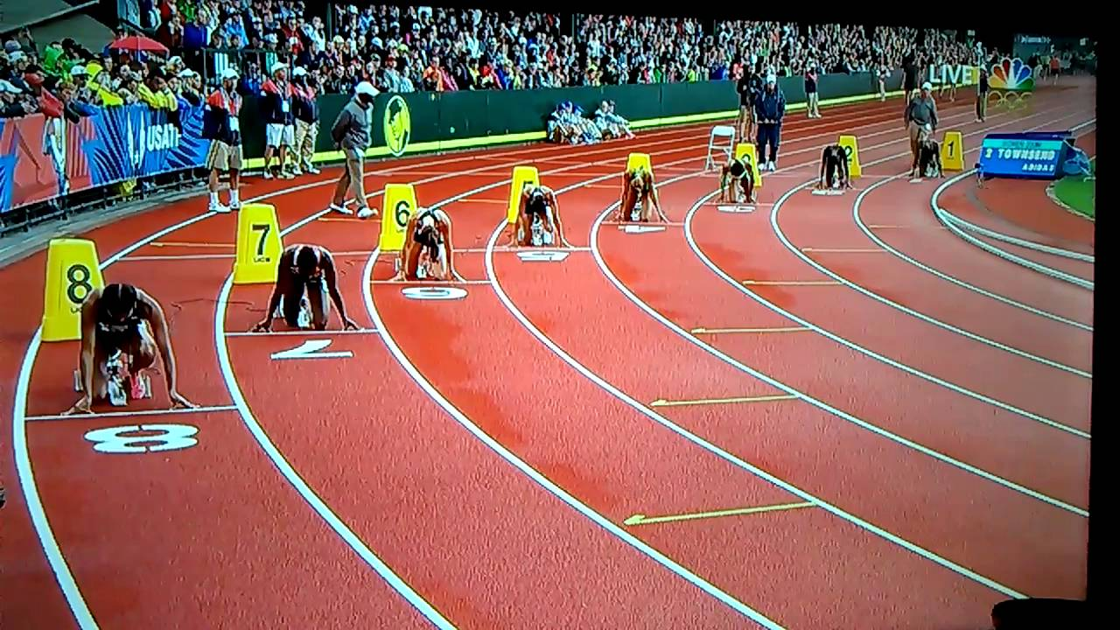
STAGGERED START
In races with at least one curve and athletes have to run in their lanes partially or throughout the race, STAGGERED start is given.
Races with One Curve – Half Stagger
e.g.- 200m, 800m
Races with Two Curves – Full Stagger
e.g.- 400m
Races with Three Curves – One and Half Stagger .eg.- 4 x 400m Relay

Slide 17
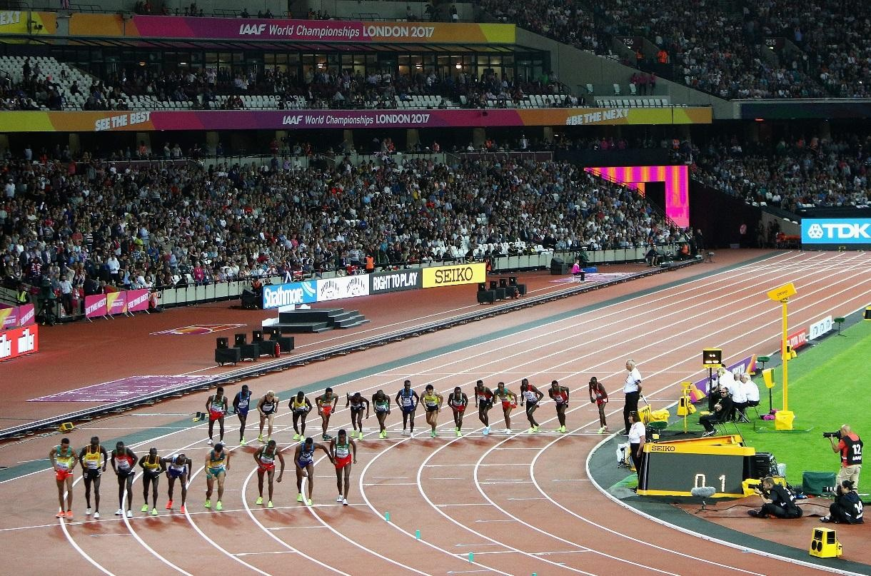
SPLIT START
When more than 12 athletes in a race over 1000m, 2000m, 3000m, 5000m or 10000m, they may be divided in two groups with one group approximately 2/3rd of athletes on the regular arced start line and other group on separate arched start line marked across outer half of the track.
The group on the outer half should run on the outer half till the end of first bend till the break line.

Slide 18
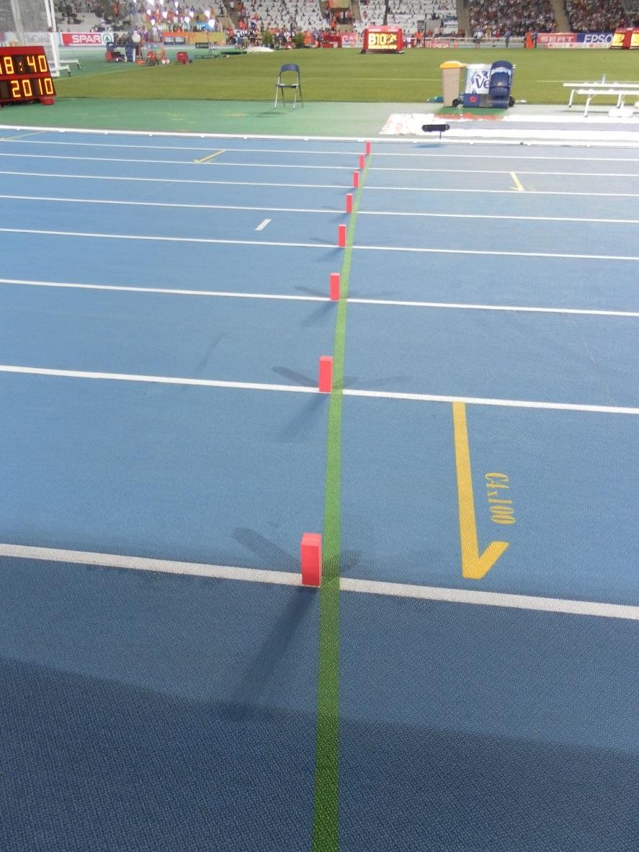
BREAK LINE
The 800m event shall be run in lanes as far as the nearer edge of the break line where athletes may leave their respective lanes.
Break line shall be an arched line marked after the first bend, 50mm wide, across all lanes other than lane 1.

Slide 19
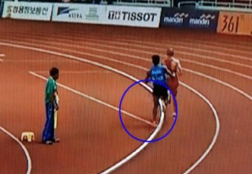
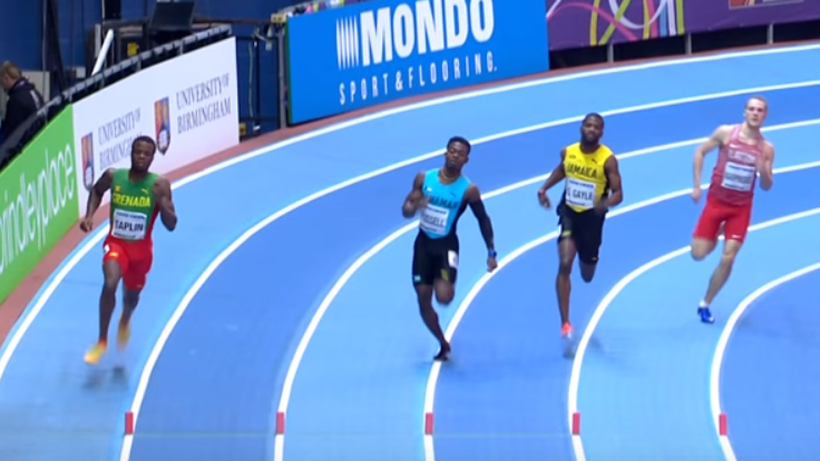
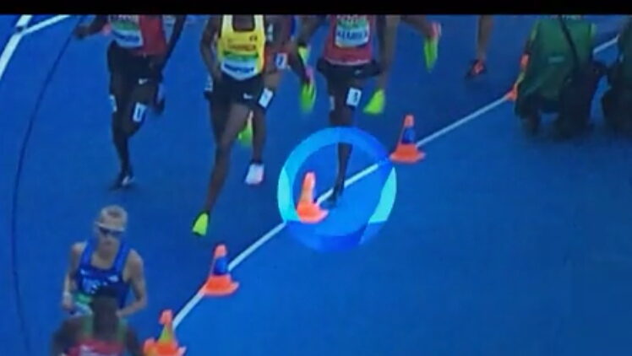
LANE INFRENGEMENT
In all races run in lanes, athlete shall keep within their allocated lane from start to finish. Also apply to portion of race run in lanes.
The athlete shall not step or run on or inside the kerb or line marking the applicable border.

Slide 20
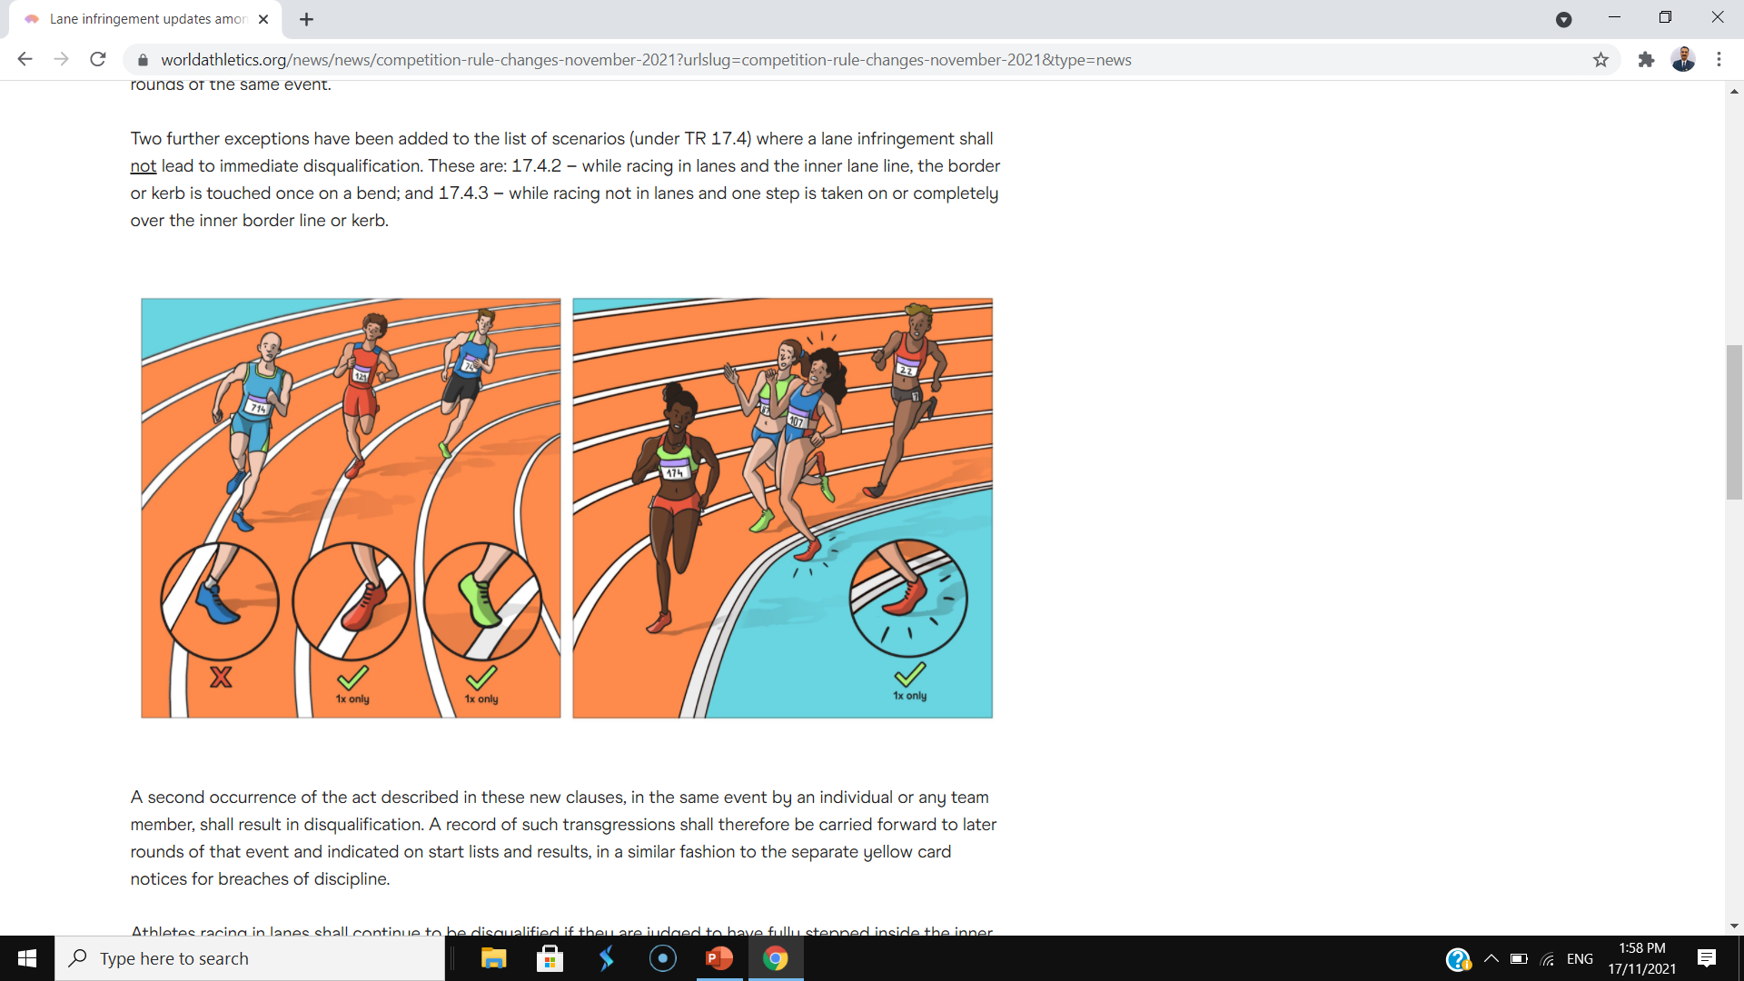
LANE INFRENGEMENT
A lane infringement shall not lead to immediate disqualification.
While racing in lanes - the inner lane line, the border or kerb is touched once on a bend.
While racing not in lanes - one step is taken on or completely over the inner border line or kerb.
A second occurrence of the act described above, in the same event (Including all the rounds) by an Athlete or any team member, shall result in disqualification.
Athletes racing in lanes shall continue to be disqualified if they are judged to have fully stepped inside the inner border line or kerb, even only once. Or if either of the acts described are judged to bring positional advantage or impede another athlete.

Slide 21
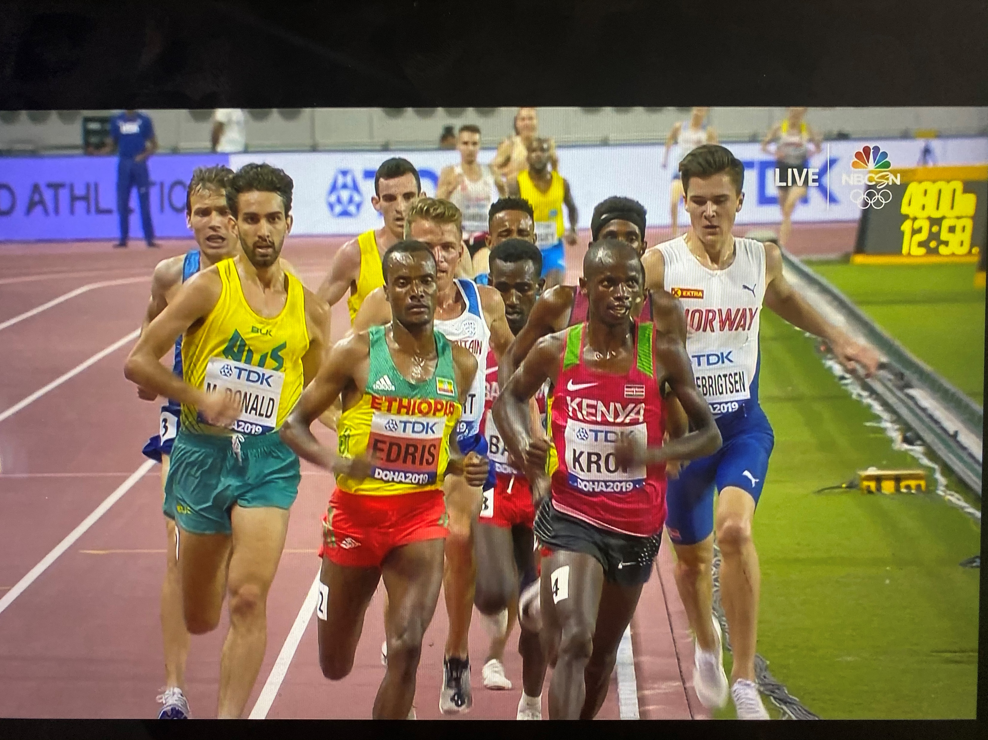
NOT A LANE INFRENGEMENT
An athlete or a relay team shall not be disqualified if -
Pushed or forced by another person to step or run outside their lane or on or inside kerb.
Step or run outside their lane in the straight*.
No material advantage is gained and no other athlete being jostled or obstructed so as to impede their progression.

Slide 22
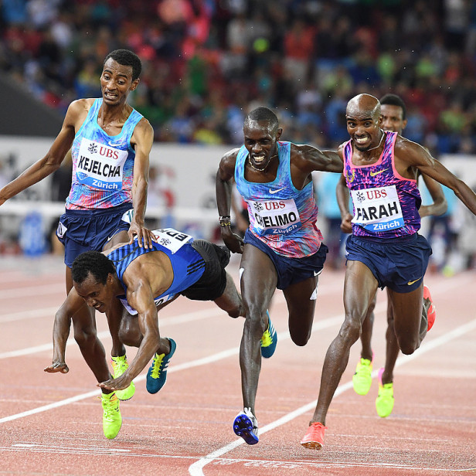
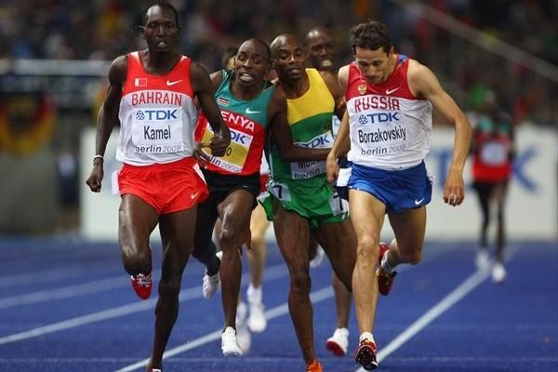
JOSTLING OR OBSTRUCTION
Unintentional jostling or obstruction
The Referee may order the race to be re-held or allow the affected athlete (or team) to compete in the subsequent round of the event.
Intentional jostling or obstruction
The athlete responsible for the jostling or obstruction, shall be liable to disqualification from the event.
The re-held races shall be held excluding the disqualified athlete (or team).
In the cases above, such athlete (or team) should normally have completed the event with bona fide effort.

Slide 23
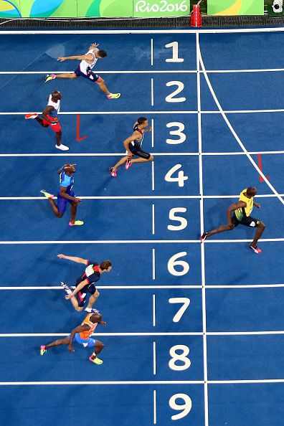
FINISH
The Finish of a race shall be denoted by a white line 50mm wide.
The athletes shall be placed in order in which their Torso reaches the vertical plane of the nearest edge of the finish line.

Slide 24
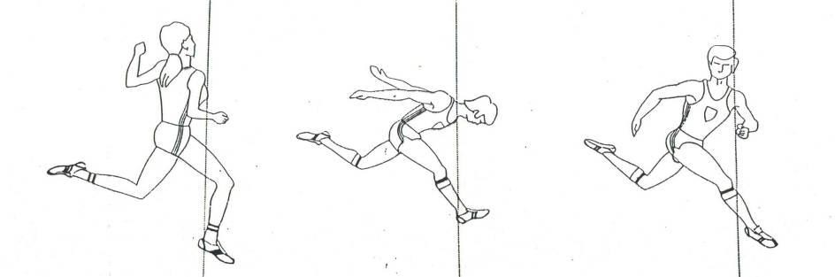
TORSO
The human body considered without the head, neck, hands and legs is the TORSO.

Slide 25
TIME KEEPING

Slide 26
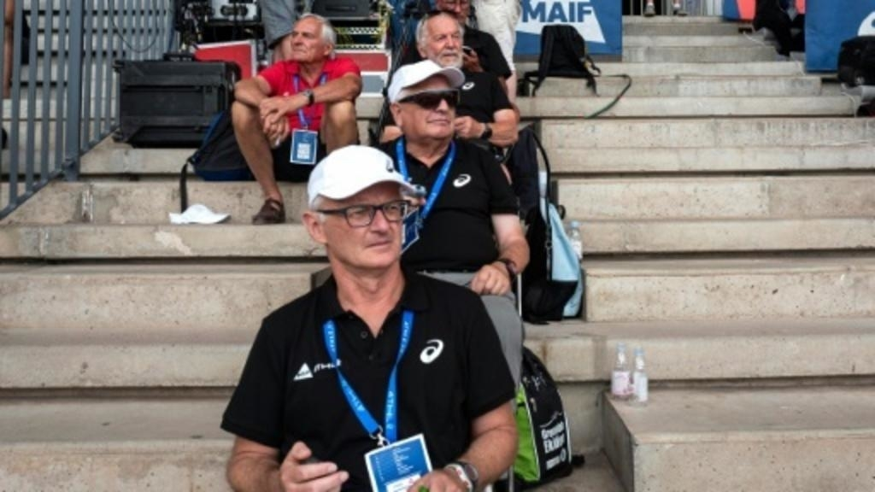
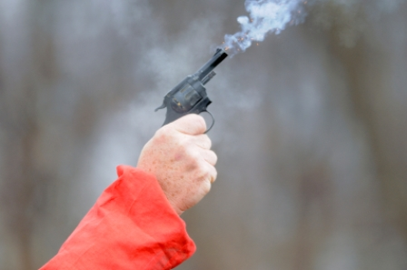
POSITIONING OF TIMEKEEPERS & TIME
The Timekeepers shall be in line with the finish and, placed in elevated stand, at least 5m from the outside lane of track.
The time shall be taken from the flash / smoke of the gun till the moment when the torso of an athlete reaches the vertical plane of the nearer edge of the finish line.

Slide 27
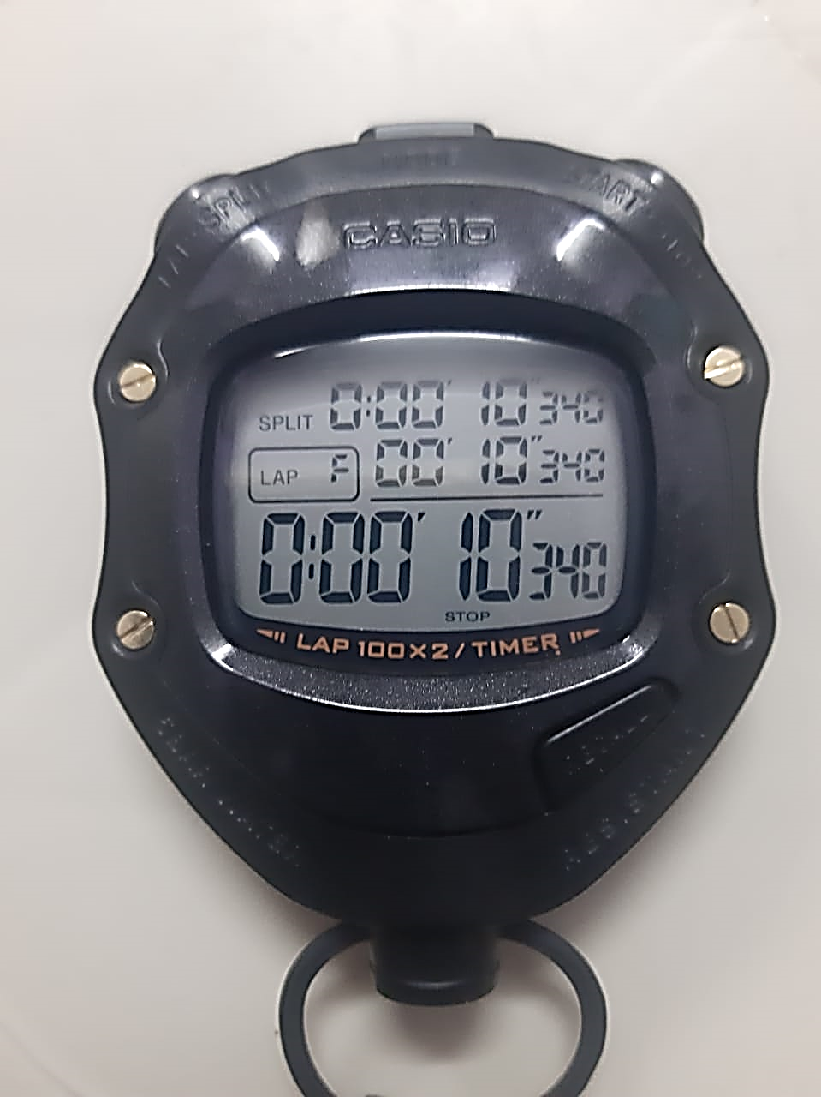
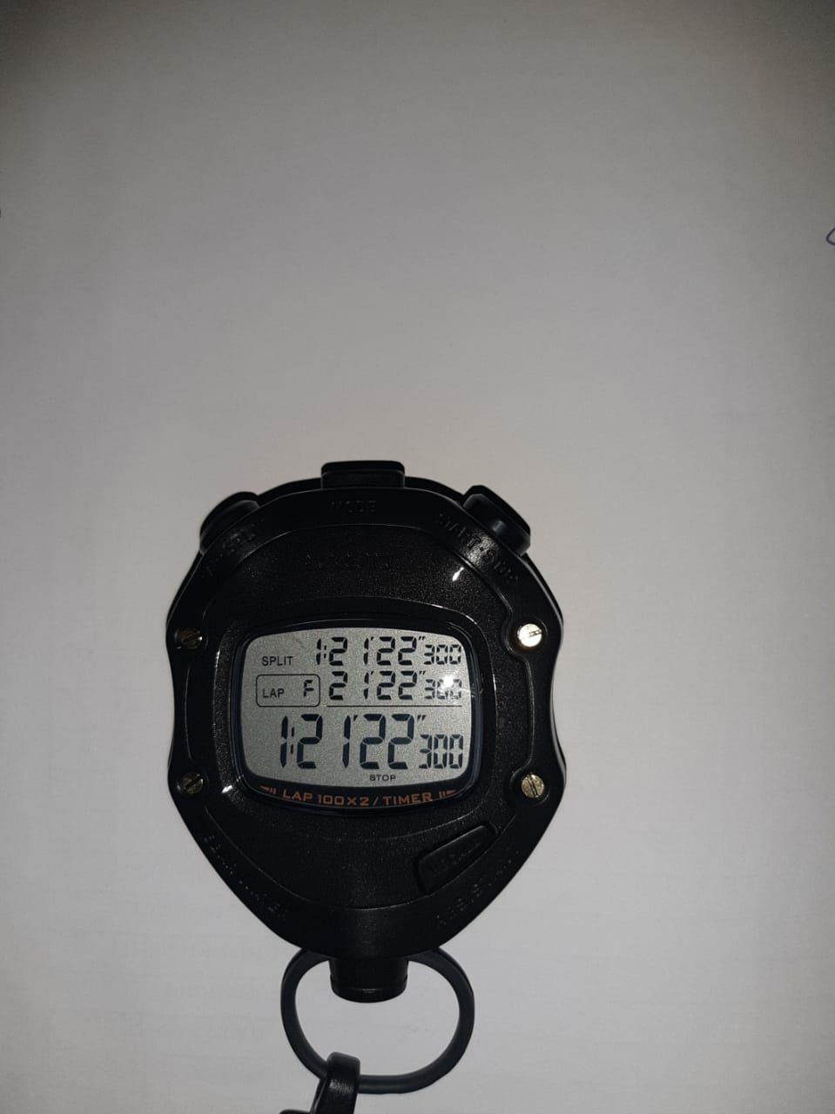
CONVERTING & RECORDING TIME
(HAND TIMING)
For races on track, unless the time is an exact 0.10 second, the time shall be converted and recorded to the next longer 0.1 second,
Example - 10.34 shall be recorded as 10.4
but 10.30 shall be recorded as 10.3
For races partly or entirely outside the stadium, unless the time is an exact whole second, the time shall be converted and recorded to next longer whole second,
Example- 1:21:22.20 shall be recorded as 1:21:23
but 1:21:22.00 shall be recorded as 1:21:22

Slide 28
OFFICIAL TIMING – HAND TIMING
If, after converting the times, two of the three watches agree and the third disagrees, the time recorded by the two shall be the official time.
If all three watches disagree, the middle time shall be official time.
If only two times are available and they disagree, the longer time shall be official.
Sr. No. | Watch 1 | Watch 2 | Watch 3 | Official Time
1 | 10.8 | 10.8 | 10.9 | 10.8
2 | 10.8 | -- | 10.9 | 10.9
3 | 10.8 | 10.9 | 10.7 | 10.8
The Chief Timekeeper shall decide the official time for each athlete.

Slide 29
SEEDING, DRAWS AND QUALIFICATION

Slide 30
ROUNDS AND HEATS
If the number of athletes are more than the number of lanes then the qualification rounds shall be held.
All athletes have to compete in all the rounds to qualify for finals.
Preliminary Rounds / Heats, Semi Finals and Finals are the common ways of rounds.

Slide 31
RANKING AND COMPOSITION OF HEATS
For First round athletes are placed in heats using zig zag distribution with seeding determined from the relevant list of valid performances achieved during the predetermined period.
If Performances of athletes is not available then ranking is given randomly.
The Lane order in first round or preliminary round should be drawn by lot.

Slide 32
RANKING AFTER FIRST ROUND
After the first round, the athletes shall be placed in the heats of subsequent rounds in accordance with the following procedures :-
For all events of 100m to 400m inclusive and relays up to and including 4 x 400m, seeding should be based upon placing and times of each previous round. For this athletes should be ranked as -
Fastest Heat winner
2nd fastest Heat winner
3rd fastest heat winner
.
Fastest 2nd place
2nd fastest 2nd place
3rd fastest 2nd place
.
Concluding with
Fastest time qualifier
2nd fastest qualifier
3rd fastest qualifier, etc.

Slide 33
ZIG-ZAG DISTRIBUTION
The athletes shall then be placed in heats in order of seeding by a zig zag distribution (i.e.) Three heats will consists of following seedings:
HEAT ‘A’ - 1 6 7 12 13 18 19 24
HEAT ‘B’ - 2 5 8 11 14 17 20 23
HEAT ‘C’ - 3 4 9 10 15 16 21 22

Slide 34
PROGRESSION
Progression should be done on PLACING and TIMING
In qualification round at least first and second placed athletes in each heats should be allowed to qualify for subsequent round, but where ever possible at least three in each heat should qualify.
In races longer than 800m where rounds are conducted, it is recommended that only a small number of athletes qualify by time.

Slide 35
RANKING OF ATHLETES AFTER
PRELIMINARY ROUND
A 200m Run event has 3 Semi-Finals and the results of the heats are as below:
HEAT 1
1201 TRACK MASTER 22.2
986 UNITED SPORTS 22.3
545 SAMARTH S. C. 22.4
645 QUEENS SPORTS 22.5
375 DECCAN SPORTS 23.0
101 SILVERS SPORTS 23.5
470 SPRINT MASTER 23.7
HEAT 2
121 SILVERS SPORTS 22.5
976 UNITED SPORTS 22.6
655 QUEENS SPORTS 22.8
235 FLYING BIRD 23.0
111 SILVERS SPORTS 23.2
370 DECCAN SPORTS 23.5
782 KRIDA PREMI 23.6
599 LITTLE MASTERS 23.7
HEAT 3
201 GOLD STAR 22.3
476 SPRINT MASTER 22.4
855 DYNAMITE 22.5
335 JEET STARS 23.3
771 KRIDA PREMI 23.4
270 BRAYAN SPORTS 23.5
1009 SAMARTH S. C. 24.0
1110 ACE S. C. 24.2
Q
Q
q
Q
Q
Q
Q
q
Q – Qualified by Place q – Qualified by Time
How many qualify for FINAL?
2 in each heat by Placing and 2 by Time

Slide 36
RANKING FOR FINALS
Ranking for Final:
1201 TRACK MASTER 22.2
201 GOLD STAR 22.3
121 SILVERS SPORTS 22.5
986 UNITED SPORTS 22.2
476 SPRINT MASTER 22.4
976 UNITED SPORTS 22.6
545 SAMARTH S. C. 22.4
855 DYNAMITE 22.5
First Places in Semi Finals
Second Places in Semi Finals
Qualified by Time

Slide 37
COMPOSITION & LANE ASSIGNMENT
How to allot lane order to athletes in FINAL?
1201 TRACK MASTER 22.2
201 GOLD STAR 22.3
121 SILVERS SPORTS 22.5
986 UNITED SPORTS 22.2
476 SPRINT MASTER 22.4
976 UNITED SPORTS 22.6
545 SAMARTH S. C. 22.4
855 DYNAMITE 22.5
LANE – 3,4,5,6
LANE – 7,8
LANE – 1,2
Allotment in each group of Lanes is finalised through a draw

Slide 38
FINAL LANE ALLOTMENT
Lane allotment for the Finals may be as under [Through Lots on each group]-
Lane 1. 855 DYNAMITE
Lane 2. 545 SAMARTH S. C.
Lane 3. 1201 TRACK MASTER
Lane 4. 201 GOLD STAR
Lane 5. 986 UNITED SPORTS
Lane 6. 121 SILVERS SPORTS
Lane 7. 976 UNITED SPORTS
Lane 8. 476 SPRINT MASTER

Slide 39
MINIMUM TIME BETWEEN ROUNDS
The following minimum times must be allowed, when practicable between the last heat of any round and the first heat of subsequent round:
Up to and including 200m - 45 minutes
Over 200m up to & including 1000m - 90 minutes
Over 1000m - Not on the same day.

Slide 40
HOW TO FILL THE CARDS & REPORTS

Slide 41
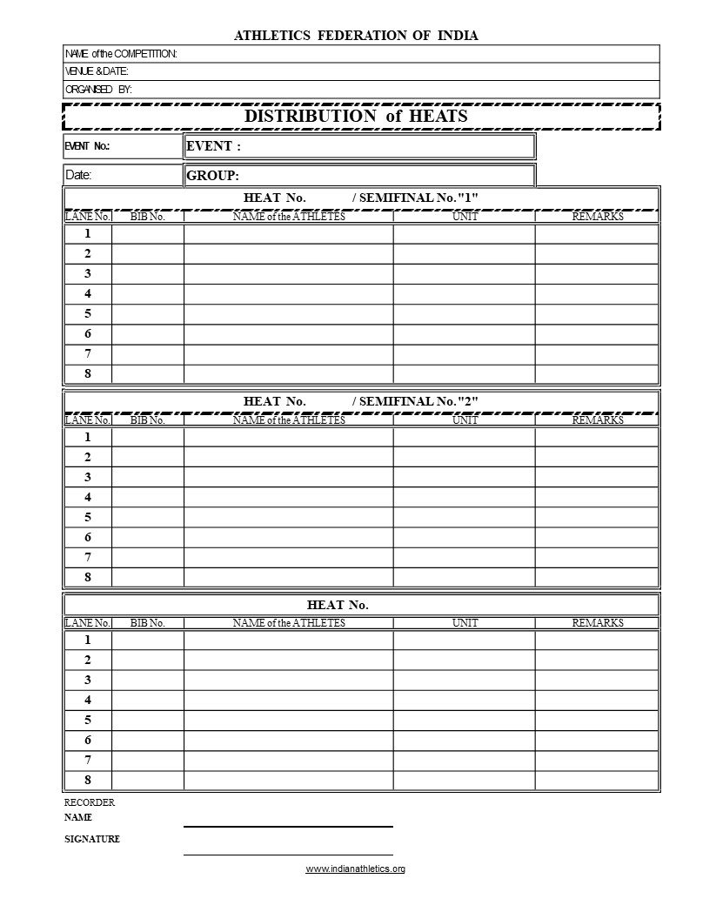
FILLING DISTRIBUTION OF HEATS SHEET
National Inter State Junior Athletics Championship
DELHI, 22nd – 28th November 2019
Athletics Federation of India
62
1500m Run
23/11/2019
Women Under 20 yrs
PLACE
1
456
Sunita Singh
Delhi
211
Priya Joshi
Maharashtra
645
Anuradha Ghosh
West Bengal
135
Shirley Koshy
Kerala
323
Parmeet Kaur
Punjab
L
__
513
Shreelatha
Tamil Nadu
__
298
Komal Patel
Gujarat
DNF
DNF – Athlete started but did not complete the race
DNS – Athlete did not start the race
L – Lane infringement done once
499
Manu Kumari
U. P.
DNS
PLACE
PLACE
Name of Recorder
Sign. of Recorder

Slide 42
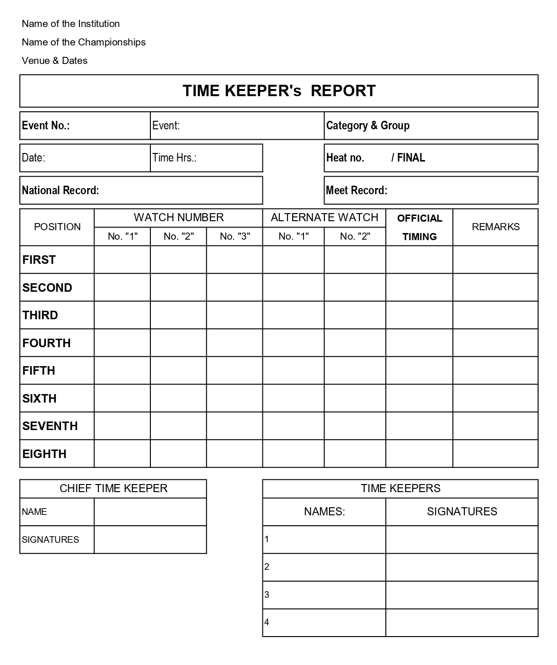
FILLING TIME KEEPERS REPORT
Athletics Federation of India
National Inter State Junior Athletics Championship
DELHI, 22nd – 28th November 2019
62
1500m Run
Women / 20 yrs
23/11/2019
16:00 Hrs
1
Enter National Record
Enter Meet Record
4:32.6
4:33.0
4:32.4
4:32.6
4:35.4
4:36.0
4:36.0
4:38.5
4:38.5
4:38.5
4:40.6
4:40.8
4:40.8
4:44.4
4:44.4
4:45.8
4:45.8
Name of Chief T.K
Sign. of Chief T.K
Name of T.K 1
Signature of T.K 1
Name of T.K 2
Signature of T.K 2
Name of T.K 3
Signature of T.K 3
Name of T.K 4
Signature of T.K 4

Slide 43

FILLING THE REPORT OF REFEREE TRACK
Athletics Federation of India
National Inter State Junior Athletics Championship
DELHI, 22nd – 28th November 2019
62
1500m Run
Women / 20 yrs
16:00 Hrs
23/11/2019
Enter Nat. Record
Enter Meet Record
456
456
211
211
645
645
135
DQ – Disqualified (for infringement of rule)
135
323
323
Athlete Shreelatha, Bib No – 513 was Disqualified for stepping inside the kerb border on a Curve
456
Sunita Singh
Delhi
4:32.6
211
Priya Joshi
Mah
4:36.0
645
Anuradha Ghosh
W. B.
4:38.5
135
Shirley Koshy
Kerala
4:40.8
_______
323
Parmeet Kaur
Punjab
4:44.4
_______
513
Shreelatha
T. N.
DQ (TR-17.3.2)
_______
298
Komal Patel
Guj
DNF
499
Manu Kumari
U. P.
DNS
Name of Referee Track
Sign. of Referee Track
Name of Chief Judge
Sign. of Chief Judge
Name of Chief TK
Sign. of Chief TK

Slide 44

FILLING THE LAP COUNTER CARD
Athletics Federation of India
National Inter State Junior Athletics Championship
DELHI, 22nd – 28th November 2019
62
5000m Run
23/11/2019
07:00 Hrs
MEN Under 20 yrs
Enter N. R.
Enter M. R.
416
07:00 Hrs
612
07:00 Hrs
______________
__________
8.5
3400
Bib No. 416 – Finished at 5th Place
Bib No. 612 – D.N.F. left after 8.5 Laps (3400m)
Name of Lap Scorer
Signature of Lap Scorer

Slide 45


