Slide 1
VERTICAL JUMPS

Slide 2
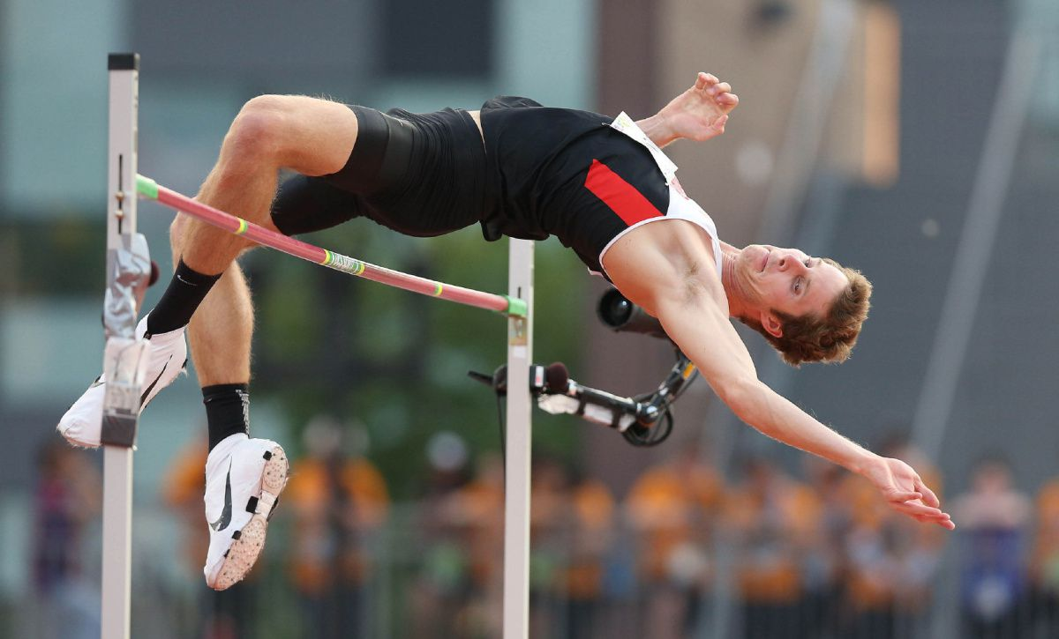
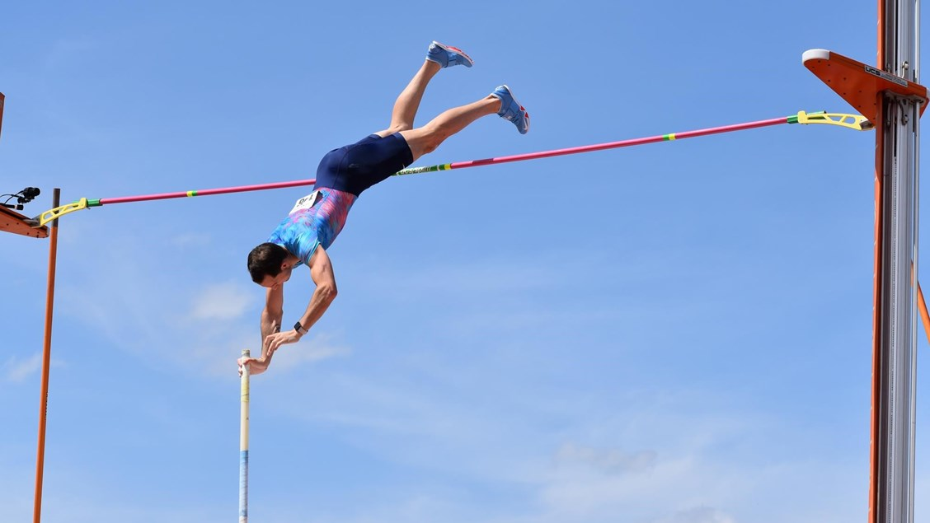
VERTICAL JUMPS
HIGH JUMP
POLE VAULT

Slide 3
HIGH JUMP

Slide 4
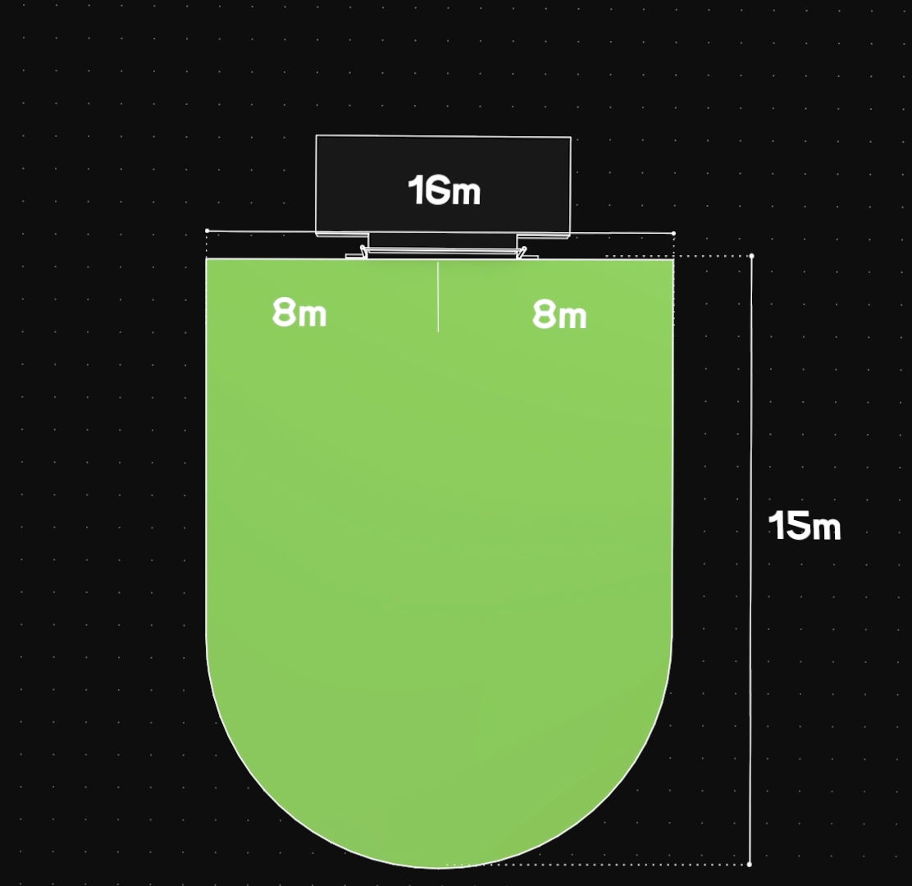
HIGH JUMP –
RUNWAY & TAKE-OFF AREA
The minimum width of the runway shall be 16m and the length of the runway shall be 15m.
The minimum length of runway in International competitions shall be minimum 25m.

Slide 5
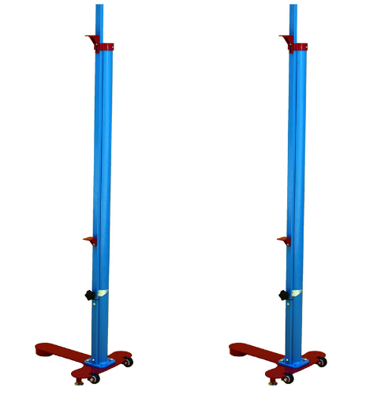
HIGH JUMP – UPRIGHTS
Shall be rigid
Shall have supports for the crossbar firmly fixed to them.
The uprights shall not be moved during the competition unless the Referee considers that either the take-off or landing area has become unsuitable.
In such a case, the changes shall be made only after a round of trial has been completed.

Slide 6
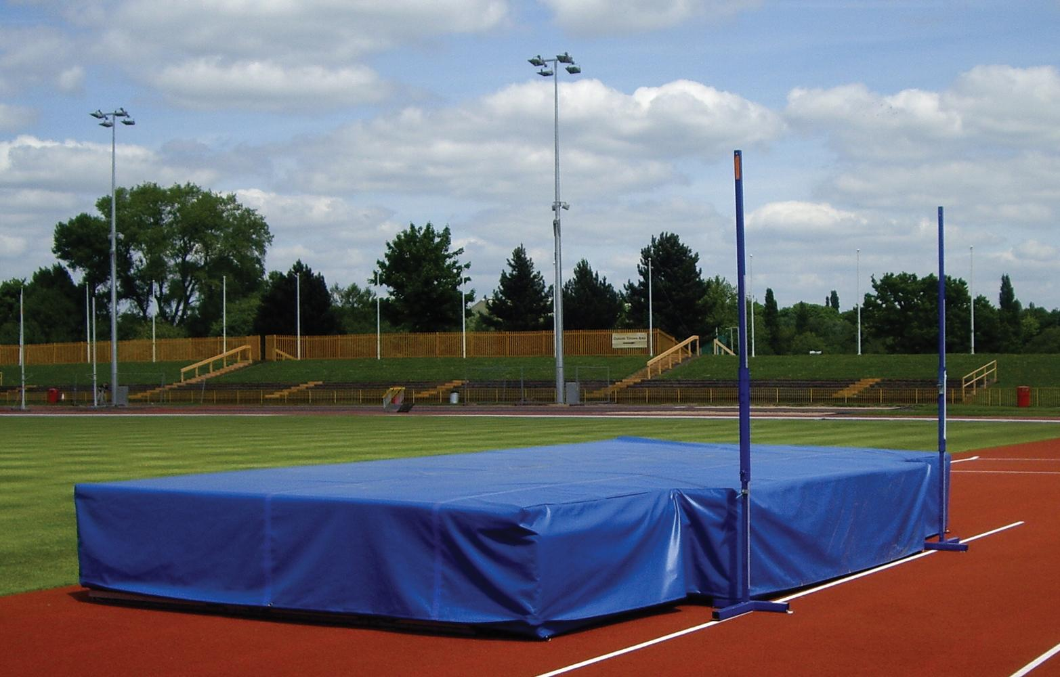
HIGH JUMP – LANDING AREA
For International competitions shall not be smaller than 6m long x 4m wide x 0.7m high behind the vertical plane of cross bar.
There should be clearance of at least 0.10m between the uprights and landing area.
For other competitions shall not be smaller than 5m long x 3m wide x 0.7m high behind the vertical plane of cross bar.

Slide 7
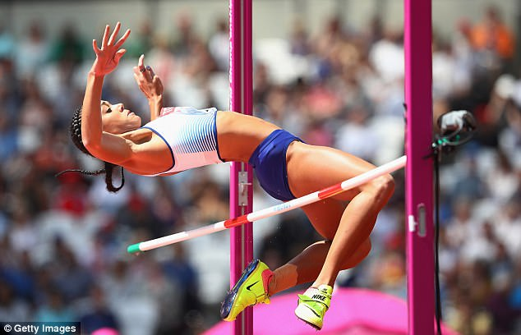
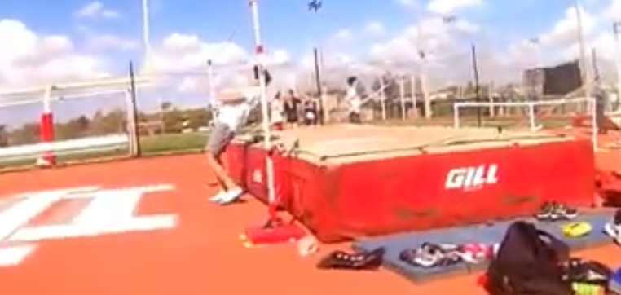
HIGH JUMP – FAILURES
An athlete shall take of from one foot.
An athlete fails if:
After jumping, the bar does not remain on the supports due to the action of the athlete while jumping.
They touch the crossbar or the vertical section of the uprights when running up without jumping.

Slide 8
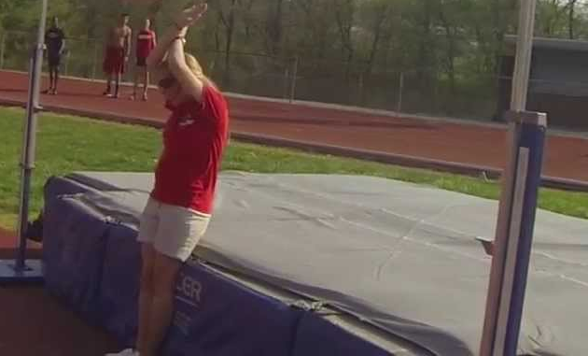
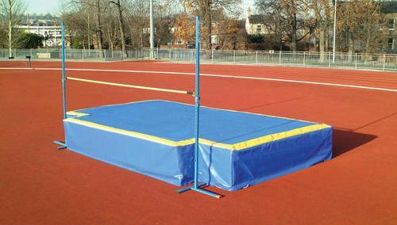
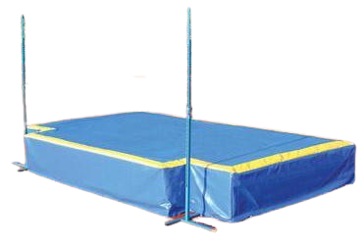
HIGH JUMP – FAILURES
An athlete fails if:
Athlete touch the ground including the landing area beyond the vertical plane through the nearer edge of the crossbar, either between or outside the uprights with any part of their body, without first clearing the bar.
To assist in implementing this rule a white line of 50mm wide shall be drawn (Usually by adhesive tape or similar material) between the points 3m outside of each upright.

Slide 9
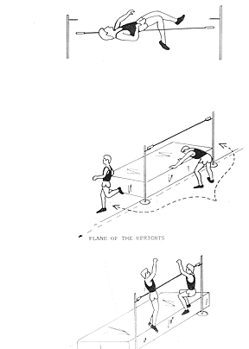
HIGH JUMP – FAILURES
Cross bar does not remain on the support
Athlete touches the ground beyond the vertical plane through the nearer edge of crossbar, between the uprights or out side the uprights
Taking off on both legs

Slide 10
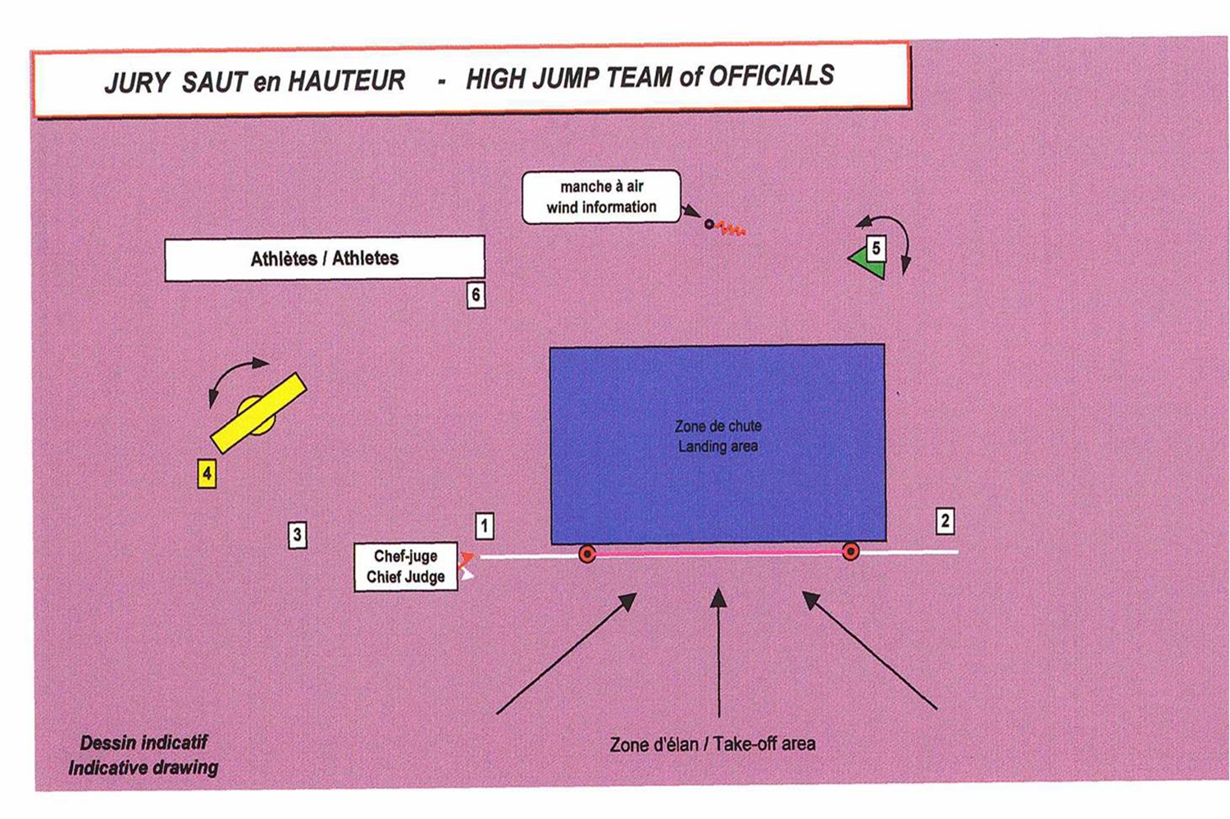
HIGH JUMP – TEAM OF OFFICIALS

Slide 11
POLE VAULT

Slide 12
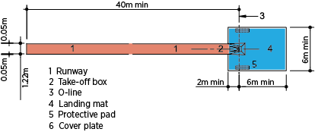
POLE VAULT – RUNWAY
The minimum length of the runway measured from the “Zero” line shall be 40m and if condition permits 45m.
Width of the runway to be 1.22m ± 0.01m, marked with white lines 50mm in width.

Slide 13
POLE VAULT – VAULTING BOX
Take-off for the Pole Vault shall be from a box.
It shall be 1.00m in length and 0.60m in width at the front end and tapering to 0.15m in width at the bottom of the stop board.
Note: Athlete may place padding around the box for additional protection during any of their trials. It is to be done in the time provided for trial, and removed by athlete immediately after the trial is completed.

Slide 14
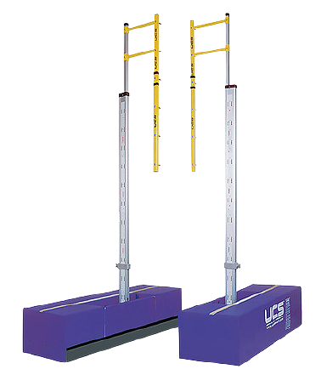
POLE VAULT – UPRIGHTS
Any style of uprights may be used.
They must be rigid.
The metallic structure of the base and the lower part of uprights must be covered with padding of appropriate material in order to provide protection to athletes and the poles.

Slide 15
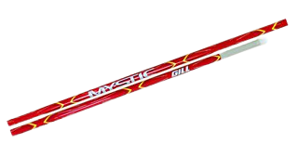
POLE VAULT – POLES
Athletes may use their own poles.
No athletes shall use any other athlete’s pole without the consent of the owner.
The pole may be of any material or combination of materials and of any length or diameter but the basic surface must be smooth.
The pole may have layers of tape at the grip end (to protect the hand) and of the tape and /or any other suitable material at the bottom end (to protect the pole)
The tape at the grip should be uniform, and must not result in any sudden change in the diameter, such as creation of any “ring” on the pole.

Slide 16
POLE VAULT – LANDING AREA
For International competitions shall not be smaller than 6m long (behind the zero line and excluding the front pieces) x 6m wide x 0.8m high. The front pieces must be at least 2m long.
The sides of landing area nearest to the box shall be placed 0.10m to 0.15m from the box and shall slope away from the box at an angle of 45º.
For other competitions shall not be smaller than 5m long (excluding the front pieces) x 5m wide x 0.8m high.

Slide 17
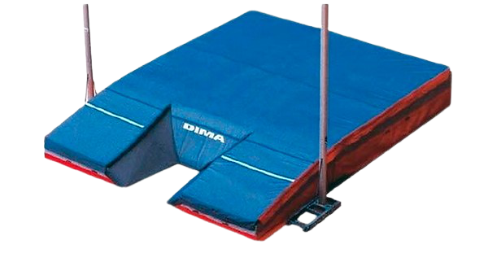
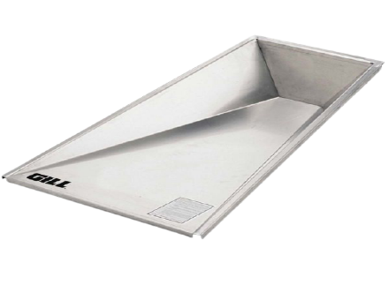
POLE VAULT – LANDING AREA

Slide 18
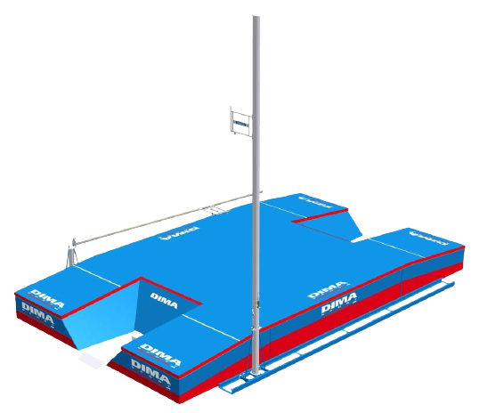
ZERO LINE & MOVEMENT OF UPRIGHTS
Athletes may have the crossbar moved up to 80cms in the direction of landing area.
An athlete shall, before the competition starts, inform the appropriate official of the position of the crossbar they require for their first trial and this position shall be recorded.
A line, 10mm wide and of distinguishable colour, shall be drawn at right angle to the axis of runway, in line with the back end of the box (Zero Line)
A similar line, up to 50mm wide, shall appear on the surface of the landing area and be prolonged as far as the outside edge of the uprights.
80cms
Zero Line
The edge of the line nearer to the approaching athlete coincides with the back end on the box.

Slide 19
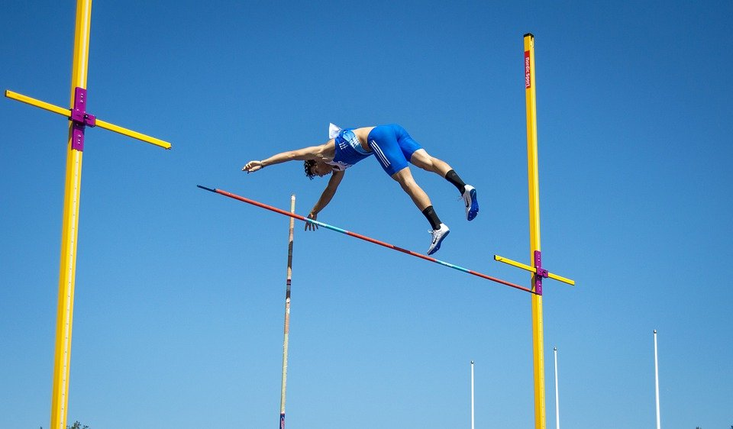
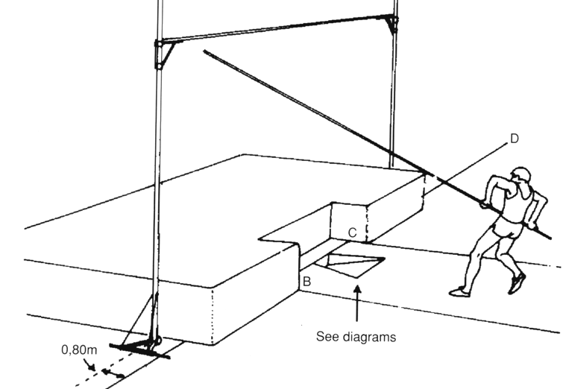
POLE VAULT – FAILURES
An athlete fails if:
After the vault, the bar does not remain on both pegs due to the action of athlete while vaulting.
They touch the ground including landing area, beyond the vertical plane through the back end of the box with any part of the body or pole, without first clearing the bar.
After leaving the ground, they place their lower hand above the upper hand higher Or move the upper hand higher on the pole.
During the vault, they steady or replace the bar with their hands.

Slide 20
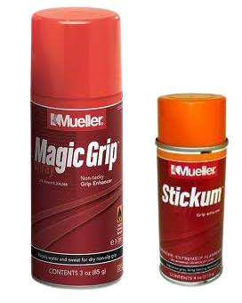
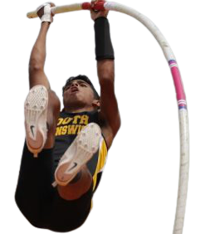
NOT CONSIDERED AS ASSISTANCE
An athlete is allowed to place a substance on their hand or on the pole, during the competition, in order to obtain a better grip.
The use of gloves is permitted.
After the release of the pole, no one including the athlete shall be allowed to touch the pole unless it is falling away from the bar or uprights.

Slide 21
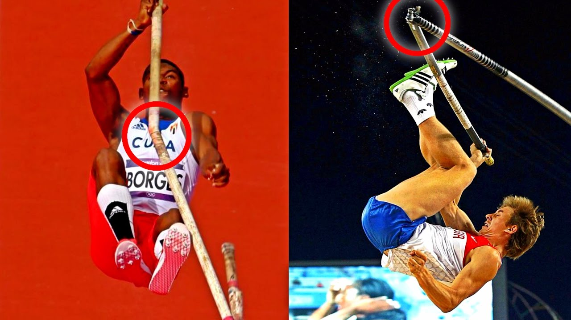
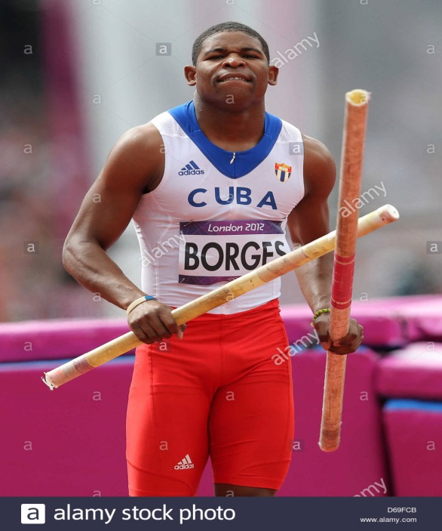
BREAKING OF POLES
If, in attempting a trial, an athlete’s pole is broken, it shall not be considered as a failure and shall be awarded a replacement trial.

Slide 22
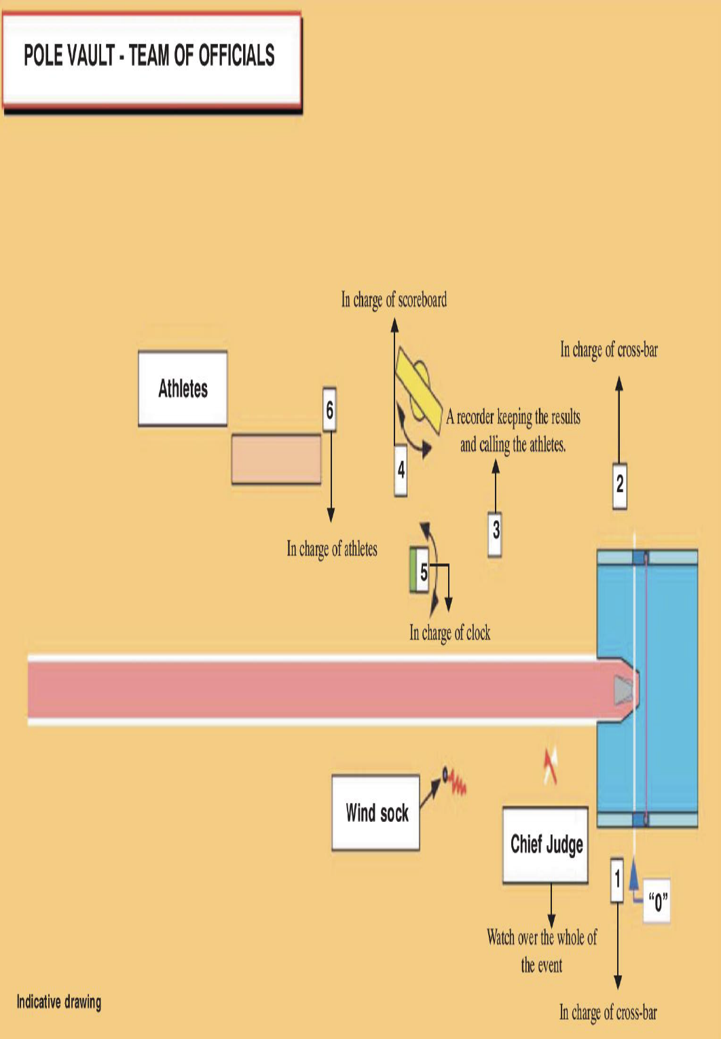
POLE VAULT – TEAM OF OFFICIALS

Slide 23
VERTICAL JUMPS –
GENERAL CONDITIONS
Starting height of the competition to be announced to all athletes before the competition begins.
EXAMPLE for practice height & progression of heights
EVENT | Group | Practice Height | Starting & Progression of Height
High Jump | Men | 1.90m & 2.10m | 1.95 – 5 – 2.05 – 3 – 2.17 - 2
High Jump | Women | 1.55m & 1.70m | 1.55 – 5 – 1.65 – 3 – 1.74 - 2
Pole Vault | Men | 4.00m & 4.60m | 4.20 – 20 – 4.40 – 10 – 4.80 – 5
Pole Vault | Women | 2.80m & 3.60m | 3.00 – 20 – 3.40 – 10 – 3.70 – 5
The heights to which the bar will be raised at the end of each round of trials shall be announced to the athletes before the competition begins .

Slide 24
VERTICAL JUMPS –
GENERAL CONDITIONS
Three consecutive failures at any height shall disqualify from further jumping / vaulting, except in case of tie for first place.
An athlete can pass their second or third trial at a particular height (after failing first or second trial) and still jump / vault at a subsequent height.
If an athlete passes a trial at certain height, they may not be allowed to take a subsequent trial at that height. Except in case of jump-off for first place.
If an athlete is not present for his turn, the Referee shall deem that such athlete(s) has abandoned the competition, once the period for one further trial has elapsed.

Slide 25
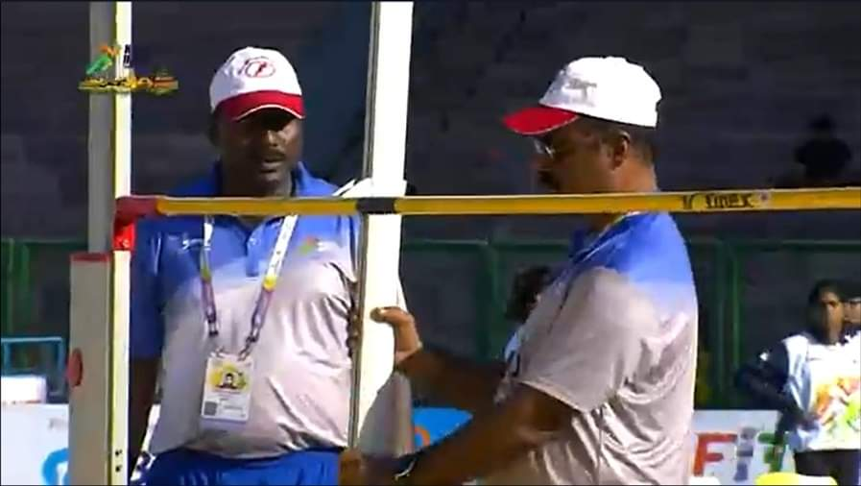
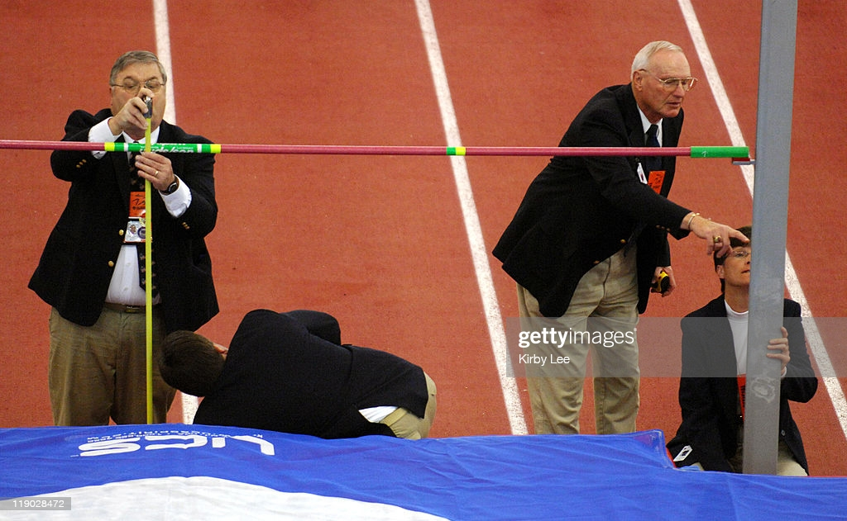
VERTICAL JUMPS –
INCREMENT OF HEIGHT
Unless there is only one athlete remaining and has won the competition, the bar shall never be raised by less than 2cm in High Jump and 5cm in Pole Vault.
The increment of raising the bar shall never increase.
If an athlete has won the competition, the height or heights to which the bar is raised shall be decided by the athlete.

Slide 26
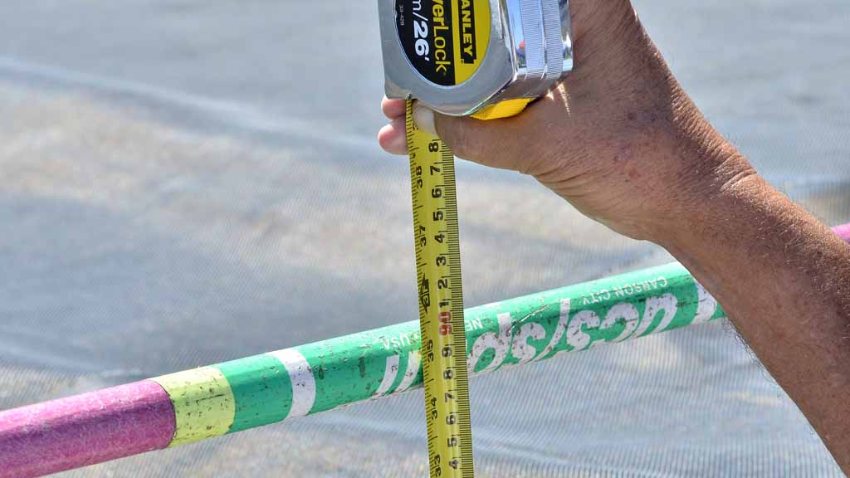
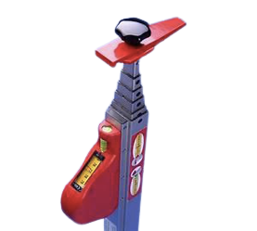
VERTICAL JUMPS –
INCREMENT OF HEIGHT
In all vertical jumping events, measurement shall be made, in whole centimetres.
Measured perpendicularly from the ground to the lowest part of the upper side of the bar.
Remeasurement should be done if bar has been substituted.

Slide 27
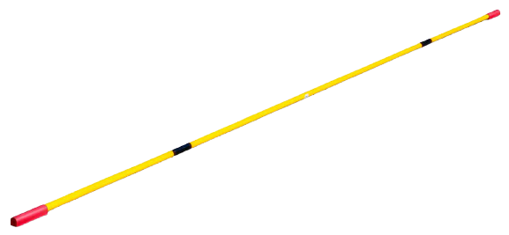
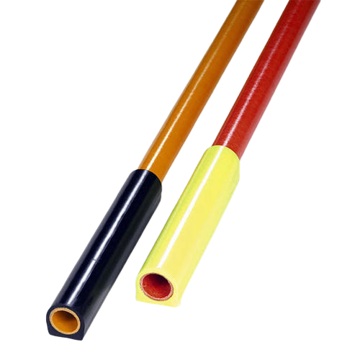
VERTICAL JUMPS – CROSS BARS
Shall be made of fibre-glass, or other suitable material but not metal.
Circular in cross-section except for the end pieces.
Coloured so as to be visible to all sighted athletes.
The diameter of the crossbar shall be 30mm ± 1mm.
The over all length and weight of the crossbar shall be as under -
Type of Vertical Jump | Length of Crossbar | Weight of Crossbar
High Jump
4.00m ± 0.02m
2kg
Pole Vault
4.50m ± 0.02m
2.25kg

Slide 28
VERTICAL JUMPS – PLACINGS
If two or more athletes clear the same final height, the procedure to decide the places will be following:
The athlete with the lowest number of failures at the height last cleared shall be given higher place.
If the Tie is not resolved
The athlete with the lowest total of failures throughout the competition up to and including the height last cleared, shall be given the higher place.
If after above two conditions, the athletes are still equal, the athletes concerned shall be awarded the same place unless it concerns the first place.
If it concerns a first place, a jump off between these athletes may be conducted
The athletes at any stage may decide not to jump further for jump-off.
If no jump-off is carried out, the tie for first place shall remain.

Slide 29
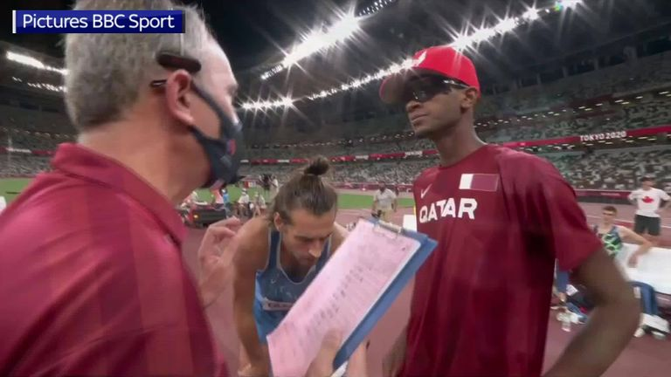
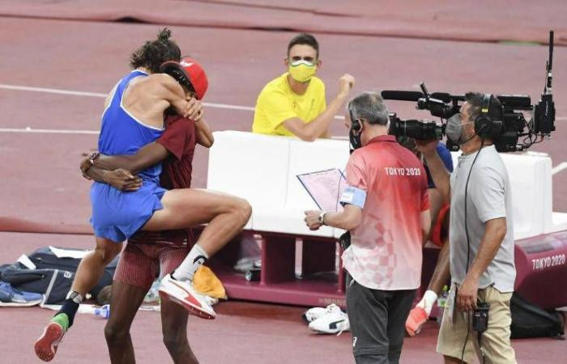
VERTICAL JUMPS – JUMP OFF
Athletes concerned must jump at every height until a decision is reached or until all of the athletes concerned decide not to jump further.
Each athlete shall have one jump at each height.
CAN WE HAVE TWO GOLDS?
The jump-off shall start at the next height determined, after the height last cleared by athletes concerned.
The bar shall be raised if more than one athlete concerned were successful, or lowered if all of them failed, by 2cm for High Jump and 5cm for Pole Vault.
If an athlete is not jumping at a height, they automatically forfeit any claim to a higher place.

Slide 30
VERTICAL JUMPS – SCORING
“A”, “B” , “C”, “D” all cleared 1.88m in the second attempt.
X : Fail to clear the height
O : Cleared the height
-- : Pass
Judges add up total number of failures up to and including the last height cleared, i.e 1.88m.
“D” has more failures than “A” , “B”, “C” and so “D” is awarded FOURTH place.
“A” , “B” and “C” are still equal and as it concerns first place, they go for jump off with the next height cleared by all athletes, i.e. 1.91m.
As all the athletes failed, the bar is lowered to 1.89m for another jump-off.
As only “C” fails to clear 1.89m, “C” is awarded THIRD place. “A” and “B” shall have a third jump-off at 1.91m, which only “B” cleared and is therefor declared the winner.

Slide 31


